Slide 1
INSPIRE BRANDS . QUALITY ENGINEERING
GitHub Copilot for Automation Frameworks
From writing test code to building intelligent, self-documenting frameworks
how AI-assisted development changes the game for QE teams.
Agent Mode
Custom Agents
Selenium + TestNG
Inspire Framework
GitHub Copilot x Inspire Brands QE
GitHub Copilot x Inspire Brands QE

Slide 2
Why GitHub Copilot for Automation Frameworks?
Accelerate Development
Understand the Codebase
Generate Page Object classes from a URL in seconds Auto-complete @FindBy locators using site context Scaffold new brand test classes from existing patterns Reduce boilerplate from hours to minutes
Ask questions about any class without reading it Navigate complex inheritance chains instantly Explain why a test is failing with context Onboard new team members in minutes, not days
Keeps Code Inside Your Org
Enforces Team Standards
Runs inside VS Code - code stays on your machine Respects corporate network and security policies GitHub Enterprise support for air-gapped environments No external calls with proprietary test code
Custom agents encode your specific project rules Consistent patterns across all developers and brands Prevents re-discovery of already-solved problems Hard-won fixes become permanent team knowledge
GitHub Copilot x Inspire Brands QE

Slide 3
GitHub Copilot vs Cursor IDE
For Enterprise QE Teams
Dimension
GitHub Copilot
Cursor IDE
IDE Integration
Runs inside VS Code - no context switch
Separate fork of VS Code
Enterprise Security
GitHub Enterprise + SSO + audit logs
Business plan; limited controls
Custom Agents
.agent.md files committed to the repo
Rules files, no agent concept
Team Knowledge Sharing
Agent in Git - everyone uses same rules
Per-developer settings only
Automation-Specific Tools
runTests, testFailure, browser tools
Generic code tools only
Cost per developer
USD 19/mo - bundled with GitHub
USD 20/mo - separate vendor
Licensing
Already in GitHub org - no new vendor
New vendor relationship required
GitHub Copilot x Inspire Brands QE

Slide 4
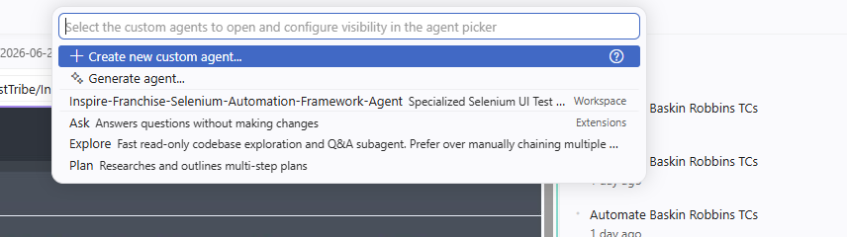
GitHub Copilot - Three Interaction Modes
Ctrl+Shift+I
ASK
PLAN
AGENT
Ask Mode
Plan Mode
Agent Mode
Conversational Q and A about your code Explains classes, methods, errors Answers WITHOUT making any changes Best for: understanding and learning Example: What does AbstractBrandPage do?
Researches and outlines multi-step tasks Shows what it WOULD do before acting Review proposed changes before applying Best for: complex refactoring, new features Example: Plan how to add Baskin Robbins brand
Autonomously reads, edits and runs code Uses tools: terminal, browser, file system Iterates until the task is complete Best for: end-to-end automation tasks Example: Add Baskin Robbins brand to the framework
VS Code - actual Copilot mode picker (@ shortcut)
GitHub Copilot x Inspire Brands QE

Slide 5
Deep Dive - Agent Mode
How Agent Mode Works
Tools It Can Use
Receives your task in natural language Reads relevant files across your workspace Makes edits, runs terminal commands, runs tests Reads output and iterates if something fails Continues until the task succeeds
File system: read, create, edit, rename files Terminal: run Maven, compile, execute tests Browser: open pages, take screenshots Semantic search across your entire codebase Test runner: run tests, read results inline
What Makes It Different
Real Example - Inspire Framework
Not just code completion - it ACTS autonomously Multi-step reasoning across many files at once Self-correcting: reads errors and fixes them Combines read plus edit plus execute in one loop
Prompt: Add Dunkin brand to the framework Agent automatically: Creates DunkinPage.java with correct @FindBy Adds case DUNKIN: in BrandPageFactory.java Creates DunkinTest.java + testng-dunkin.xml Runs smoke tests to verify - PASS
GitHub Copilot x Inspire Brands QE

Slide 6
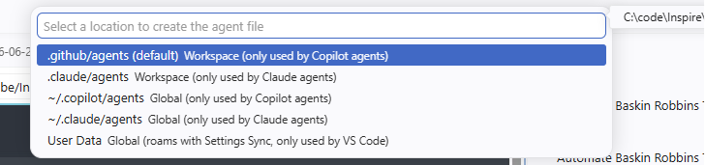
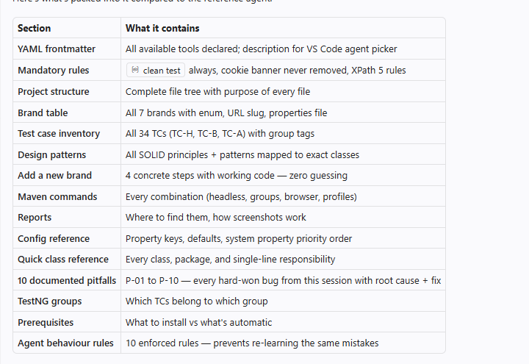
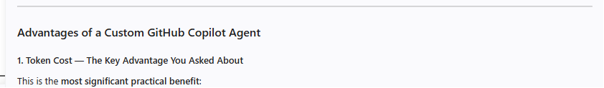
How to Create a Custom GitHub Copilot Agent
1
2
3
4
5
Open Agent Picker
Create New Agent
Choose Location
Fill the Template
Commit and Share
Press @ or click Agent button then Configure Custom Agents
Click + Create new custom agent in the picker
.github/agents/ (default) shared via Git with the team
Edit the .agent.md with YAML frontmatter + instructions
git push - all teammates get the agent immediately
Step 2 - Configure dialog
Step 4 - Template in VS Code
Step 3 - Location picker
GitHub Copilot x Inspire Brands QE

Slide 7
Necessary Components of a Custom Agent File
YAML Frontmatter (Required)
Tools Permissions
Mandatory Rules Section
name, description, tools list, argument-hint Declares the agent identity and permissions Users see permissions before running the agent
Explicitly declare only what the agent needs Groups: vscode, execute, read, edit, search, web Principle of least privilege - nothing extra
NEVER-break rules in ALL-CAPS headers Examples: always clean test, never use text() Enforced on every single Copilot response
Project Structure Tree
Pitfalls and Solutions
Agent Behaviour Rules
Full file tree with inline annotations per file Tells agent what each file is responsible for Prevents wrong-file edits and hallucinations
Documents every hard-won bug: root cause + fix Prevents team re-discovering same issues Numbered P-01 to P-N for easy reference
Numbered constraints for every code-gen action XPath rules, screenshot rules, brand extension rules Same quality output from every developer
GitHub Copilot x Inspire Brands QE

Slide 8
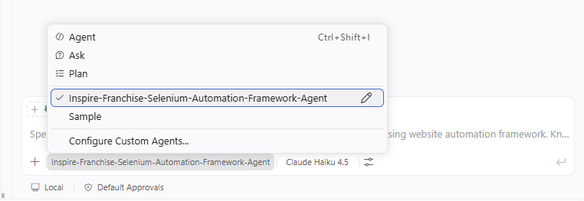
Tools in the Inspire Agent - What Each Enables
vscode/* - IDE Integration
execute/* - Test Execution
read/* - Inspection
installExtension - auto-install Java Pack on clone memory - remember clean already ran this session runCommand - Java: Clean Workspace for stale bytecode askQuestions - Which brand are you adding?
runInTerminal - .\mvnw.cmd clean test -P arbys runTests - trigger play button per test method testFailure - read stack traces from last run getTerminalOutput - parse PASSED/FAILED counts
readFile - read any Java/XML/properties file problems - see compile errors in Problems panel terminalLastCommand - was clean already run?
edit/* - Code Generation
search/* - Navigation
web/* and agent/*
createFile - DunkinPage.java, DunkinTest.java editFiles - add case DUNKIN: to BrandPageFactory createDirectory - create package directories
codebase - where is cookie banner handled? textSearch - find all text() locators to fix usages - who calls isVisibleAfterWait()? changes - git diff since last run
web/fetch - inspect live page DOM for locators browser/openBrowserPage - open Extent report agent/runSubagent - delegate complex tasks todo - track multi-step task progress
GitHub Copilot x Inspire Brands QE

Slide 9
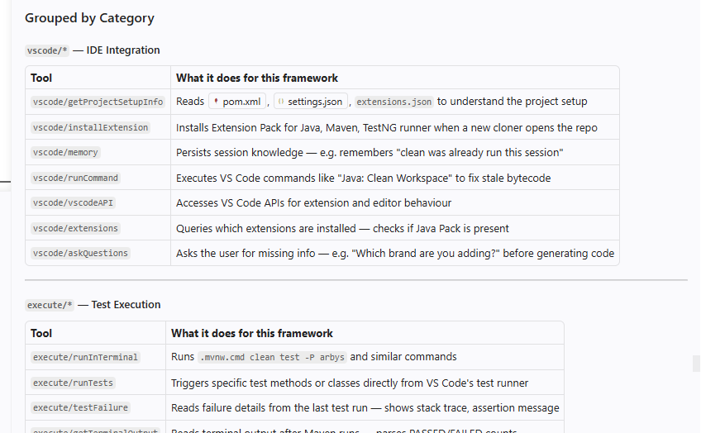
Key Sections in the Inspire Franchise Agent
Section
Contains
Why It Matters
MANDATORY Rules x3
clean test always, cookie banner, 5 XPath rules
Prevents the most common failures
Project Structure
Full file tree with inline annotations
Agent edits the right file always
Brands Table
7 brands: enum, URL slug, properties file
Correct names and paths for all brands
Test Case Conventions
TC prefix map, naming pattern, valid groups
Consistent IDs without a stale registry
Design Patterns + SOLID
9 patterns mapped to exact classes
New code follows same architecture
Add New Brand (4 Steps)
Copy-paste ready code for each step
New brand in 5 mins, zero existing changes
Pitfalls P-01 to P-10
Root cause + fix for every hard-won bug
No developer rediscovers the same issue
Agent Behaviour Rules
10 numbered constraints for code generation
Same quality from every developer
GitHub Copilot x Inspire Brands QE

Slide 10
Demo - Select Agent and Add Baskin Robbins Brand
PART 1 - Selecting the Custom Agent
PART 2 - Add Baskin Robbins Brand
1
Open Copilot Chat
5
Type the Request
Press Ctrl+Shift+I or click the Copilot icon in sidebar
Add Baskin Robbins brand to this framework
2
Click the Agent Picker
6
Agent Creates 4 Files
Type @ or click the Agent button at bottom of chat panel
BaskinRobbinsPage.java + BrandPageFactory case + BaskinRobbinsTest.java + testng XML
3
Select the Inspire Agent
Choose Inspire-Franchise-Selenium-Automation-Framework-Agent
7
Agent Runs Smoke Tests
.\mvnw.cmd clean test -P baskin-robbins -Dgroups=smoke - all TC-B tests PASS
4
Agent is Active
Agent name in chat header. All framework rules pre-loaded.
The 12 common TC-B brand tests run automatically for Baskin Robbins - zero code duplication. Open/Closed Principle.
GitHub Copilot x Inspire Brands QE

Slide 11
Key Takeaways
Speed
Consistency
Knowledge Preservation
A new brand that took a day now takes 5 minutes with the custom agent.
Every developer produces the same quality output - patterns and rules always applied.
Every hard-won fix is permanently encoded. No one rediscovers the same bug twice.
The custom agent is not just a productivity tool - it is a living document of your team's collective intelligence.
The .agent.md lives in .github/agents/, committed to Git. Every team member who clones the repo gets the same expert-level Copilot experience.
Inspire-Franchise-Selenium-Automation-Framework-Agent | .\mvnw.cmd clean test -P arbys | Zero existing files modified when adding a brand
GitHub Copilot x Inspire Brands QE

