Slide 1


Paris Performance Review
24/10/2021

Slide 2

1 | Delivery Performance
2 | Growth

Slide 3
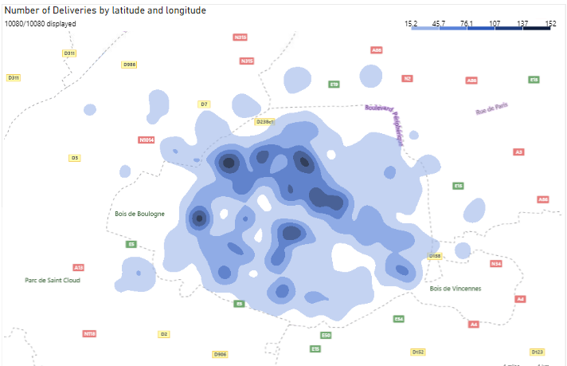

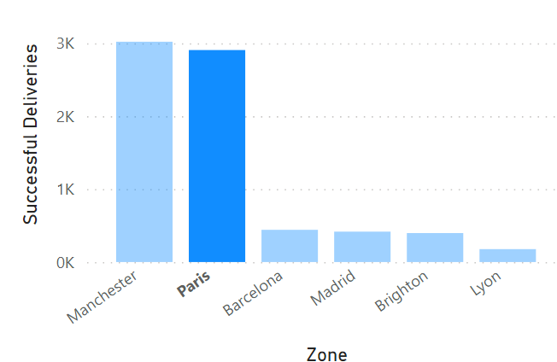
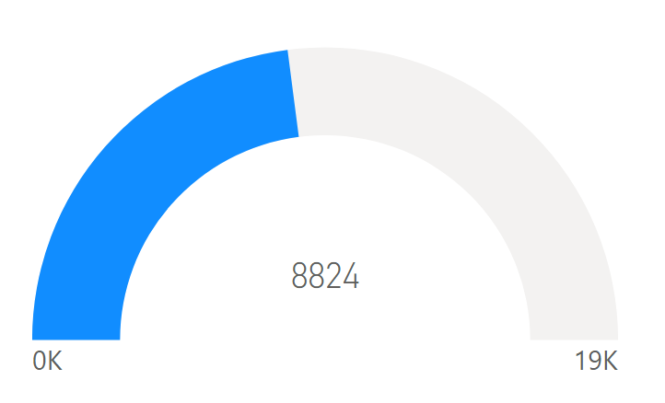
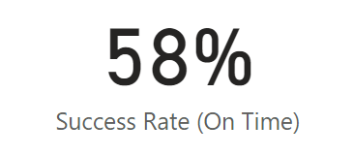
Delivery Performance
Total Deliveries Across Region
Successful deliveries by zone
Paris can be seen to provide the most number of successful deliveries
Largest sum of deliveries occur in Paris.
Success rate of deliveries are just above average.
Notes:
SPEAKER NOTES:
Over the month of December, Paris can be seen to provide the most number of successful deliveries in relation to the other zones with also a large sum of deliveries flowing through. Though Paris has a high rate of deliveries, the overall success rate of deliveries that are on time is just above 50% and therefore could be improved on.

Slide 4
1 | Delivery Performance
2 | Growth

Slide 5
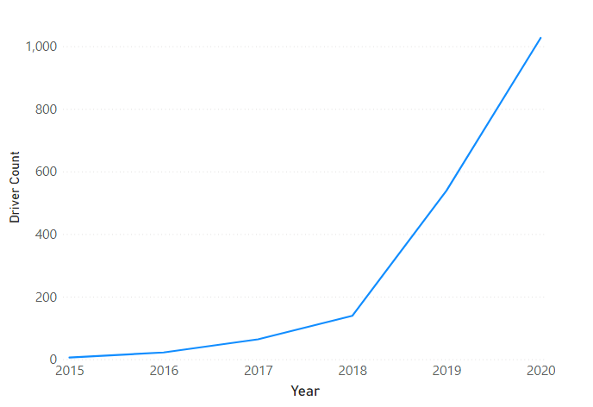
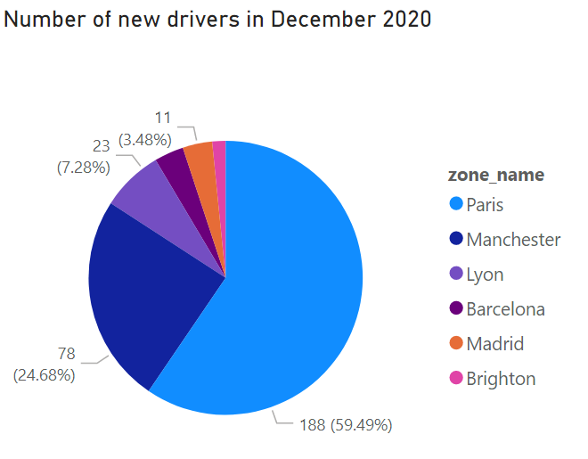
Growth
Substantial growth of drivers can be seen in Paris .
Large number of drivers are joining Paris followed by Manchester.
Notes:
SPEAKER NOTES:
There has been substantial growth of drivers over the last 4 years in Paris . This is critical to match the increase in flow of inventory currently seen within this zone throughout the years and is currently where a large number of drivers are joining followed by Manchester.

