Slide 1
CredTech – AI powered Credit Intelligence Platform
Team Member(1) : C Kalyan
Event: IIT Kanpur Hackathon

Slide 2
Problem Statement
Current credit assessment is slow, outdated, and opaque.
Companies rely on manual reports and incomplete data sources.
Investors, banks, and regulators lack real-time insights.

Slide 3
Proposed Solution
Unified Credit Intelligence Dashboard.
Multi-source data integration (Yahoo, Alpha Vantage, SEC, FRED, News).
Compute Credit Score (0–100) with explainability.
Streamlit Web Dashboard for visualization.

Slide 4
System Architecture
Ingestion Layer → APIs
Pipeline Layer → Data Cleaning, Sentiment, Scoring
Model Layer → Scorecard, Tree Models, Explainability
Dashboard Layer → Streamlit
Deployment → GitHub + Streamlit Cloud

Slide 5
Tech Stack
Data: Yahoo Finance, Alpha Vantage, SEC, World Bank, News
Libraries: Pandas, NumPy, yfinance, scikit-learn, SHAP, TextBlob, Plotly
Backend: Python, Pipelines
Frontend: Streamlit
Infra: Docker, GitHub, Streamlit Cloud

Slide 6
Data Pipeline (ETL)
Ingest APIs → src/utils/
Store CSV → data/
Transform & Score → src/model/scorecard.py
Prototype & Dashboard → app.py

Slide 7
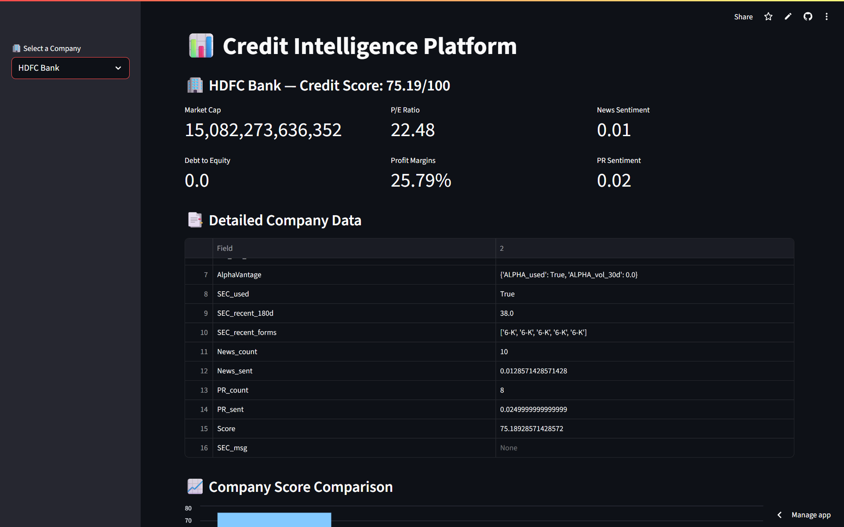
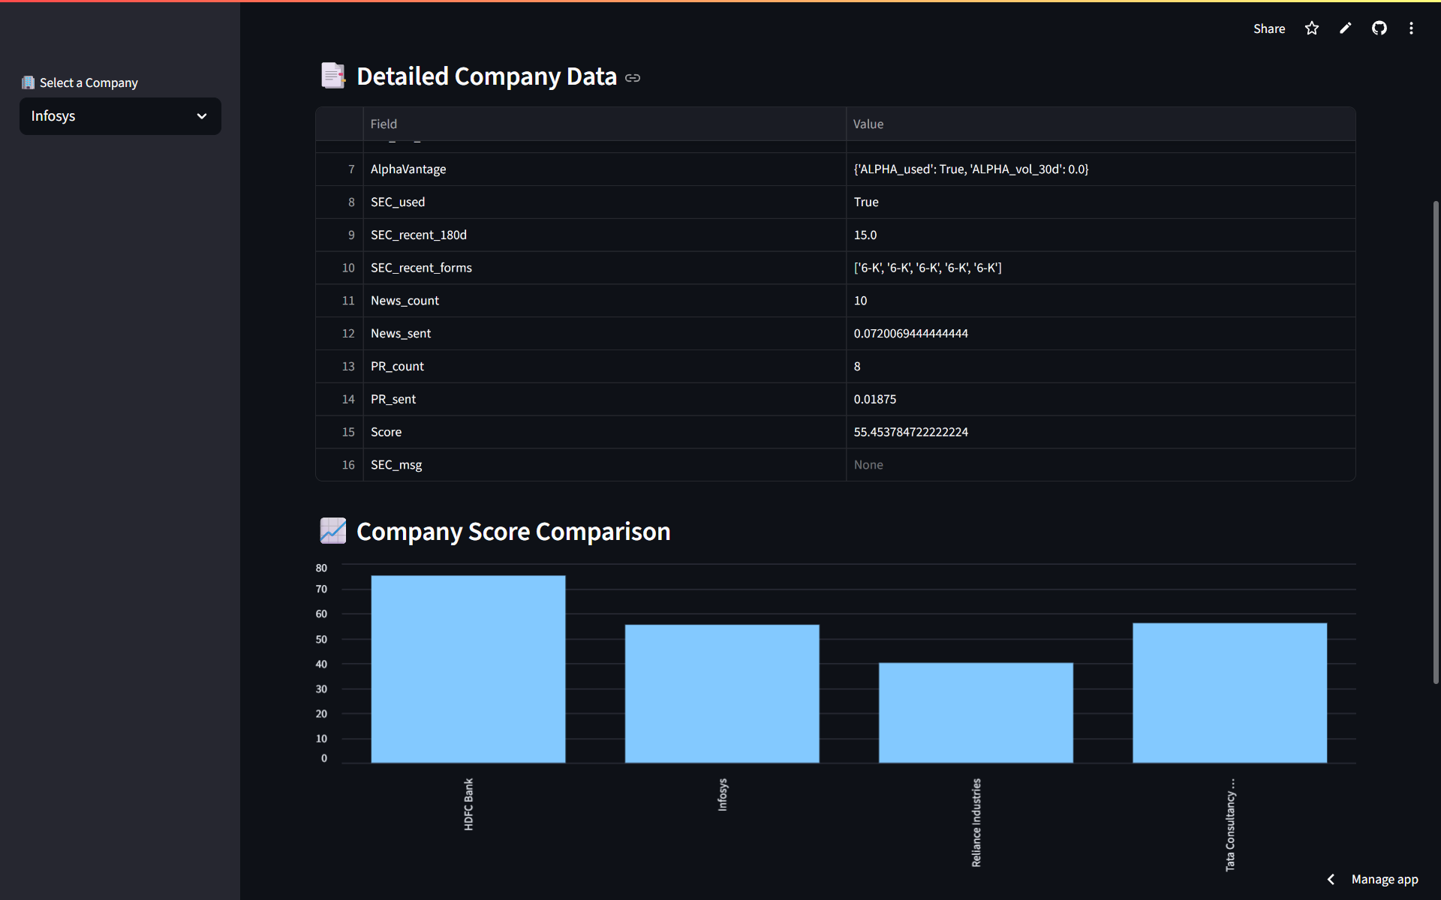
Sample Dashboard Screenshots Dashboard consists of -> Company Selector -> Credit Score Information -> Compliance (SEC EDGAR) -> Sentiment Charts

Slide 8
Dashboard Insights
Real-time score updates
Financial health indicators
Compliance visibility
Sentiment tracking

Slide 9
Deployment
GitHub Repository
Public Streamlit Domain – link: https://credtech-hackathon-project-xdokbheb2scyyendh4cq7v.streamlit.app/
Docker support for portability

Slide 10
Future Work
ML credit risk prediction (tree models, SHAP)
More global companies & sectors
Real-time alerts
Bank/fintech pilot testing

Slide 11
Conclusion
Transparent, explainable credit scoring.
Multi-source real-time data.
Scalable for regulators and fintechs.

Slide 12
Public link is Available
https://credtech-hackathon-project-xdokbheb2scyyendh4cq7v.streamlit.app/

Slide 13
Final Greetings
Thank You all for all this wonderful and challenging Problem statement.
I have learnt so many things – Once Again thank you all.
"Thank you! Built with ❤️ for IIT Kanpur Hackathon — Team Credit Intelligence“

