Slide 1
AKSHAY SOMAYAJI (113322316)
ADITH KUMAR (113217801)
ML/DL BASED INTELLIGENT INTRUSION DETECTION SYSTEM
CSE-534 PROJECT - FINAL PRESENTATION + DEMO
INSTRUCTOR: PROF. ARUNA BALASUBRAMANIAN

Slide 2
INTRODUCTION
Intrusion Detection Systems
Inspect traffic traversing the devices on which they sit to detect malicious traffic on a network
Usually placed at the edge of the network to monitor incoming traffic
Can be Signature-based (look for specific patterns in payload) or Anomaly-based (uses ML to create a defined model of trustworthy activity, and then compare new behavior against this trust model

Slide 3
PROBLEM statement
Use ML techniques to detect any abnormal traffic within the network, including ones that have not been encountered before.
A classification task, that is, either binary (normal/attack) or multi-class (normal and different types of attacks)

Slide 4
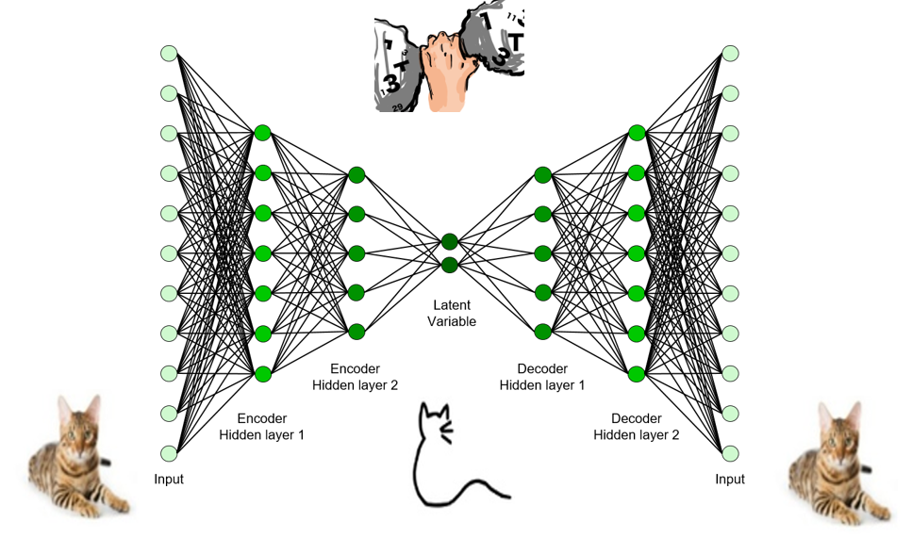
Introduction
Autoencoders
Unsupervised Deep Learning technique that learns the pattern of a normal process. Anything that does not follow this pattern is classified as an anomaly
Made of two modules: encoder and decoder.
Encoder transforms the input data vector into a lower dimension.
The decoder can recreate the original data from these underlying features.

Slide 5
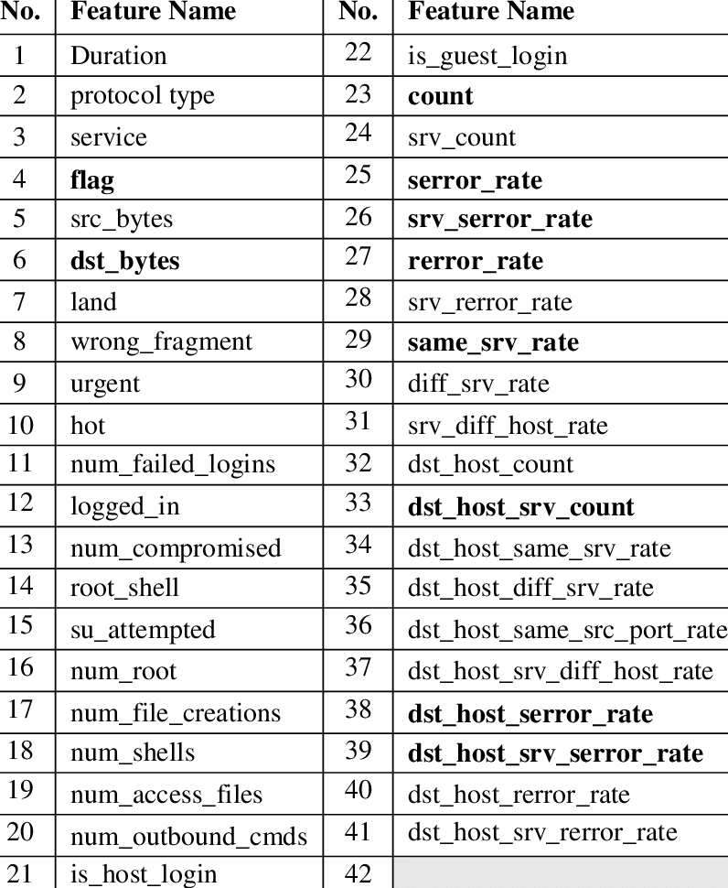
Approach
DATA GATHERING
We use the NSL-KDD Dataset which is widely used as the benchmark for several intrusion detection systems. The dataset contains 140000 labeled network data with 4 different attack classes: Denial of Service (DoS), Root to Local (R2L), User to Root (U2R) and Probing.

Slide 6
Data FEATURES
Features 1- 9:
Intrinsic features, can be derived from the header of the packet.
Features 10 – 22:
Content features, hold information about the original packets
Features 23 – 31:
Time-based features, hold the analysis of the traffic input over a two-second window
Features 32 – 41:
Host-based features, hold the analysis of the traffic input over a series of connections made

Slide 7
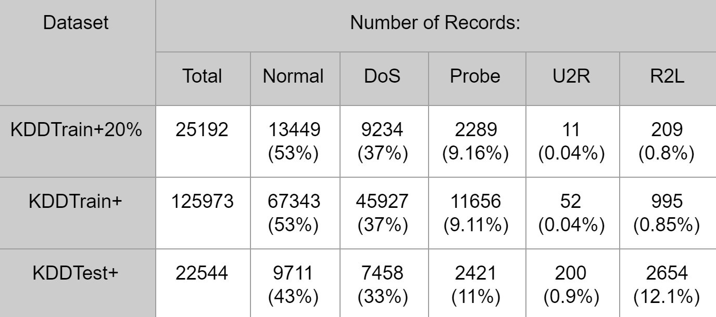
Attack classes

Slide 8
APPROACH
2. DATA PREPROCESSING
Outlier detection and removal – Use Median Absolute Deviation Estimator (MADE) to remove columns containing more than 80% of rows as 0 values
Data Normalization:
Use Min-Max Normalization for continuous features
Use One Hot Encoding for categorical features

Slide 9
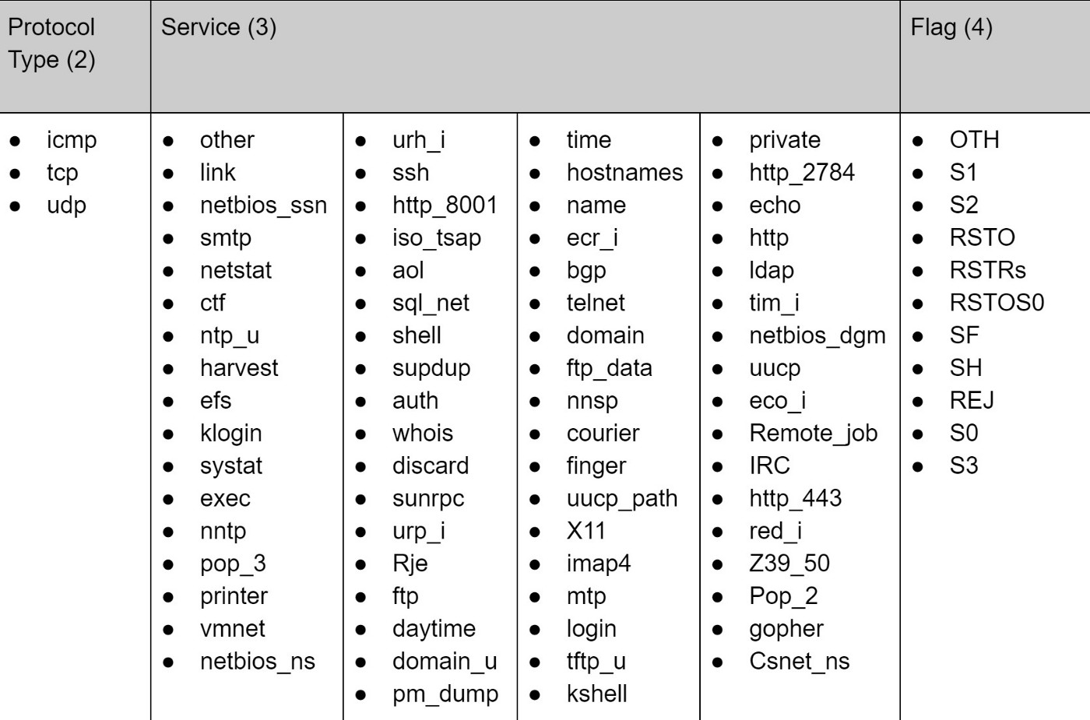
CATEGORICAL FEATURES

Slide 10
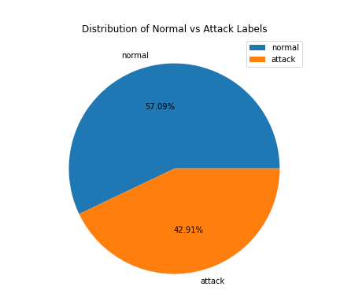
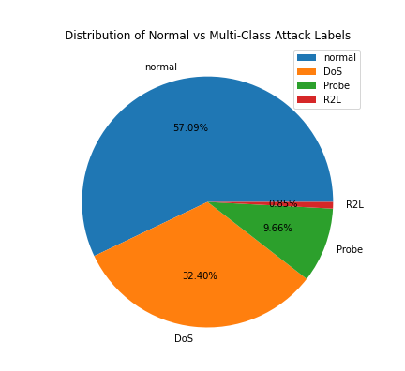
APPROACH
3. DATA LABELING

Slide 11
APPROACH
METHOD | BINARY CLASSIFICATION | MULTI-CLASS CLASSIFICATION
AE | 79.78% | 72.24%
LSTM | 78.21% | 73.56%
MLP | 79.13% | 79.27%
LSVM | 78.74% | 76.48%
QSVM | 79.40% | 60.69%
DT | NA | 78%
RF | NA | 81%
4. MODEL COMPARISON AND RESULTS

Slide 12
Approach
flag_SF | 0.1388173254
flag_SH | 0.1013037257
flag_RSTOS0 | 0.05530383838
diff_srv_rate | 0.05362965763
dst_host_serror_rate | 0.05043431042
count | 0.05036498005
same_srv_rate | 0.046870484
dst_host_same_srv_rate | 0.04102180549
dst_host_srv_serror_rate | 0.03919656876
dst_host_diff_srv_rate | 0.03827516109
flag_S2 | 0.03742586889
dst_host_srv_count | 0.03646796814
serror_rate | 0.03601367121
dst_host_same_src_port_rate | 0.03408792591
srv_count | 0.02834251542
src_bytes | 0.02675718331
service_http | 0.02652195825
dst_host_srv_diff_host_rate | 0.02292469064
service_courier | 0.02069135504
srv_serror_rate | 0.01938870169
dst_host_count | 0.01914347793
service_domain_u | 0.0165630458
service_ftp | 0.01255886245
dst_bytes | 0.0115121764
5. FEATURE IMPORTANCE
RANDOM FOREST

Slide 13
Approach
flag_SF | 0.5042174285
dst_host_serror_rate | 0.1631269608
service_domain_u | 0.08479269121
service_ftp | 0.06442231693
srv_count | 0.04391217008
dst_host_same_src_port_rate | 0.04276541923
dst_host_srv_count | 0.02605876103
diff_srv_rate | 0.01200549473
service_finger | 0.01080040149
dst_host_diff_srv_rate | 0.009467338802
count | 0.007985459171
flag_SH | 0.00745500481
dst_host_srv_diff_host_rate | 0.003906072998
dst_host_same_srv_rate | 0.003448542843
service_http | 0.002941056308
service_ecr_i | 0.002767832586
dst_host_srv_serror_rate | 0.001896128179
flag_S2 | 0.001615414413
flag_RSTOS0 | 0.0009576552736
flag_OTH | 0.0008991251776
flag_RSTO | 0.0007772885237
dst_host_count | 0.0007274481444
serror_rate | 0.0006735467431
src_bytes | 0.0006103840527
5. FEATURE IMPORTANCE
DECISION TREE

Slide 14
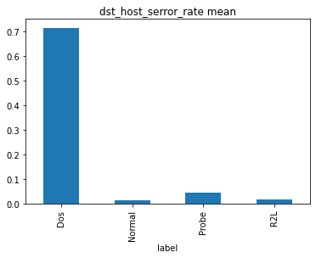
FEATURE ANALYSIS
DOS

Slide 15
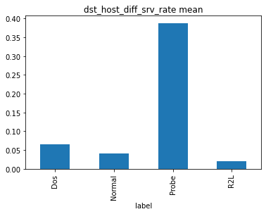
FEATURE ANALYSIS
Probe

Slide 16
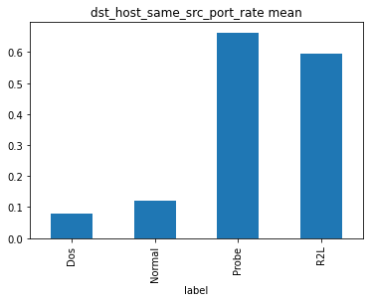
FEATURE ANALYSIS
R2L

Slide 17
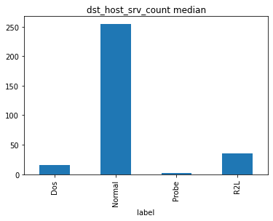
FEATURE ANALYSIS
R2L

Slide 18
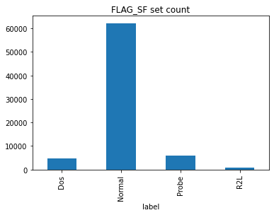
FEATURE ANALYSIS
Normal

Slide 19

THANK YOU!

