Slide 1
Splash screen
Notes: scroll bar; heatmap expands vertically
Resources
Events
Permissions
Quarantine
Lockdown
Configuration and settings
Sensitive data over time
System Statuses

Slide 2
Resources
Resources
Total Size | Late Event | Last Accessed | Last Modifed | Last Toucher | etc
Expandable folder tree

Slide 3
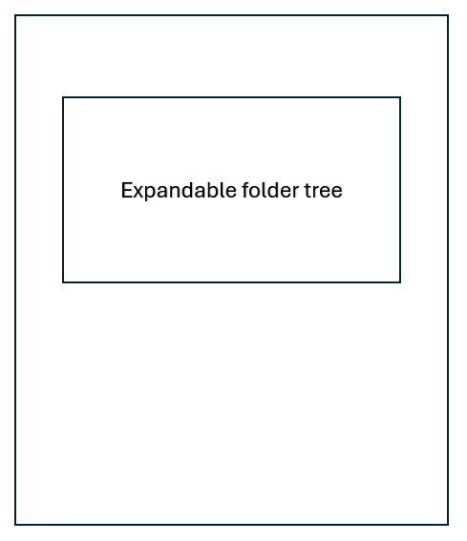
Events on Sensitive Data

Slide 4
Permissions Explorer
ACE | Permission

Slide 5
Remediation
Create New job config: Quarantine, Repermission, or both
Current Jobs (tabbed)

Slide 6

Reports
Query1
gasList of precanned reports
Reports: reports tab
Reports: sql query tab with AI assistant (user enters either anthropic or open AI key in configuration)
, precanned reports. User selects which they want to use and it creates a tab, either a query tab with a
Grid for output, or a precanned report

Slide 7
Reports
Query1
gasList of precanned reports
Reports:
Sql editor
Query tab
Ask AI – sends query with full schema and engineered prompt

Slide 8
Configuration (settings in example below) Links of configuration items, opens new tab to configure
Setting1
Setting2
setting3
<Value 1>
<Value 2>
<Value 3>

