Slide 1

HARMONIC COMPLEXIFIER
Nicolò Chillè
Rocco Scarano
Michele Murciano

Slide 2
Main idea:
Develop a sort of didactic tool that allows inexperienced musicians to generate intricate chord sequences
Add up to 5 level of complexity to a commonly structured 4-chords sequence, given as input

Slide 3
Features:
Six possible "complexifiable" sequences
Seven possible chord types as input
Preset selection
Level of complexity selection
Chord sequence playback
2 different playback patterns
3 levels of playback speed
Guitar tablature for the outputted chords
Midi file export of the "complexified" sequence

Slide 4
Complexifying the sequence:
Find the root of the sequence
Find the most similar sequence
Complexify the sequence

Slide 5
Root finding:
Take all the chords from the input
Check if one of the notes is the root of the sequence
I.E: at least 3, belong to the key of that note
If none of the notes is the root, check all the other possible notes
If a chord isn’t in scale, it is pointed out to the user

Slide 6
Sequences:
I II V I
I IV V I
I V IV I
I VI V I
I VI II V
I V VI IV
The program can also work with slightly different sequences, reducing them to one of these with which it can work best.
The sequence can be entered either by inserting the key and the preset, or by having it recognized by the program itself from a circle of chords.

Slide 7
Levels of Complexity:
Substitutions are cumulative
Transition from triads to tetrads
Relative minor substitution
Secondary dominant substitution
Parallel minor substitution
Tritone substitution

Slide 8
Audio playback:
Implemented using "Howler.js" audio library
Sound source created by using ".wav" audio files
Each file plays a chord for the duration of one quarter
Concatenated according to the chord actual duration
Played back in a loop using the "setTimeout()" function, with the chosen speed

Slide 9
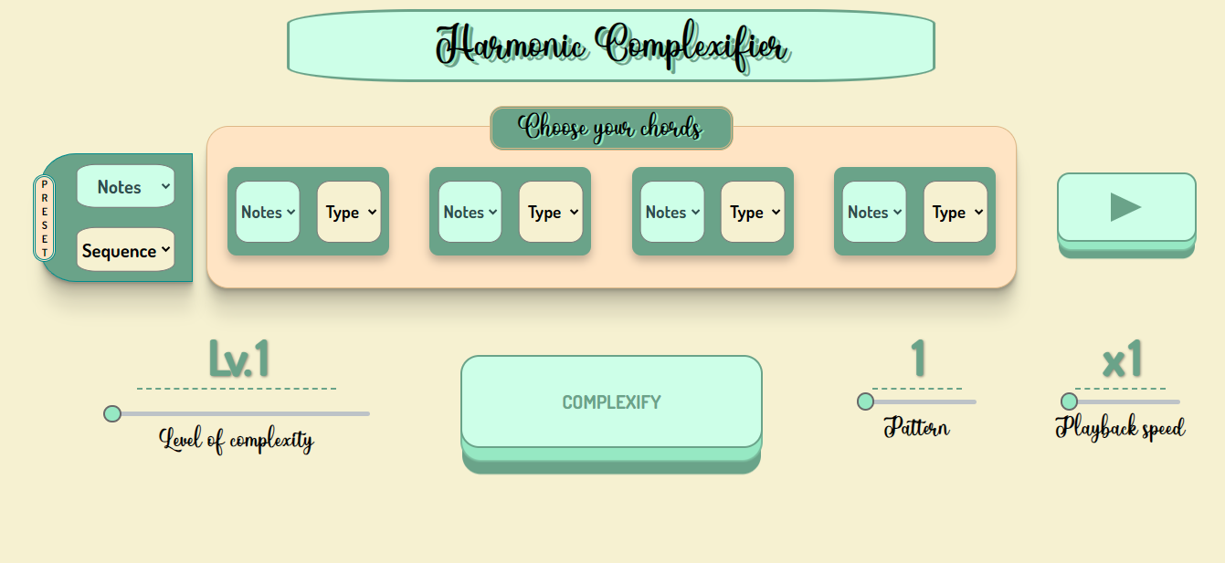
Graphical User Interface
Initial state

Slide 10
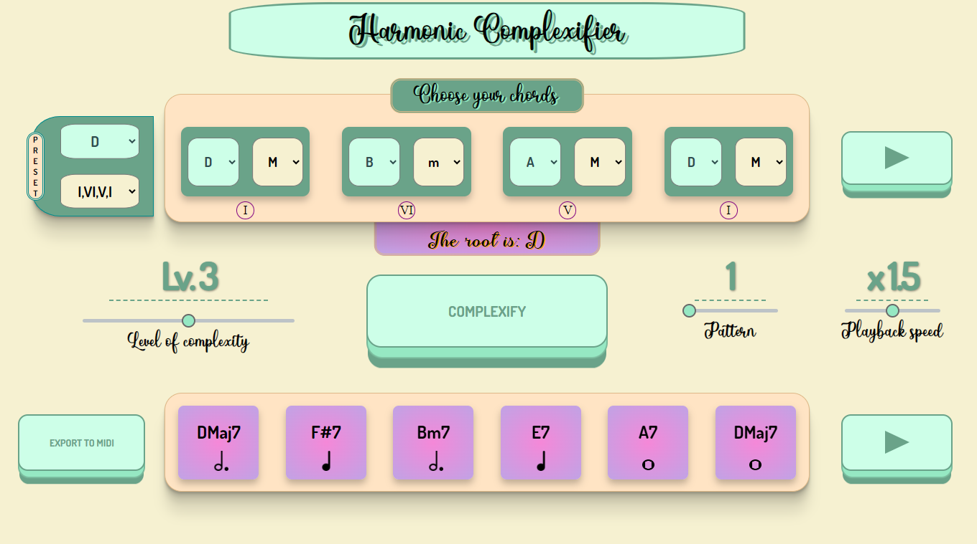
Graphical User Interface
After user interaction

Slide 11
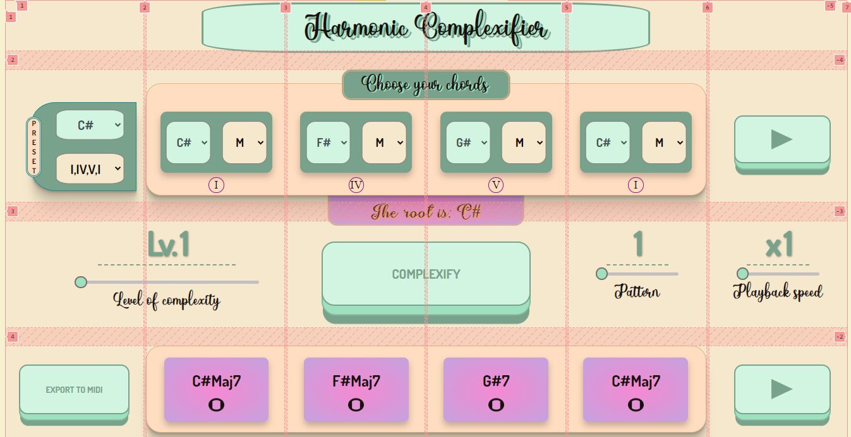
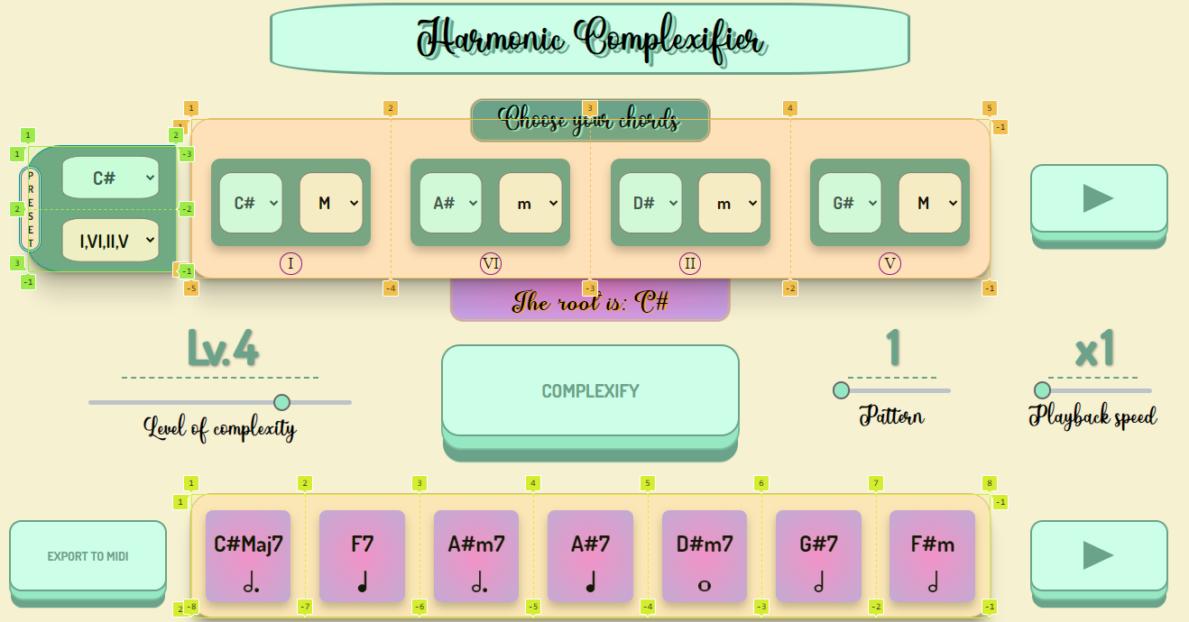
Graphical User Interface
CSS Grid Layout

Slide 12
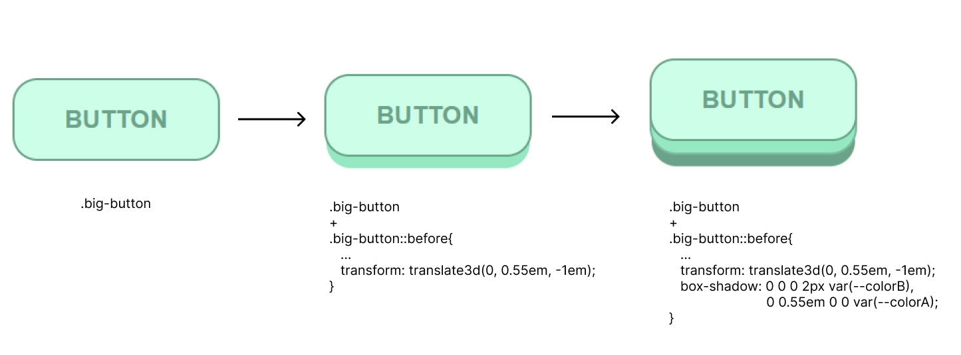
Graphical User Interface
3D Button implementation

Slide 13
Midi Export:
Implemented using "midi-writer-js" library
Extract, for each chord of the output sequence, the notes
Create a noteEvent of its duration
Add it to the midi track
Once done, generate a download url of the midi track

Slide 14
Conclusions
Successfullyin guides a beginning musician in music theory
Encourages him to evolve and vary using the level of complexity and transformations he likes best.
Helpful to understand and learn new chords, by using the guitar tablature and the midi export function

Slide 15
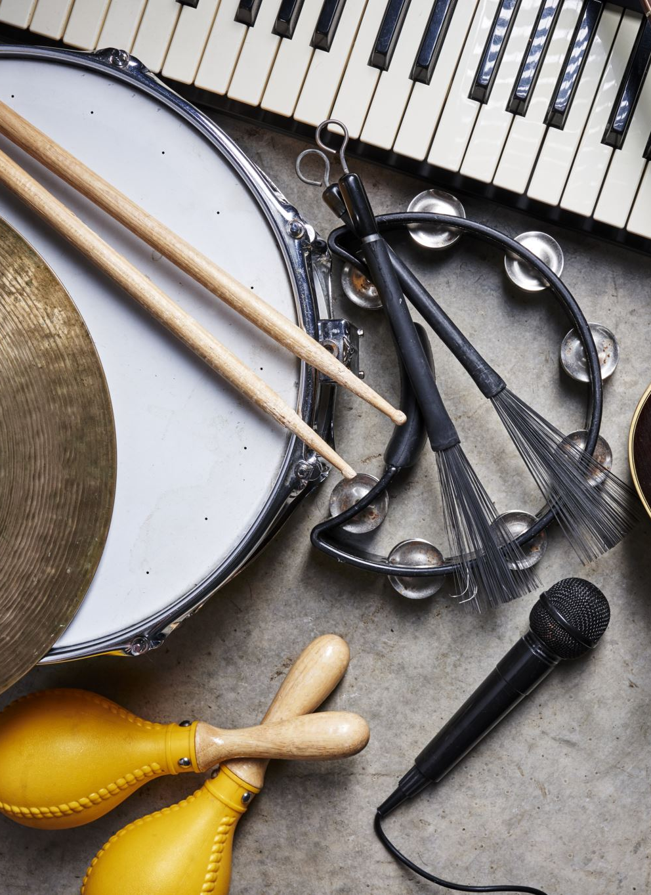
Ideas
Further increase the sequences with which the program performs best
Increase the number of musical instruments with which you can hear the result
Being able to visualize how to play the output chords with different musical instruments

