Slide 1
Deployment of Hadoop MapReduce environment in a private cloud and implement Sentiment Analysis of Yelp dataset
Team-Parallel Cloud
Dhanyatha Manjunath
Rajath Agasthya
Sonali Bhat
Notes:
*

Slide 2
Project Description
The project is aimed at performing Sentiment Analysis on Yelp dataset to predict accurate rating of the review
Sentiment Analysis is an important technique to bring consistency between the review and the actual star rating. This is crucial for the businesses as it provides an accurate rating of their products/services. Businesses can then alter their services to provide a better customer experience.
The analysis will be performed using MapReduce framework on a Hadoop cluster deployed in Vlab private cloud.
The main tasks of the project include deploying Hadoop cluster in Vlab cloud, analyzing sentiment of a yelp review and predict a rating based on the sentiment of the review.
The rating can be predicted using various machine learning techniques such as Naive Bayes Classifier or support vector machine (SVM) learning algorithms.
Notes:
*

Slide 3
Project Tasks
Task 1 : Setting up the Hadoop environment on the Vlab cloud
Task 2: Choosing the best learning algorithm for predicting the rating based on the yelp dataset considering accuracy as the primary goal.
Task 3: Implementation of the above chosen algorithm using map-reduce framework.
Task 4: Running and testing of the application on the local system
Task 5: Deployment of the code, running and testing of the application.
Notes:
*

Slide 4
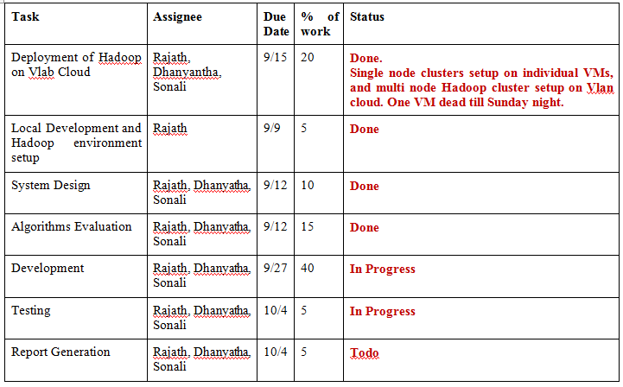
Task Allocation
Task Allocation Table
Task Percentage
Dhanyatha - 33%
Rajath - 34%
Sonali - 33%
Notes:
*

Slide 5
Hardware and Software Tools
Software
Programming Language: Java
Libraries: Apache Mahout
Tools: Eclipse, Git, Hadoop Environment
Hardware
Deployment of Hadoop on Vlab cloud
Notes:
*

Slide 6
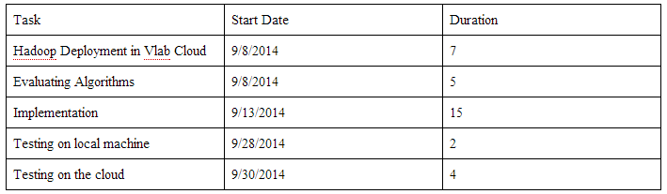
RoadMap of the Project
Roadmaps of the project
Notes:
*

Slide 7
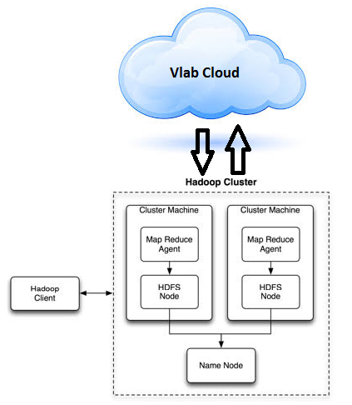
Technical Details
The goal of this project is to perform sentiment analysis of the text input by the user as reviews and to capture the positive, negative or neutral sentiment in the review and decide the rating based on these factors. There are various pattern recognition methods available for text analysis. This project aims at finding the best approach and designing an algorithm to do the sentiment analysis and implementing it.
System Model
Notes:
*

Slide 8
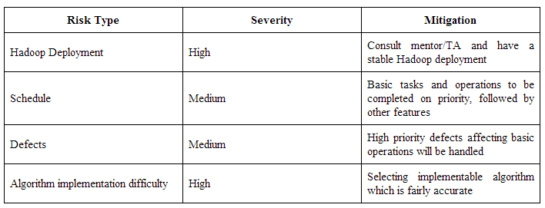
Risks and Benefits
Risks
Potential applications & benefits:
As a future work, we can include a larger interest set that can be included in the search criteria to let the user filter the reviews based on multiple categories like location, check-in sets and tips etc.
It is often the case that a review and its corresponding rating provided by the user are subjective and not consistent. Hence, this application can be used to get consistent ratings and the same can be used to effectively recommend businesses that fall in the similar rating categories.
Notes:
*

Slide 9
Tasks Accomplished by Now
Setting up the local Hadoop environment on the Vlab cloud
Initially single node cluster backed by Hadoop Distributed File system was set up on the Ubuntu machine .
Then multi node cluster backed by Hadoop Distributed File system was set up on the Ubuntu machine .
Choosing the best learning algorihm for predicting the rating based on yelp dataset.
Random Forest classifier is chosen as the best learning algorithm as it is very accurate for numerical data.
Notes:
*

Slide 10
Tasks Accomplished by Now
3. Preprocessing of Yelp Review Dataset using map-reduce framework.
The main part of the preprocessing- writing the mapper and reducer classes is completed. Testing of the same is in progress.

Slide 11
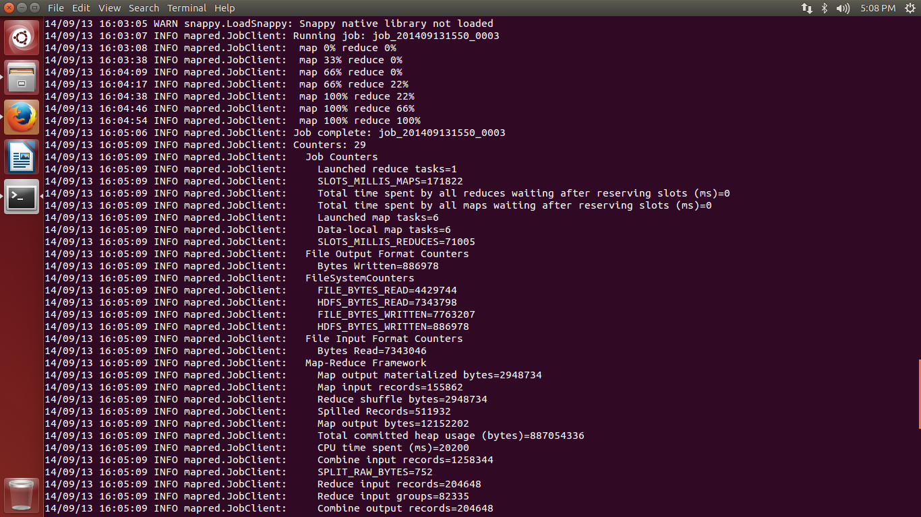
Screenshots of the Single Node cluster set up
Results obtained on running word count program on a single node cluster

Slide 12
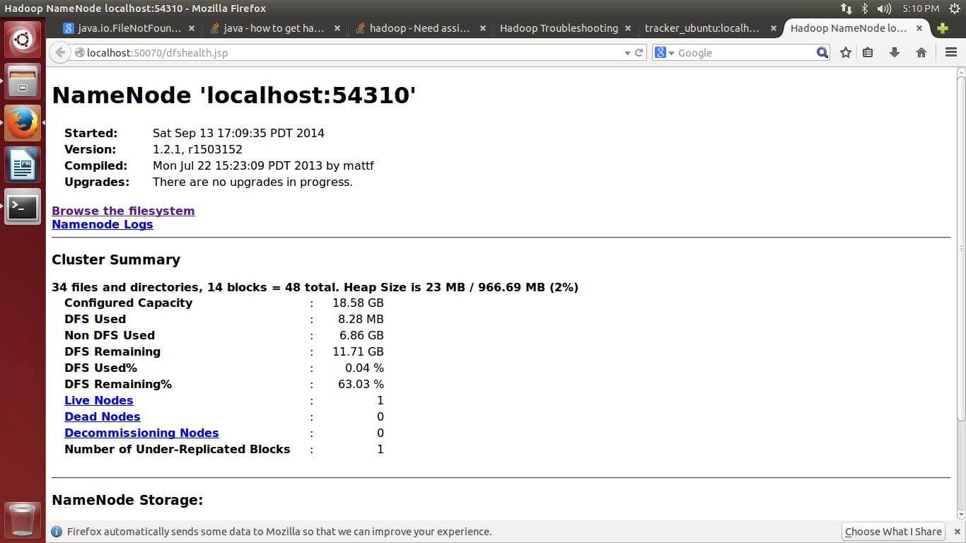
Screenshots of the Single Node cluster set up
Screenshot of NameNode summary

Slide 13
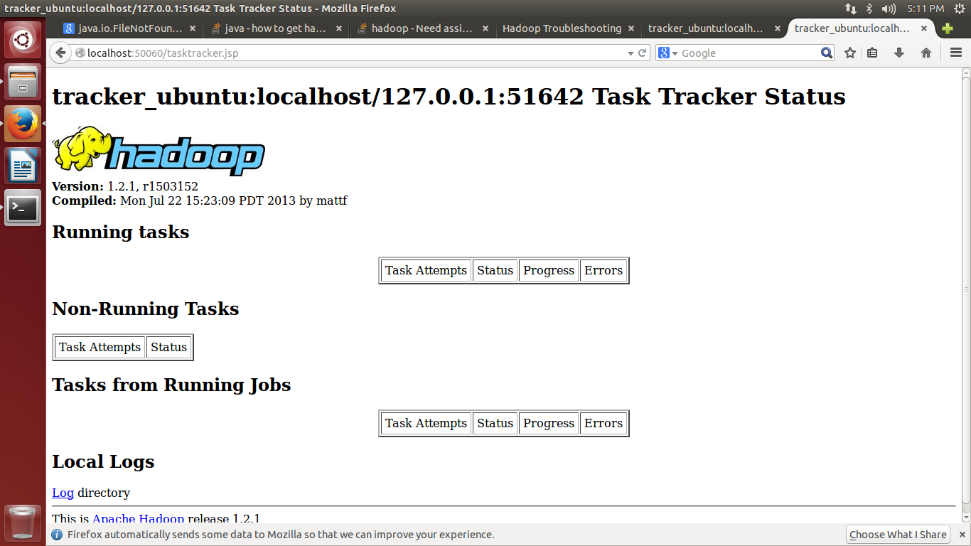
Screenshots of the Single Node cluster set up
Screenshot of TaskTracker status

Slide 14
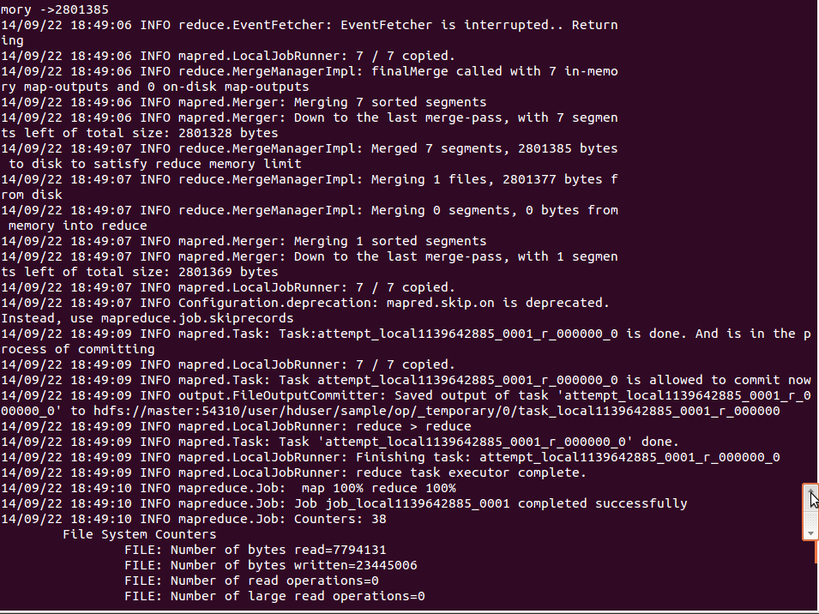
Screenshots of the Multiple Node cluster set up
Screenshot of running the word count program on a multiple node cluster set up

Slide 15
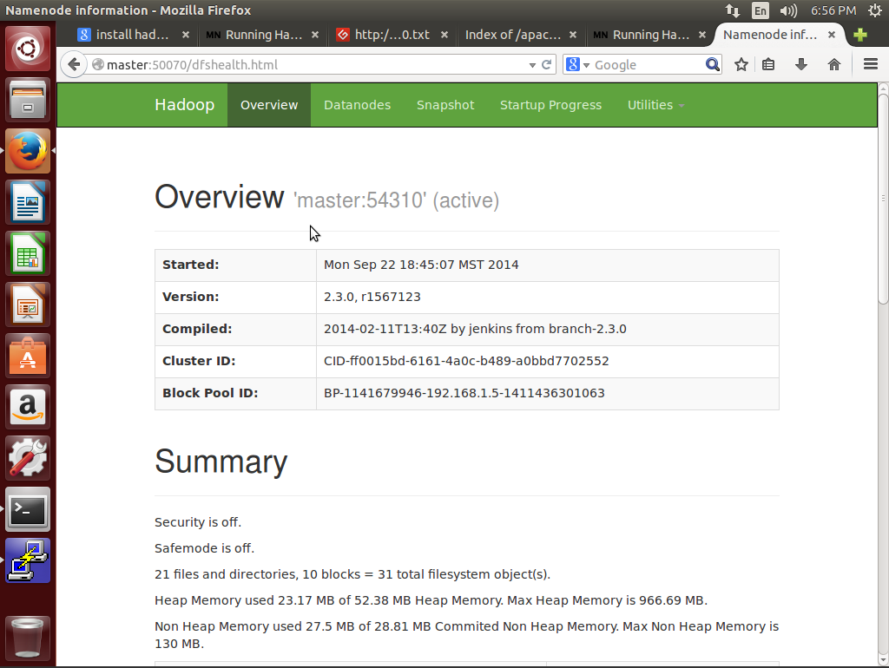
Screenshots of the Multiple Node cluster set up
Screenshot of NameNode Summary

Slide 16
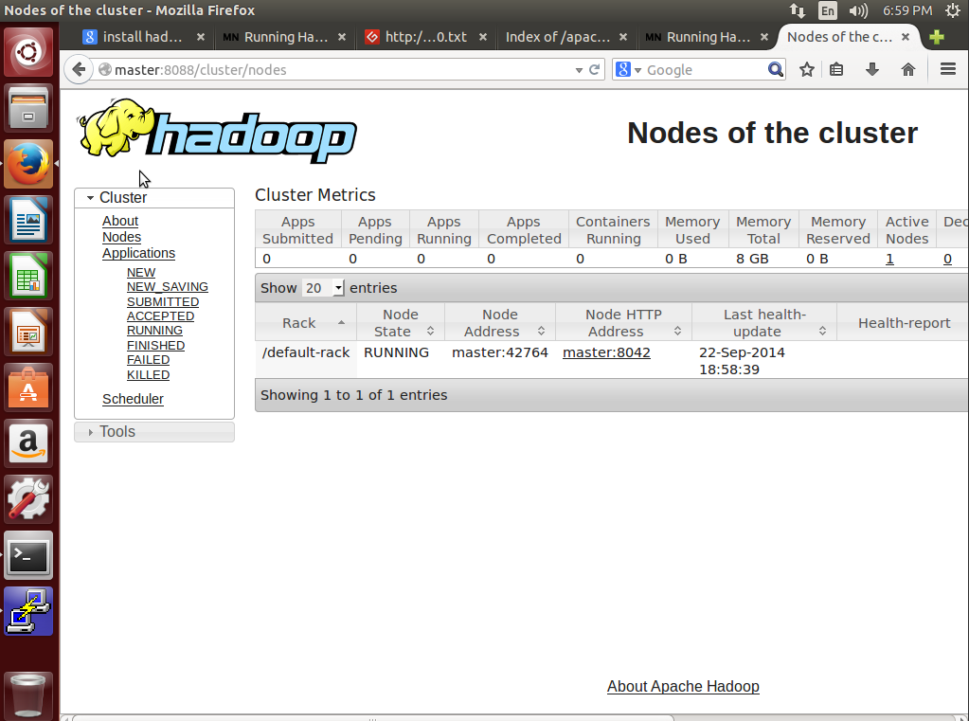
Screenshots of the Multiple Node cluster set up
Screenshot of Resource Manger summary

Slide 17
Conclusion
The major task of this project is to understand the requirement and structure of a Hadoop mapreduce environment and to implement and deploy an application developed using mapreduce algorithm to solve sentimental analysis on a private section in a public cloud.
The application should be able to take user inputs to filter review descriptions in the yelp dataset for a particular business category and list the corresponding review ratings.
Notes:
*

Slide 18
Demo (if have)
Notes:
*

