Slide 1
Deployment of Hadoop MapReduce environment in a private cloud and implement Sentiment Analysis of Yelp dataset
Team-Parallel Cloud
Dhanyatha Manjunath
Rajath Agasthya
Sonali Bhat
Notes:
*

Slide 2
Project Description
This project is aimed at performing Sentiment Analysis on Yelp dataset to predict accurate rating of the review.
Sentiment Analysis is an important technique to bring consistency between the review and the actual star rating. This is crucial for the businesses as it provides an accurate rating of their products/services. Businesses can then alter their services to provide a better customer experience.
The main tasks of the project include deploying Hadoop cluster in Vlab cloud, analyzing sentiment of a yelp review and predict a rating based on the sentiment of the review.
The rating can be predicted using various machine learning techniques such as Naive Bayes Classifier or support vector machine (SVM) learning algorithms. Random forest classifier has been chosen for this project as it is accurate for numerical data.
Notes:
*

Slide 3
Project Tasks
Task 1 : Setting up the Hadoop environment on the Vlab cloud
Task 2: Choosing the best learning algorithm for predicting the rating based on the yelp dataset considering accuracy as the primary goal.
Task 3: Preprocessing of Yelp Review Dataset algorithm using map-reduce framework.
Task 4: Implementation of Random Forest Classifier using Apache Mahout.
Task 5: Implementing the User Interface to take user inputs
Task 6: Running and testing of the application on the local system
Task 7: Deployment of the code, running and testing of the application.
Notes:
*

Slide 4
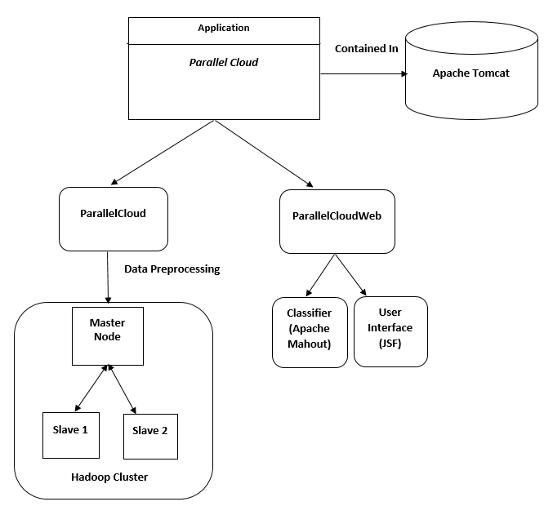
System Design

Slide 5
System Design
The application is divided into two projects
1. Parallel Cloud: This project preprocesses the yelp dataset. The dataset contains 1.1 million reviews provided by users for business entities. This project contains the application logic to preprocess the dataset using map reduce framework. The output data contains review rating followed by feature set determined for the review using parameters such as unigram score, unigram count, bigram score, bigram count, stop words, positive and negative words. This is the training dataset which shall be used in the subsequent steps to generate a learning model.
2. ParallelCloudWeb: This project implements the random forest classifier. A sequence file is generated from the preprocessed data obtained from previous step, to provide as input to the classifier. The classifier is initially trained using this data and generate a model. Upon receiving user input, which is the test data, the classifier predicts a rating for the review using the model.
This project includes the design and implementation of the user interface. The interface takes a review description from the user as input test data and displays the rating predicted by the classifier.

Slide 6
Algorithm for Classification
Random Forest Classifier is a learning technique used for classification. It constructs a multitude of decision trees during preprocessing the training dataset. In this project, training data consists of 1.1 million reviews provided by the users.
Random Forest Classifier creates random subset of decision trees. This subset consists of 60-65% of the decision trees in total set. Remaining data i.e. out-of-bag data (OOB) are used to estimate error and variable importance.
The classifier performs following actions at each node:
1. For a given number m, the classifier selects m predictor variables at random from the set of all predictor variables.
2. An objective function is used to determine the predictor variable which provides the optimal split. A binary split is performed on that node.
3. Another variable m is chosen at random at the next node and same steps are resumed [1]

Slide 7
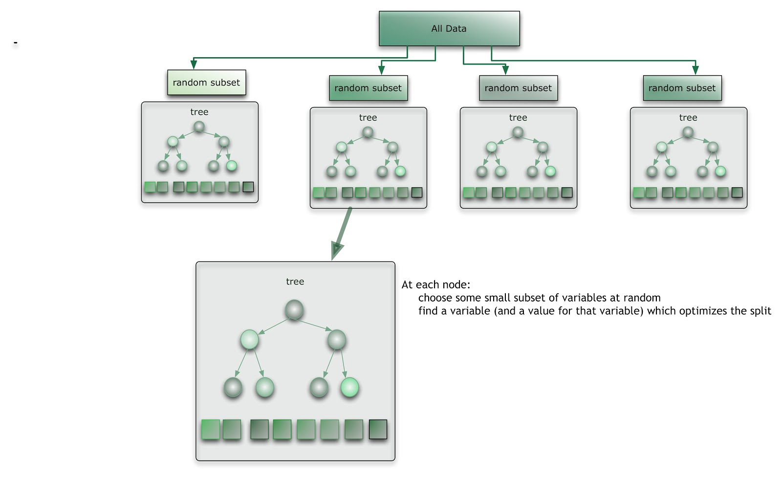
Random Forest Classifier

Slide 8
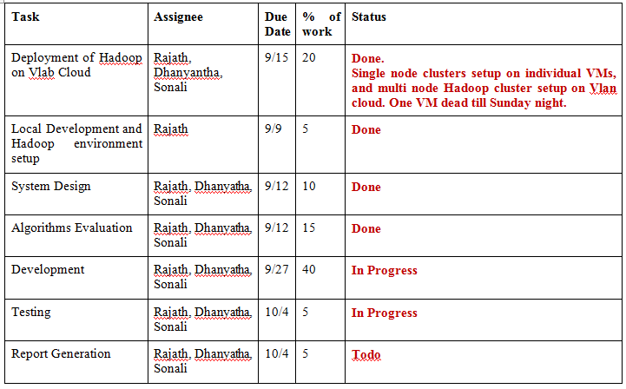
Task Allocation
Task Allocation Table
Task Percentage
Dhanyatha - 33%
Rajath - 34%
Sonali - 33%
Notes:
*

Slide 9
Dataset Overview
The dataset includes Yelp review data for businesses in Phoenix, Las Vegas, Madison, Waterloo and Edinburgh. It contains data for the following entities:
42,153 businesses
320,002 business attributes
31,617 check-in sets
252,898 users
955,999 edge social graph
403,210 tips
1,125,458 reviews

Slide 10
Hardware and Software Tools
Software
Programming Language: Java
Framework: JSF Framework, Twitter Bootstrap, Hadoop Java Client
Libraries: Apache Mahout (Classification)
Tools: Eclipse, Git
Environment: Hadoop 2.3.0
Hardware
3 Virtual Machines on Vlab Cloud with 64-bit Ubuntu 14.04 LTS as the OS each with 10 GB disk space and 1 GB RAM
Notes:
*

Slide 11
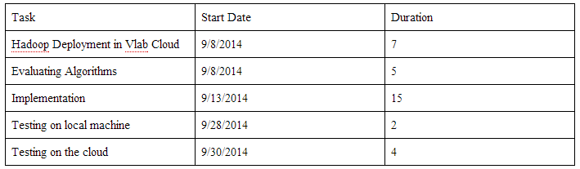
RoadMap of the Project
Roadmap of the project
Notes:
*

Slide 12
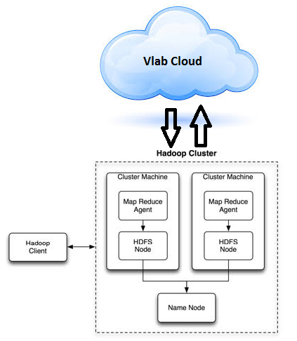
Technical Details
The goal of this project is to perform sentiment analysis of the text input by the user as reviews and to capture the positive, negative or neutral sentiment in the review and decide the rating based on these factors. There are various pattern recognition methods available for text analysis. This project aims at finding the best approach and designing an algorithm to do the sentiment analysis and implementing it.
System Model
Notes:
*

Slide 13
Build Instructions
Please follow the below build instructions to setup and run the project:
1. Import ‘parallelcloud’ and ‘ParallelCloudWeb’ into Eclipse workspace and do maven update on both the projects.
2. Change corresponding file paths in ‘WordsReaderHelper.java’, ‘YelpBean.java’ and ‘Yelp.java’ to point to helper files on local file system. Helper files are used to determine feature set score for a review. The files are located under parallelcloud/data directory.
3. Assuming maven is installed, go to command line and cd into workspace/parallelcloud.
4. Do mvn clean compile assembly:single. A JAR will be generated in parallelcloud/target.
5. Copy this JAR into ParallelCloudWeb/target.
6. Add ParallelCloudWeb to Tomcat and start the server. Go to index.xhtml and click run on server.
7. Start MapReduce job once from the web page
8. Provide 20 as input to number of trees field and train the classifier once by clicking the ‘train’ button. You can track the completion of this step in eclipse console.
9. Upon completion of previous step, enter a review description to get a prediction.

Slide 14
User Interaction
Start the MapReduce process for the first time. Note that for subsequent runs the button to start the MapReduce job is disabled since it was completed once.
Enter the number of trees for the training the dataset. Note that a number greater than 30 may cause memory issues depending on memory availability. Button to train the dataset will be disabled once it is trained.
Enter a review in the text box and get a prediction.

Slide 15
Technical Dependencies
Please run the mapreduce job part of ‘ParallelCloud’ project initially to preprocess the yelp review dataset and generate the preprocessed data- ‘output.csv’.
This file is necessary for the random forest classifier implemented in the project -’ParallelCloudWeb’.

Slide 16
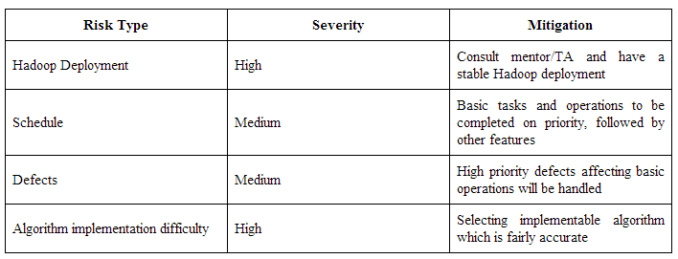
Risks and Benefits
Risks
Potential applications & benefits:
As a future work, we can include an interest set that can be provided as a search criterion to let the user filter the reviews based on multiple categories like location, check-in sets and tips etc.
It is often the case that a review and its corresponding rating provided by the user are subjective and not consistent. Hence, this application can be used to get consistent ratings and the same can be used to effectively recommend businesses that fall in the similar rating categories.
Notes:
*

Slide 17
Tasks Accomplished by Now
Setting up the local Hadoop environment on the Vlab cloud
Initially single node cluster backed by Hadoop Distributed File system was set up on the Ubuntu machine .
Then multi node cluster backed by Hadoop Distributed File system was set up on the Ubuntu machine .
Choosing the best learning algorithm for predicting the rating based on yelp dataset.
Random Forest classifier is chosen as the best learning algorithm as it is very accurate for numerical data.
3. Preprocessing of Yelp Review Dataset using map-reduce framework.
The mapper and reducer classes for preprocessing of Yelp Review Dataset are created and pushed to Gitlab repository. Testing the preprocessing of data is complete.
Notes:
*

Slide 18
Tasks Accomplished by Now (Continued)
4. Implementation of Random Forest Classifier using Apache Mahout.
Sequence file was generated from the preprocessed data. Random forest classifier was implemented to learn patterns from the input dataset. Once a model was constructed, the classifier predicted a rating for the input review
Implementation of the User Interface to take user inputs.
User interface was created to receive input reviews from the user and display the rating predicted by the classifier.

Slide 19
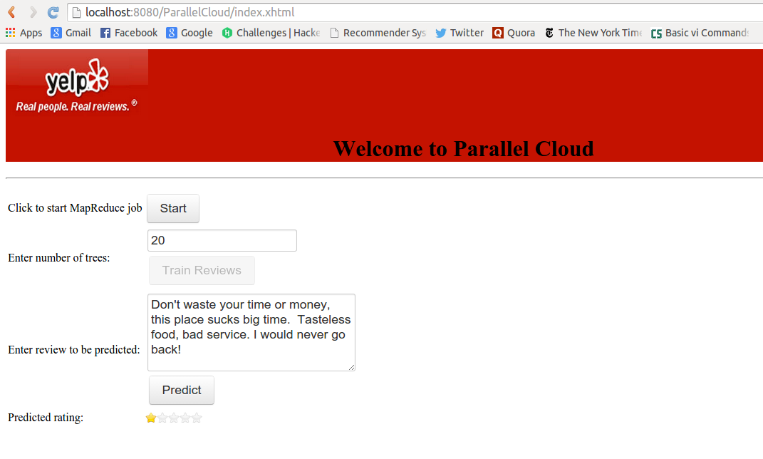
Screenshot -Rating for a poor review

Slide 20
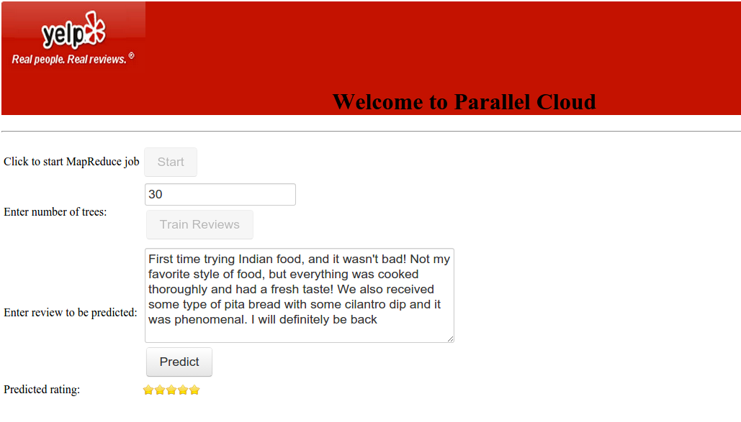
Screenshot -Rating for a good review

Slide 21
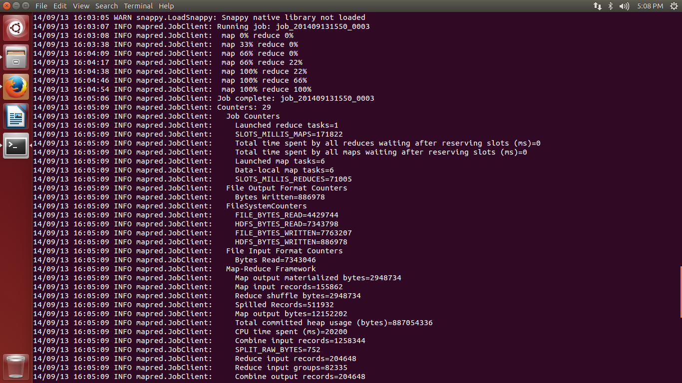
Screenshots of the Single Node cluster set up
Results obtained on running word count program on a single node cluster

Slide 22
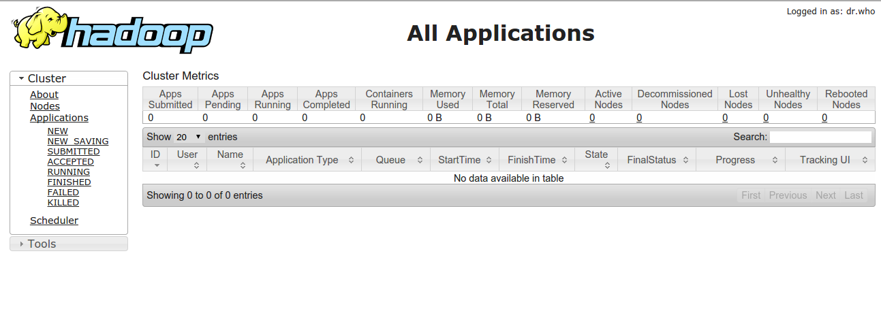
Screenshots of the Single Node cluster set up
Screenshot of Resource Manager summary:

Slide 23
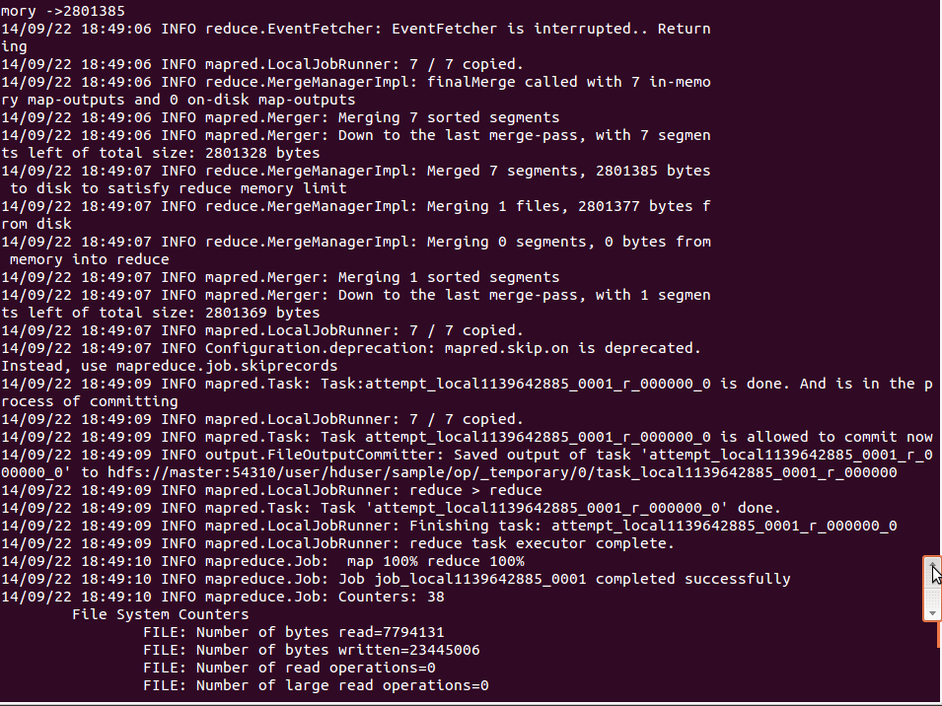
Screenshots of the Multiple Node cluster set up
Screenshot of running the word count program on a multiple node cluster set up

Slide 24
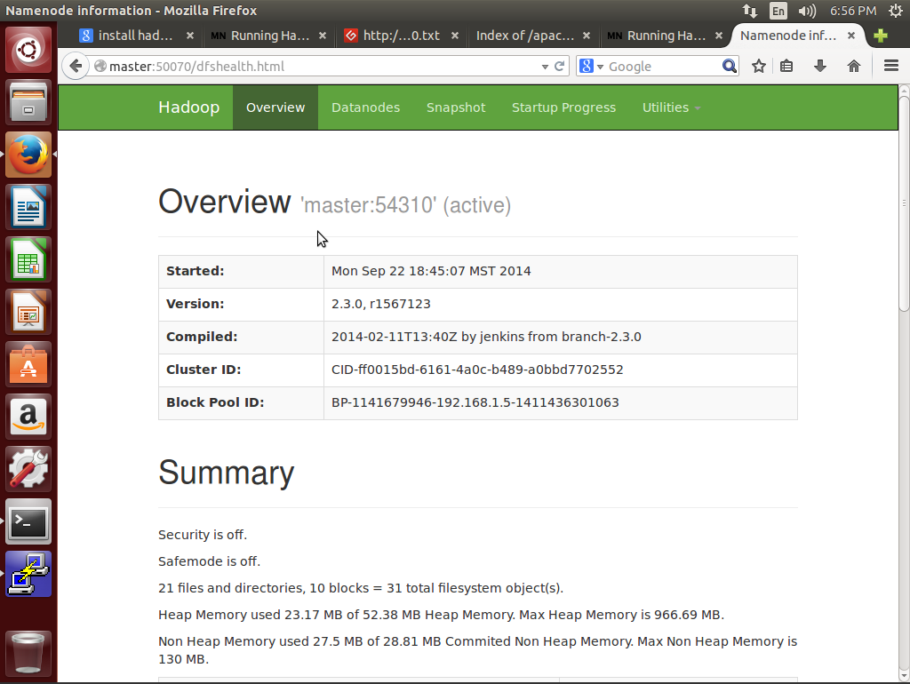
Screenshots of the Multiple Node cluster set up
Screenshot of NameNode Summary

Slide 25
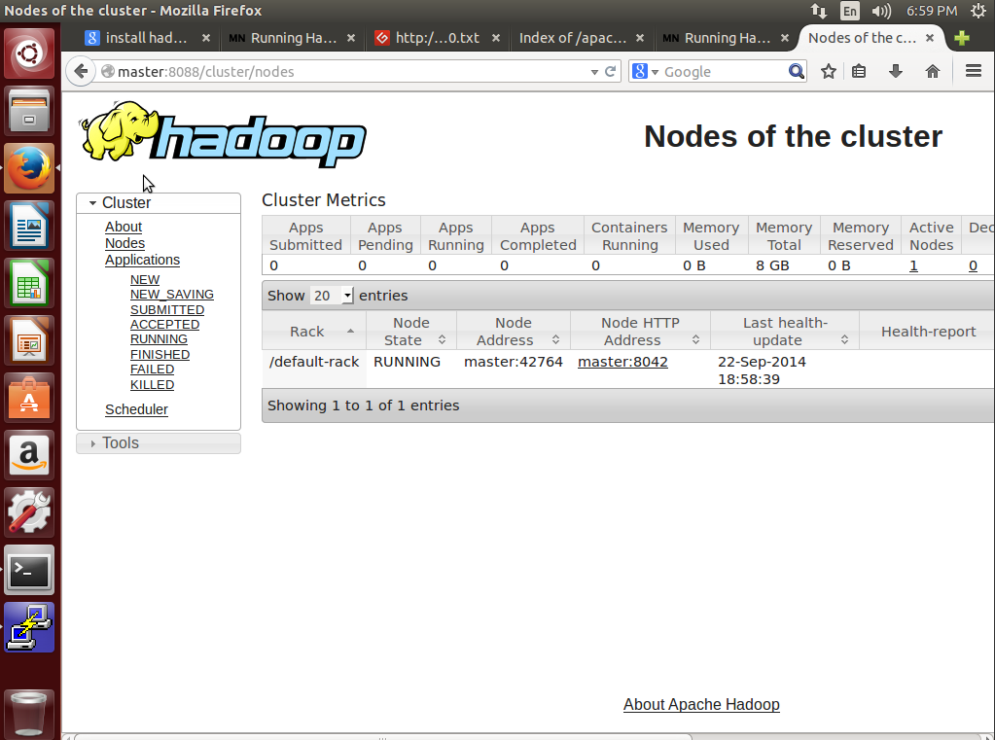
Screenshots of the Multiple Node cluster set up
Screenshot of Resource Manger summary

Slide 26
Technical Difficulties and Known Issues
Technical difficulties
1. The VM 591101 was dead until 20th of September. Hence, the multi node cluster setup was only done on the other three VMs 591103(master), 591102(slave1) and newly allocated VM 591104(slave2).
2. Faced VM disconnection issue initially, which hindered our progress with setting up Hadoop cluster on Vlab.
3. The VMs were slow and required TA/mentor’s frequent intervention to restart the machines.
Known Issues
1. Number of trees for training the data cannot exceed more than 30 due to system memory limits. The number may be less for the Vlab VMs since the available RAM is 1GB.

Slide 27
Conclusion
The major task of this project is to understand the requirement and structure of a Hadoop mapreduce environment and to implement and deploy an application developed using mapreduce algorithm to solve sentimental analysis on a private section in a public cloud.
The application should be able to take input review description from the user and predict a rating based on the model generated using the training yelp dataset.
Notes:
*

Slide 28
References
http://citizennet.com/blog/2012/11/10/random-forests-ensembles-and-performance-metrics/
Jong, Jason. "Predicting Rating with Sentiment Analysis." (2011).
Pang, Bo, and Lillian Lee. "Opinion mining and sentiment analysis."Foundations and trends in information retrieval 2.1-2 (2008): 1-135.
http://www.cs.uic.edu/~liub/FBS/sentiment-analysis.html
http://nlp.stanford.edu/sentiment/index.html
https://developer.yahoo.com/hadoop/tutorial/

