Slide 1
FAYAFLEX · CONCEPT REVIEW
Team Stakes
A safe, social alternative to peer-to-peer fitness betting.
Concept design · v0.1 · May 2026

Slide 2
FayaFlex · Team Stakes
The opportunity
Peer-to-peer fitness betting is going viral — but the apps doing it have a real problem.
• Friend-group accountability is the strongest behavior driver in fitness — stronger than streaks, badges, or coaching.
• Apps like StepBet, DietBet, and HealthyWage have validated demand: people will put money on themselves to follow through.
• But money-based bets carry real risk: state gambling laws, App Store policy 5.3, custody of funds, refund disputes, adverse selection (lazy people lose to disciplined people).
• FayaFlex already has the team primitive, the activity ledger, and the social feed. We can capture the psychology without taking on the legal and ethical baggage.
Concept review · May 2026
2 / 10

Slide 3
FayaFlex · Team Stakes
The thesis
Money is not what makes betting work. Social pressure is.
If a team can lose its streak, lose its multiplier, lose face on the feed, and one
member has to actually post a goofy 30-second workout video to the whole team —
you get ~80% of the motivation of a money bet, with 0% of the legal exposure.
Three stake types — pick what fits the team:
Charity pool
Loser pays for it
Bragging rights
$50 unlocked for the cause your
team picks. Sponsor-funded — no
member money ever changes hands.
Anyone who falls short does the
forfeit. Default: post a 30-second
workout video to the team feed.
No charity, no forfeit. Just the
team streak and the multiplier
rolling forward week over week.
Concept review · May 2026
3 / 10

Slide 4
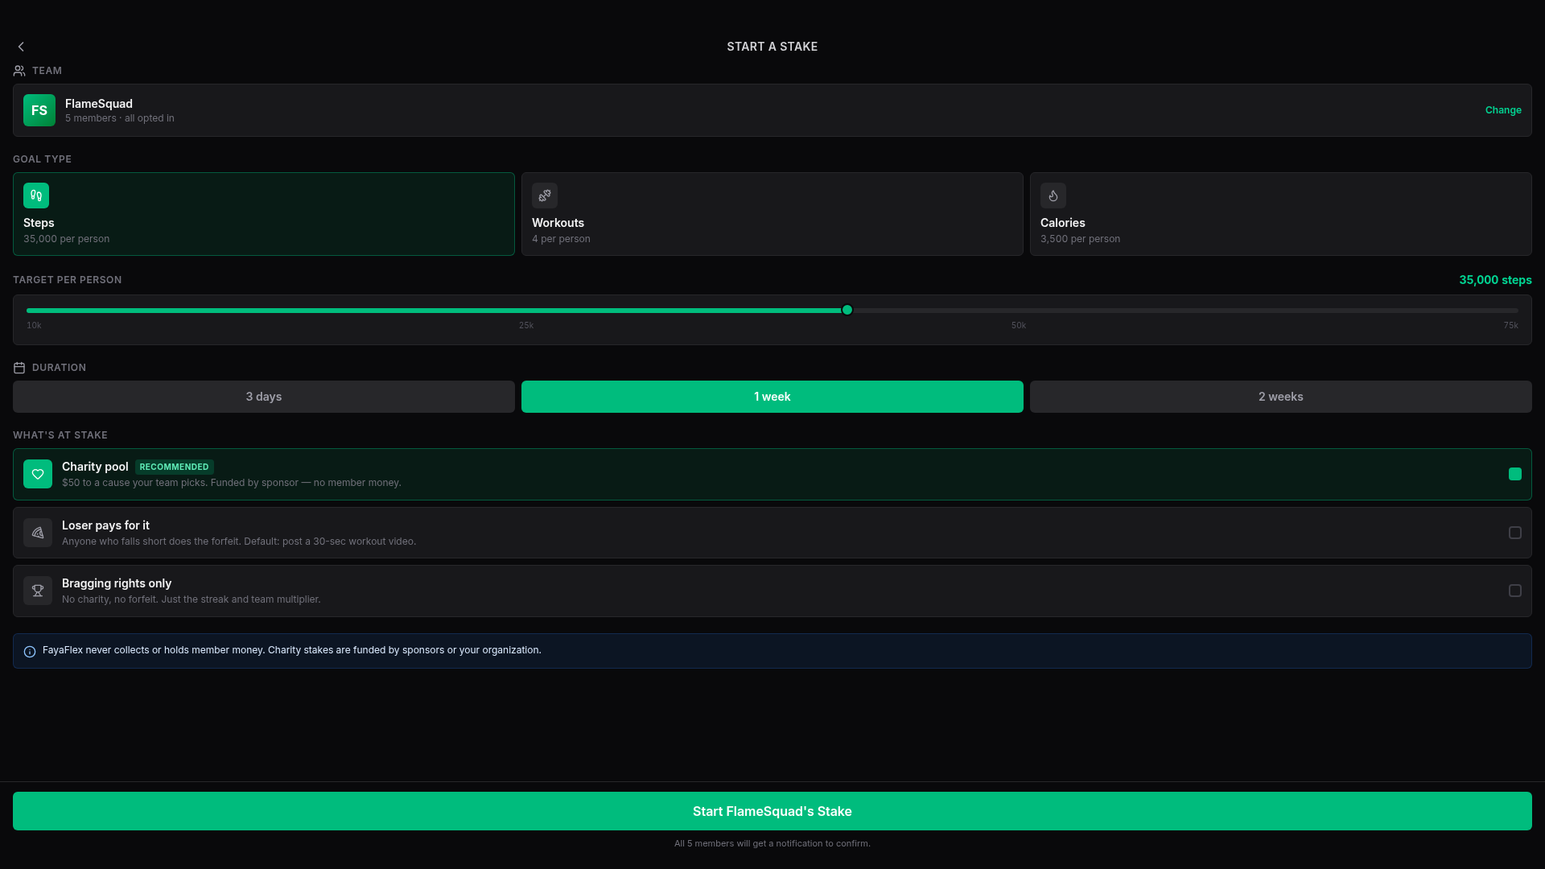
FayaFlex · Team Stakes
Captain starts a stake
Three taps from team page to running stake. Charity is the default.
• Pick goal type: steps, workouts, or calories.
• Slide a target per person and pick a duration.
• Choose what's at stake — charity is recommended and on by default.
• Inline note: 'FayaFlex never collects or holds member money.'
• Tap the bottom button — every member gets a confirm notification.
Concept review · May 2026
4 / 10

Slide 5
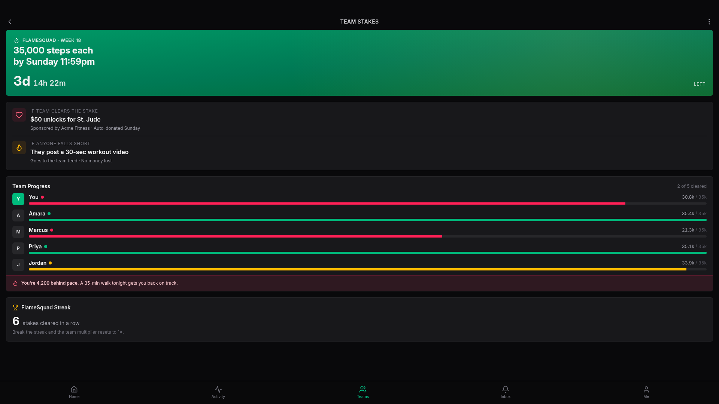
FayaFlex · Team Stakes
Stake in flight
Live progress, both outcomes visible, personal nudge if you're behind.
• Hero countdown reinforces urgency.
• Both outcomes shown side by side: charity unlock vs. forfeit.
• Per-member status dots — cleared / on pace / behind — at a glance.
• Personal coaching: 'A 35-min walk tonight gets you back on track.'
• Streak counter at the bottom — breaking it resets the multiplier.
Concept review · May 2026
5 / 10

Slide 6
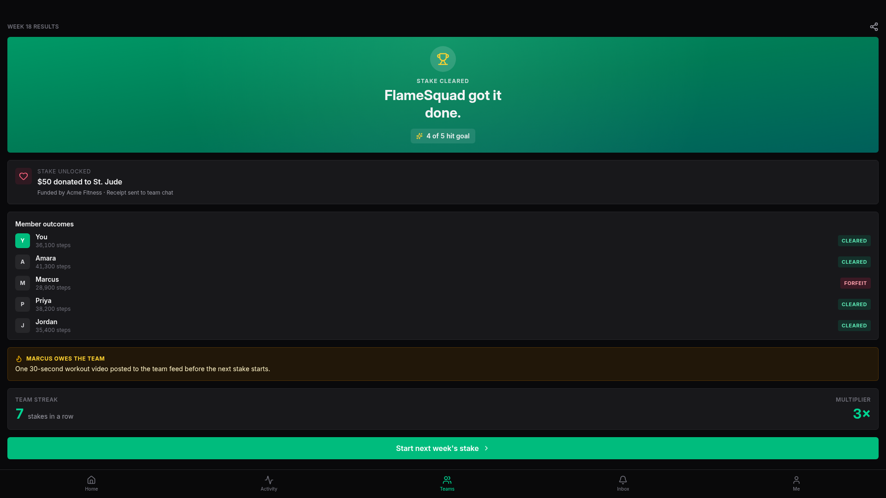
FayaFlex · Team Stakes
Stake settles
Win or lose, the team walks away with momentum and a story.
• Hero proof: 'FlameSquad got it done. 4 of 5 hit goal.'
• Charity receipt with sponsor credit — auto-posted to team chat.
• Per-member outcomes — Marcus has a Forfeit badge attached.
• Public callout: 'Marcus owes the team one 30-second video.'
• Streak grew to 7, multiplier now 3× — straight into the next stake.
Concept review · May 2026
6 / 10

Slide 7
FayaFlex · Team Stakes
Why this is safe
Every legal/ethical risk of peer-to-peer betting — neutralized by design.
State gambling laws
App Store policy 5.3
No prize-of-value funded by member money. Charity pool is sponsor-funded; forfeit is non-monetary.
No real-money wagering. Stays inside the standard fitness/social-feature category.
Custody of funds
Adverse selection
FayaFlex never holds member money. Sponsor donates directly to the registered charity.
Whole team wins or carries the laggard — disciplined members can't profit off lazy ones.
Refund / dispute load
Sponsor brand safety
No money in, no money out. Sick days end with a streak reset, not a chargeback.
Charity unlock is the on-brand outcome. Sponsor logo appears next to a real donation.
Concept review · May 2026
7 / 10

Slide 8
FayaFlex · Team Stakes
What it unlocks for FayaFlex
Charity-stake sponsorships open a B2B revenue line on top of the consumer app.
Brand sponsors
Corporate wellness
Cause partnerships
Fitness apparel, supplements, and
wellness brands fund stake pools to
be associated with team challenges.
CPM-style or per-stake pricing.
HR teams sponsor stakes for
employee teams. Built-in proof of
activity, charity receipt as ESG
documentation. SaaS pricing per seat.
Charities co-promote: 'Move with
St. Jude this month.' Drives our
user acquisition + their fundraising.
Revenue-share or flat partnership.
Why these conversations get easier than for a betting app:
• No 'gambling-adjacent' label — sponsors can co-market this in any channel.
• Charity outcome gives sponsors a clean PR story; the forfeit is the entertainment angle.
• Same plumbing serves consumers, brands, and HR teams — no separate product line to build.
Concept review · May 2026
8 / 10

Slide 9
FayaFlex · Team Stakes
What could still go wrong
Honest risks worth flagging before we build.
Forfeit content moderation
Public workout videos = user-generated content. Need report/remove flow + team-only visibility option.
Pressure on injured / sick members
Add a 'pause' option per member with team approval. Streak protection on first-time use.
Sponsor pipeline takes time
Ship Bragging-rights and Forfeit modes first; Charity mode can soft-launch with one anchor sponsor.
Notification fatigue
Stake updates piggyback on existing daily reminder schedule. Cap at 1 nudge per stake per day.
Concept review · May 2026
9 / 10

Slide 10
FayaFlex · Team Stakes
Proposed rollout
Three stages, each independently shippable.
Phase 1 · Bragging rights
Phase 2 · Forfeit mode
Phase 3 · Charity stakes
Streaks + multiplier on top of existing team challenges.
No new external dependencies. ~1 sprint.
Add forfeit selection, video forfeit posting flow,
team-feed forfeit card. ~2 sprints + moderation tooling.
Sponsor onboarding portal, charity directory, donation
receipt pipeline. ~1 quarter + first sponsor signed.
Recommendation
Ship Phase 1 in the next release as a no-risk test of the streak/multiplier mechanic, then commit to Phase 2 once we see retention lift.
Concept review · May 2026
10 / 10

