Slide 1
FAYAFLEX · APP REVIEW
Engagement Review
Six months of growth, where the curve bent, and what to ship next.
Production read replica · May 15, 2026

Slide 2
FayaFlex · Engagement & App Review
Executive summary
Six months in, FayaFlex is finding product-market fit with a small but unusually engaged base.
• 1,282 activities logged across 41 users — average of 31 activities per user, with one user active every single day for the last 30.
• April was a clear inflection: monthly active users jumped from 6 → 16 (+167%) and activities tripled from 151 → 437.
• 56% of users have joined a team (23 of 41) — the social loop is the strongest driver of repeat engagement.
• Auto-posted workouts feature shipped in March is working: 2 → 40 → 27 posts/month; the team feed is becoming the spine of the app.
• Two big gaps to close: zero reactions or comments on posts (the engagement is one-way), and a soft month-2 retention cliff for cohorts that don't land in a team.
Source: production read replica · May 15, 2026
2 / 12

Slide 3
FayaFlex · Engagement & App Review
Where we are today
Topline platform metrics, current totals.
TOTAL USERS
ACTIVITIES LOGGED
MONTHLY ACTIVE (Apr)
AUTO-POSTED WORKOUTS
41
1,282
16
69
+14 in last 30 days
Lifetime
+167% vs March
Last 90 days
USERS ON A TEAM
DEVICE CONNECTIONS
MONTHLY WINNERS LOGGED
REACTIONS · COMMENTS
23 / 41
23
19
0 · 0
56% of base
Apple Health · Garmin · others
Victory Wall is operational
Shipped, never used
Source: production read replica · May 15, 2026
3 / 12

Slide 4
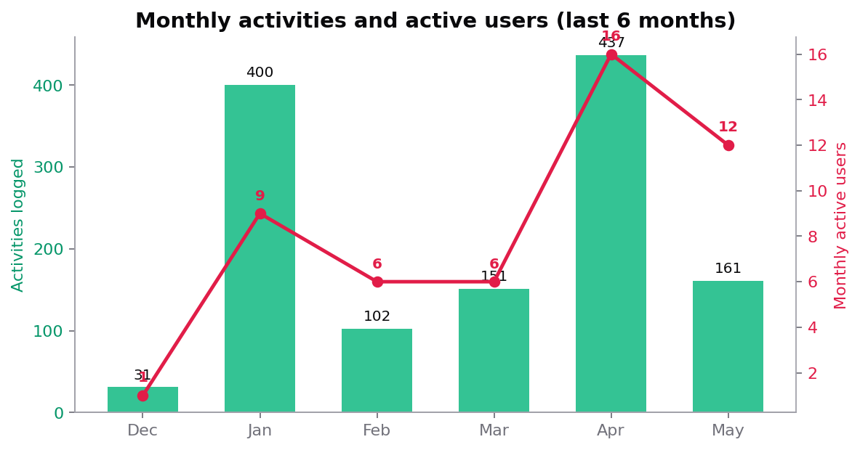
FayaFlex · Engagement & App Review
The engagement curve
April was the inflection point. Activity volume and active users both jumped together.
What changed in April
Auto-posted workouts went live mid-March.
Four weeks later, both volume and the
distinct-user count jumped — strong signal
that the social-feed loop drives logging.
Why May looks softer
May is mid-month (only 15 of 31 days).
Prorated, May is on track to roughly
match April. Watch the next 2 weeks
before calling a regression.
Source: production read replica · May 15, 2026
4 / 12

Slide 5
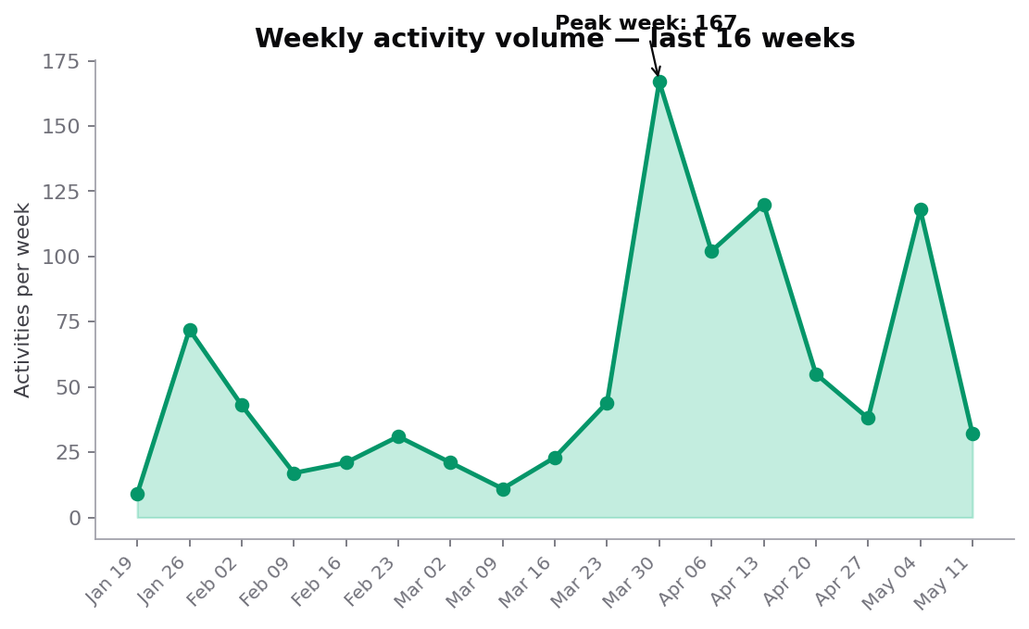
FayaFlex · Engagement & App Review
Weekly volume tells a sharper story
Two surges in 16 weeks. Both correlate with feature shipping — not seasonality.
Reading the weekly chart
• The Mar 30 spike (167) lines up with
auto-posted workouts shipping.
• The May 4 surge (118) lines up with
the Workout Calendar dashboard going
live — proving that visibility into your
own history drives logging.
• Quiet weeks (Feb–Mar) align with
weeks where no new feature shipped.
Source: production read replica · May 15, 2026
5 / 12

Slide 6
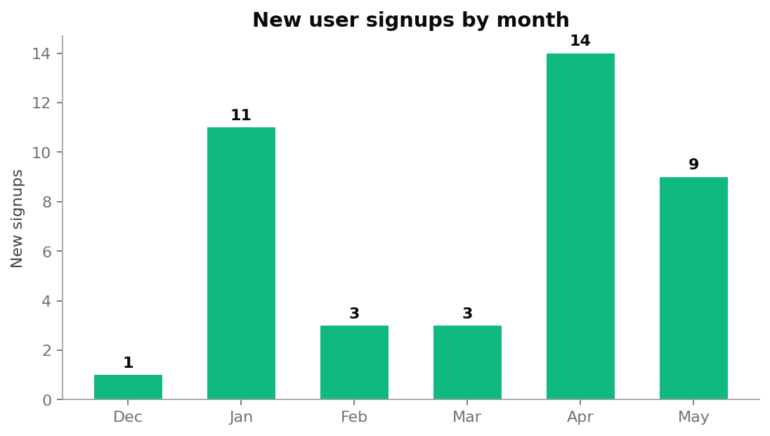
FayaFlex · Engagement & App Review
Acquisition
Signups are uneven — driven by hand-recruited cohorts, not organic discovery.
• Two acquisition spikes: Jan (11) and Apr (14).
• Both look like batch invites — not steady organic.
• Avg signup rate the rest of the time: ~3/month.
• No paid acquisition or referral mechanic running yet.
• Strong implication: the app retains better than it discovers.
Source: production read replica · May 15, 2026
6 / 12

Slide 7
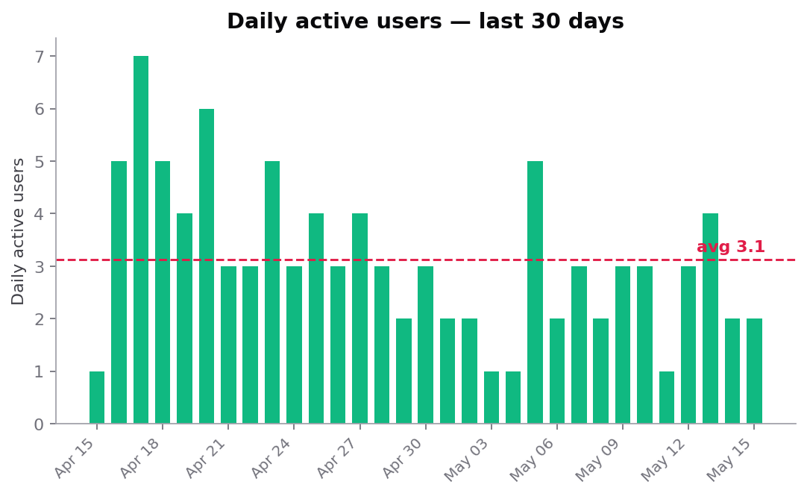
FayaFlex · Engagement & App Review
Daily active users — last 30 days
Average 3.1 DAU. One day a week, traffic spikes — usually weekends.
DAU / MAU ratio
DAU avg 3.1 ÷ MAU 16 = 19%.
Healthy fitness apps land 25–35%.
Gap = headroom for re-engagement
nudges, not a structural problem.
Spike pattern
Apr 17 (69 acts), May 5 (58),
May 10 (32) — all weekend or
post-weekend syncs. Most users are
logging in batches when they sit
down to their phone after a workout.
Source: production read replica · May 15, 2026
7 / 12

Slide 8
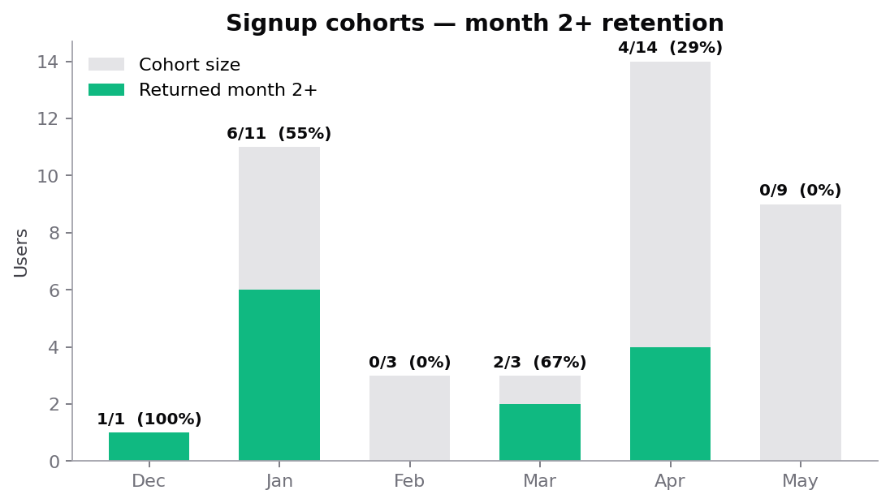
FayaFlex · Engagement & App Review
Cohort retention
Joining a team in week 1 is the single best retention signal we have.
What's working
Jan cohort: 6 of 11 returned the
next month — 55%. That's category-
leading retention for fitness apps.
The core loop works for the right user.
What's not
Feb cohort retained 0 of 3.
Apr cohort retained 4 of 14 (29%).
The difference: Jan signups were
seeded into existing teams; Feb/Apr
landed as solo users with nobody
to compete against.
Source: production read replica · May 15, 2026
8 / 12

Slide 9
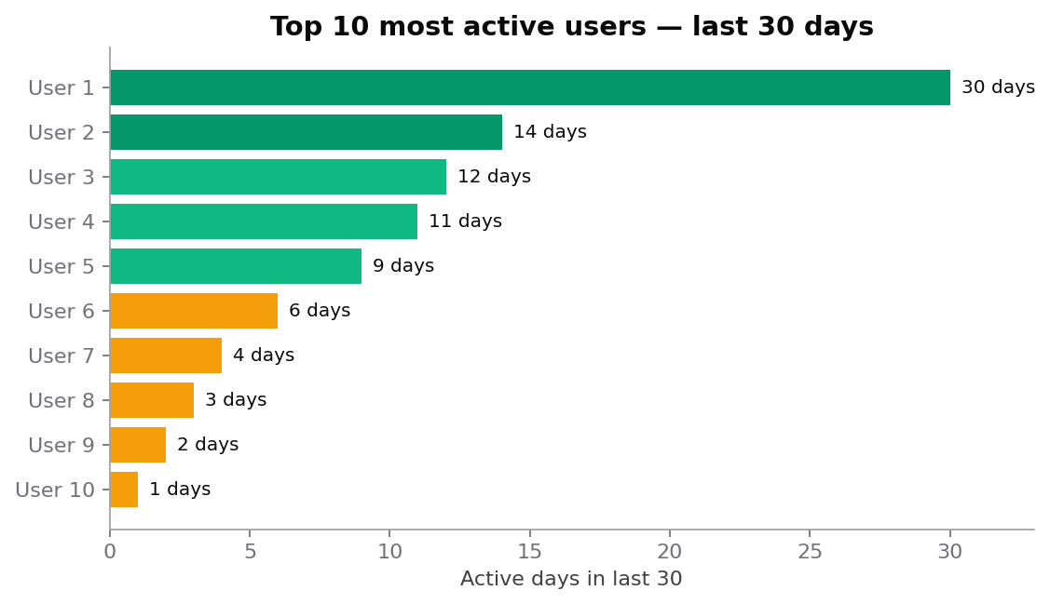
FayaFlex · Engagement & App Review
Power-user concentration
1 user logged every single day. The top 5 users drive most of the volume.
Power-user law in action
Top 5 users alone account for ~75%
of activities in the last 30 days.
Common to social-fitness apps —
they are the gravitational center
of their teams.
Intensity over time
Activities per active user/month:
Dec 31 → Jan 44 → Feb 17
Mar 25 → Apr 27 → May 13
(May still mid-month).
Intensity is steady; growth comes
from adding active users, not from
asking each one to log more.
Source: production read replica · May 15, 2026
9 / 12

Slide 10
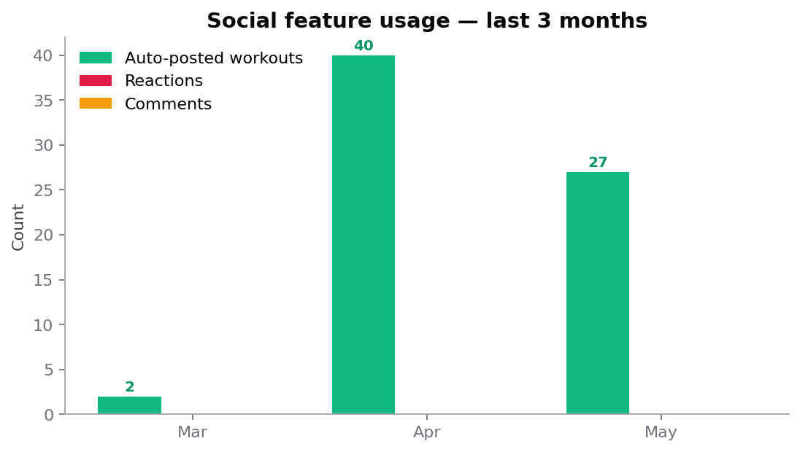
FayaFlex · Engagement & App Review
The social-feature gap
We built reactions and comments. Users haven't touched them. Feed posts are the bright spot.
Auto-posted workouts ✓
0 → 40 → 27 in three months.
Clear adoption — users are happy to
broadcast workouts when posting is
automatic. The supply side works.
Reactions / comments ✗
Zero reactions. Zero comments.
The demand side doesn't fire.
Likely root cause: users see their own
posts, not their team's. Feed is a
broadcast log, not a conversation —
yet.
Source: production read replica · May 15, 2026
10 / 12

Slide 11
FayaFlex · Engagement & App Review
Recommendations
Six bets, prioritized by expected lift. The first three are 1-sprint each.
1. Force teamed onboarding (P0)
2. Push the team feed, not the personal feed (P0)
Retention data is unambiguous: solo signups churn, teamed signups stay.
Make 'join or create a team' the second screen of onboarding, not optional.
Default Home tab to team activity, not your own. Reactions don't fire because
users never see other people's posts. Same data, different ordering.
3. Ship Team Stakes — bragging-rights phase (P0)
4. Re-engagement push for users at 3+ days inactive (P1)
Streaks + multipliers on top of existing team challenges. ~1 sprint, no new
integrations. Tests the mechanic before investing in sponsor pipeline.
Personal nudge ('your team is 4,200 steps ahead — a 35-min walk catches up').
Uses existing push infra. Aim: lift DAU/MAU from 19% → 25%.
5. Referral mechanic with team-context (P1)
6. Sunset unused passkey UI until adoption case is proven (P2)
'Invite a friend to your team and unlock a charity stake' — wraps acquisition
inside the social loop. Solves the inconsistent signup curve.
0 passkeys created across 41 users. Either remove the entry point or run
a dedicated activation campaign. Don't carry dead UI.
Source: production read replica · May 15, 2026
11 / 12

Slide 12
FayaFlex · Engagement & App Review
The 90-day ask
If we ship the P0 trio, here's what the next engagement deck should look like.
Targets for August 2026 review
MAU
DAU/MAU
Reactions / post
Month-2 retention
16 → 40
19% → 28%
0 → 3+
29% → 50%
Forced teaming + referral
Re-engagement push + Team Stakes
Default to team feed
Onboard into a team, not solo
Bottom line
FayaFlex has product-market fit for the right user. The job for the next quarter is
not building more features — it's funneling every new signup into the team-based
loop that already retains them, and giving teams more reasons to talk to each other
(reactions visible, stakes to win, streaks to defend).
Source: production read replica · May 15, 2026
12 / 12

