Slide 1

Prototyping & User Research For Everyone
Architecture Overview

Slide 2

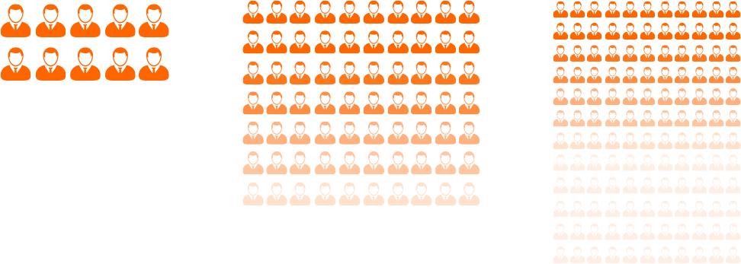
1 Designer
Ideal 1:10
Vendor 1:100
Customers 1:1000
DEVELOPERS

Slide 3
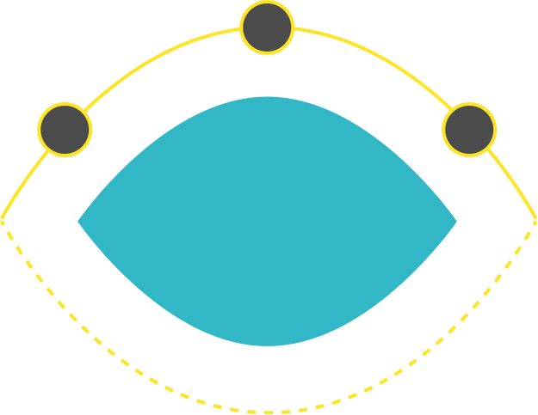
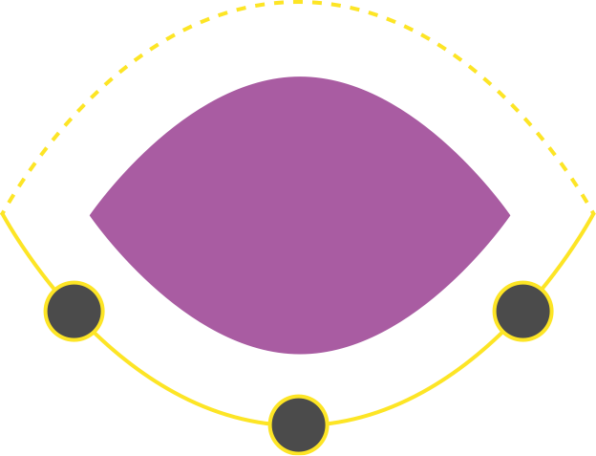
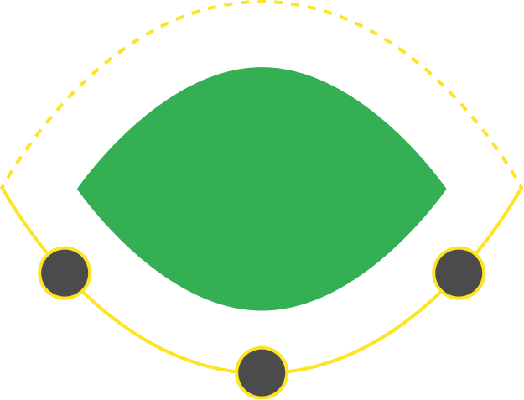
Design Thinking In Practice
Prototype
Ideate
Validate
DISCOVER
DESIGN
DELIVER
Scope
Synthesize
Implement
Deploy
360° Research
Test
WebIDE

Slide 4



Boundary Conditions
Cloud Based
Delightful UX

Slide 5
DEMO

Slide 6




Technology Stack: MEAN
Web Browser
BUILD UI
R
AngularJS
R
Express
R
BUILD Services
BUILD Data

Slide 7
High-Level Block Diagram
Shell
User Research
Prototype Composition
Knowledge Base
User Study Mgmt
UI Composition
UI Catalog
Study Participation
Data Modeler
Business Catalog
Survey Analysis
Sample Data Mgr
UX Rule Engine
Project Management
Common Services

Slide 8
BUILD in the UXaaS Big Picture
UXaaS Web Site
Shell
Community & Marketplace
Learning Center
Home Page
Project Page
WebIDE
Project « Widgets »
Gallery
3rd Party Tools
Tools
UXCoE
Project Mgmt
Editors (BUILD, Persona,…)
WebCMS
Web Page Templating & Editing
Asset Mgmt
Forums
Blogging
Search

Slide 9
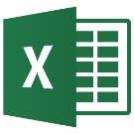


Prototype Composition
UI Composer
Data Modeling UI
Control Palette
Outline
Data Modeler
Excel Import
Sample Data Mgr
Property Pane
Canvas
R
R
UI Catalog
UI Composer Svc
R
Data Model Svc
UI Lib Artefacts
Controls & Design Templates Metadata
Business Catalog
Prototype Builder
Entities
Rels
notifies
R
Shared Workspace
Generated Artefacts
Views.xml + Ctrl.js
Model.edmx, Annotation file
Mock data.json
Other metadata
Page Definition
Data Model & Sample Data
Snapshot
Deployer

Slide 10

User Research
User Research UI
User Study Mgmt UI
Study Participation UI
BUILD Prototype Snapshots
Survey Analysis UI
R
User Research Svc
Assets
User Research Study
Images
Tasks
Answers
Statistics
External HTML Protos
Questions
Annotations
Tracking Info

Slide 11
UX Rule Engine
UI Catalog
UI Lib Artefacts
Controls & Design Templates Metadata
UX Rule Engine
Compliance Check
Data Driven Generation
UX Guidelines
UX Statistics
Shared Workspace
Page Definition
Data Model & Sample Data

Slide 12
Integration & Extensibility
Code Generators
Prototype Composition
Code Importers
Deployment Destinations
Data model Sources
UI Catalog
Other UI Libs than UI5
Business Catalog
Other sources than OData
Custom compliance checkers
UX Rule Engine
Custom generators

Slide 13
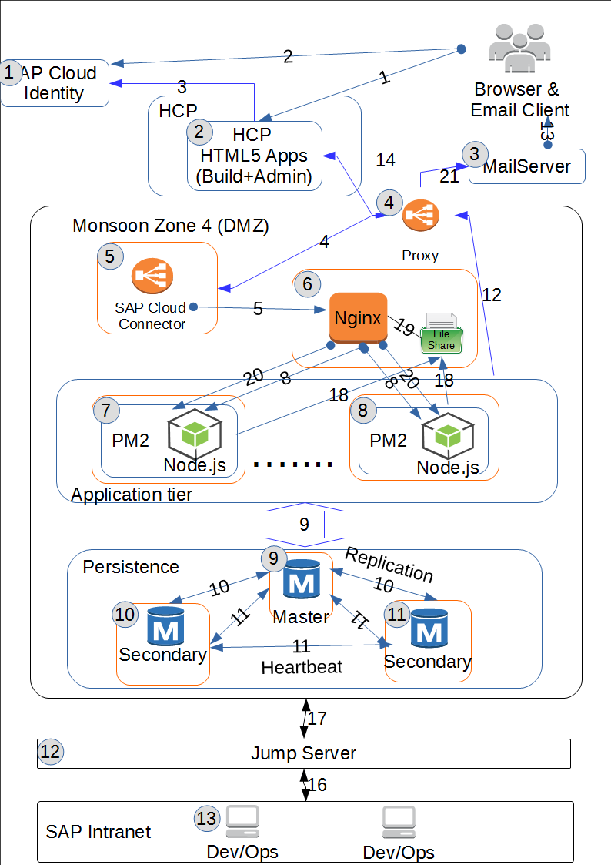
Deployment

Slide 14
Appendix: Smart Templates

Slide 15
Admin
PO
Excel file
Backend System
R
Import OData & Anno
R
R
BUILD
UI Composer
Control Palette
Smart Template UI Lib
import
UI Catalog Manager
Smart View Outline Editor
Interactive Canvas
Data Modeler
+ Data Sample Mgr
PropertyPane
R
R
in sync
R
UI Composer Services
R
Data Modeling
Services
UI Catalog
Prototype Builder
Design Template
UI outline
UI constraints
Link to annotations
=
new component
notifies
generates
R
SharedWorkspace
Page Definition
Latest Generated Artefacts
Views.xml + ctrl.js
Model.edmx
Annotation file
Mock data.json
Other app metadata
Data Model
+
Groups
+
Sample Data
WebIDE
copy
BUILD Plugin
import
Snapshot

Slide 16
An admin imports the smart templates libraries into the BUILD UI Catalog, as he or she would do for other UI libraries.
Technically, the import processing works the same, but in the case of a library containing smart templates, it’s followed by a post-processing phase used to map the smart templates to design templates (new or existing) and executed by the Smart Template Mapper component. During this post-processing phase, the smart templates are parsed, and information digestible by BUILD is extracted and created/updated into the corresponding design template, expressed in JSON format:
The UI outline of the view
The UI constraints (which properties and aggregations can be modified, and what can be put into the aggregations)
Information to help creating/updating annotations on a model depending on the UI modifications
Note that we will ensure that Smart and Design templates are kept in sync without manual operation.

Slide 17
When working in the UI Composer on a page that was created based on a Smart/Design Template, the Control Palette and the Property Pane display a restricted set of controls, respectively properties, depending on the constraints expressed in UI Catalog definition.

Slide 18
The Smart View Outline Editor presents the UI outline of a Design Template, which can be updated according the UI constraints.
Each change in the Smart View Outline Editor (including via the Property Pane), is saved into the Page Definition stored in the Shared Workspace, as for any other Page editing.
For the UI Elements inserted or updated in the outline, you can set their specific properties in the property pane or create bindings to a data model. When the corresponding data model piece (Entity or Property) doesn’t exist, you can create it on the fly (call from UI Composer Services to Data Modeling services).
When an editing transaction is committed, the Shared Workspace notifies the Prototype Builder, which in turn generates the runtime artefacts for the smart app: the UI (views, controllers…), the data model, annotations, sample data, and smart app metadata.
The UI Composer canvas, based on a UI5 runtime, is then refreshed by loading the generated smart app.
Note that the Smart View Outline Editor and the view-only canvas is a first step, before moving to a full WYSIWYG solution post July.

Slide 19
As it is already the case in BUILD, data models can be built in the Data Modeler:
Either manually
Either via Excel import
Either by importing an OData model from a backend system into the BUILD Business Catalog
Later on, we’ll add support for importing annotation files and adding them into the BUILD data models as groups.

Slide 20
When ready for moving into development, we have a BUILD plugin in WebIDE. This plugin connects to a BUILD system, retrieves the list of projects and their snapshots, then import into WebIDE the content of a snapshot.
Inside a snapshot, there’s all the code generated by the Prototype Builder:
XML views + controllers JS
EDMX file for the data model
XML annotation file
JSON files for the mock data
Other app metadata (component.js, smart app config, etc…)
Note that this is an initial integration step for Sapphire. In the future, we envision an integration that allows version control and bi-directional flow between designer/PO and developer.

