Slide 1
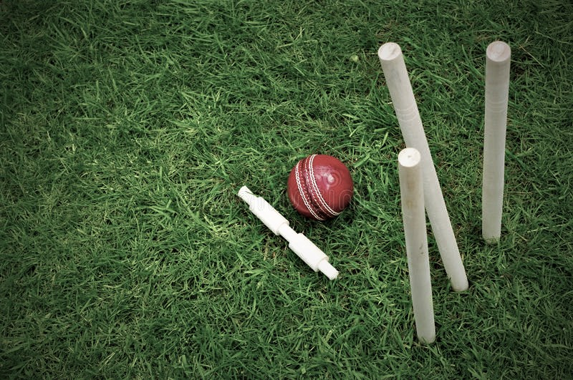
FUN from HOME

Slide 2
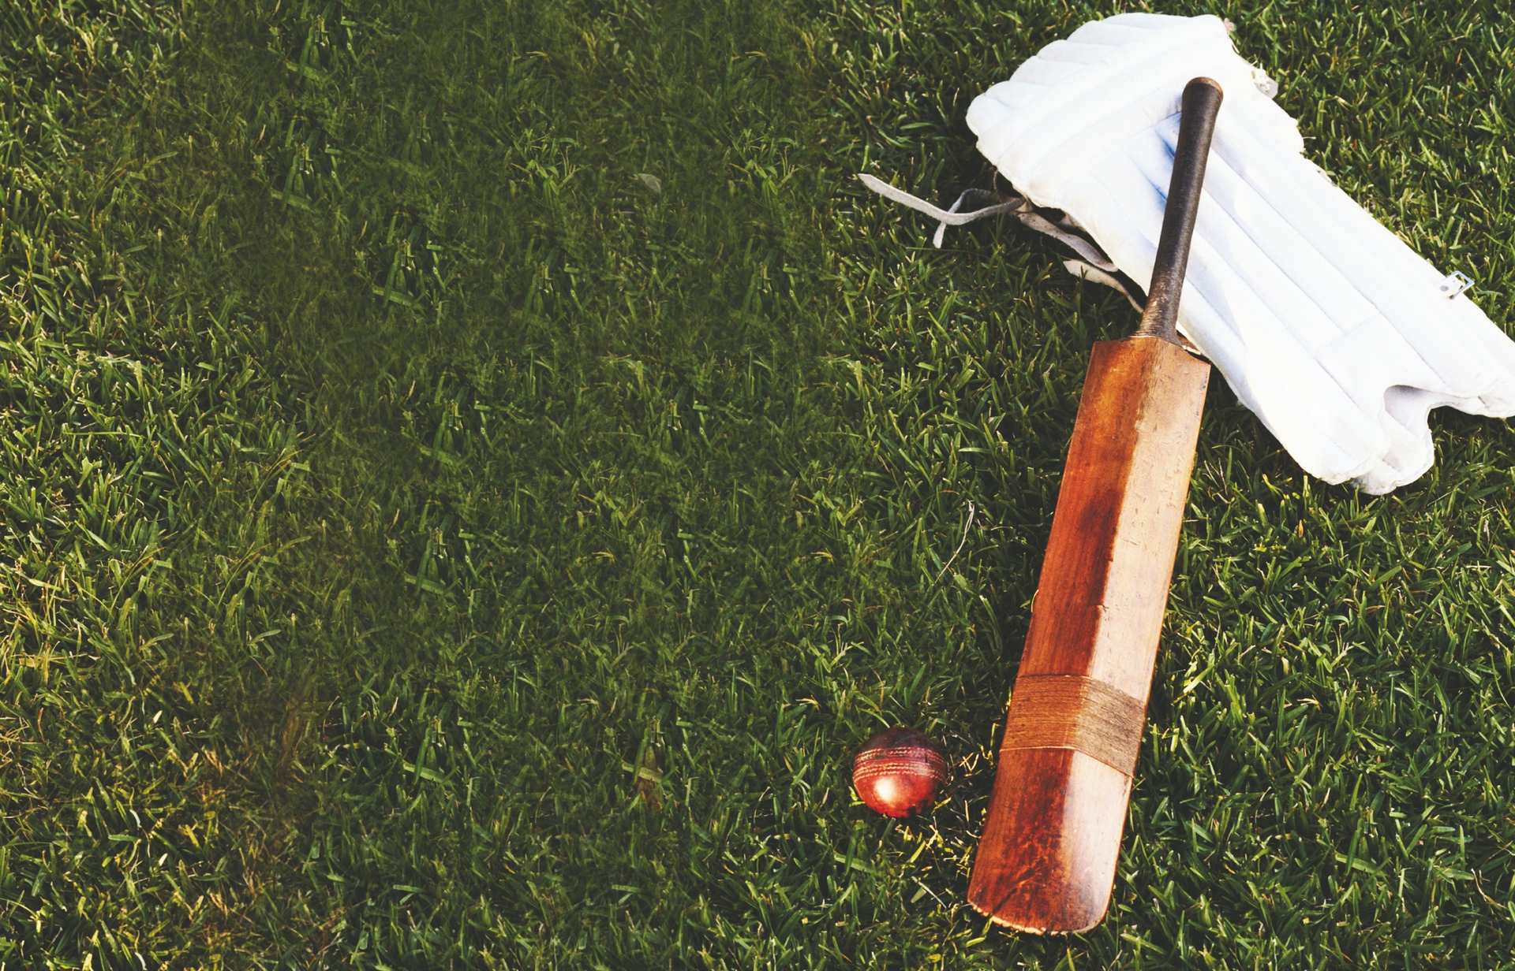
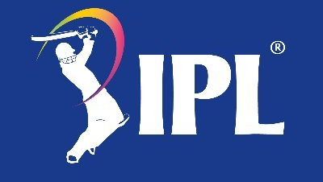
IPL
TRIVIA
+10 points

Slide 3
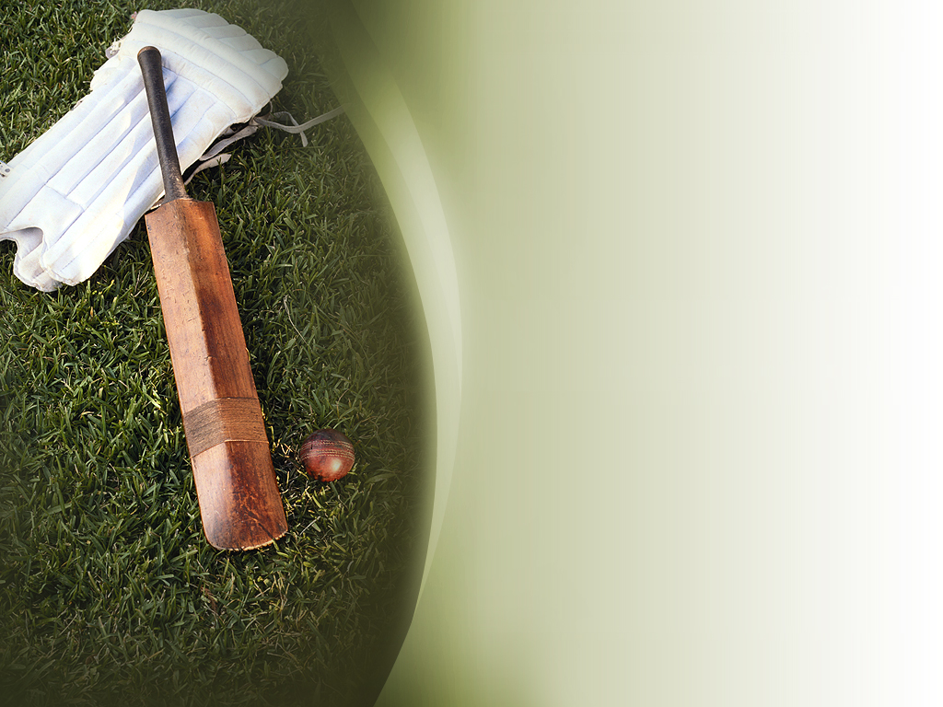
Who was the captain of Mumbai Indians in IPL 2012?
Rohit Sharma
Sachin Tendulkar
Harbhajan Singh

Slide 4
Who was the captain of Mumbai Indians in IPL 2012?
Rohit Sharma
Sachin Tendulkar
Harbhajan Singh
Harbhajan Singh. He took over from Sachin Tendulkar, who quit captaincy before the start of the season.

Slide 5
In which season did Virat Kohli score all his IPL centuries?
IPL 2013
IPL 2014
IPL 2016

Slide 6
In which season did Virat Kohli score all his IPL centuries?
IPL 2013
IPL 2014
IPL 2016
Virat Kohli scored four centuries in the ninth edition of the Indian Premier League.

Slide 7
Which is the only IPL game in which the Super Over too ended in a tie?
Sunrisers Hyderabad vs Kolkata Knight Riders, 2013
Kolkata Knight Riders vs Rajasthan Royals, 2014
Rajasthan Royals vs Kings XI Punjab, 2015

Slide 8
Which is the only IPL game in which the Super Over too ended in a tie?
Sunrisers Hyderabad vs Kolkata Knight Riders, 2013
Kolkata Knight Riders vs Rajasthan Royals, 2014
Rajasthan Royals vs Kings XI Punjab, 2015
Both KKR and RR could not be separated in both the regulation 20-over game and the one-over eliminator. However, RR won on the boundary countback rule.

Slide 9
Which Indian player has the fastest 100 in IPL?
Yusuf Pathan
Virat Kohli
Virender Sehwag

Slide 10
Which Indian player has the fastest 100 in IPL?
Yusuf Pathan
Virat Kohli
Virender Sehwag
In 2010, Yusuf Pathan scored a 37-ball 100 for Rajasthan Royals against Mumbai Indians.

Slide 11
Which player is the oldest to win the IPL purple cap, which is given to the highest wicket-taker in the tournament?
Imran Tahir
Lasith Malinga
Ashish Nehra

Slide 12
Which player is the oldest to win the IPL purple cap, which is given to the highest wicket-taker in the tournament?
Imran Tahir
Lasith Malinga
Ashish Nehra
The South African leg-spinner, aged 40, claimed 26 wickets in the 2019 season.

Slide 13
Which among these cities has hosted the most number of IPL matches?
Mumbai
Bangalore
Kolkatta

Slide 14
Which among these cities has hosted the most number of IPL matches?
Mumbai
Bangalore
Kolkatta
Bangalore’s M. Chinnaswamy Stadium has hosted 81 matches so far.

Slide 15
Which player holds the record for the fastest fifty in IPL?
K. L. Rahul
Sunil Narine
Yuvraj Singh

Slide 16
Which player holds the record for the fastest fifty in IPL?
K. L. Rahul
Sunil Narine
Yuvraj Singh
KL Rahul scored a 14-ball fifty for Kings XI Punjab against Delhi Daredevils in 2018.

Slide 17
Which player has won the most number of IPL orange caps, which is given to the season’s highest run-scorer?
Chris Gayle
Sachin Tendulkar
David Warner

Slide 18
Which player has won the most number of IPL orange caps, which is given to the season’s highest run-scorer?
Chris Gayle
Sachin Tendulkar
David Warner
Warner has won the orange cap thrice (2015, 2017, 2019).

Slide 19
Which among these players has the most ducks in IPL history?
Rohit Sharma
Parthiv Patel
Ravindra Jadeja

Slide 20
Which among these players has the most ducks in IPL history?
Rohit Sharma
Parthiv Patel
Ravindra Jadeja
Parthiv has the joint-most ducks (13) in IPL alongside Harbhajan Singh.

Slide 21
Which Overseas player feature in top-5 list of most maidens bowled in all IPL editions?
James Faulkner
Lasith Malinga
Sunil Narine

Slide 22
Which Overseas player feature in top-5 list of most maidens bowled in all IPL editions?
James Faulkner
Lasith Malinga
Sunil Narine
He is currently placed 4th on the List with 8 maidens

Slide 23
Ali Khan is set to become first player from USA to play in IPL this season. Which team is he playing for?
Kings XI Punjab
Mumbai Indians
Kolkata Night Riders

Slide 24
Ali Khan is set to become first player from USA to play in IPL this season. Which team is he playing for?
Kings XI Punjab
Mumbai Indians
Kolkata Night Riders
Ali Khan had a successful stint with TKR in CPL 2020 and has joined as Harry Gurney replacement in KKR.

Slide 25
Who has hit most runs in an over in an IPL match?
Chris Gayle
Andre Russell
Suresh Raina

Slide 26
Who has hit most runs in an over in an IPL match?
Chris Gayle
Andre Russell
Suresh Raina
Gayle hit 36 runs in an over against Kochi Tuskers in 2011. Bowler was Prasanth Parameswaran.

Slide 27
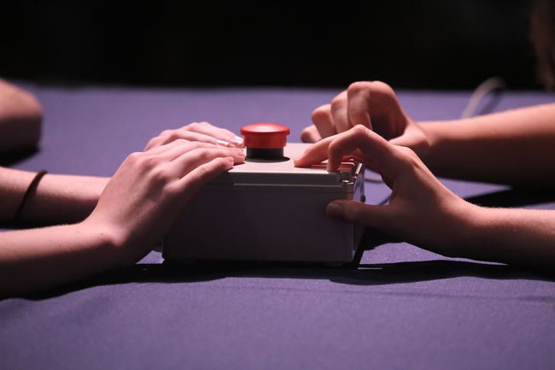
BUZZER ROUND
+20 points
-10 points

Slide 28
What has been the highest successful run chase in an IPL final?
192 by MI
200 by KKR
209 by CSK

Slide 29
What has been the highest successful run chase in an IPL final?
192 by MI
200 by KKR
209 by CSK
Kolkata Knight Riders (KKR) chased 200 against Kings XI Punjab in the 2014 final at the M. Chinnaswamy Stadium.

Slide 30
Three bowlers took hat-tricks in IPL 2017. Who among the following was the first?
Jaydev Unadkat
Samuel Badree
Andrew Tye

Slide 31
Three bowlers took hat-tricks in IPL 2017. Who among the following was the first?
Jaydev Unadkat
Samuel Badree
Andrew Tye
Samuel Badree took the first hat-trick in IPL 2017 when the Royal Challengers Bangalore played against Mumbai Indians at the M. Chinnaswamy Stadium.

Slide 32
Which player has won the last three seasons of IPL as part of different teams?
Vijay Shankar
Ben Cutting
Karn Sharma

Slide 33
Which player has won the last three seasons of IPL as part of different teams?
Vijay Shankar
Ben Cutting
Karn Sharma
Karn Sharma won the IPL with Sunrisers Hyderabad in 2016, with Mumbai Indians in 2017 and with Chennai Super Kings in 2018.

Slide 34
Who won the man of the match award in the IPL 2008 final?
Shane Warne
Sohail Tanvir
Yusuf Pathan

Slide 35
Who won the man of the match award in the IPL 2008 final?
Shane Warne
Sohail Tanvir
Yusuf Pathan
Yusuf Pathan took three wickets for 22 with the ball and scored a 39-ball 56 with the bat.

Slide 36
How many IPL finals has Mahendra Singh Dhoni appeared in?
7
6
5

Slide 37
How many IPL finals has Mahendra Singh Dhoni appeared in?
7
6
5
7 (Six with Chennai Super Kings and one with Rising Pune Supergiant)

Slide 38
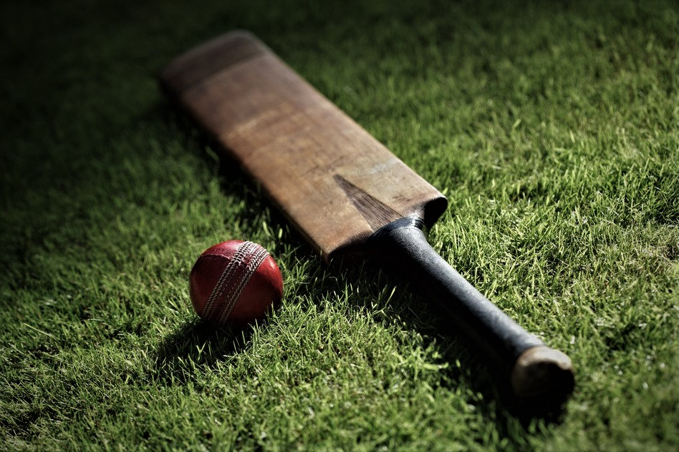
BRAIN
TEASERS
+15 points

Slide 39
Chennai Super Kings’s scorecard reads after 0.2 overs as 12/0 Murali vijay: 6* and Shane Watson: 6*. How is it possible?

Slide 40
Chennai Super Kings’s scorecard reads after 0.2 overs as 12/0 Murali Vijay: 6* and Shane Watson: 6*. How is it possible? First ball: Vijay runs 3 runs, out of which one run is short. The fielder overthrows and the ball goes to the boundary. Second ball: Watson will hit a Six and the result is achieved.

Slide 41
If in a game of Cricket all the ten batsmen got clean bold in consecutive balls, starting with first ball of the game, then which number batsman remains not out?

Slide 42
If in a game of Cricket all the ten batsmen got clean bold in consecutive balls, starting with first ball of the game, then which number batsman remains not out? 8th Batsman

Slide 43
In a T20 day cricket match, There were no wide balls, no wides, no extras and no overthrows. What is the maximum number of runs that a batsman can score in an ideal case scenario?

Slide 44
In a T20 day cricket match, There were no wide balls, no wides, no extras and no overthrows. What is the maximum number of runs that a batsman can score in an ideal case scenario? (33 * 19) + 36 = 663 runs

Slide 45
If in a game of Cricket 3 runs were required in 2 balls to win and with only one wicket left. One batsman is on 98 and non striker is on 97. How will both batsmen score centuries and still win the match?

Slide 46
If in a game of Cricket 3 runs were required in 2 balls to win and with only one wicket left. One batsman is on 98 and non striker is on 97. How will both batsmen score centuries and still win the match? Batsman will run 3 runs, 3rd run short. Umpire will not count the run as well as he won’t ask them to change sides. Hence 1st batsman completes 100. On the last ball the other batsman can hit a 4 or a 6 and complete his century and win the match for the team.

