Slide 1
Lab4-1 FAQ

Slide 2
Distiller
Distiller is an open-source Python package for neural network compression research.

Slide 3
Distiller install
$ cd /tmp/work
$ git clone https://github.com/NervanaSystems/distiller.git
$ python3 –m venv venv
# Resume from this line when container is restarted
$ source /tmp/work/venv/bin/activate
$ cd distiller/
$ pip install –r requirements.txt

Slide 4
Tensorboard example
$ cd examples/classifier_compression
$ mkdir logs
$ cd logs
# upload pretrained model .tgz file to logs/ by jupyter
$ tar –zxvf resnet20_cifar_baseline.tgz
# kill tensorboard ex: 1505
$ tensorboard --logdir=./

Slide 5
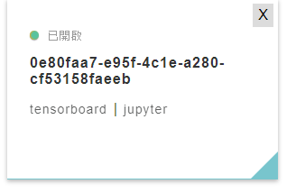
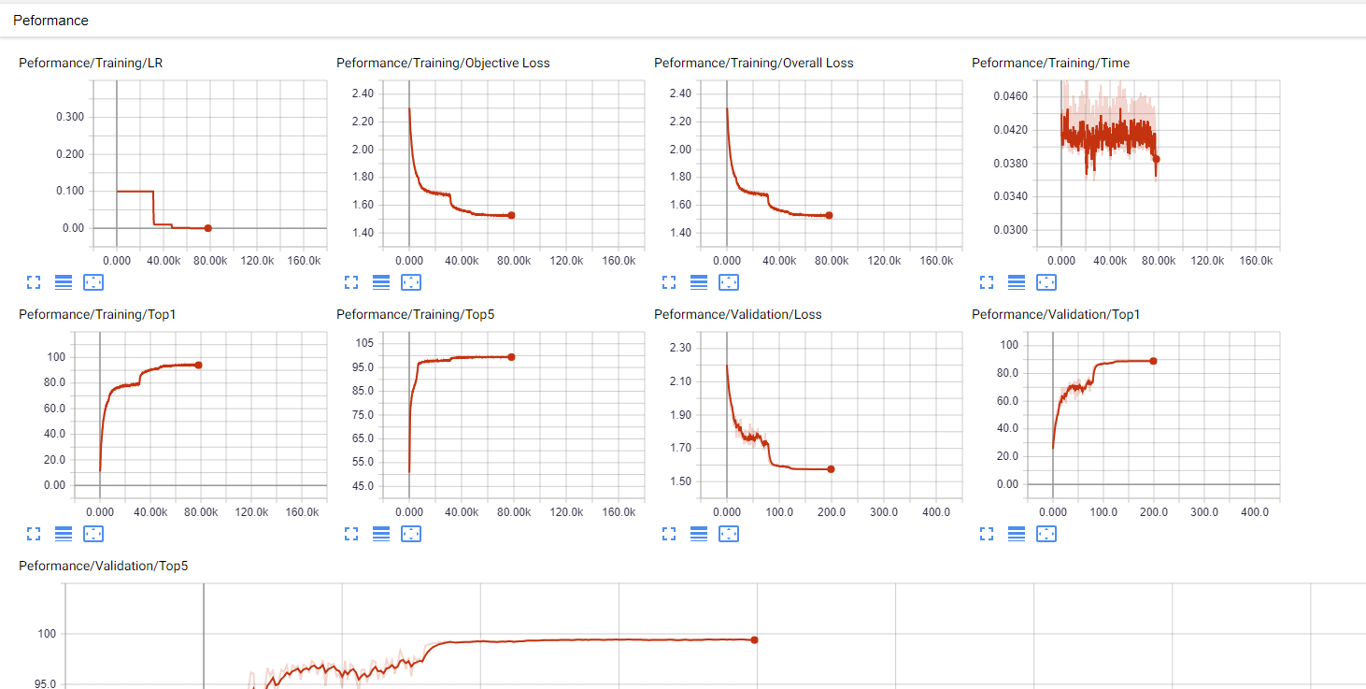
Result

Slide 6
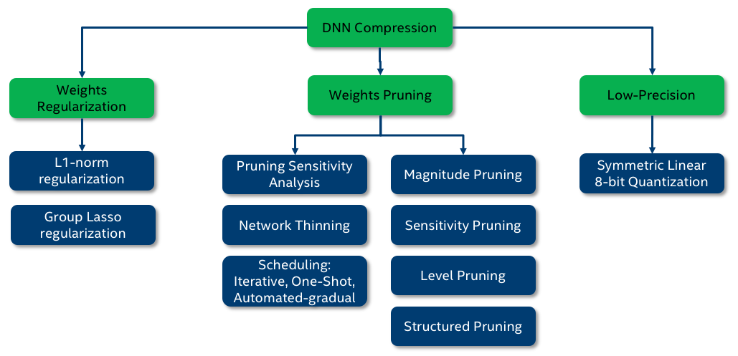
Element-wise Pruning
Sensitivity pruner
Level pruner
Automated gradual pruner (AGP)
自由選擇 , quantization 同理

Slide 7
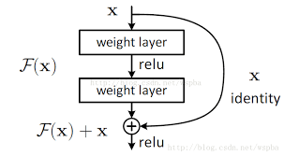

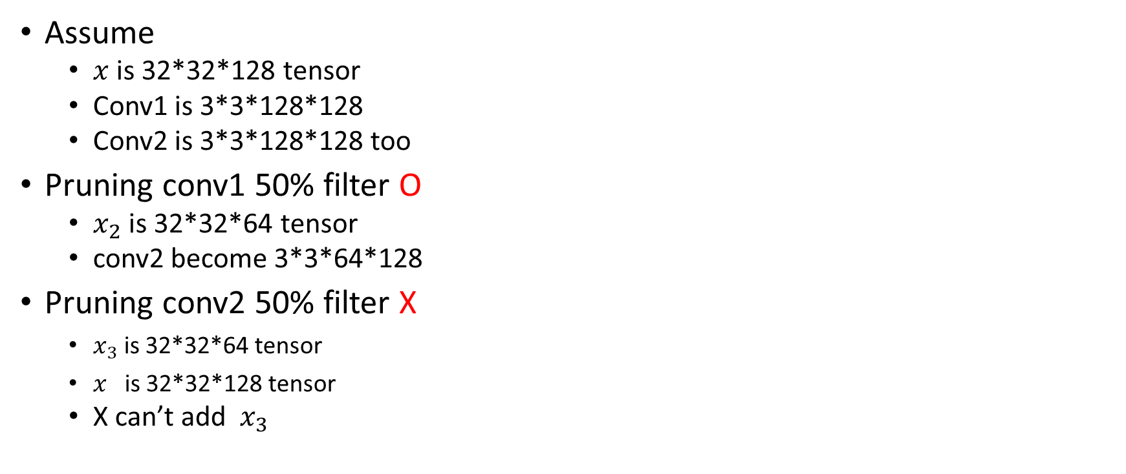

Filter pruning for ResNet
Assume
  is 32*32*128 tensor
  Conv1 is 3*3*128*128
  Conv2 is 3*3*128*128 too
Pruning conv1 50% filter O
  is 32*32*64 tensor
  conv2 become 3*3*64*128
Pruning conv2 50% filter X
    is 32*32*64 tensor
    is 32*32*128 tensor
  X can’t add

