Slide 1
深度學習系統與實現 LAB5 Deployment of Trained Models
Dept. of Computer Science and
Information Engineering
National Chiao Tung University

Slide 2
LAB 5
Dataset: Food11 from Lab2
Model: resnet18, your pretrained model
Accuracy: 91+ on evaluation dataset
Realized with nGraph and TensorRT

Slide 3
Outline
Tool
TensorRT workflow
LAB 5-1
LAB 5-2
Report Spec
Grading

Slide 4
Tool
Ngraph
https://github.com/NervanaSystems/ngraph
see http://ngraph.nervanasys.com/index.html/howto/import.html
TensorRT
https://docs.nvidia.com/deeplearning/sdk/tensorrt-developer-guide/index.html
Python API https://docs.nvidia.com/deeplearning/sdk/tensorrt-api/python_api/index.html
PyCUDA https://documen.tician.de/pycuda/index.html
Importing a serialized model
Ngraph currently only support TensorFlow, MXNet, intel neon natively
Other frameworks are supporter over ONNX

Slide 5
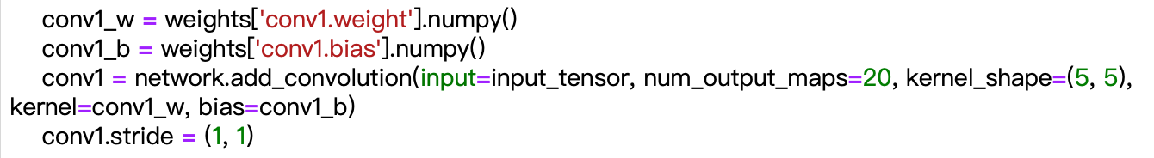
TensorRT deployment supported
Support C++/Python interface
With Python, need Pycuda installed
Support network definition
Import pre-trained weight to perform inference
Support framework parsers
Caffe parser, UFF parser, ONNX parser

Slide 6
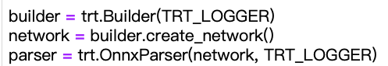

TensorRT workflow (ONNX parser)
Prepare builder, network definition, and parser
We use TensorRT ONNX parser here
Build engine via the network from ONNX parser
Create context from engine

Slide 7
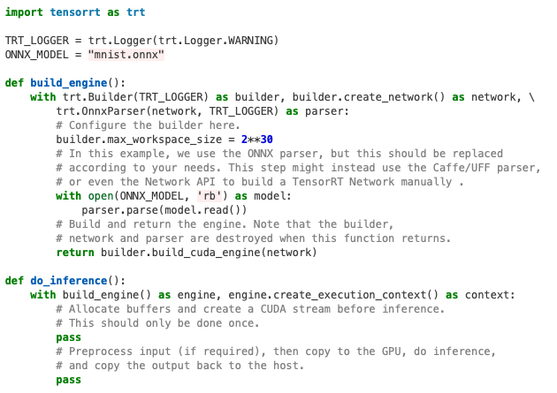
Perform engine on CUDA devices
Prepare Input/output on CPU/GPU
Based on test image size and batch size
Copy input to GPU
Perform inference
Copy output to CPU

Slide 8
LAB 5-1(50%)
Model serialization
The given model is based on pytorch framework, which needs to be transform into ONNX model
Ngraph
Use the above mentioned transformed model, import into Ngraph for optimization
Hints :
Reshaping and batchsize

Slide 9
LAB 5-2(50%)
Model serialization
The given model is based on pytorch framework, which needs to be transform into ONNX model
TensorRT
Use the above mentioned transformed model
Parse ONNX model for TensorRT optimization

Slide 10
Grading
LAB 5-1 (30%)
Serialize to ONNX (20%)
Inference (30%)
LAB 5-2 (30%)
Serialize to ONNX (20%)
Inference (30%)
Bonus (10%)
Batch size adjustment
Submission to E3:
Source code + report
YAML, log files
zip format (ex: dllab_lab4_{group id}.zip )
Deadline : Demo
Total: 110

Slide 11
Report
Introduction
Result
nGraph
Ngraph accuracy on evaluation dataset
Batch size verses speedups
TensorRT
TensorRT accuracy on evaluation dataset
Batch size verses speedups
Conclusion
Anything you want to say

Slide 12
Reference
Ngraph:
http://ngraph.nervanasys.com/index.html/index.html
TensorRT:
https://docs.nvidia.com/deeplearning/sdk/tensorrt-developer-guide/index.html

