Slide 1
Netflow V5 V9 介紹
Presented by ChiLung Ou

Slide 2
Outline
NetFlow Version 5
NetFlow Version 9
Different

Slide 3
Outline
NetFlow Version 5
NetFlow Version 9
Different

Slide 4
NetFlow Version 5
IP/UDP packet
NetFlow v5 is the most popular version of Cisco NetFlow so far.
NetFlow Version 5 consists of header part and record part.
NetFlow
v5 header
v5 record
…
…
v5 record
Notes:
V5是目前使用最廣泛的Netflow version

Slide 5
NetFlow Version 5
Header Part
Bytes | Contents | Description
0-1 | version | NetFlow export format version number
2-3 | count | Number of flows exported in this packet (1-30)
4-7 | sys_uptime | Current time in milliseconds since the export device booted
8-11 | unix_secs | Current count of seconds since 0000 UTC 1970
12-15 | unix_nsecs | Residual nanoseconds since 0000 UTC 1970
16-19 | flow_sequence | Sequence counter of total flows seen
20 | engine_type | Type of flow-switching engine
21 | engine_id | Slot number of the flow-switching engine
22-23 | sampling_interval | First two bits hold the sampling mode; remaining 14 bits hold value of sampling interval
Notes:
version; /* 5 */ 版本號碼
count; /* The number of records in the PDU */ 有多少record要被記錄
sysUpTime; /* 系統啟動至今的時間
unix_secs; /*從1970 0點0分至今的的秒數
unix_nsecs; /* 從1970 0點0分的奈米秒數
flow_sequence; /* 輸出系統至今處理過的flow總數
engine_type; /* 交換流系統的引擎Type of flow switching engine (RP,VIP,etc.) */
使用者定義值 (0-255)，指派給發出流量詳細記錄的 PacketShaper。使用 setup flowrecords engineType 命令可為單元指派類型。
engine_id; /* Slot number of the flow switching engine */
使用者定義值 (0-255)，指派給發出流量詳細記錄的 PacketShaper。使用 setup flowrecords engineID 命令可為單元指派 ID。
reserved; / 保留區

Slide 6
NetFlow Version 5
28-31 | last | SysUptime at the time the last packet of the flow was received
32-33 | srcport | TCP/UDP source port number or equivalent
34-35 | dstport | TCP/UDP destination port number or equivalent
36 | pad1 | Unused (zero) bytes
37 | tcp_flags | Cumulative OR of TCP flags
38 | prot | IP protocol type (for example, TCP = 6; UDP = 17)
39 | tos | IP type of service (ToS)
40-41 | src_as | Autonomous system number of the source, either origin or peer
42-43 | dst_as | Autonomous system number of the destination, either origin or peer
44 | src_mask | Source address prefix mask bits
45 | dst_mask | Destination address prefix mask bits
46-47 | pad2 | Unused (zero) bytes
Record Part
Bytes | Contents | Description
0-3 | srcaddr | Source IP address
4-7 | dstaddr | Destination IP address
8-11 | nexthop | IP address of next hop router
12-13 | input | SNMP index of input interface
14-15 | output | SNMP index of output interface
16-19 | dPkts | Packets in the flow
20-23 | dOctets | Total number of Layer 3 bytes in the packets of the flow
24-27 | first | SysUptime at start of flow
Notes:
Srcaddr 來源ip位置
Dstaddr 目的地ip位置
dPkts packet的數量
dOctets 總total大小
First flow開始時間
Last flow結束時間
SNMP(Simple Network Management Protocol)目前網路上用來進行網路管理的通訊協定，最主要的目的在於管理網路上各式各樣的設備
Prot：Layer 4 Protocol第 4 層通訊協定類型。例如：ICMP=1，TCP=6，Telnet=14，UDP=17

Slide 7
Outline
NetFlow Version 5
NetFlow Version 9
Different

Slide 8
NetFlow Version 9
Packet Header
Template FlowSet
Data FlowSet
Data FlowSet
...
Template FlowSet
Data FlowSet
...
NetFlow Version 9 packet mainly has three parts：
1.Header
2. Template FlowSet
3. Data FlowSet
(Option Template FlowSet)
Notes:
Netflow version 9 主要分成三個部分：
1.Header
2. Template FlowSet
3. Data FlowSet
Option Template Flowset 是用來記錄Netflow 本身的進程，紀錄Metadata描述有關Netflow之結構的資訊

Slide 9
NetFlow Version 9
Header
Bytes | Contents | Description
0-1 | version | NetFlow export format version number
2-3 | count | Number of flow sets exported in this packet, both template and data (1-30).
4-7 | sys_uptime | Current time in milliseconds since the export device booted.
8-11 | unix_secs | Current count of seconds since 0000 UTC 1970.
12-15 | package_sequence | Sequence counter of all export packets sent by the export device. Note: This is a change from the Version 5 and Version 8 headers, where this number represented total flows.
16-19 | source_id | A 32-bit value that identifies the Exporter Observation Domain. NetFlow Collectors SHOULD use the combination of the source IP address and the Source ID field to separate different export streams originating from the same Exporter
Notes:
version; /* 9*/ 版本號碼
count; /* The number of records in the PDU */ 有多少record要被記錄 最多30
sysUpTime; /* 系統啟動至今的時間
unix_secs; /*從1970 0點0分至今的的秒數 去掉了
package_sequence=flow_sequence; /* 輸出系統開始至今處理過的flow總數 紀錄是否有丟失的封包
source_id; / 等同engine_type engine_id
Type of flow-switching engine
engine_id Slot number of the flow-switching engine

Slide 10
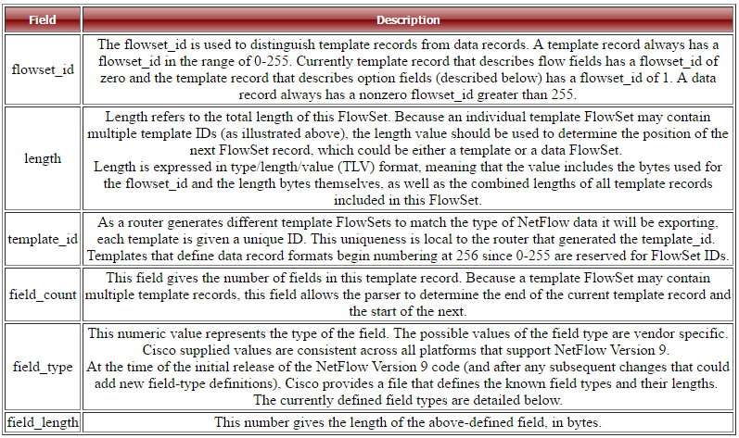
NetFlow Version 9
bit 0-15
flowset_id = 0
length
template_id
field_count
field_1_type
field_1_length
...
field_N_type
field_N_length
template_id
field_count
field_1_type
field_1_length
...
field_N_type
field_N_length
Template FlowSet
Notes:
Template FlowSet
Flowset_ID 介於0~255之間 (option Template flowset 的Flowset ID 固定為1)
Length 用來記錄總模板的長度 如右邊的圖 可能有多個模板設定
Template ID 皆256以上是用來連結Template FlowSet 與之後Dataset (Recode的部分) 讓接收端知道該以那些value的type
Field_count 紀錄有多少欄位
Field_type 欄位的type設定
Field length 長度

Slide 11
NetFlow Version 9
bit 0-15
flowset_id = template_id (>255)
length
record_1-field_1_value
record_1-field_2_value
...
record_1-field_M_value
record_2-field_1_value
...
record_2-field_M_value
...
record_N-field_M_value
padding
Data FlowSet
Field | Description
flowset_id | A FlowSet ID precedes each group of records within a NetFlow Version 9 data FlowSet. The FlowSet ID maps to a (previously received) template_id. The collector and display applications should use the flowset_id to map the appropriate type and length to any field values that follow.
length | This field gives the length of the data FlowSet. Length is expressed in TLV format, meaning that the value includes the bytes used for the flowset_id and the length bytes themselves, as well as the combined lengths of any included data records.
record_N field_M | The remainder of the Version 9 data FlowSet is a collection of field values. The type and length of the fields have been previously defined in the template record referenced by the flowset_id/template_id.
padding | Padding should be inserted to align the end of the FlowSet on a 32 bit boundary. Pay attention that the length field will include those padding bits.
Notes:
Template FlowSet
Flowset_ID 介於0~255之間 (option Template flowset 的Flowset ID 固定為1)
Length 用來記錄總dataflow的長度 如右邊的圖 可能有多個模板設定
record_N field_M 記錄第N個模板的第M個field value

Slide 12
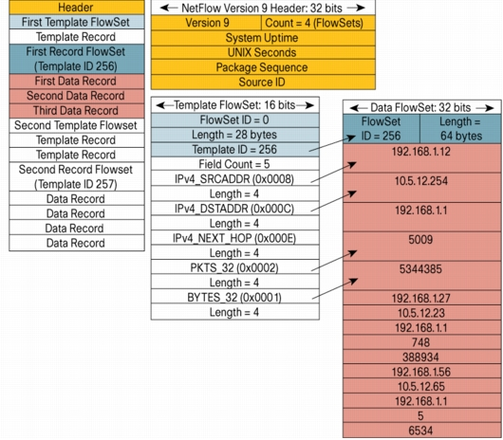
NetFlow Version 9

Slide 13
Outline
NetFlow Version 5
NetFlow Version 9
Different

Slide 14
Different
Netflow V5 | Netflow V9
packet format is fixed | packet format is flexible
Only support for Ipv4 | Support for Ipv6
 | Additional fields like MPLS labels
Notes:
由前面介紹可以知道V9的封包格式是能變動的，能夠直接挑選所需要的欄位資料來降低資料量，並且能選擇更多樣的field 像是MPLS。以及支援更多的protocol跟更多的
什麼是MPLS多重通訊協定標籤交換傳輸(Multi-Protocol Label Switching 它是實現寬頻網際網路最熱門的技術；
其目的是要提供一個更具彈性、擴充性及效率更高的IP層交換技術。
MPLS 是一種整合了標籤交換架構與網路層的路由機制的技術，最基本的概念是將進入MPLS Network 的封包(Packet)
配置一個固定長度的標籤(Label)，在MPLS Network中Packet會根據標籤(Label) 做Forwarding , 由Label來決定Packet在網路上的路徑，不會再看 Layer 3的 IP Header(標頭)。
NetFlow關注流量特徵，SNMP關注設備狀態； NetFlow直接圍繞Session會話連接進行數據提取，而SNMP則以物理接口為基本單位進行數據統計

Slide 15
END

