Slide 1
PeerFox : Detecting Parasite P2P Botnets in their Waiting Stage
ISPCC 2015 p.350~p.355
Presented by ChiLung Ou

Slide 2
Outline
Abstract
Introduction
Approach
Result
Conclusions

Slide 3
Outline
Abstract
Introduction
Approach
Result
Conclusions

Slide 4
Abstract
Because of P2P botnets’ distributed platform, these have emerged as a significant threat against network security.
The decentralized nature of these botnets makes their detection very challenging.
In this paper they present a detection scheme to detect parasite P2P botnets.
They have considered two basic behavior of botnets for detection: (i)long-living peers and (ii)search requests’ intensity.
Notes:
這篇論文提出一種雙層檢驗p2p botnet的方法，他們是以兩種p2p botnet常見的行為作為偵測標準，一項是長時間存活以及搜尋、請求的強度

Slide 5
Outline
Abstract
Introduction
Approach
Result
Conclusions

Slide 6
Introduction
Botnets have led to increase in security threats to the internet community.
The command and control(C&C) traffic generated by botnets resembles to benign traffic of the exploited P2P network. This result in stealthiness and thus it becomes very difficult to detect these botnets.
Notes:
Botnet已經形成網路安全的威脅，因為p2p網路架構傳輸使得他很像是正常的網路傳輸，因此很難去偵測到底是不是botnet。

Slide 7
Outline
Abstract
Introduction
Approach
Result
Conclusions

Slide 8
Approach
In this work, their approach is focus on detection of bots while they are in waiting stage.
PeerFox is a two-tier approach based on ‘long-living peers ’ and ‘intensity of search requests’.
Notes:
在這篇論文裡面，他們在bot的潛伏階段進行偵測。
然後是以前面提到的兩種行為長時間存活以及搜尋、請求的強度來辨別是否為botnet

Slide 9
Approach
Long-living Peers
Benign peers remain in the network only for the time they require any file, once they get or download the desired file, they leave the network.
Whereas, the bots advertise themselves till the system on which the bot is installed is up.
Search Requests’ Intensity
For the DDoS attacks to be effective, all the bots should get commands or updates from the attacker as soon as possible so that they can update themselves and can initiate an attack or act accordingly.
The bots are required to regularly and frequently search for updates on commands.
Notes:
第一種行為是因為正常的網路工作在取得所需的檔案或下載後就會停止但是bot會持續寄身於網路工作中。
第二種行為則是因為要讓DDoS有效攻擊，所以他們必須定期的搜尋更新命令
所以這篇論文利用這兩種行為來辨別是否為bot或是正常的network

Slide 10
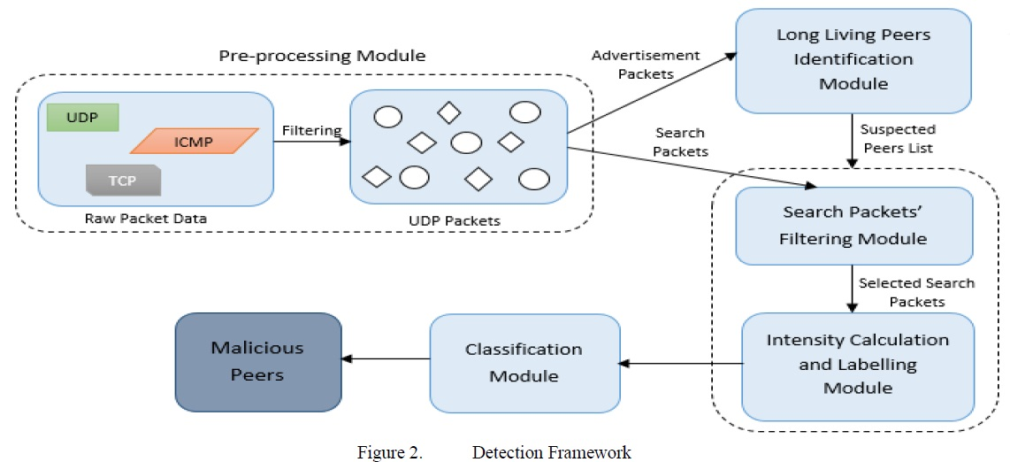
Approach
Pre-processing Module
This module consists of two sub-modules as shown in Fig. 2.
The first sub-module deals with the pre-processing of raw data consisting of all types of packets.
The data that is exchanged during the waiting stage consists of UDP packets only.
Notes:
這是前期的準備程序
分成兩部分 第一部分是將所有的raw data挑出UDP packet
因為p2p bot大多採用UDP(User Datagram Protocol)進行傳輸
在資料損失時並不會造成重大影響，但對時效需求較高，或者應用層有能力來處理這些問題，如一些P2P程式，此時才會使用UDP協定。

Slide 11
Approach
Pre-processing Module
The second sub-module deals with the classification of output from the first sub-module into advertisement packets and search request packets.
Notes:
而第二部分將這些UDP封包分成advertisement跟search request兩種封包

Slide 12
Approach
Long-living Peers Identification Module
This module creates a list of IP addresses of peers, which have been advertising themselves for a specific duration of time.
Notes:
接著是將advertisement封包作為long-living peers module的輸入 然後利用演算法將可疑的ip列出

Slide 13
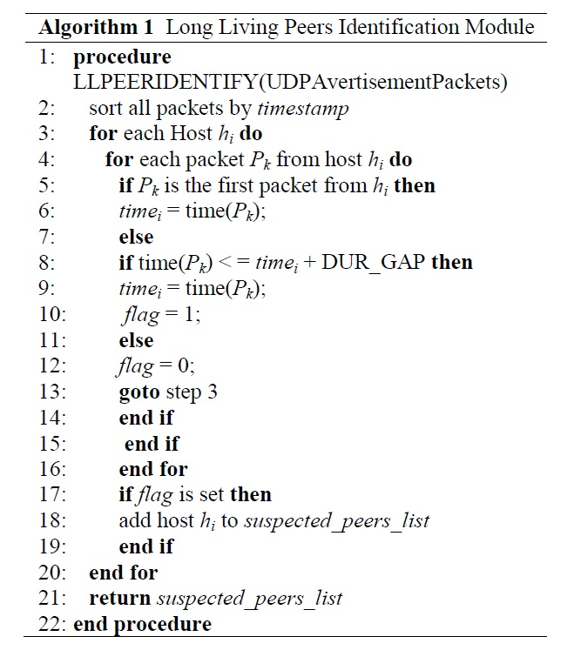
Approach
Notes:
後面這一頁是他使用的演算法 主要是框框中的這一行，表示host Hi傳輸的每個封包間隔時間都小於設定的DUR_GAP時間的話就代表他很可能是botnet就將ip列在可疑表上

Slide 14
Approach
Search requests’ intensity module
This module consists of two sub-modules.
In first sub-module, only those peers which are present in the output file of long-living peers’ identification module are chosen and send out to the next sub-module.
Notes:
接著是search requests’ intensity module
這個module也分兩個步驟
第一個步驟是將前置處理的search request 封包與上一步驟的所列出的可疑表ip比對，將兩者共同的ip挑出，放入下一步驟計算他的search request intensity

Slide 15
Approach
Search requests’ intensity module
They have considered the intensities of search requests at the end of every d time unit, for finally classifying bots.
Notes:
計算他的search request intensity，放置下一步驟進行確認

Slide 16
Approach
Classification Module
In this module, they analyzed intensities of search requests at the end of every d seconds.
If a peer shows intensity values of its search requests more than th (percentage) chunks of total chunks of d seconds each, we mark the peer as a bot.
In this case, construct the neighborhood based on 2 types of features
Notes:
下一步的Classification Module
就看計算出的結果是否超出設定的search request intensity 若超過則將它視為bot
例如 若d 秒內 reques強度高於所設定的th percentage的話就將他視為bot

Slide 17
Outline
Abstract
Introduction
Approach
Result
Conclusions

Slide 18
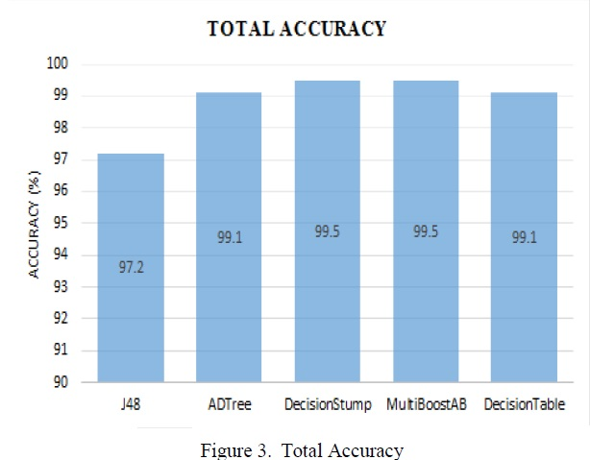
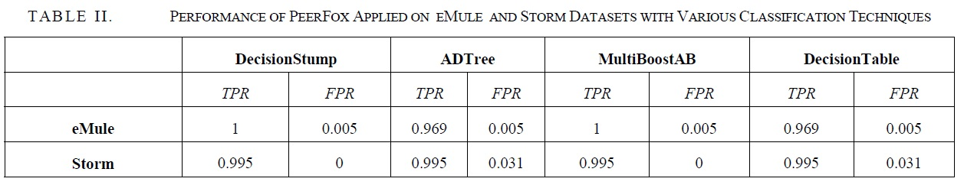
Result
The data of eMule P2P application along with data of Storm botnet from the dataset are used.
DecisionStump and MultiBoostAB provided best results with 99.5% detection accuracy and zero FPR.
FPR = FP /（FP + TN）
Notes:
接著是Result 他是用emule跟storm做為起始資料接著採用不同機器學習的方式來實驗
最後DecisionStump and MultiBoostAB能有最高的準確率99.5%以及FPR=0
DecisionStump是一種機器學習 採用單層的決策樹
False Positive Rate （假正率, FPR） FPR = FP /（FP + TN） 被誤判為正的負樣本結果數/負樣本實際數

Slide 19
Outline
Abstract
Introduction
Approach
Result
Conclusions

Slide 20
Conclusions
In this paper, PeerFox is able to detect bots based on two basic behavior long-living and search requests’ intensity.
Their work is able to detect bots even if they are exchanging benign traffic.
Notes:
結論是 這篇paper提出的方式，能利用兩種bot行為分辨是否為bot，即使他是否看起來像正常的網路傳輸

Slide 21
END

