Slide 1




SOFTWARE
ENGINEERING
SEQUENCE DIAGRAM
CLASS DIAGRAM

Slide 2
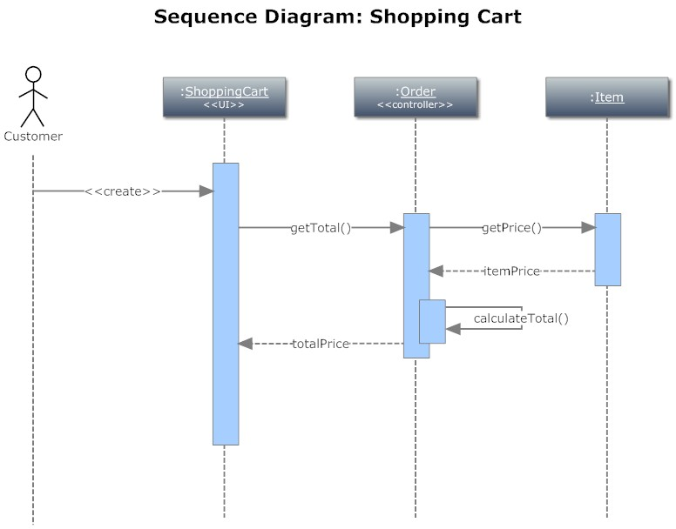
SEQUENCE DIAGRAM
• Describe the flow of messages, events, actions between objects
• Show concurrent processes and activations • Show time sequences that are not easily depicted in other diagrams
• Typically used during analysis and design to document and understand the logical flow of your system
• Emphasis on time ordering!

Slide 3
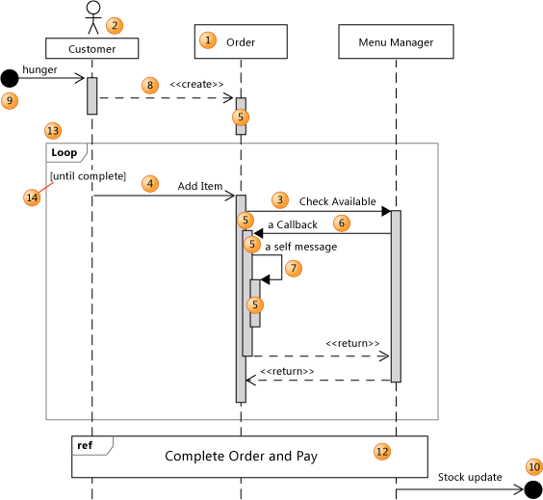
SEQUENCE DIAGRAM
• message: communication between participant objects
• the axes in a sequence diagram:
– horizontal: which object/participant is acting
– vertical: time (down -> forward in time)
• Actor - A participant that is external to the system that you are developing.

Slide 4
SEQUENCE DIAGRAM
 | (Lifeline) | Vertical line is called an object's lifeline. Represents an object's life during interaction.
1 | (Classifiers) | Rectangles of participants - objects, classes, subjects.
2 | (Actor) | A participant that is external to the system .
3 | (Synchronous message) | The sender waits for a response to a synchronous message before it continues. The diagram shows both the call and the return.
4 | (Asynchronous message) | A message that does not require a response before the sender continues. An asynchronous message shows only a call from the sender.

Slide 5
SEQUENCE DIAGRAM
5 | (Execution occurrence) | A vertical shaded rectangle that appears on a participant's lifeline and represents the period when the participant is executing an operation. The execution begins where the participant receives a message. If the initiating message was a synchronous message, the execution ends with a «return» arrow back to the sender.
6 | Callback message | A message that returns back to a participant that is waiting for the return from an earlier call. The resulting execution occurrence appears on top of the existing one.
7 | Self message | A message from a participant to itself. The resulting execution occurrence appears on top of the sending execution.
8 | Create message | A message that creates a participant. If a participant receives a create message, it should be the first it receives.

Slide 6
SEQUENCE DIAGRAM
9 | (Found message) | An asynchronous message from an unknown or an unspecified participant.
10 | (Lost message) | An asynchronous message to an unknown or an unspecified participant.
12 | (Interaction Use) | Encloses a sequence of messages that are defined in another diagram.
13 | Combined Fragment | A collection of fragments. Each fragment can enclose one or more messages. There are different kinds of combined fragments (loop).
14 | (Fragment Guard) | Can be used to state a condition relevant to whether the fragment will occur.

Slide 7
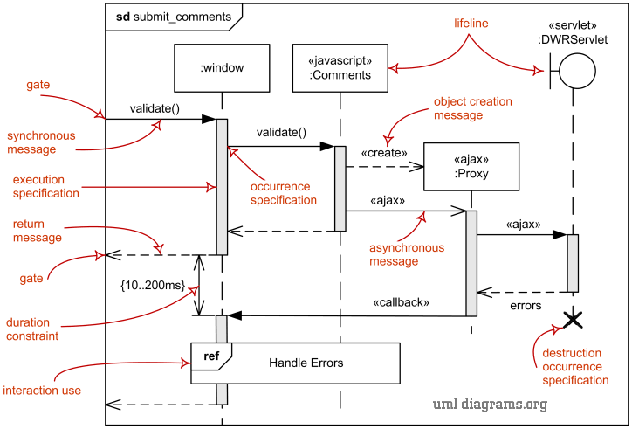
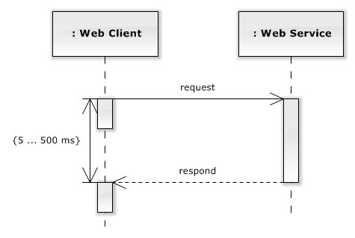
SEQUENCE DIAGRAM
X | (Destruction Event) | Represents the point at which the object is deleted or no longer accessible. Appears at the bottom of every lifeline.
 | (Duration Constraint) | Duration constraint is an interval constraint that refers to a duration interval.

Slide 8
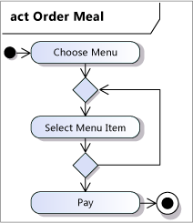
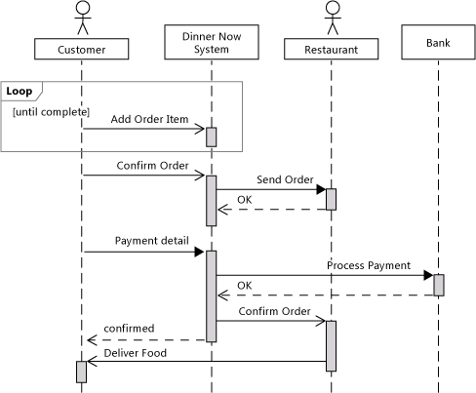
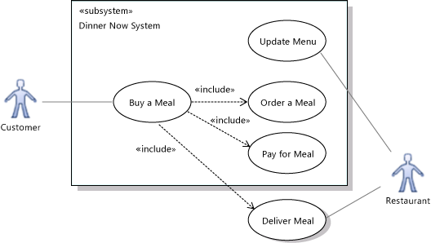
EXAMPLES

Slide 9
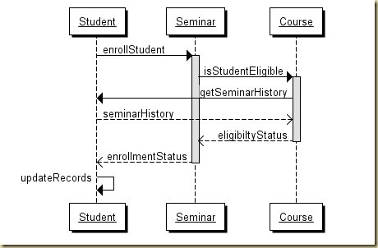
EXAMPLES

Slide 10
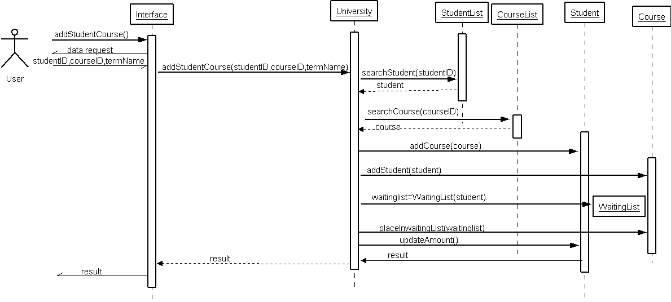
EXAMPLES

Slide 11
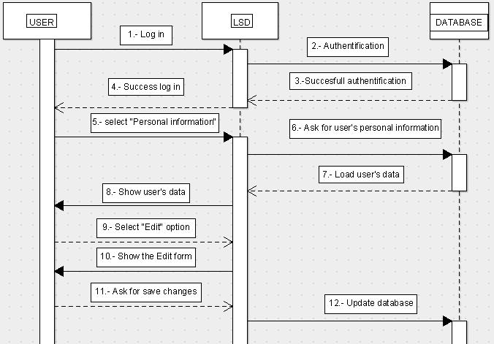
EXAMPLES

Slide 12
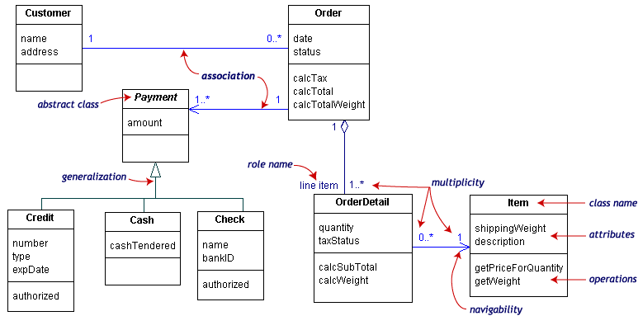
CLASS DIAGRAMS
UML class diagrams show the classes of the system, their interrelationships (including inheritance, aggregation, and association), and the operations and attributes of the classes.

Slide 13
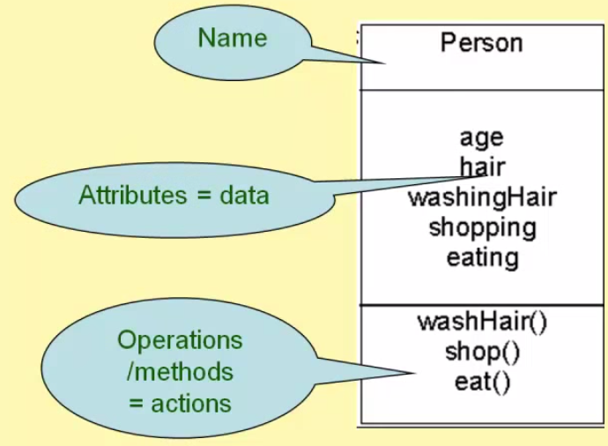
CLASS DIAGRAMS
The UML representation of a class is a rectangle containing three compartments stacked vertically, as shown in Figure.
The top compartment shows the class's name.
The middle compartment lists the class's attributes.
The bottom compartment lists the class's operations.

Slide 14
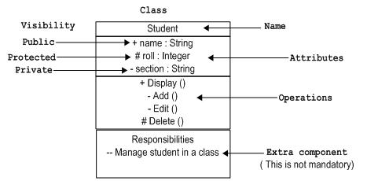
CLASS DIAGRAMS
(Visibility):
A public element is visible to all elements that can access the contents of the namespace that owns it.
A private element is only visible inside the namespace that owns it.
A protected element is visible to elements that have a generalization relationship to the namespace that owns it.
+ | (Public)
- | (Private)
# | (Protected)

Slide 15
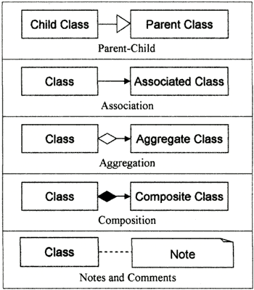
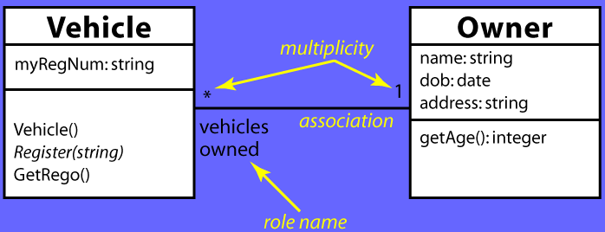
CLASS DIAGRAMS
Objects are often associated with, or related to, other objects.
Associations are modeled as lines connecting the two classes whose instances (objects) are involved in the relationship. Typically one or two words are used to describe the association – vehicles owned”.

Slide 16
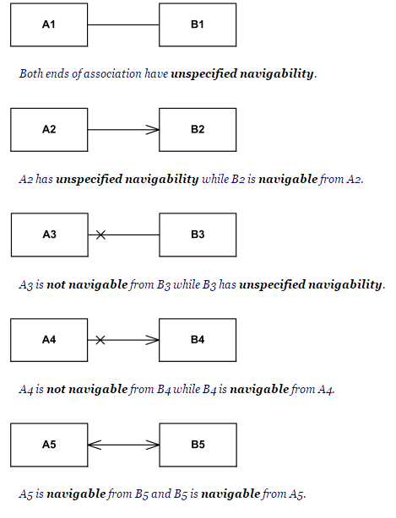
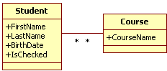
CLASS DIAGRAMS - Associations
- multiplicity - The multiplicity of the association is labeled on either end of the line, one multiplicity indicator for each direction
navigability arrows

Slide 17
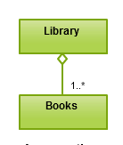
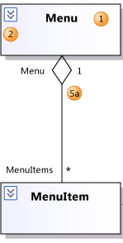
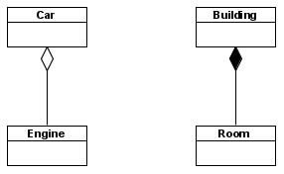
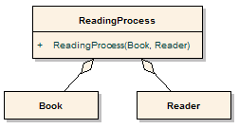
CLASS DIAGRAMS - Aggregation
Refers to the formation of a particular class as a result of one class being aggregated or built as a collection. In aggregation, the contained classes are not strongly dependent. The aggregations "has-a" relationship is of "weak-type". Weak meaning the linked components of the aggregator may survive the aggregations life-cycle or may be accessed in some other way.
For example, the class “library” is made up of one or more books, among other materials. In aggregation, the contained classes are not strongly dependent on the life cycle of the container. In the same example, books will remain so even when the library is dissolved.

Slide 18
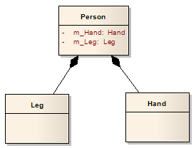
CLASS DIAGRAMS – Composition
The composition "has-a" relationship is of "strong-type". Strong meaning that one can't exists without the other.
The part can not exist without the main.
Пример: The rooms can not exist without the building.
1
12

Slide 19
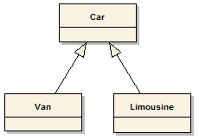
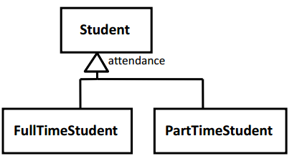
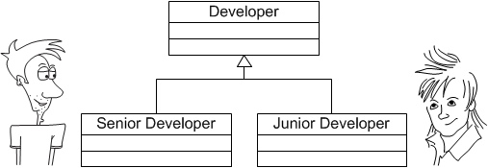
CLASS DIAGRAMS – GENERALIZATION
The generalization relationship is also known as the inheritance or "is a" relationship.
The superclass (base class) in the generalization relationship is also known as the "parent", superclass, base class, or base type.
The subtype in the specialization relationship is also known as the "child", subclass, derived class, derived type, inheriting class, or inheriting type.

Slide 20
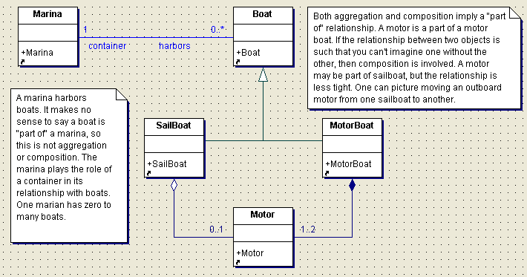
Watch
1
1
1
1
2
1
2
1
Button
LCD Display
Battery
load
Time
now
state
blinkIdx
blinkSeconds()
blinkMinutes()
blinkHours()
stopBlinking()
refresh()
push() release()

Slide 21
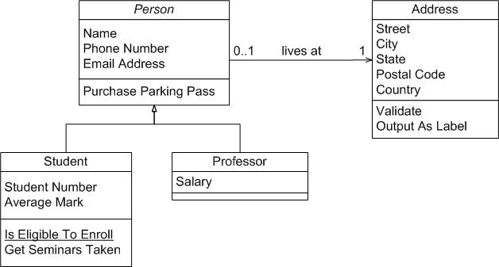

Slide 22
