Slide 1
E-news Express Project
Rochita Sundar
Postgraduate program, Data Science & Business Analytics
The University of Texas at Austin

Slide 2
Background
The aim is to expand business by acquiring new subscribers. Every visitor to the website (online news portal) takes certain actions based on their interests. Analysis of these interests can help determine if a new feature will be useful or not.
The design team of the company has created a new landing page. 100 randomly selected users are divided into two equal groups. The old landing page is served to the first group (control group) and the new landing page is served to the second group (treatment group).
User actions/ interests recorded includes the time spent (in minutes) on either of the old or new landing pages, whether they were successfully converted as a subscriber, and the language chosen by the user to view the landing page (English, French or Spanish).

Slide 3
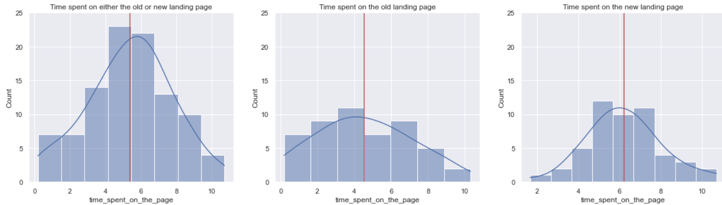
Time spent on the landing pages
Time spent on either the old or the new landing page (100 users)
Time spent on the old landing page (50 users)
Time spent on the new landing page (50 users)
From the data, total (across all users) and average time spent on the new landing page (311.16 & 6.22 mins) is higher than on the old landing page (226.62 & 4.53 mins).
Statistically found enough evidence to support the claim (with more than 95% certainty) that mean time spent on the new landing page is higher than mean time spent on the old landing page.
(calculated using a two independent sample T-test for equality of means - unequal std. dev.)

Slide 4
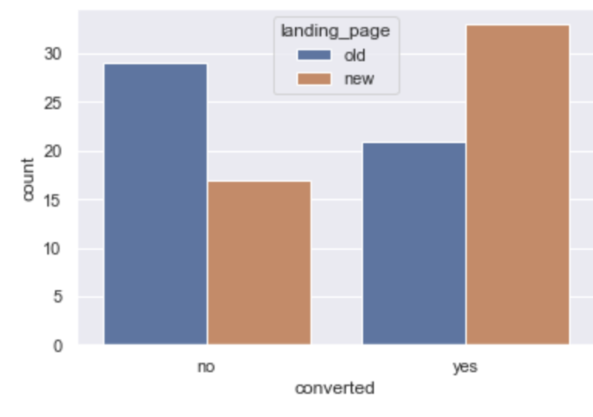
Conversion rate (the proportion of users who visit the landing page and get converted)
% conversion rate is higher for new landing page (66%) when compared to old landing page (42%).
Statistically found enough evidence to support the claim (with more than 95% certainty) that conversion rate for the new landing page is higher than conversion rate for the old landing page.
(calculated using a two proportion Z-test.)

Slide 5
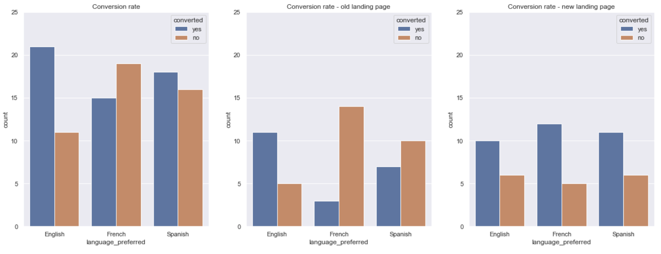
Conversion rate, preferred language and landing pages
Conversion rate – old landing page (50 users)
Conversion rate – new landing page (50 users)
Conversion rate (100 users)
There are approximately equal number of English, French and Spanish preferring users (32, 34 and 34) in the dataset.
% change in conversion for new landing page vs. old landing page is -10% for English, 75% for French and 36.36% for Spanish. Users that prefer French converted more on the new landing page while users that prefer English converted marginally poorer on the new landing page.
Did not find enough statistical evidence to support the claim (with more than 95% certainty) that conversion rate is dependent on the preferred language considering all data in the dataset (both new and old landing pages included).
(calculate using a chi-square test for independence.)

Slide 6
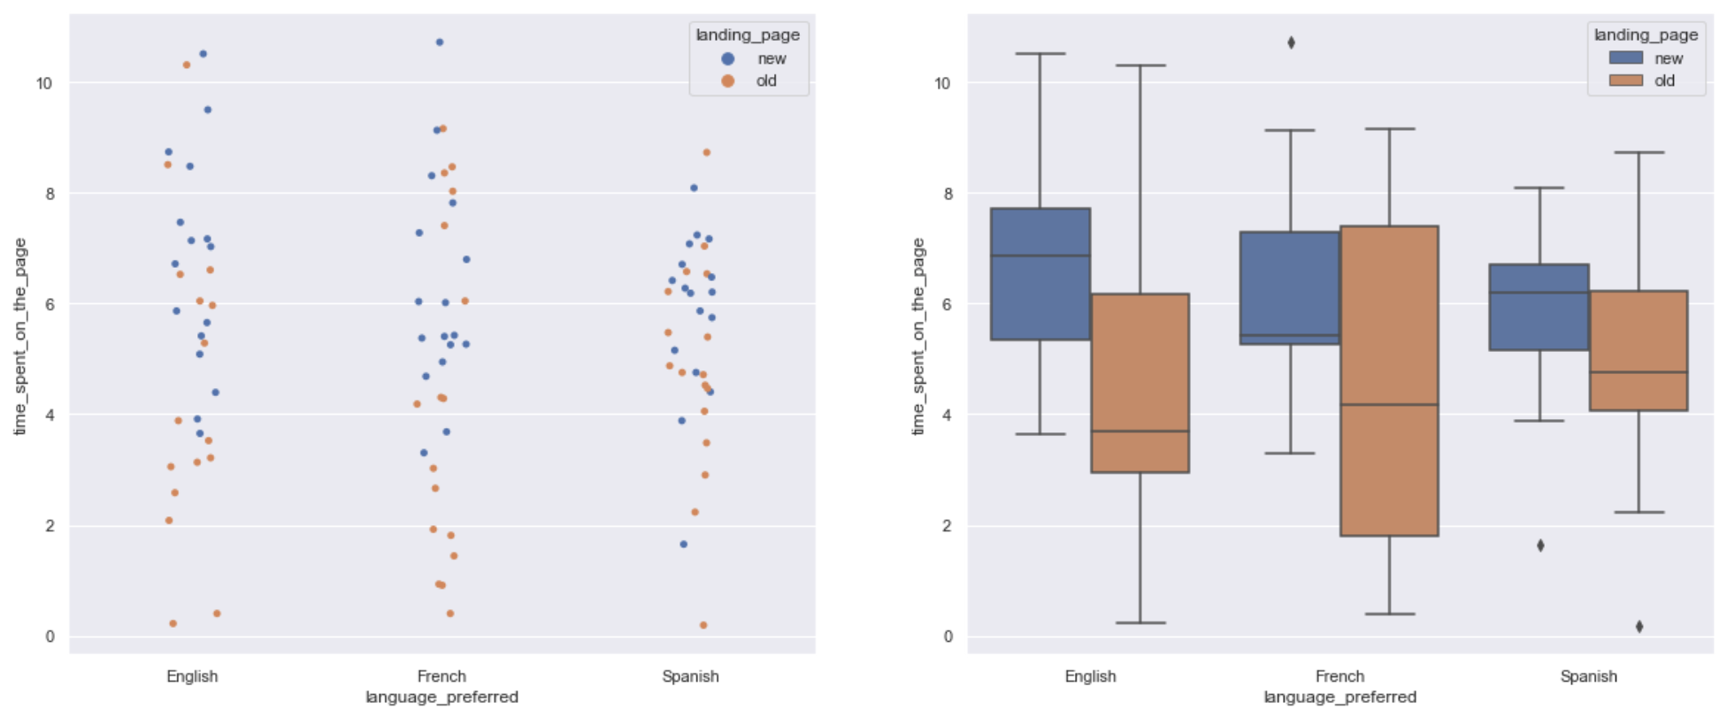
Time spent on the landing pages and landing pages
The median time spent on the new landing page are significantly more than old landing page for all users irrespective of preferred language. The mean time spent on the new landing page are 6.66mins, 6.19mins and 5.83 mins for users that prefer English, French and Spanish (~approximately equal).
Did not find enough statistical significance to conclude that at least one of the mean time spent on the new landing page for different preferred languages is different from the rest (at 5% significance level or 95% confidence).
(calculated using a one-way ANOVA test, assumptions tested using Shapiro-Wilk’s and Levene’s tests.)

Slide 7
Summary and recommendations
The new landing page was found to be statistically better in time spent by users on the page as well as the conversion rate of a user as a subscriber when compared to the old landing page. Hence, the new landing page is effective from business standpoint.
While we did not find enough statistical evidence from the dataset that conversion rate is dependent on the preferred language, exploratory data analysis of the dataset revealed that French and Spanish preferring users had a higher conversion rate on new landing page while English preferring users had a marginally poorer conversion rate on the new landing page. Also, did not find enough statistical significance to conclude that at least one of the mean time spent on the new landing page for different preferred languages is different from the rest (at 5% significance level or 95% confidence). - This needs to be communicated to the design team as it appears even though mean time spent by English preferring users on the new landing page is higher than old landing page, and similar to the Spanish and French preferring users, conversion rate was marginally poorer on the new landing page. Requires further data gathering and investigation.

