Slide 1
Into the Service Mesh

Slide 2


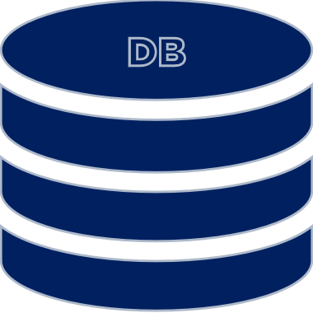
Service discovery
Traffic managment
Observability

Slide 3
Service discovery
http://api
Address
Traffic split
Deployment patterns
db:5432

Slide 4

http://api
Address
Traffic split
Deployment patterns
db:5432

Slide 5


db.svc
http://api
Address
Traffic split
Deployment patterns
db:5432

Slide 6


Traffic management
http://api
Load-balancing
Retries
Fault injection
db:5432

Slide 7

mTLS
http://api
Mutual TLS
Cert management
Authn & authz
db:5432

Slide 8


Traffic visualization
Distributed tracing
Metrics & logging
Observability

Slide 9

All in the proxy
proxy
Sidecar
Network proxy
Rules & extensions
proxy

Slide 10
# ...
spec:
containers:
- name: app
image: service1
env:
- name: TARGET_HOST
value: localhost:9000
- name: proxy
image: service1-proxy
ports:
- containerPort: 8000
name: proxy
# ...
- name: service2
connect_timeout: 0.250s
type: strict_dns
lb_policy: round_robin
load_assignment:
cluster_name: service2
endpoints:
- lb_endpoints:
- endpoint:
address:
socket_address:
address: service2
port_value: 8000
- name: jaeger
connect_timeout: 1s
type: strict_dns
lb_policy: round_robin
load_assignment:
cluster_name: jaeger
endpoints:
- lb_endpoints:
- endpoint:
address:
socket_address:
address: jaeger
Complex config
Sidecar setup
Envoy configuration
eltons.show/ecs-v4

Slide 11

control-plane
mesh
proxy
Sidecar
Network proxy
Automatic injection
proxy

Slide 12




0.0 in 2016
Now 2.9
CNCF
0.1 in 2017
Now 1.8
Google & IBM
0.0 in 2020
Now 0.6
CNCF
Linkerd
Istio
Open Service Mesh
Service Mesh Interface (SMI)
0.4 in 2020; now 0.6
CNCF

Slide 13


CLI / Operator
CRDs
Mutating Webhooks

Slide 14
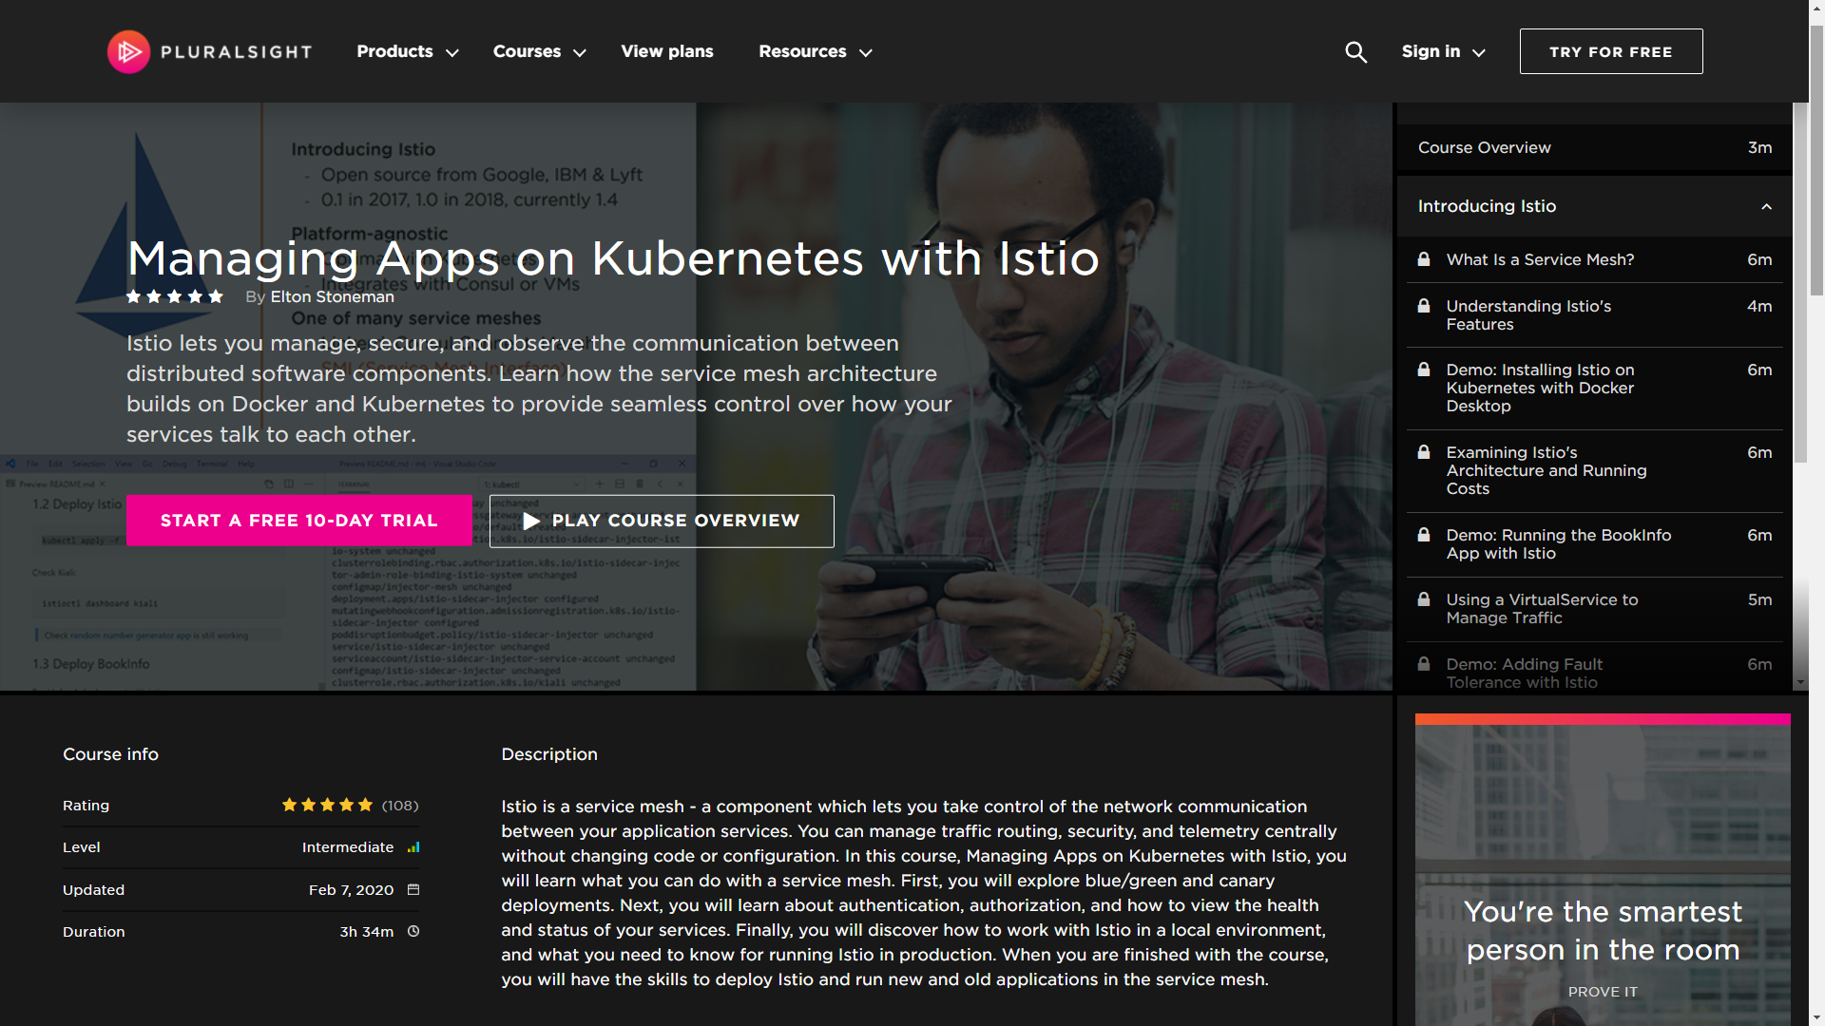
eltons.show/istio

Slide 15
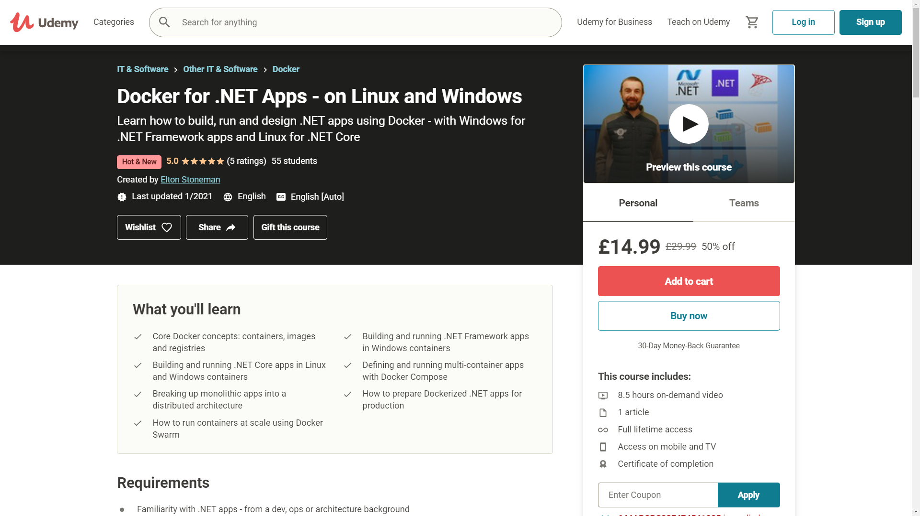
eltons.show/udemy

Slide 16
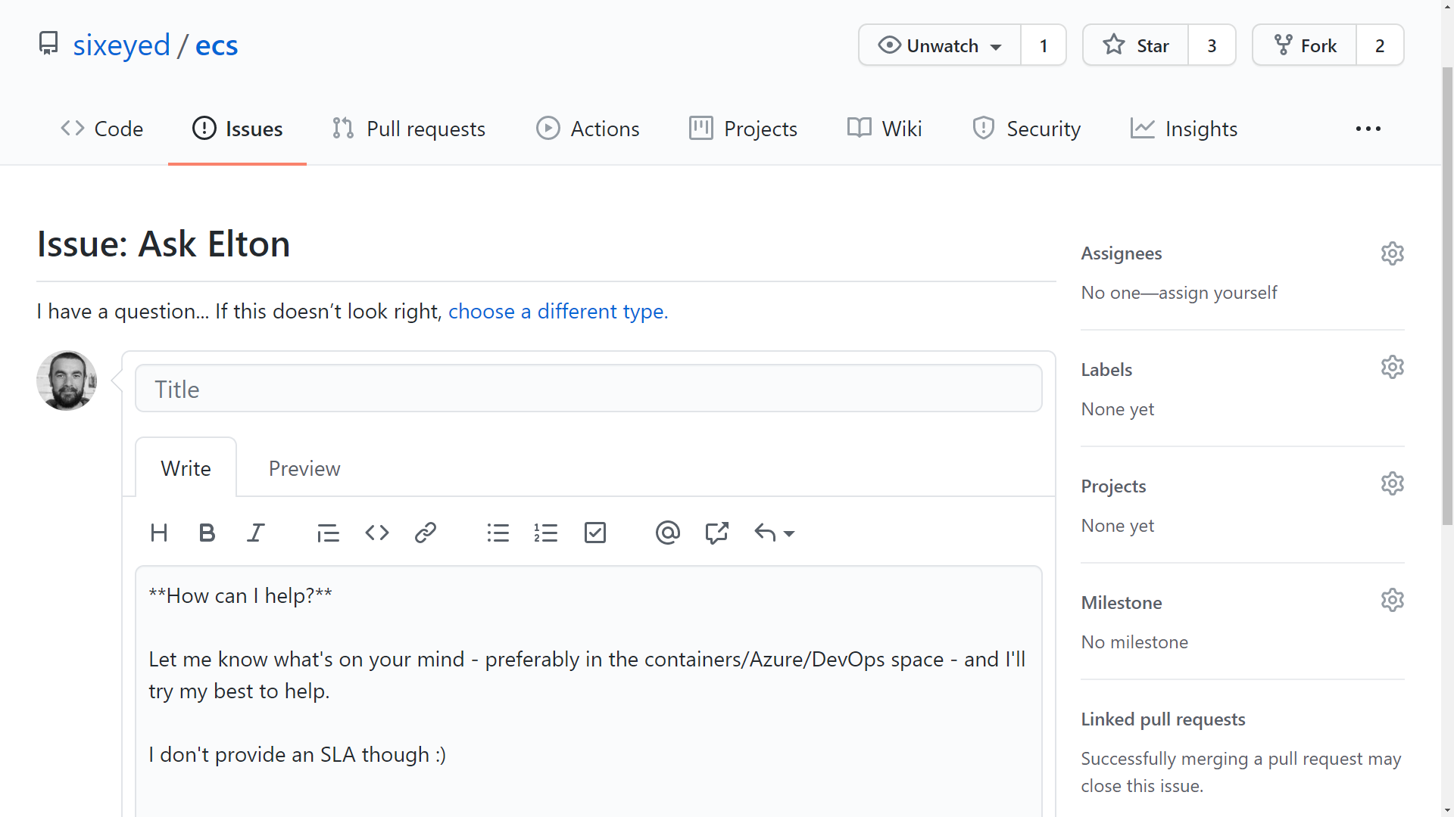
eltons.show/ama

Slide 17
ECS-M2:
Service Mesh
with
Linkerd
and
Kubernetes

