Slide 1


Department of Information Technology
V R Siddhartha Engineering College
Advanced Graph-based and Autonomous Architectures for Hyperspectral Anomaly Detection
Batch-21
B.Tech in Information Technology
MAJOR Project Review Presentation
Presented by
CH. Venkata Akhila(228W1A12E4)
G. Swathi(228W1A12F1)
Under the guidance of
Dr. M. Suneetha, HOD Of IT Department

Slide 2
Agenda
Introduction and Problem statement
Objectives and Outcomes of the Project
Literature Survey and Summary
Datasets and Requirement
Algorithms used in the Project
Architecture diagram
Implementation steps and Execution
Results obtained
Result Analysis & Observations
Conclusion & Future work
References

Slide 3
MINI-2 Introduction and Motivation
Hyperspectral Imaging (HSI) provides detailed spectral signatures across hundreds of contiguous bands, enabling the identification of objects invisible to standard sensors.
Hyperspectral Anomaly Detection (HAD) is critical for national defense, as it identifies unauthorized high-altitude aircraft without requiring prior knowledge of their spectral profiles.
Detecting these anomalies is challenging due to the subtle spectral differences between small targets and complex geographical backgrounds like urban or coastal areas.
Traditional methods often struggle with high-dimensional data, necessitating advanced deep learning models capable of autonomous background modeling and anomaly isolation.

Slide 4
Problem Statement
Identification and extraction of subtle spectral signatures from high-dimensional hyperspectral data to characterize complex background patterns, followed by automated background reconstruction using advanced deep learning architectures to isolate high altitude anomalies, for enhancing the precision and reliability of hyperspectral surveillance systems.

Slide 5
Objectives and Outcomes
Objectives | Outcomes
1. To design and implement advanced deep-learning architectures, specifically Gated Transformers and Autonomous Autoencoders, to model complex spectral-spatial correlations in high-dimensional hyperspectral imagery. | 1. Provides a high-fidelity modeling framework that accurately distinguishes subtle aircraft signatures from complex geographical and atmospheric backgrounds.
2. To evaluate the models' performance across diverse operational environments (urban, coastal, and island) to ensure consistent reliability in wide-area airspace monitoring. | 2. Validates the system's cross-terrain resilience, proving that high-altitude anomalies are successfully identified regardless of the underlying terrestrial complexity.

Slide 6
Literature Survey
Paper Title | Objectives | Algorithms / Methods | Observations | Limitations | Conclusion
Title: Synergistic Kolmogorov–Arnold Networks and Fidelity-Gated Transformer for Hyperspectral Anomaly Detection Year: 2025 | Improve HSI background reconstruction fidelity and achieve state-of-the-art detection precision. | Fidelity-Gated Transformer (GCAT), LARB/GBRB branches, KAN-MLP (Kolmogorov-Arnold Network). | Achieve near-perfect AUC (>0.99); KAN-MLP significantly increases the network's representational capacity. | High computational complexity of KAN layers compared to traditional MLPs. | Proves that fidelity-based gating and learnable activations are critical for high-fidelity HAD.
Title: Enhancing hyperspectral anomaly detection with a novel differential network approach for precision and robust background suppression Year: 2024 | Enhance local feature extraction to improve background suppression in geographically complex HSI. | DifferNet, Differential Convolution (5x5 & 3x3), Local Detail Attention (LDA), Local Transformer Attention (LTA). | Successfully isolates anomalies by subtracting inner window features from outer window features. | Focal area reconstruction may miss global contextual clues in extremely large targets. | Differential networks offer a superior approach to decoupling anomalies from local background noise.

Slide 7
Paper Title | Objectives | Algorithms / Methods | Observations | Limitations | Conclusion
Title: Robust multi-stage progressive autoencoder for hyperspectral anomaly detection Year: 2024 | Address the oversight of global distribution and long-range dependencies in standard Autoencoders. | RMSAD, Multi-stage learning, Cross-stage Multi-scale Fusion (CMF), Cross-Stage Spatial Feature Extraction (CSFE). | Incremental refinement across stages consistently improves AUC and robustness against noise. | Multi-stage architecture results in significantly longer training times and higher complexity. | Concludes that progressive learning ensures total restoration of global texture while suppressing anomalies.
Title: Hyperspectral anomaly detection with auto-encoder and independent target Year: 2023 | Achieve unbiased reconstruction of background and target using mathematical decomposition logic. | AE-IT, LRaSMD (Low Rand and Sparse Decomposition), ATGP target extraction, Sparse Cardinality (SC). | Adaptively determines latent layer size based on Virtual Dimension (VD), improving background preference. | Accuracy is heavily dependent on the precision of the VD estimation module. | Integrates traditional subspace decomposition into an unsupervised neural network framework effectively.

Slide 8
Paper Title | Objectives | Algorithms / Methods | Observations | Limitations | Conclusion
Title: Background Reconstruction via 3D-Transformer Network for Hyperspectral Anomaly Detection, Year: 2023 | Solve background contamination in AE-based detectors by deeply characterizing spatial-spectral correlations. | 3DTR, Serial Spatial and Spectral Transformers, Similarity-based patch generation, Coarse pre-detection. | Similarity-weighted patches significantly reduce "pollution" from irrelevant background pixels during training. | Serial processing of spatial then spectral features can create sequential bottlenecks. | 3D Transformers are more effective than standard AEs in modeling multidimensional HSI data.
Title: Hyperspectral anomaly detection based on adaptive low-rank transformed tensor Year: 2023 | Preserve high-order spectral-spatial structure by avoiding the destructive unfolding of HSI into 2D matrices. | ALRTT, Tensor-based decomposition, $l_{2,1}$-norm matrix optimization, Proximal Alternating Minimization (PAM). | Tensor modeling captures inherent structural correlations that are lost in standard 2D/matrix methods. | High tensor rank complexity requires heavy GPU resources for multi-pixel scenarios. | Tensor transformation remains the most robust method for maintaining HSI structural integrity.

Slide 9
Datasets and Requirements
Dataset:
Source: AVIRIS and ROSIS Hyperspectral Benchmark Repositories
Files: Hyperspectral Spectral Cubes (.mat) and ground-truth binary maps
Requirements:
Software: Python 3.8+, PyTorch, NumPy, SciPy, Scikit-learn
Hardware: Kaggle GPU support for accelerated deep learning training
Dataset | Bands | Dimensions | Targets
los-angeles-1 | 100 | 100x205 | 144
los-angeles-2 | 100 | 100x205 | 87
Gulfport | 100 | 100x191 | 60
texas-goast | 100 | 100x204 | 67
cat-island | 150 | 150x188 | 19
pavia | 150 | 150x102 | 68

Slide 10
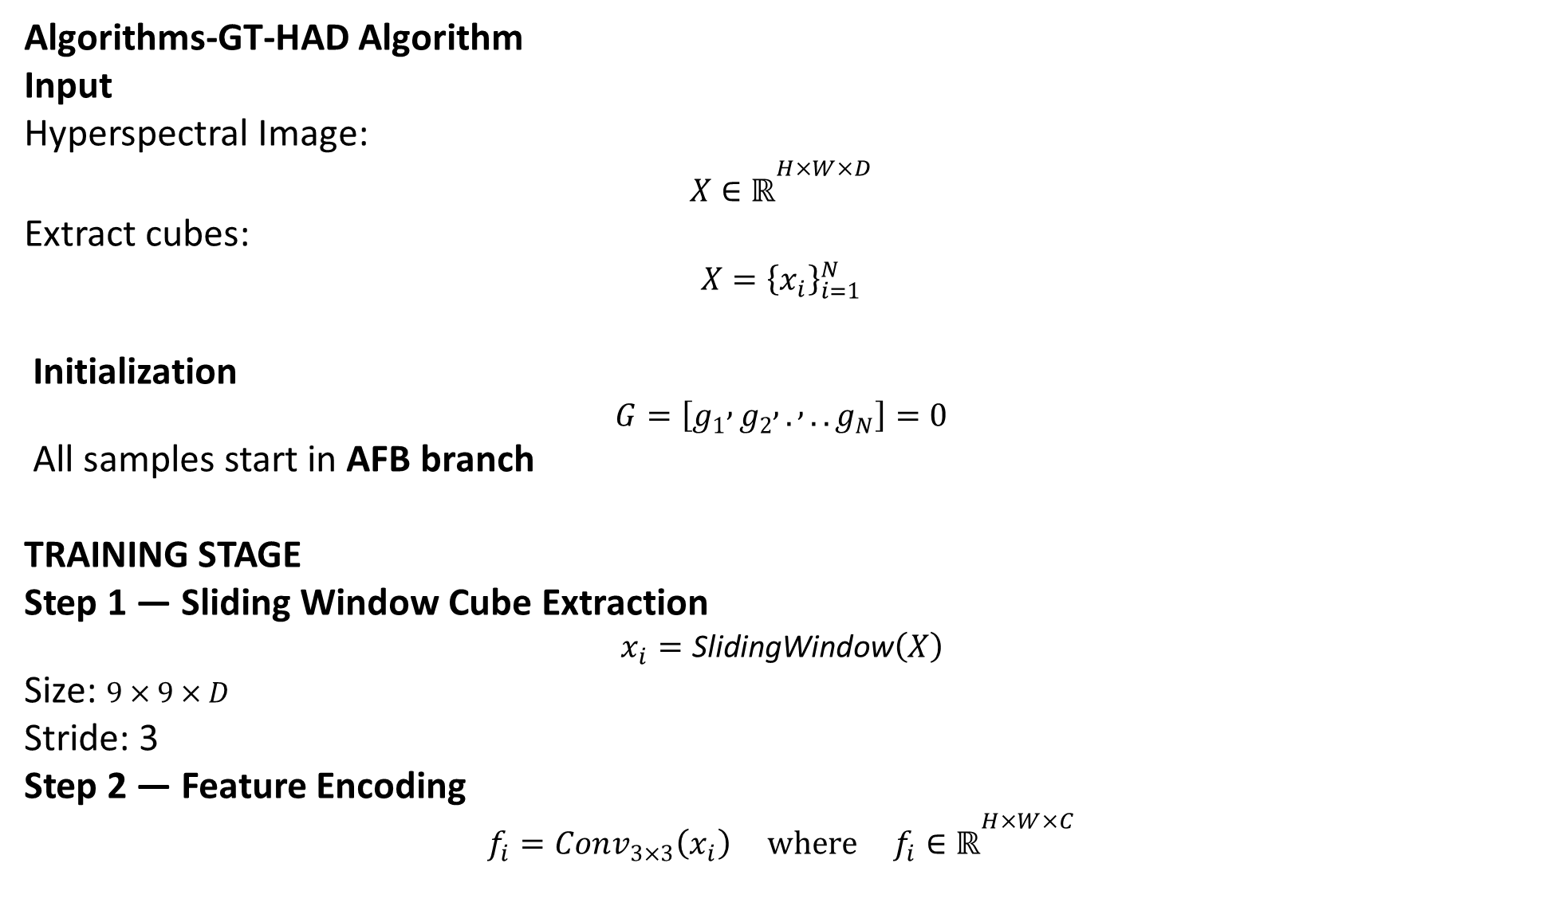
Algorithms-GT-HAD Algorithm Input
Hyperspectral Image:
$$X∈ℝ^{H×W×D}$$
Extract cubes:
$$X={\left\{x_{i}\right\}}_{i=1}^{N}$$
Initialization
$$G=\left[g_{1} , g_{2} , . , ..g_{N}\right]=0$$
All samples start in AFB branch
TRAINING STAGE
Step 1 — Sliding Window Cube Extraction
$$x_{i}=\text{SlidingWindow}\left(X\right)$$
Size: $9×9×D$
Stride: 3
Step 2 — Feature Encoding
$$f_{i}=Conv_{3×3}\left(x_{i}\right) where f_{i}∈ℝ^{H×W×C}$$

Slide 11
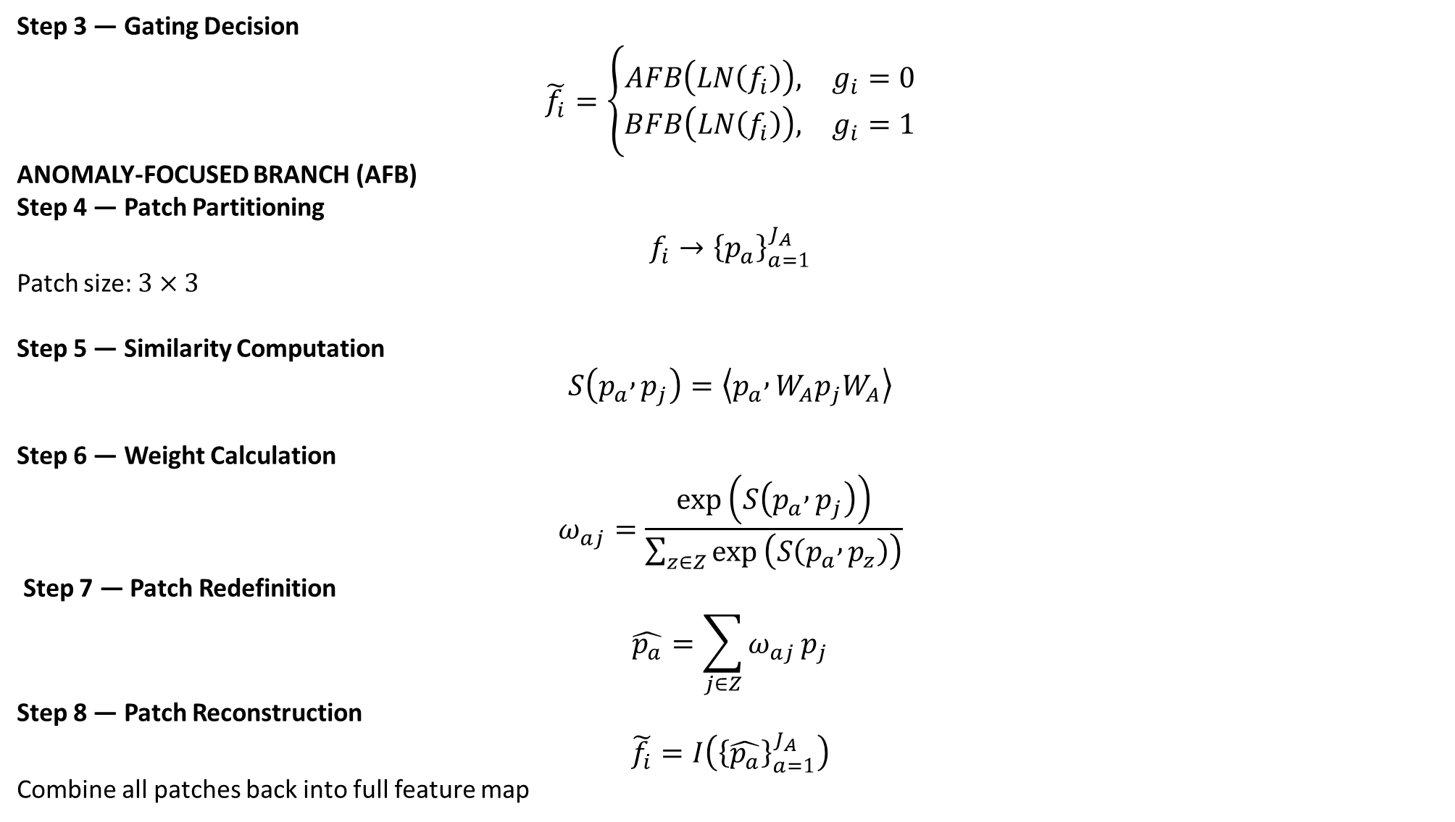
Step 3 — Gating Decision
$$\tilde{f_{i}}=\left\{\begin{matrix}AFB\left(LN\left(f_{i}\right)\right), & g_{i}=0 \\ BFB\left(LN\left(f_{i}\right)\right), & g_{i}=1\end{matrix}\right.$$
ANOMALY-FOCUSED BRANCH (AFB)
Step 4 — Patch Partitioning
$$f_{i}→{\left\{p_{a}\right\}}_{a=1}^{J_{A}}$$
Patch size: $3×3$
Step 5 — Similarity Computation
$$S\left(p_{a} , p_{j}\right)=\left\langle p_{a} , W_{A}p_{j}W_{A}\right\rangle$$
Step 6 — Weight Calculation
$$ω_{aj}=\frac{exp⁡\left(S\left(p_{a} , p_{j}\right)\right)}{\sum_{z∈Z}{exp}⁡\left(S\left(p_{a} , p_{z}\right)\right)}$$
Step 7 — Patch Redefinition
$$\hat{p_{a}}=\sum_{j∈Z}{ω_{aj}}p_{j}$$
Step 8 — Patch Reconstruction
$$\tilde{f_{i}}=I\left({\left\{\hat{p_{a}}\right\}}_{a=1}^{J_{A}}\right)$$
Combine all patches back into full feature map

Slide 12
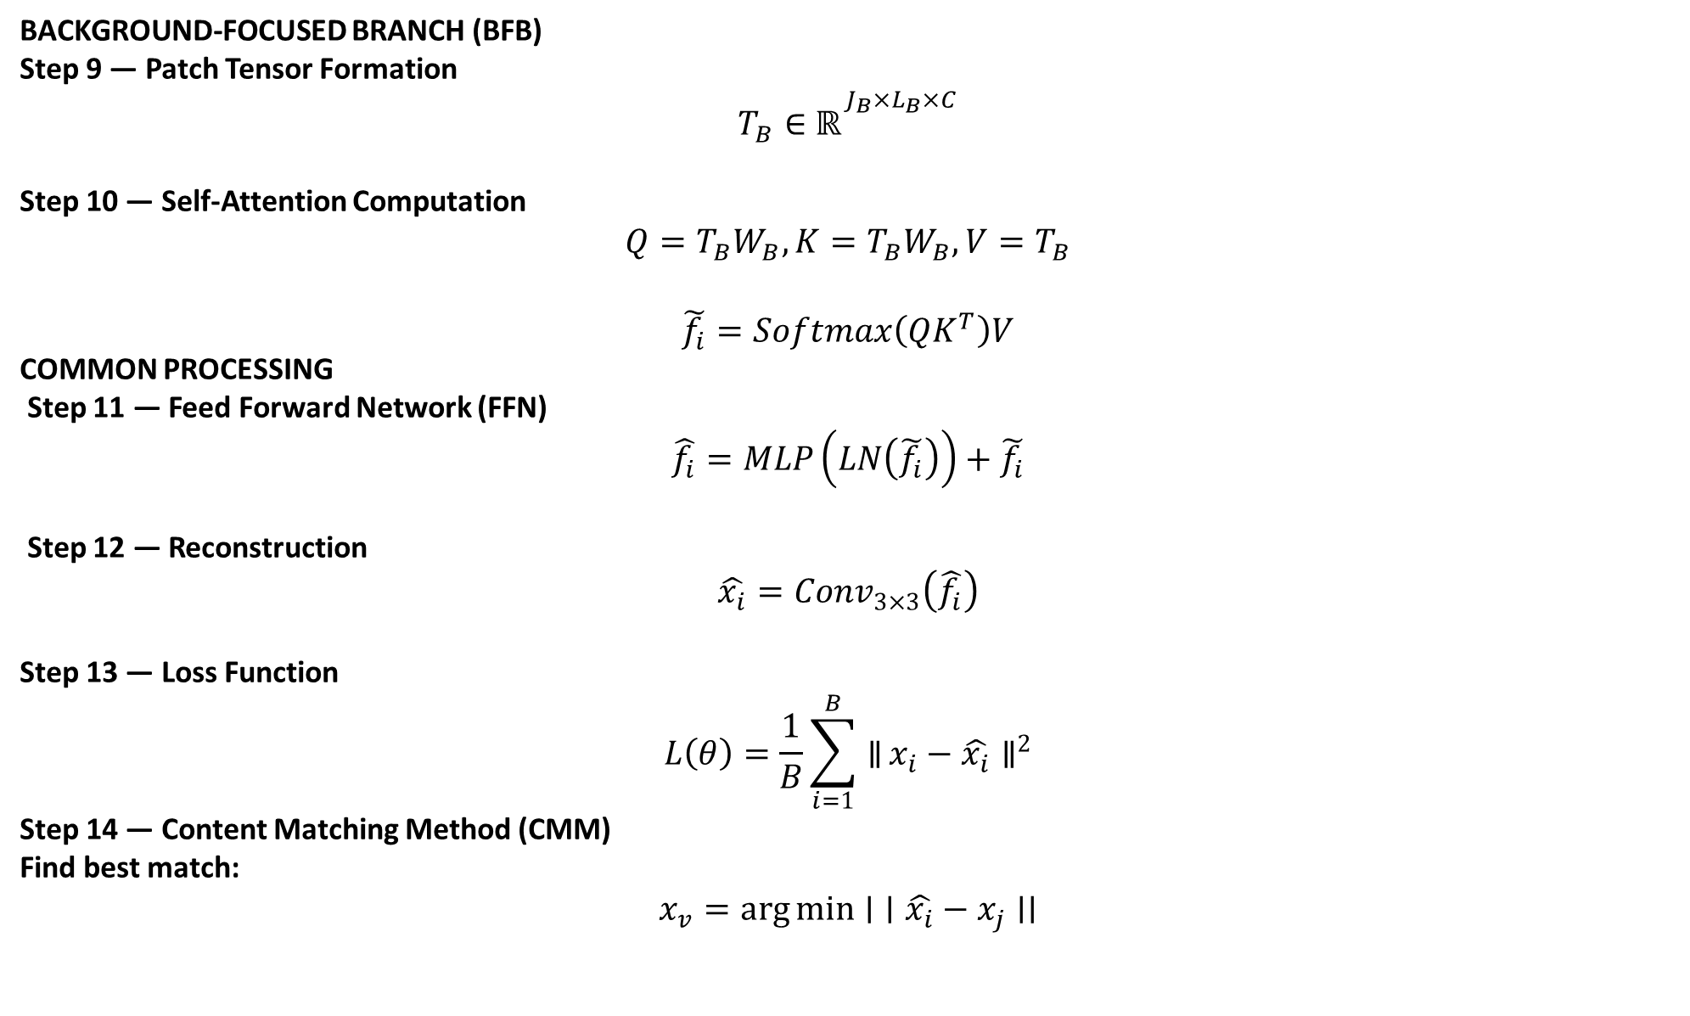
BACKGROUND-FOCUSED BRANCH (BFB)
Step 9 — Patch Tensor Formation
$$T_{B}∈ℝ^{J_{B}×L_{B}×C}$$
Step 10 — Self-Attention Computation
$$Q=T_{B}W_{B}, K=T_{B}W_{B}, V=T_{B}$$
$$\tilde{f_{i}}=Softmax\left(QK^{T}\right)V$$
COMMON PROCESSING
Step 11 — Feed Forward Network (FFN)
$$\hat{f_{i}}=MLP\left(LN\left(\tilde{f_{i}}\right)\right)+\tilde{f_{i}}$$
Step 12 — Reconstruction
$$\hat{x_{i}}=Conv_{3×3}\left(\hat{f_{i}}\right)$$
Step 13 — Loss Function
$$L\left(θ\right)=\frac{1}{B}\sum_{i=1}^{B}{∥}x_{i}−\hat{x_{i}}∥^{2}$$
Step 14 — Content Matching Method (CMM)
Find best match:
$$x_{v}=\arg{min}{∣}∣\hat{x_{i}}−x_{j}∣∣$$

Slide 13

Update gating:
$$g_{i}=\left\{\begin{matrix}1, & v=i \left(\text{background}\right) \\ 0, & v≠i \left(\text{anomaly}\right)\end{matrix}\right.$$
Step 15 — Backpropagation
Update weights
Update gating states
DETECTION STAGE
Step 16 — Residual Computation
$$r_{i}={\left(x_{i}−\hat{x_{i}}\right)}^{2}$$
Step 17 — Residual Map
$$m_{i}=\sum_{bands}{r_{i}}$$
Step 18 — Aggregation
$$M=F\left(\left\{m_{i}\right\}\right)$$
Step 19 — Residual Diffusion
$$e_{i}=AvgPool3D\left(r_{i}\right)$$
FINAL OUTPUT
$$\text{Anomaly} \text{Map} M$$

Slide 14
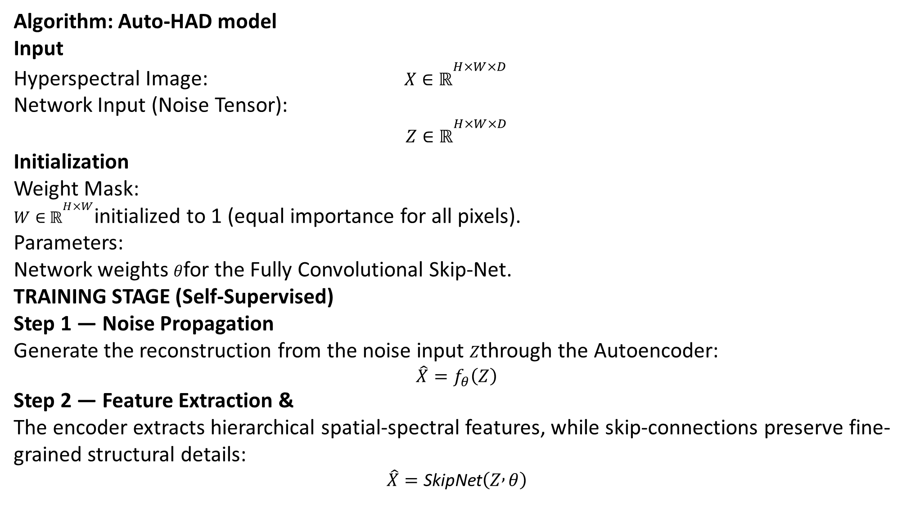
Algorithm: Auto-HAD model
Input
Hyperspectral Image: $X∈ℝ^{H×W×D}$
Network Input (Noise Tensor): $$Z∈ℝ^{H×W×D}$$
Initialization
Weight Mask: $W∈ℝ^{H×W}$initialized to 1 (equal importance for all pixels).
Parameters: Network weights $θ$for the Fully Convolutional Skip-Net.
TRAINING STAGE (Self-Supervised)
Step 1 — Noise Propagation
Generate the reconstruction from the noise input $Z$through the Autoencoder: $$\hat{X}=f_{θ}\left(Z\right)$$
Step 2 — Feature Extraction &
The encoder extracts hierarchical spatial-spectral features, while skip-connections preserve fine-grained structural details: $$\hat{X}=\text{SkipNet}\left(Z , θ\right)$$

Slide 15
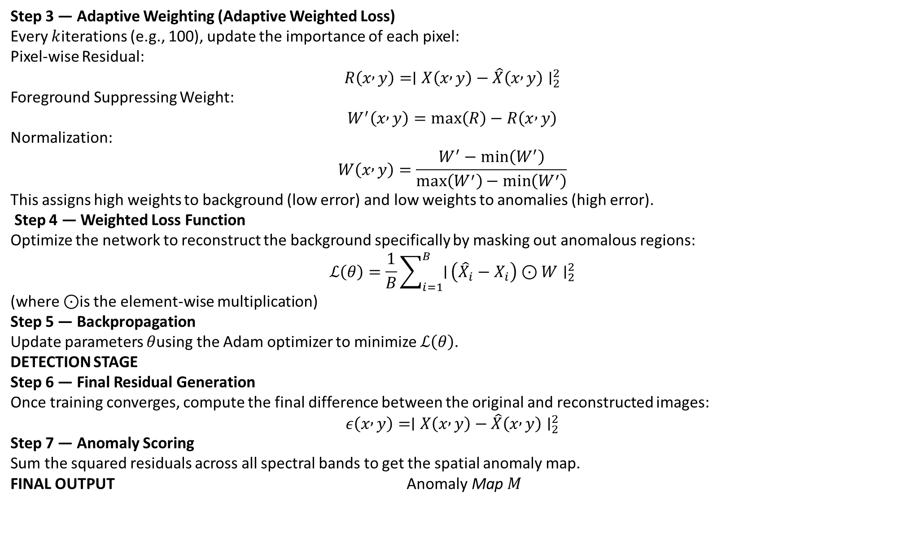
Step 3 — Adaptive Weighting (Adaptive Weighted Loss)
Every $k$iterations (e.g., 100), update the importance of each pixel:
Pixel-wise Residual: $$R\left(x , y\right)=∣X\left(x , y\right)−\hat{X}\left(x , y\right)∣_{2}^{2}$$
Foreground Suppressing Weight: $$W^{′}\left(x , y\right)=max⁡\left(R\right)−R\left(x , y\right)$$
Normalization: $$W\left(x , y\right)=\frac{W^{′}−min⁡\left(W^{′}\right)}{max⁡\left(W^{′}\right)−min⁡\left(W^{′}\right)}$$
This assigns high weights to background (low error) and low weights to anomalies (high error).
Step 4 — Weighted Loss Function
Optimize the network to reconstruct the background specifically by masking out anomalous regions: $$ℒ\left(θ\right)=\frac{1}{B}\sum_{i=1}^{B}{∣}\left({\hat{X}}_{i}−X_{i}\right)⊙W∣_{2}^{2}$$
(where $⊙$is the element-wise multiplication)
Step 5 — Backpropagation
Update parameters $θ$using the Adam optimizer to minimize $ℒ\left(θ\right)$.
DETECTION STAGE
Step 6 — Final Residual Generation
Once training converges, compute the final difference between the original and reconstructed images: $$ε\left(x , y\right)=∣X\left(x , y\right)−\hat{X}\left(x , y\right)∣_{2}^{2}$$
Step 7 — Anomaly Scoring
Sum the squared residuals across all spectral bands to get the spatial anomaly map.
FINAL OUTPUT $\text{Anomaly} \text{Map} M$

Slide 16
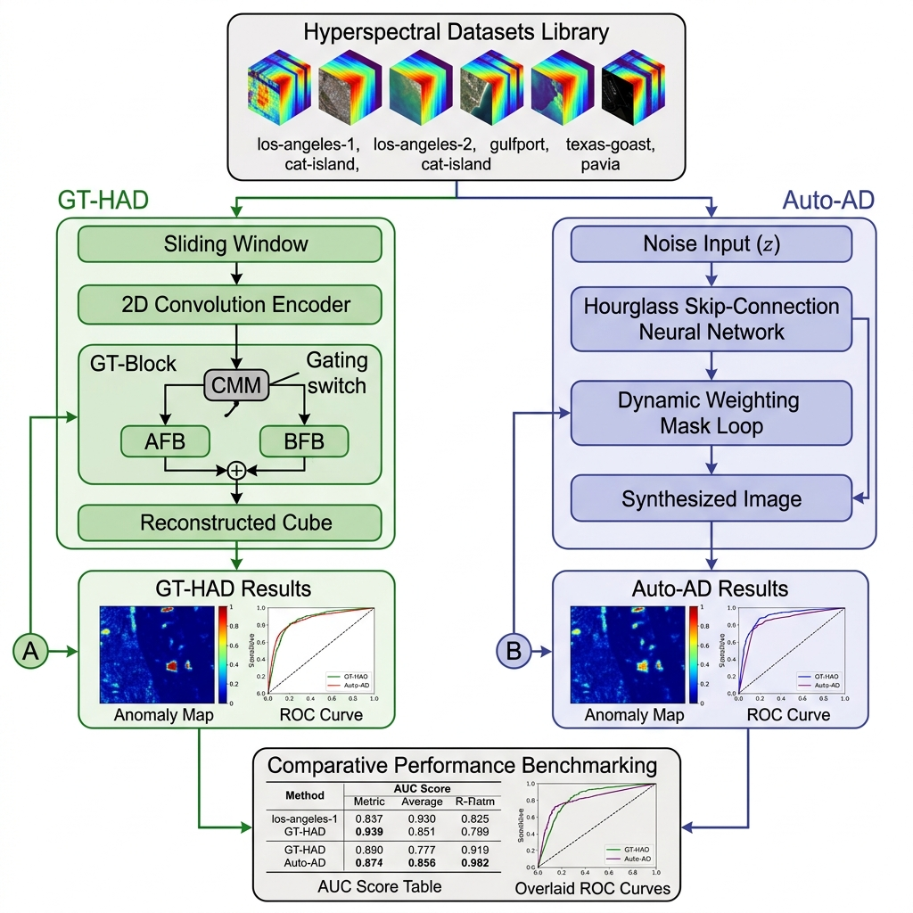
Architecture Diagram

Slide 17
Implementation steps and Execution
Data Preparation:Load hyperspectral datasets (Los Angeles, Pavia, etc.) and normalize pixel values for stable processing.
Prepare inputs for both models:
1. GT-HAD, divide the image into overlapping patches
2. For Auto-HAD, generate a noise tensor of the same size as the image
Process the data using two independent models:
GT-HAD Model: Patches are passed through convolution layers to extract features, followed by transformer blocks to capture spatial relationships. A gating mechanism is used to separate background and anomaly features during processing.
Auto-HAD Model: Noise input is passed through an encoder–decoder (Skip-Net) network, which gradually reconstructs the hyperspectral image while preserving important structural details.

Slide 18
Both models are trained independently to learn background patterns by minimizing reconstruction error.
After training, the reconstructed output is compared with the original image to calculate reconstruction error.
Regions with high reconstruction error are identified as anomalies, while low-error regions correspond to normal background.
Anomaly maps are generated for both GT-HAD and Auto-HAD based on the error values.
Finally, the performance of both models is evaluated and compared using ROC curves and AUC scores across different datasets.

Slide 19
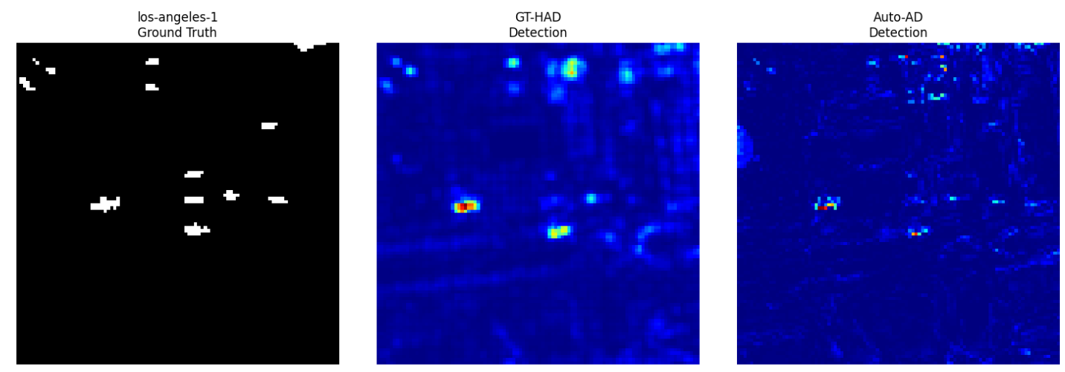
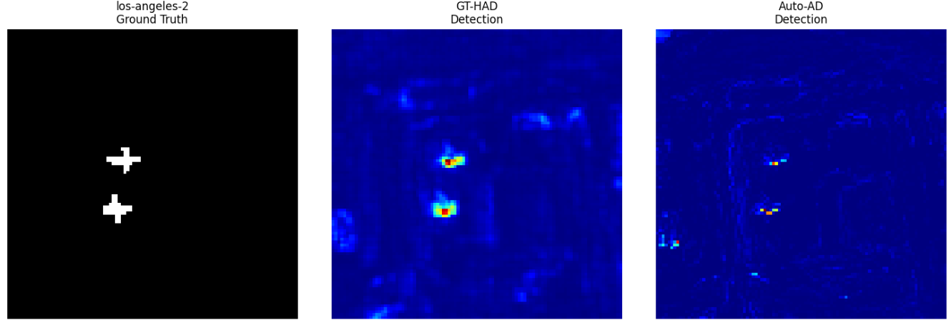
RESULTS: Residual Maps

Slide 20
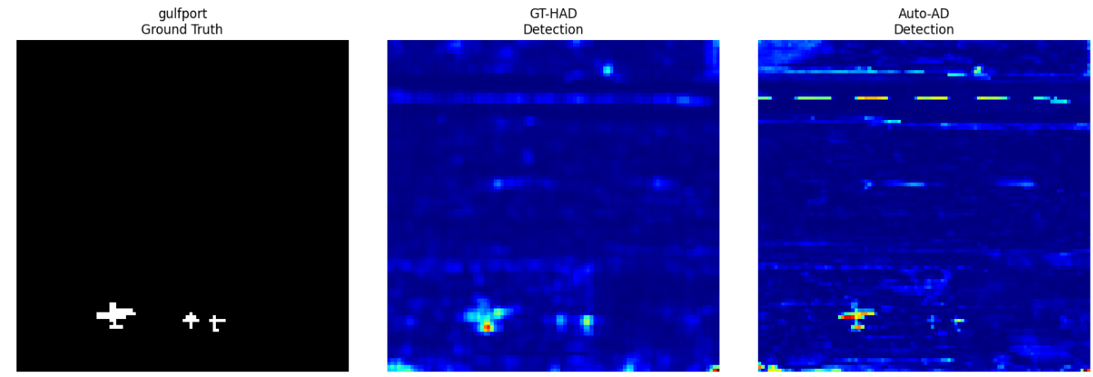
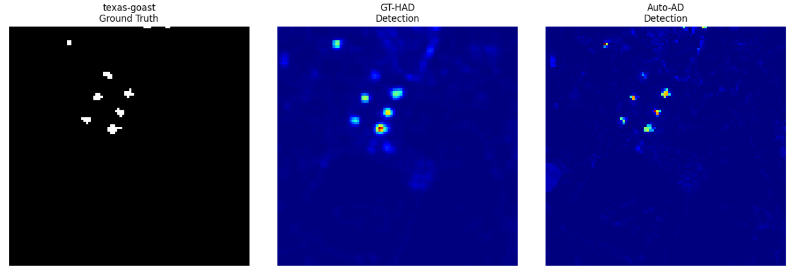

Slide 21
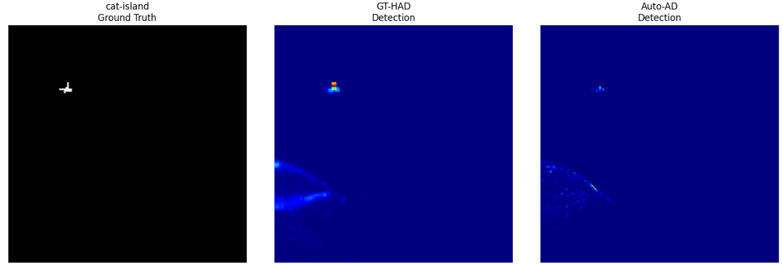
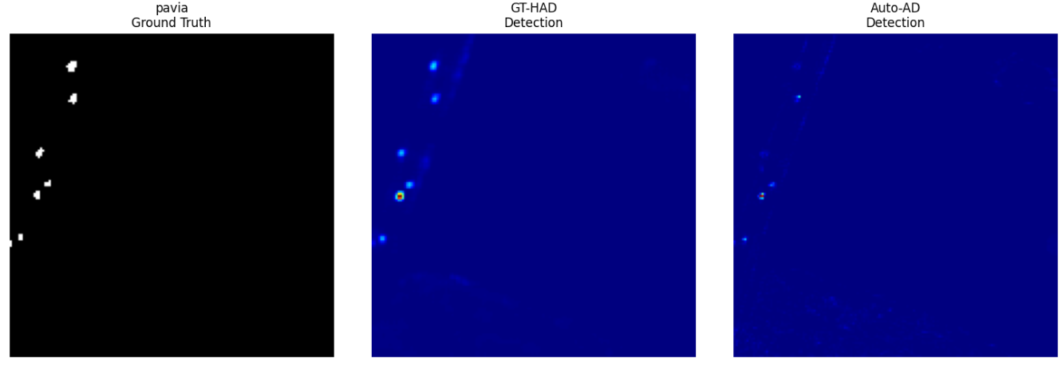

Slide 22
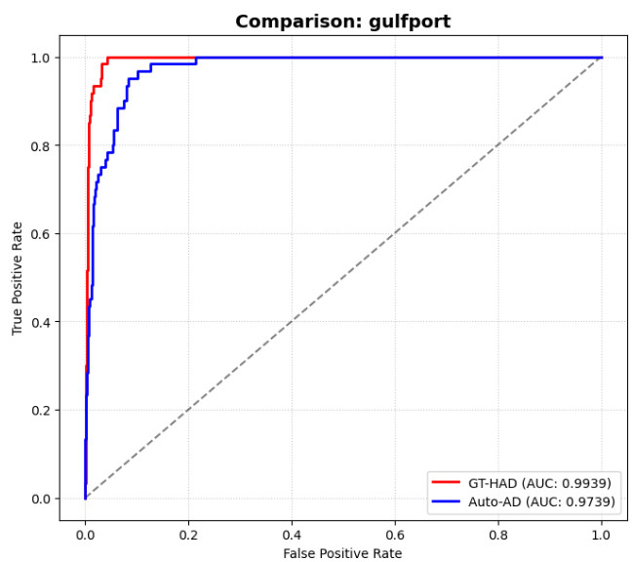
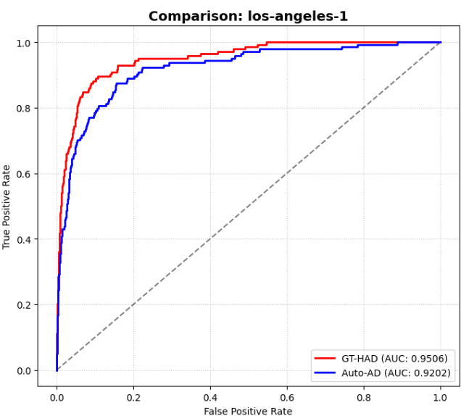
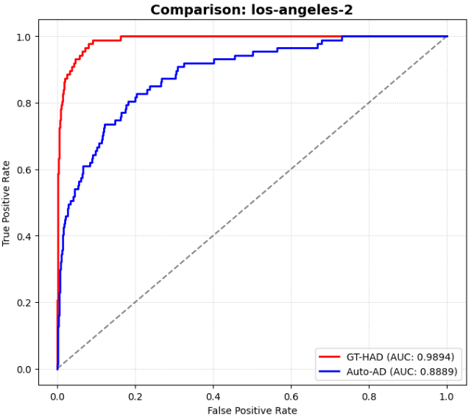
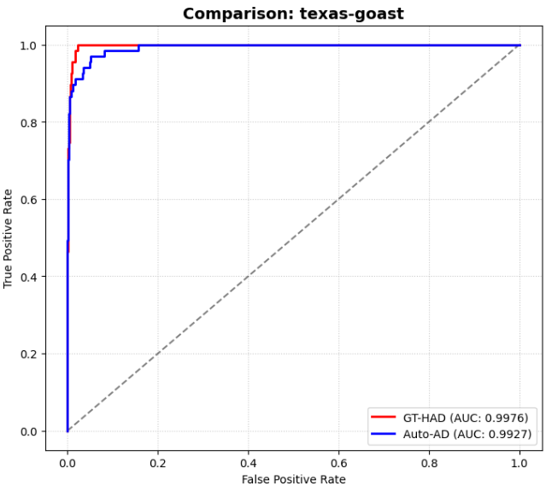
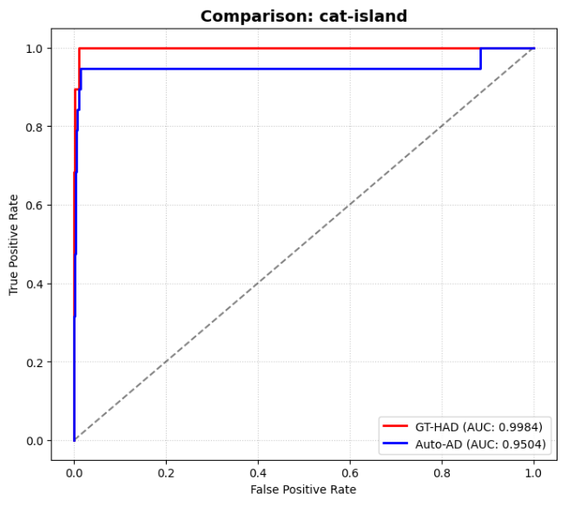
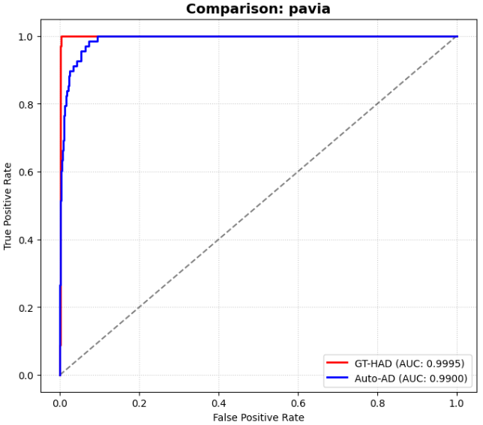
DATASET AOC CURVES

Slide 23
RESULT ANALYSIS AND OBSERVATIONS
Dataset AOC Values
Dataset | GT-HAD AUC | Auto-HAD AUC | Winner
los-angeles-1 | 0.9506 | 0.9202 | GT-HAD
los-angeles-2 | 0.9894 | 0.8889 | GT-HAD
gulfport | 0.9939 | 0.9739 | GT-HAD
texas-goast | 0.9976 | 0.9927 | GT-HAD
cat-island | 0.9984 | 0.9504 | GT-HAD
pavia | 0.9995 | 0.9900 | GT-HAD

Slide 24
Consistent Superiority of GT-HAD: Across all six benchmark datasets, GT-HAD consistently outperforms Auto-HAD, maintaining a 100% win rate in this comparative study.
Near-Perfect Detection Accuracy: GT-HAD achieves exceptional performance on the Pavia (0.9995) and Cat Island (0.9984) datasets, indicating near-perfect separation between high-altitude anomalies and background signatures.
Performance Stability: While Auto-HAD performs competitively (surpassing 0.99 in the Texas Coast dataset), it exhibits more performance variability, such as the dip to 0.8889 in the Los Angeles-2 scene, whereas GT-HAD remains robust.
Dimensionality Management: Both models effectively managed the "curse of dimensionality" inherent in HSI by utilizing deep convolutional layers to compress hundreds of spectral bands into meaningful feature maps, ensuring that critical diagnostic information was preserved while minimizing computational noise.
Effective Spectral-Spatial Fusion: GT-HAD’s patch-based processing successfully captured the complex spectral-spatial correlations within the HSI cubes, allowing the model to distinguish subtle aircraft signatures from highly similar atmospheric and terrestrial background pixels.

Slide 25
Conclusion
The GT-HAD model effectively resolved the "pixel mixing" challenge at high altitudes by using a dual-branch system to separate anomalous targets from complex backgrounds.
The Auto-HAD framework demonstrated superior performance in background reconstruction through its Adaptive Weighted Loss, eliminating the need for prior ground-truth or labeled data.
Future Work
Multi-Sensor Data Fusion: Incorporate and fuse hyperspectral data with SAR (Synthetic Aperture Radar) or thermal imaging to enable detection through clouds, smoke, or night-time conditions.
Explainable AI (XAI) in HAD: Develop visualization modules to interpret why a specific pixel was flagged as an anomaly, identifying which specific spectral bands contributed most to the detection.

Slide 26
References
[1] J. Xiang, T. Wang, P. Wang, C. Chen, N. Wang, J. Cao, and Q. Wang, “Synergistic Kolmogorov–Arnold Networks and Fidelity-Gated Transformer for Hyperspectral Anomaly Detection,” Remote Sens., vol. 17, Art. no. 3981, 2025, doi: 10.3390/rs17033981.
[2] J. Zhang, P. Xiang, X. Teng, D. Zhao, H. Li, J. Song, H. Zhou, and W. Tan, “Enhancing hyperspectral anomaly detection with a novel differential network approach for precision and robust background suppression,” Remote Sens., vol. 16, no. 3, Art. no. 434, 2024, doi: 10.3390/rs16030434.
[3] Q. Guo, Y. Cen, L. Zhang, Y. Zhang, S. Hu, and X. Liu, “Robust multi-stage progressive autoencoder for hyperspectral anomaly detection,” Int. J. Appl. Earth Obs. Geoinf., vol. 134, Art. no. 104200, 2024. idhi correct one
[4]S. Chen, X. Li, and Y. Yan, “Hyperspectral anomaly detection with auto-encoder and independent target,” Remote Sensing, vol. 15, no. 22, p. 5266, 2023.
[5] Z. Wu and B. Wang, “Background Reconstruction via 3D-Transformer Network for Hyperspectral Anomaly Detection,” Remote Sens., vol. 15, Art. no. 4592, 2023, doi: 10.3390/rs15194592.
[6] S. Sun, J. Liu, Z. Zhang, and W. Li, “Hyperspectral anomaly detection based on adaptive low-rank transformed tensor,” IEEE Trans. Neural Netw. Learn. Syst., early access, Jan. 24, 2023, doi: 10.1109/TNNLS.2023.3236641.
[7] L. Gao, D. Wang, L. Zhuang, X. Sun, M. Huang, and A. Plaza, “BS³LNet: A new blind-spot self-supervised learning network for hyperspectral anomaly detection,” IEEE Trans. Geosci. Remote Sens., vol. 61, 2023, Art. no. 5504218.

Slide 27
[8] A. Pant et al., “Hyperspectral Anomaly Detection Methods: A Survey and Comparative Study,” arXiv preprint, arXiv:2507.05730, 2025.
[9] Y. Liu et al., “Hyperspectral Anomaly Detection with Self-Supervised Anomaly Prior,” arXiv preprint, arXiv:2404.13342, 2024.
[10] M. Wang et al., “Learning tensor low-rank representation for hyperspectral anomaly detection,” IEEE Trans. Cybernetics, vol. 53, no. 1, pp. 679–691, Jan. 2023.
[11] B. Tu et al., “Hyperspectral anomaly detection using reconstruction fusion of quaternion frequency domain analysis,” IEEE Trans. Neural Netw. Learn. Syst., 2023, doi: 10.1109/TNNLS.2022.322716
[12] Y. Ma, S. Cai, and J. Zhou, “Adaptive reference-related graph embedding for hyperspectral anomaly detection,” IEEE Trans. Geosci. Remote Sens., vol. 61, Art. no. 5504514, 2023.
[13] L. Li et al., “Prior-based tensor approximation for anomaly detection in hyperspectral imagery,” IEEE Trans. Neural Netw. Learn. Syst., vol. 33, no. 3, pp. 1037–1050, Mar. 2022.
[14] J. Liu et al., “Multipixel anomaly detection with unknown patterns for hyperspectral imagery,” IEEE Trans. Neural Netw. Learn. Syst., vol. 33, no. 10, pp. 5557–5567, Oct. 2022.
[15] H. Chen, G. Yang, and H. Zhang, “Hider: A hyperspectral image denoising transformer with spatial–spectral constraints,” IEEE Trans. Neural Netw. Learn. Syst., 2022.
[16] L. Fang et al., “Context enhancing representation for semantic segmentation in remote sensing images,” IEEE Trans. Neural Netw. Learn. Syst., 2022.

