Slide 1

ANALYSIS OF EXTREME TEMPERATURES IN PARIS
Period: 1995–2019
Prepared By
Zainab Shokunbi
Chidiebere Nnadiegbulam

Slide 2


Introduction
Environmental issue: Extreme heat and unusually high temperatures in urban environments – Paris
Variable: Daily average air temperature (°C).
Study period: 1995–2019 (25 years).
Temporal resolution: Daily observations.
Dataset: 9,072 temperature records, with no missing temperature values reported.

Slide 3
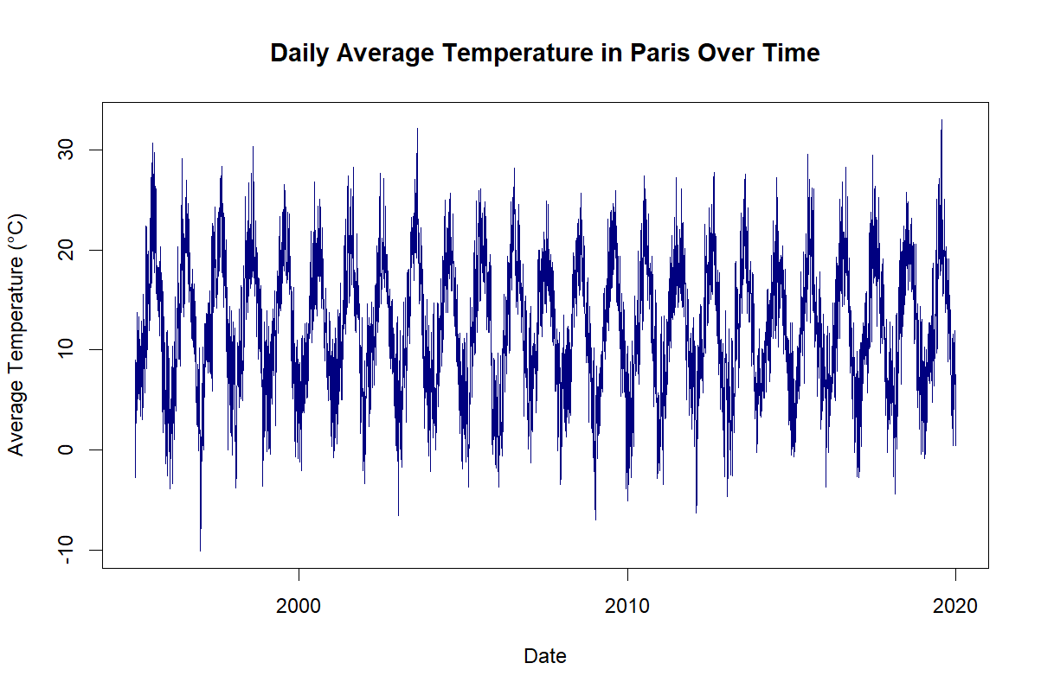
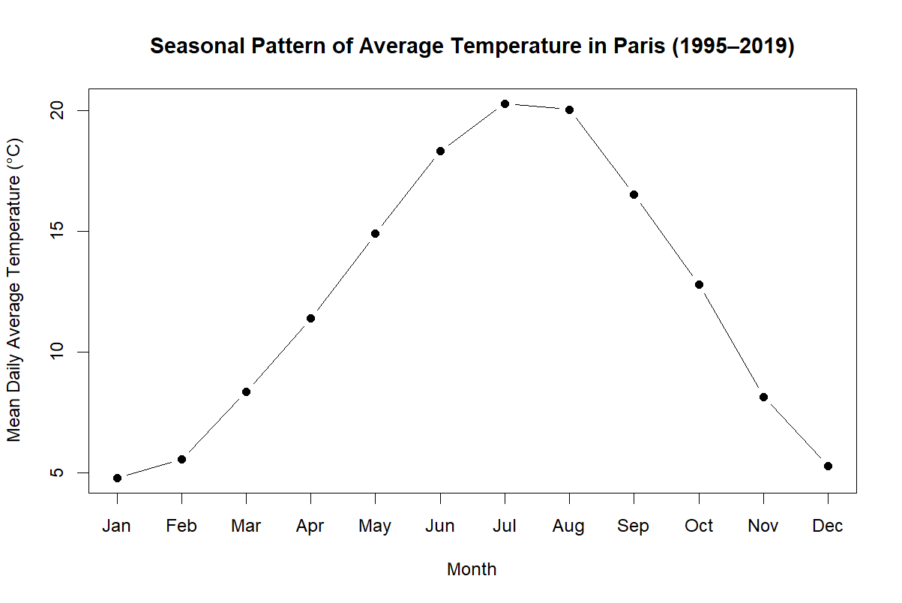
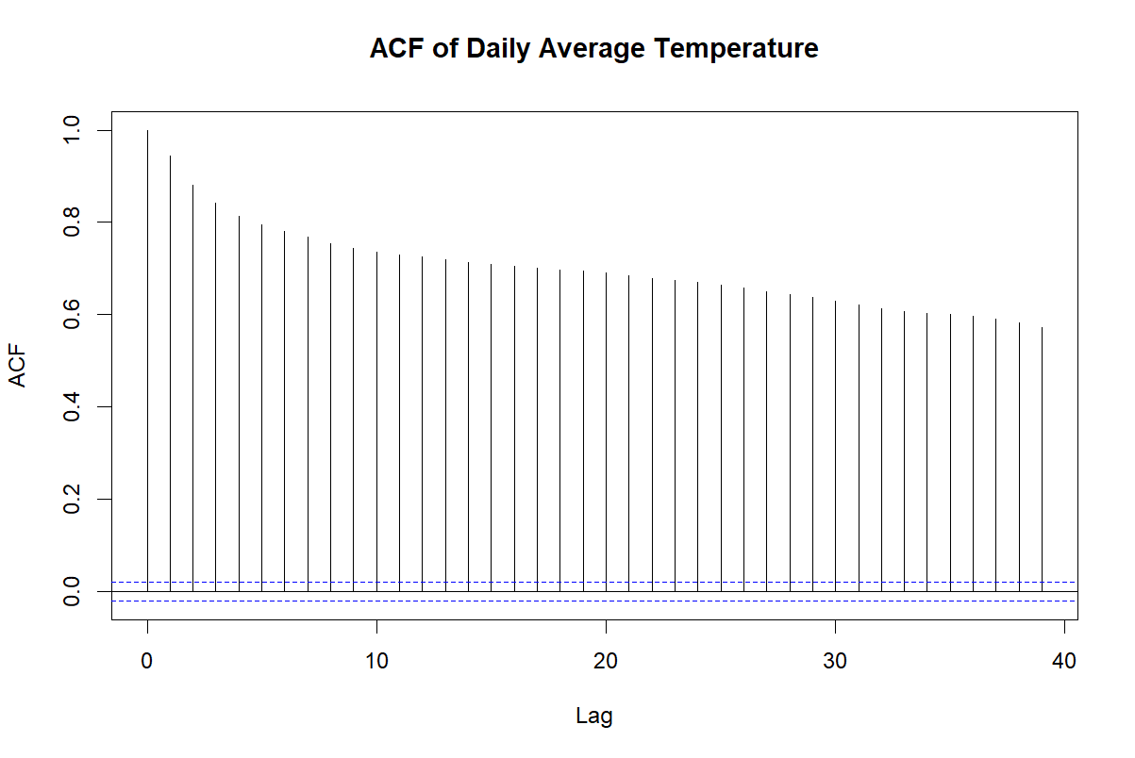
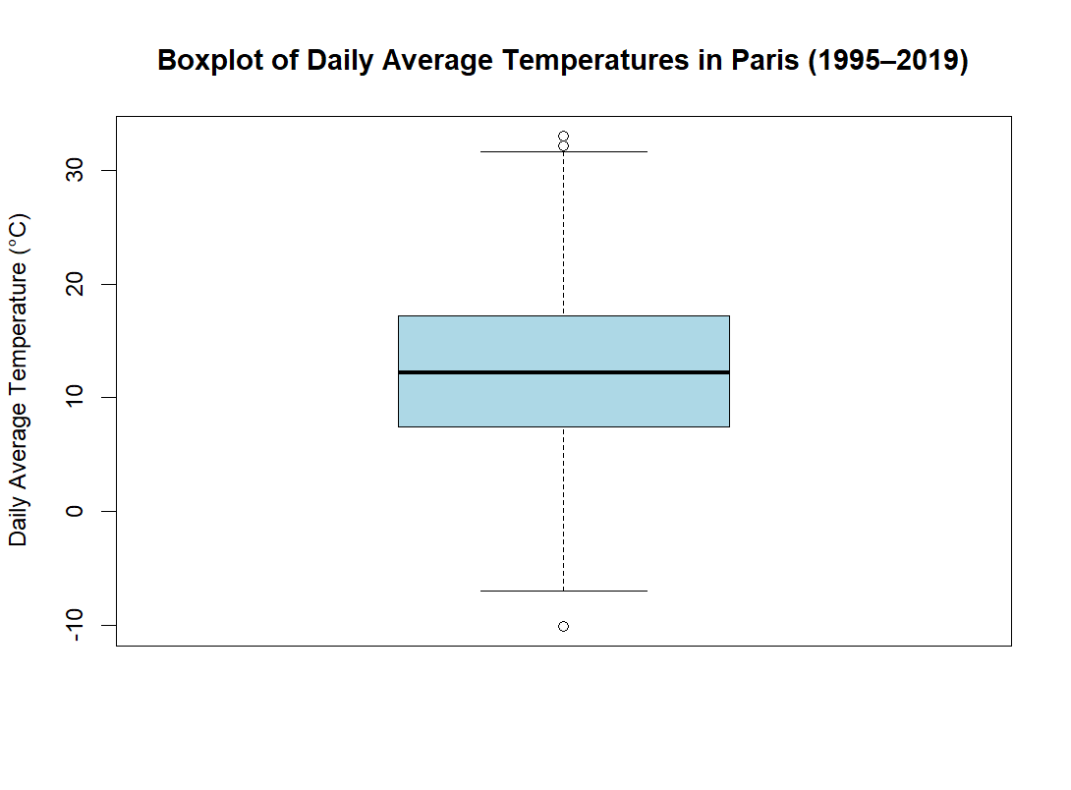
Exploratory Analysis
Daily temperature time series
Seasonal patterns and temporal variability
Autocorrelation between daily observations
Outliers
Notes:
What the graph shows
This graph displays the daily average temperature in Paris from 1995 to 2019.
Each point represents one day.
What we observe
Temperatures rise and fall in a regular cycle every year.
Warm temperatures occur in summer.
Cold temperatures occur in winter.
There is no obvious missing period in the data.
What this tells us
The data has a strong seasonal pattern.
Temperature is not random throughout the year.
We must take this seasonality into account before studying extremes.
What the graph shows
This graph gives the average temperature for each month across the whole period.
What we observe
January and December are the coldest months.
Temperatures increase gradually from spring into summer.
July and August are the warmest months.
Temperatures then decrease again during autumn.
What this tells us
Paris has a clear yearly temperature cycle.
The pattern is exactly what we expect from a temperate climate.
This confirms the seasonality that we saw in the time series plot.
3. Autocorrelation Function (bottom left)
This is probably the slide your teacher will ask about.
Simple explanation
Autocorrelation measures whether today's temperature is related to temperatures from previous days.
What we observe
The bars are very high at the beginning.
They decrease slowly as the lag increases.
What this means
If today is warm, tomorrow is likely to be warm too.
If today is cold, tomorrow is likely to be cold too.
Temperatures occur in runs rather than changing completely every day.
4. Boxplot (bottom right)
What the graph shows
The overall distribution of daily temperatures.
What we observe
Most temperatures lie in the middle range.
A few observations are unusually high or unusually low.
These appear as points outside the whiskers.

Slide 4
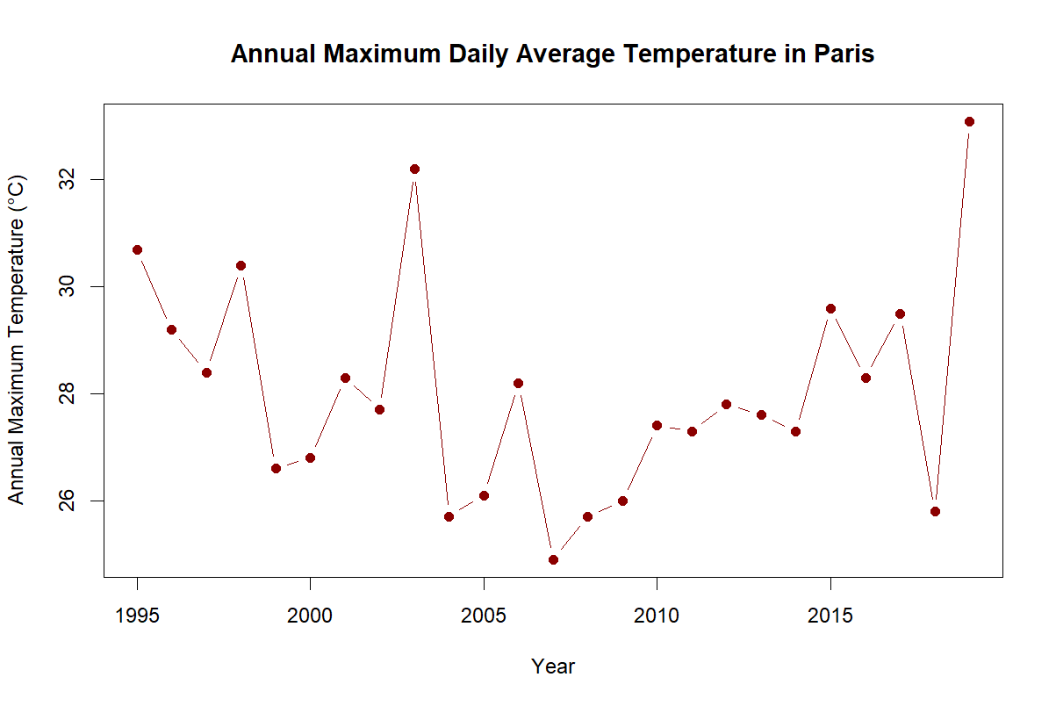
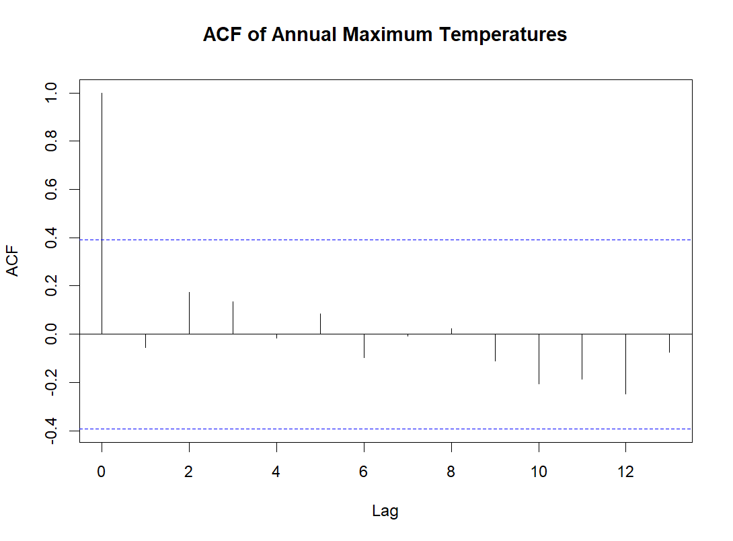
Reduction of Temporal Dependency
Annual maximum temperatures
Autocorrelation of Annual Maxima
All lags from 2 to 13 lies within the blue dashed 95% confidence limit
This suggests no clear dependence on the temperature values
Annual Box Maxima Method
25 Annual Maxima was produced
Annual values from 25 to 33-degree celcius
Notes:
What we observe
Annual maximum temperatures vary from year to year.
Some years are hotter than others.
The values generally fall between about 25°C and 33°C.
Why we did this
"Using annual maxima reduces the dependence that existed in the daily temperature series."
Instead of 9000 highly dependent observations, we now have 25 yearly extreme observations.
What we observe
Almost all bars stay inside the blue significance limits.
No strong pattern is visible.
What this means
One year's maximum temperature is not strongly related to the previous year's maximum temperature.
The dependence seen in the daily data has been greatly reduced.
Conclusion
"After extracting annual maxima, temporal dependence becomes much weaker. Therefore the annual maxima are more suitable for Extreme Value Analysis."

Slide 5
Block Maxima
The shape parameter is essentially zero, suggesting that annual temperature extremes follow a Gumbel-type behaviour.
Very predictable behaviour.
Do not increase at a very fast rate.
Parameter Estimate and Confidence Interval
Parameter | Estimate | Standard_Error | Lower_95_CI | Upper_95_CI
Location (mu) | 27.099791022 | 0.3672186 | 26.3800425 | 27.8195395
Scale (sigma) | 1.593513411 | 0.2713159 | 1.0617343 | 2.1252925
Shape (gamma) | -0.002410794 | 0.1734038 | -0.3422822 | 0.3374606
Notes:
Parameter Table
Your teacher will likely ask what these numbers mean.
Location parameter (μ = 27.10)
Simple explanation:
"The location parameter represents the typical level of annual maximum temperatures."
So:
Typical annual extreme temperature is around 27°C.
Scale parameter (σ = 1.59)
Simple explanation:
"The scale parameter measures how much annual maxima vary from year to year."
So:
Annual maxima are usually within a few degrees of the average extreme level.
Shape parameter (γ ≈ -0.002)
This is the important one.
Simple explanation:
"The shape parameter tells us about the behaviour of very extreme temperatures."
What we found:
γ is very close to zero.
Its confidence interval contains zero.
Interpretation
"The data does not provide strong evidence that the shape parameter differs from zero."
For a presentation, keep it simple:
"The shape parameter is essentially zero, suggesting that annual temperature extremes follow a Gumbel-type behaviour."

Slide 6
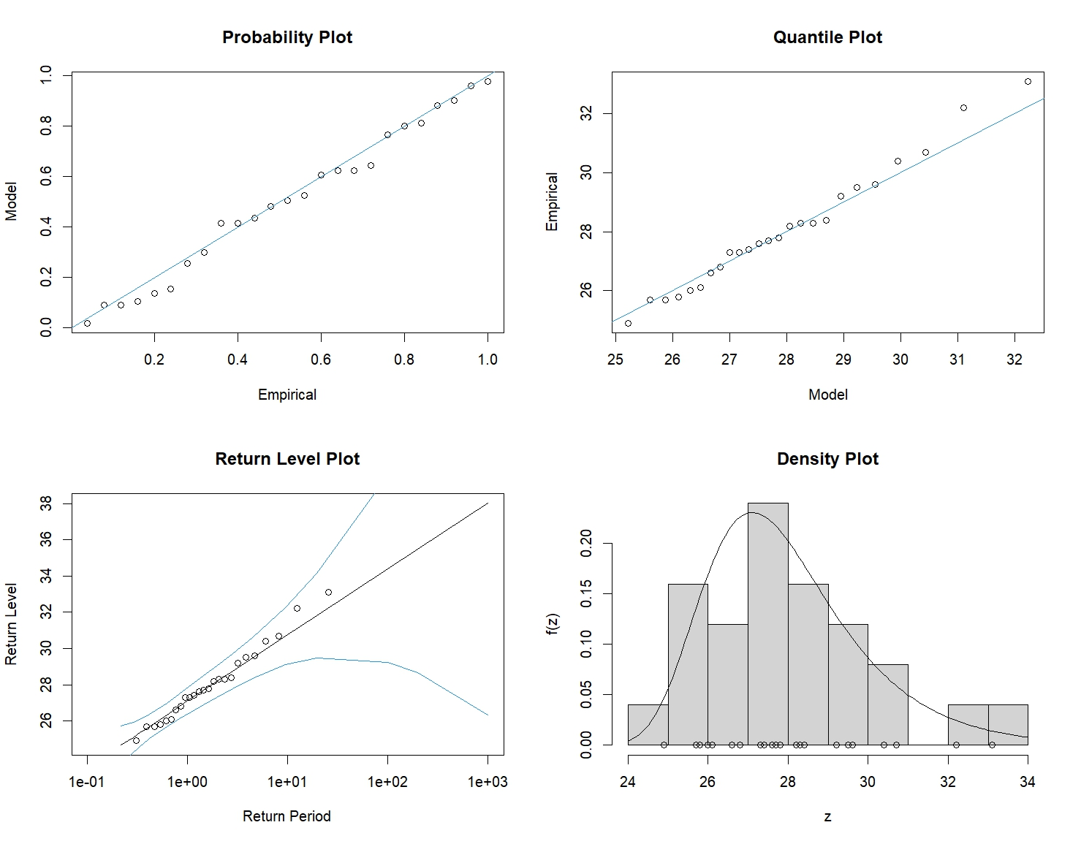
Block Maxima – Diagnostic Analysis
Notes:
1. Probability Plot (top left)
What it shows
It compares:
observed annual maxima
values expected from the fitted GEV model
What we observe
Most points lie close to the diagonal line.
Interpretation
"The points follow the reference line reasonably well, suggesting that the GEV model provides an acceptable fit to the annual maxima."
2. Quantile Plot (top right)
What it shows
Another way of comparing:
observed values
fitted GEV values
What we observe
Most observations are close to the fitted line.
Only the largest observations show slight departures.
Interpretation
"The quantile plot indicates that the fitted model captures most of the annual maxima reasonably well, although small deviations are visible for the largest extremes.“
3. Return Level Plot (bottom left)
What it shows
This plot estimates future extreme temperatures associated with different return periods.
What we observe
The points generally follow the model line.
The uncertainty bands become wider for larger return periods.
Interpretation
"The model fits the observed return levels reasonably well. However, uncertainty increases substantially for very long return periods.“
4. Density Plot (bottom right)
What it shows
The histogram of annual maxima together with the fitted GEV distribution.
What we observe
The fitted curve follows the general shape of the observed data.
Interpretation
"The fitted GEV distribution captures the overall distribution of annual maximum temperatures reasonably well."

Slide 7
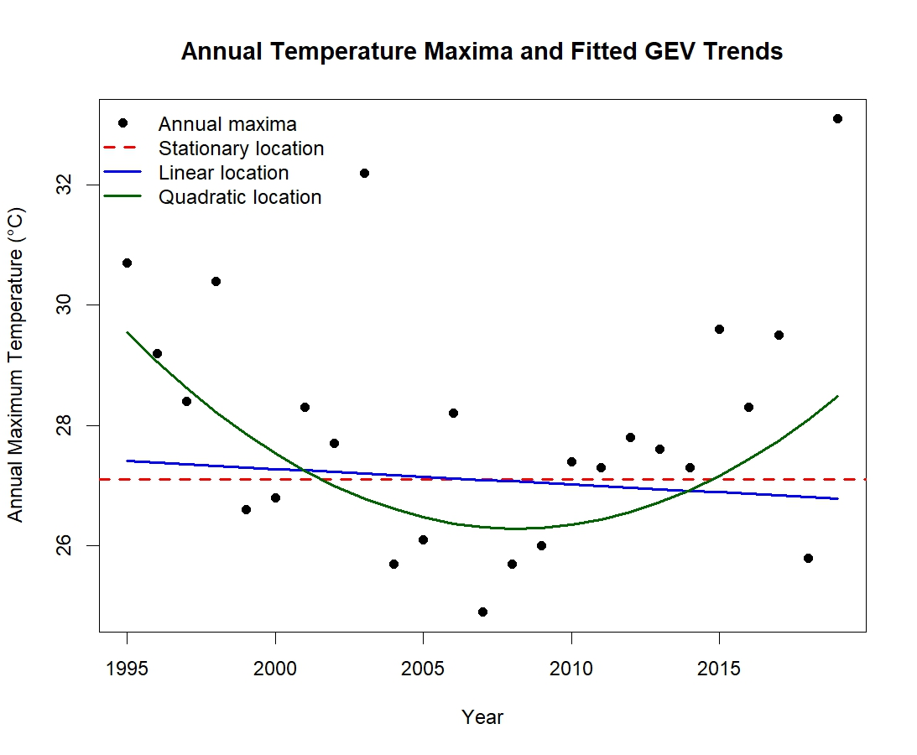
Block Maxima – Non – Stationary models
Model Parameters | Parameters | AIC
Quadratic GEV | 5 | 104.7288
Stationary GEV | 3 | 108.3451
Linear GEV | 4 | 110.1437
The quadratic model provides the best fit because it has the lowest AIC value.
This suggests that allowing a curved trend over time better describes the annual maximum temperatures.

Slide 8
Block Maxima – Analysis of Shape Parameter
Analysis of Shape Parameter
Parameter | Estimate | Standard_Error | z_statistic | P_Value
Shape (Gamma) | -0.002410794 | 0.173403780 | -0.013902775 | 0.988907547
The estimated gamma value is -0.002410794, which is very close to zero.
This suggests that the fitted GEV distribution is close to the Gumbel case.
The p-value is 0.988907547, which is greater than 0.05.
Therefore, we do not reject the null hypothesis.
This means that our analysis does not provide sufficient evidence that the shape parameter differs from zero.

Slide 9
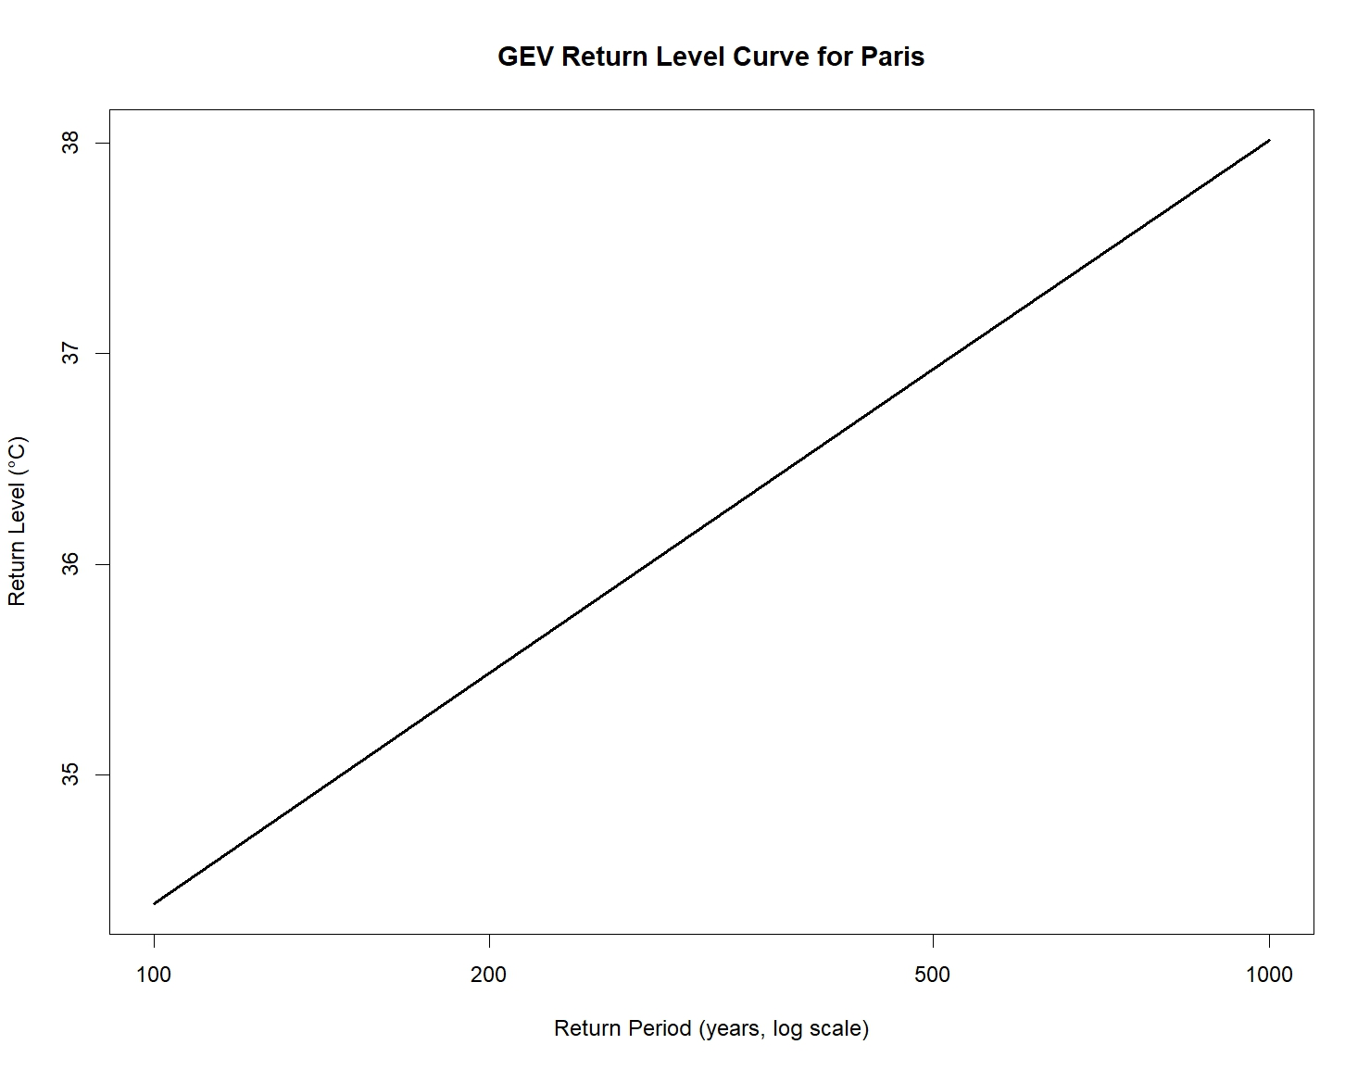
Block Maxima – Return Level
GEV Return Table
Return Period | Years | Return Level
1 | 100 | 34.39
2 | 200 | 35.49
3 | 500 | 36.93
4 | 1000 | 38.02
100-year return level: annual exceedance probability of approximately 1%
200-year return level: annual exceedance probability of approximately 0.5%
500-year return level: annual exceedance probability of approximately 0.2%
1000-year return level: annual exceedance probability of approximately 0.1%
Notes:
A return level is the temperature that is expected to be exceeded, on average, once in a given number of years."
Very important:
This does not mean it will occur exactly once every 100 years.
It means:
"It has a very small probability of occurring in any given year."

Slide 10
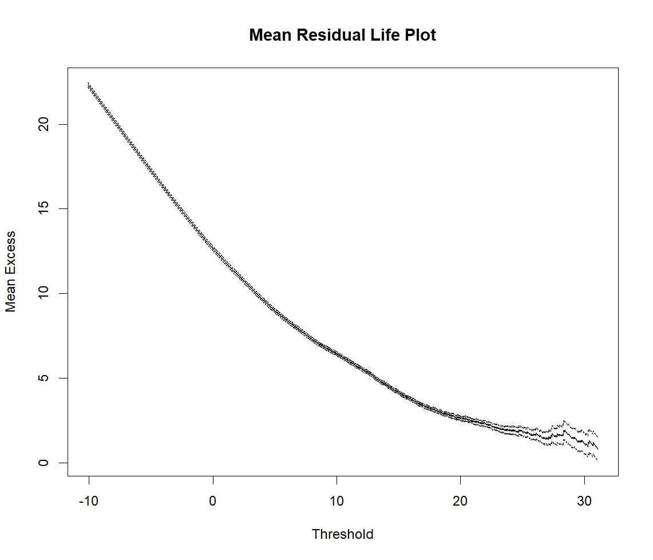
POT Method – Threshold Selection
Between 20 and 23°C
The plot appears reasonably stable.
Results
Selected Threshold | 22.65°C
Number of exceedances | 454
Proportion exceeding the threshold | 5%
23
Notes:
The POT method only analyses temperatures above a high threshold.
Therefore, we must first choose an appropriate threshold.
What does it show?
The plot helps identify a threshold above which the GPD model is likely to work well.
What we observe
Around:
22.645°C
the plot appears reasonably stable.
This is why you selected:
u = 22.645°C
The Mean Residual Life plot was used to help identify a suitable threshold for the POT analysis. A threshold of 22.645°C was selected because it provides a reasonable balance between model validity and sample size.

Slide 11
GPD distribution – Sigma & Gamma Estimation
Parameter Estimate and Confidence Interval
Parameter | Estimate | Standard_Error | Lower_95_CI | Upper_95_CI
Scale (sigma) | 2.4510336 | 0.14997664 | 2.1570794 | 2.74498785
Shape (gamma) | -0.1545222 | 0.03992059 | -0.2327665 | -0.07627784
Notes:
What is this slide doing?
"This slide presents the estimated parameters of the Generalized Pareto Distribution (GPD), together with their confidence intervals."
Scale Parameter (σ)
Estimate
σ = 2.45
What does it mean?
Don't use technical terms.
Say:
"The scale parameter measures how much the temperatures above the threshold vary."
Interpretation
"A value of 2.45 suggests that temperatures above the threshold show a moderate amount of variability."
Shape Parameter (γ)
Estimate
γ = -0.1545
What does it mean?
This is the most important number.
The shape parameter tells us about very extreme temperatures.
Because the estimate is negative:
"The negative shape parameter suggests there may be an upper limit to how large extreme temperatures can become."
Confidence Interval
Shape parameter CI:
Lower = -0.233
Upper = -0.076
Important observation:
Zero is not inside the interval.
Interpretation
"Because the confidence interval does not contain zero, the shape parameter appears to be significantly different from zero."
Presentation Conclusion
"The GPD model estimates a scale parameter of 2.45 and a shape parameter of -0.154. The confidence interval for the shape parameter does not include zero, suggesting evidence of a bounded upper tail.

Slide 12
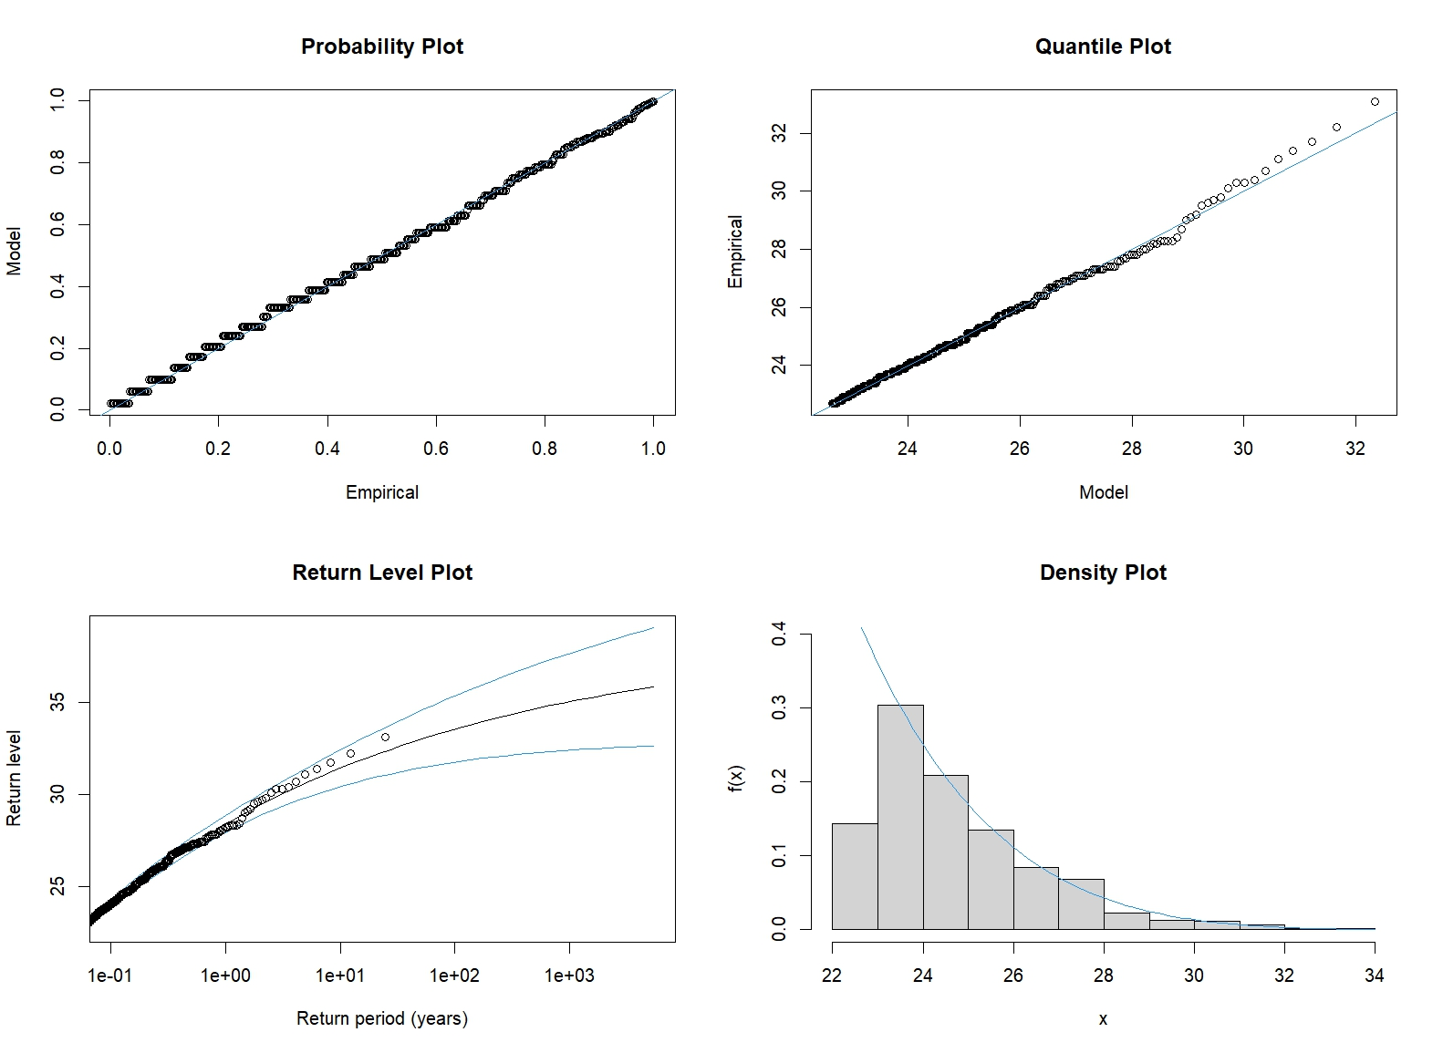
GPD distribution – Diagnostic Analysis
Notes:
. Probability Plot (top left)
What we observe
Most points lie almost exactly on the diagonal line.
Interpretation
"The probability plot shows excellent agreement between the observed exceedances and the fitted GPD model."
2. Quantile Plot (top right)
What we observe
The points closely follow the reference line.
Only the most extreme values show small departures.
Interpretation
"The quantile plot indicates that the fitted GPD distribution describes the exceedances very well."
3. Return Level Plot (bottom left)
What we observe
The points generally follow the fitted curve.
The confidence bands widen as we move to larger return periods.
Interpretation
"The model fits the observed return levels well. However, uncertainty increases for very long return periods."
Why?
You can say:
"Very extreme events are rare, so there is naturally more uncertainty when predicting 500-year or 1000-year events."
4. Density Plot (bottom right)
What we observe
The fitted curve follows the shape of the histogram reasonably well.
Interpretation
"The fitted GPD distribution captures the overall pattern of the threshold exceedances."
Overall Conclusion for the Diagnostic Slide
This is probably the sentence you should say:
"All four diagnostic plots suggest that the GPD model provides a satisfactory description of temperatures exceeding the selected threshold."
That sentence alone answers your teacher's requirement.
Very Short Presentation Version
Slide 10
"The fitted GPD model produced a scale estimate of 2.45 and a shape estimate of -0.154. The confidence interval for the shape parameter does not include zero, suggesting evidence of a bounded upper tail."
Slide 11
"The shape parameter test produced a p-value of 0.00011, which is less than 0.05. Therefore, we reject the null hypothesis and conclude that the shape parameter differs significantly from zero. This result differs from the GEV analysis, likely because the POT approach uses many more extreme observations."
Slide 12
"The diagnostic plots indicate that the GPD model fits the exceedances well. Most points follow the reference lines closely, and the fitted distribution captures the overall shape of the observed data. The uncertainty becomes larger for very long return periods, which is expected when analysing rare events."
One thing your lecturer may like if you mention it:
"The GPD diagnostics actually look slightly stronger than the GEV diagnostics because the POT method uses 454 exceedances instead of only 25 annual maxima."

Slide 13
GPD distribution – Analysis of Shape Parameter
Analysis of Shape Parameter
Estimate | Standard_Error | z_statistic | P_Value
-0.1544000000 | 0.0399400000 | -3.8657986980 | 0.000110726
The estimated gamma value is -0.1544000000
The p-value is 0.000110726, which is smaller than 0.05.
Therefore, we reject the null hypothesis.
This means that there is strong statistical evidence that the shape parameter differs from zero.
Notes:
0.00011 is much smaller than 0.05.
Interpretation
"Because the p-value is much smaller than 0.05, we reject the null hypothesis."
What does that mean?
It means:
"There is strong statistical evidence that the shape parameter differs from zero."
Comparison with the GEV result
This is something your teacher may ask.
For GEV:
p-value = 0.989
Not significant
For GPD:
p-value = 0.00011
Significant
Simple explanation
"The GEV analysis suggested a shape parameter close to zero, whereas the GPD analysis found a significantly negative shape parameter. This difference may be due to the fact that the POT method uses many more extreme observations than the annual-maxima approach."
That is a very good MSc-level answer.

Slide 14
Comparison of shape parameters
GEV P_Value | GPV P_Value
0.988907547 | 0.000110726
For GEV:
p-value = 0.989 : Greater than 0.05
Not significant
For GPD:
p-value = 0.00011: Less than 0.05
Significant
Notes:
The GEV analysis suggested a shape parameter close to zero, whereas the GPD analysis found a significantly negative shape parameter. This difference may be due to the fact that the POT method uses many more extreme observations than the annual-maxima approach.
Unlike the GEV model, the GPD model provides strong evidence that the shape parameter differs from zero. The negative value suggests the existence of an upper bound for extreme temperatures.

Slide 15
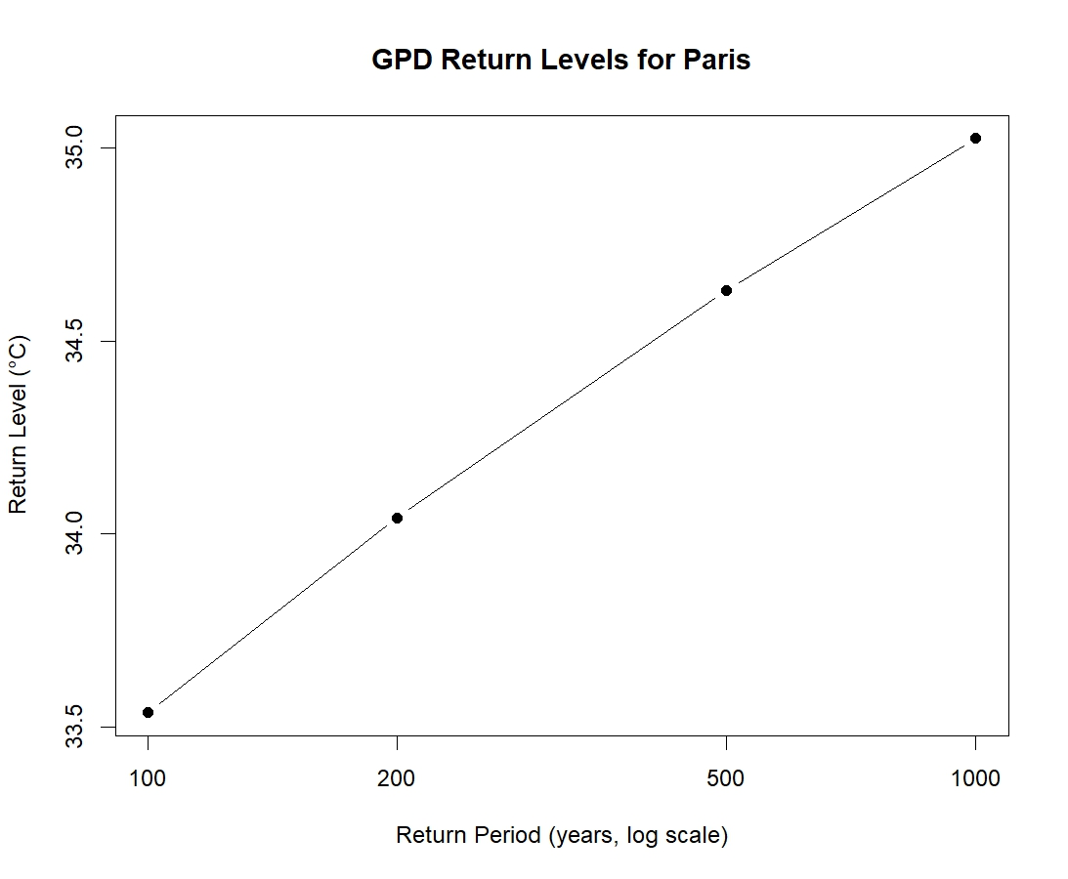
GPD Distribution – Return Level
GPD Return Table
Return Period | Years | Return Level
1 | 100 | 33.53696
2 | 200 | 34.04176
3 | 500 | 34.63127
4 | 1000 | 35.02493
Notes:
Using the POT approach, estimated return levels range from approximately 33.5°C for a 100-year event to 35.0°C for a 1000-year event. The increase is gradual, suggesting a limited growth in extreme temperatures.

Slide 16
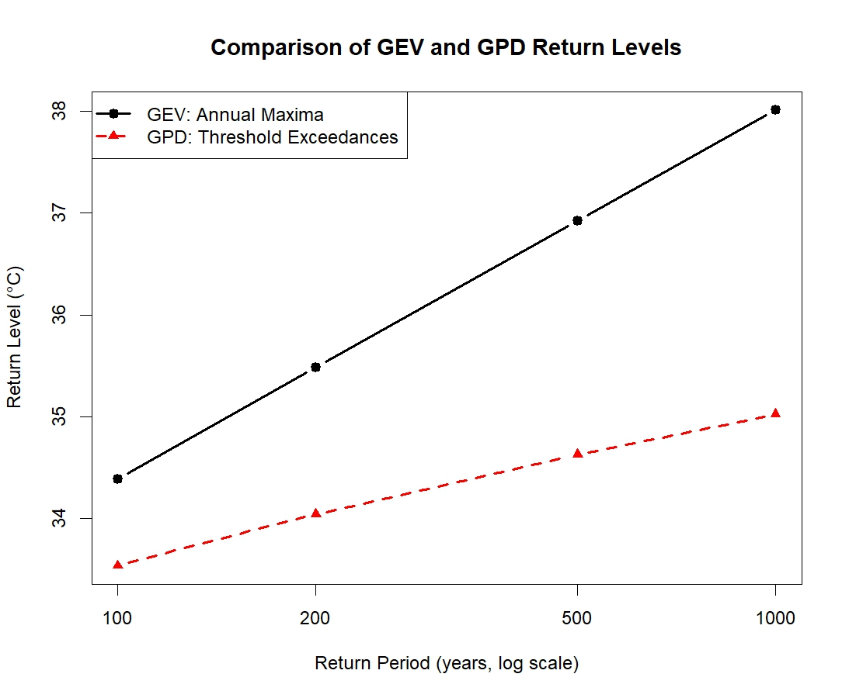
GPD vs GEV – Return Level
GPD vs GEC - Return Level Table
Return Period | Years | Return Level GPD | Return Level GEV
1 | 100 | 33.53696 | 34.38969
2 | 200 | 34.04176 | 35.48510
3 | 500 | 34.63127 | 36.92747
4 | 1000 | 35.02493 | 38.01546

Slide 17
GPD vs GEV – Return Level confidence Intervals
GPD vs GEC - Return Level Table
Return Period | Years | Return Level GPD | GPD_Lower_95 | GPD_Upper_95 | Return Level GEV | GEV_Lower_95 | GEV_Upper_95
1 | 100 | 33.53696 | 31.95660 | 35.51283 | 34.38969 | 30.89597 | 42.78209
2 | 200 | 34.04176 | 32.26095 | 36.34102 | 35.48510 | 31.19154 | 47.68846
3 | 500 | 34.63127 | 32.60006 | 37.36665 | 36.92747 | 31.48480 | 56.48000
4 | 1000 | 35.02493 | 32.80629 | 38.10197 | 38.01546 | 31.66666 | 64.96347
Notes:
The GEV model is based on only 25 annual maxima, while the GPD model uses 454 exceedances. The larger amount of information available to the GPD model may lead to more stable estimates.

Slide 18
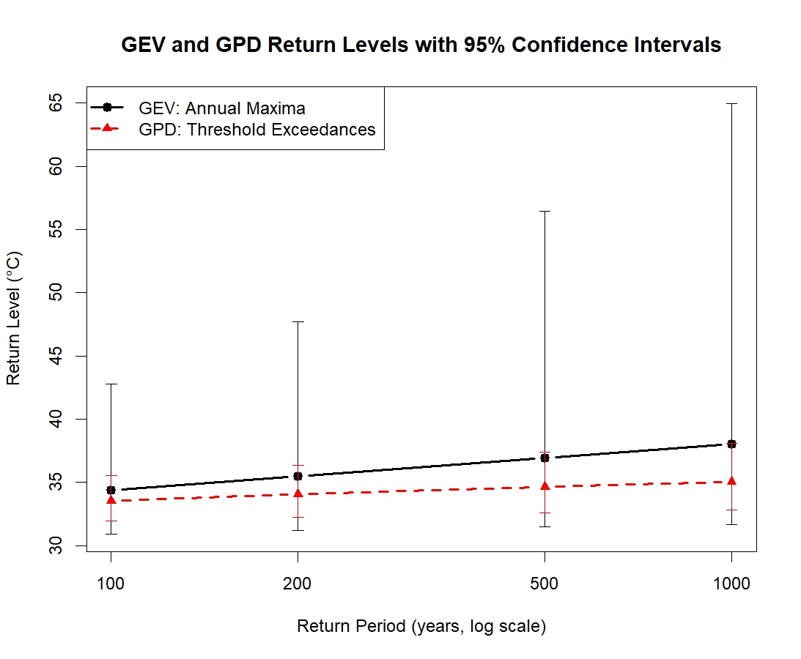
GPD vs GEV – Return Level confidence Intervals
Overlapping Confidence Intervals
Uncertainty becomes very large for long return periods.
We only have 25 years of annual maxima but are trying to predict events expected once every 1000 years.
Notes:
Confidence intervals show the range of plausible values around each estimated return level

Slide 19
Conclusion
Very long-term predictions are sensitive to modelling choices.
The shape parameter is telling us that :
Paris temperatures do not exhibit extremely heavy-tailed behaviour. In particular, the negative GPD shape parameter suggests that there may be a practical upper limit to the temperature extremes observed in this dataset.
There is a reliability problem as:
Estimating a 1000-year event from only 25 years of annual maxima involves substantial extrapolation beyond the observed data. Therefore, confidence intervals become more informative than the point estimates themselves. The analysis reminds us that uncertainty grows much faster than return levels as we move further into the future.
From a risk-management perspective,
the study suggests that Paris can experience temperature extremes higher than any observed during 1995–2019. However, estimates of very rare events should be interpreted as ranges of plausible outcomes rather than exact forecasts.

