Slide 1

Online Bookstore
Management System
Group 1
Pooja Solanki
Pushpinder Kaur
Jaypreet Kaur Sidhu
Chimdi Nwigwe
Jose Plaza Cedeno

Slide 2

Project Scope and Components
Element | Content
Title | Project Scope: Simulating E-commerce
Goal | To design, implement, and secure a transactional database capable of managing book sales, inventory, and user access.
Core Structure (7 Tables) | Books, Authors, Categories, Customers, Orders, OrderDetails, Payments.
Advanced Database Components | Stored Procedures (SPs) Views 3. User-Defined Functions (UDFs) 4. Events
Security | Implementation of Admin, Seller, and Customer Roles/Permissions.

Slide 3
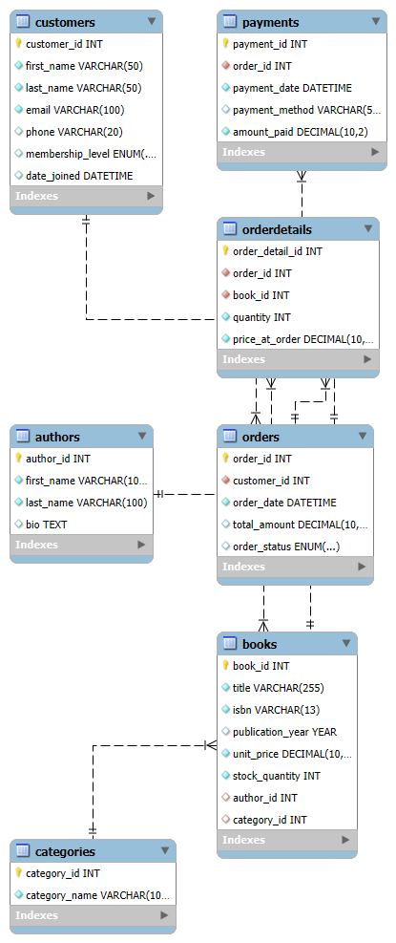

Database Design: The Blueprint
Entity-Relationship Diagram (ERD)
ThePhoto by PhotoAuthor is licensed under CCYYSA.

Slide 4


Data Structure and Normalization
User Roles and Security Model
Table Creation and Normalization (DDL)
Base Tables | 7 Tables: Authors, Categories, Books (Core Inventory), Customers (User Data), Orders, OrderDetails, Payments (Transaction Log).
Normalization | Adherence to DDL principles to achieve a normalized structure. Key focus: Elimination of data redundancy by separating Authors/Categories from the main Books table.
Data Integrity | Enforced using: Primary Keys (PKs) for unique identification. Foreign Keys (FKs) to prevent orphaned data in OrderDetails or Orders. Data Types (DECIMAL, DATETIME, ENUM) chosen for consistency.
Key Point | The schema is the foundation for all subsequent SPs, UDFs, and Views.
Admin
Access: ALL PRIVILEGES on bookstore_db.*. Purpose: System maintenance, data backup, and user management.
Seller
Access: SELECT on all tables AND EXECUTE on the Place order SP. Purpose: Process sales transactions without having raw DML access
Customer
Access: LIMITED SELECT on Books (only title, unit_price, stock_quantity). Purpose: Browse inventory securely, preventing access to sensitive customer/order data.

Slide 5
Views and User-Defined Functions (UDFs)
Views (Data Filtering& Abstraction) | User-defined function (UDF) | Key Benefits
Created reusable virtual tables to simplify complex queries. View_BookList: Returns bookID, title, price, and stock levels. View_BooksWithCategory: Joins Books and Categories to support category-based reporting. | Implements business rules formembership-based pricing. udf_membership_discount: Calculates final price using tiered discounts: Gold: 15% Silver: 10% Standard: 0% Used to standardize discount calculations across the system Category-based reporting. | Centralizes business logic. Reduces repetitive code. Enhances readability, maintenance, and role-based security.

Slide 6

Data Filtering and Calculation
Views and User-Defined Functions (UDFs)
View (Security/Simplification) | UDF (Business Logic) | Visuals
Available books by category. Purpose : Simplify complex joins for users and limit the columns a user can see (security). | Example: Calculate discount based on membership. Purpose : Returns a single scalar value. Used to apply different discount rates based on the Customers.membership_level ('Standard', 'Silver', 'Gold'). | Show a snippet of the UDF's IF/CASE logic and a screenshot of the View's output

Slide 7
Events
Database Automation: Events
Events | Goal | Event Logic | Key Point
Auto-Remove Unpaid Orders | To maintain data cleanliness and prevent system clutter from abandoned carts or incomplete transactions. | Event: Auto-remove unpaid orders after 48 hours. Action: Runs periodically (e.g., daily). Condition: Checks the Orders table for records where order_status = 'Unpaid' AND order_date is older than 48 hours. Result: Deletes matching records. | Ensures that resources reserved for abandoned orders are freed up, and the Unpaid status data is purged.
Archive Completed Orders | To maintain data cleanliness and prevent system clutter from abandoned carts or incomplete transactions. | Event: Archive orders that have been completed. Action: Runs every day. Condition: Checks the Orders table for records where order_status = 'Completed'. Result: Moves matching records from Orders to OrdersArchive | Reorganizes the data
Inventory Alert | To maintain data cleanliness and prevent system clutter from abandoned carts or incomplete transactions. | Event: Alerts database user when stock is low. Action: Runs every day. Condition: Checks the Books table for records where quantity < 15 units. Result: Alerts the database user | Ensures that the store is aware of items that are in low supply so they can prevent stock-outs

Slide 8
Stored Procedures (SPs)
A stored procedure is a precompiled set of SQL statements that performs a specific task, allowing automation and secure execution of business logic within the database.
Stored Procedure | Purpose | Logic | Key Benefits
Place Order | Automates the process of creating a new order for a customer. | Validates stock availability. Inserts order header and line items. Updates inventory and calculates total amount. Raises error if stock is insufficient. | Ensures accurate order processing prevents overselling maintains data integrity.
Update Inventory | Manages stock adjustments for books. | Retrieves current stock. Validates that update will not result in negative stock. Updates stock_quantity accordingly. Raises error for invalid operations. | Maintains correct inventory levels prevents negative stock supports controlled adjustments.

Slide 9

Integration Challenges and Solutions
Integration and Testing Results
Challenge 1 (Integration) | Ensuring the Place order SP correctly updated inventory (Books.stock_quantity) and logged a transaction (Orders, OrderDetails) in one atomic operation.
Solution | Used transaction control (BEGIN/COMMIT/ROLLBACK) within the SP to guarantee all DML operations succeed or fail together.
Challenge 2 (Security) | Restricting the Customer role to only the required columns.
Solution | Used column-level permissions: GRANT SELECT (column1, column2...) ON TableName... to enforce minimal access.
Key Success | All components (UDF, SP, View) successfully executed using the sample data, proving cross-functional integrity.

Slide 10
Conclusion
Achieved goals
Key outcomes
Future Works
✔ Designed a normalized, secure Online Bookstore database.
✔ Implemented automation via Stored Procedures, Events, Views, and UDFs.
✔ Enforced Role-Based Access Control for Admin, Seller, and Customer.
✔ Reliable order processing and inventory management.
✔ Improved data integrity and operational efficiency.
✔ Scalable design ready for integration.
✔ Add tax calculation and integrate regional tax rules in order processing.
✔ Implement multi-item cart functionality in place_order.
✔ Build real-time stock alerts dashboard for sellers/admin.
✔Enable payment gateway integration for live transactions.

