Slide 1


Web Stream Processing with OntopStream
The Web Conference 2022
Pieter Bonte
Marco Balduini
Matteo Belcao
Emanuele Della Valle

Slide 2
OBDA and Streaming Technologies: Background

Slide 3
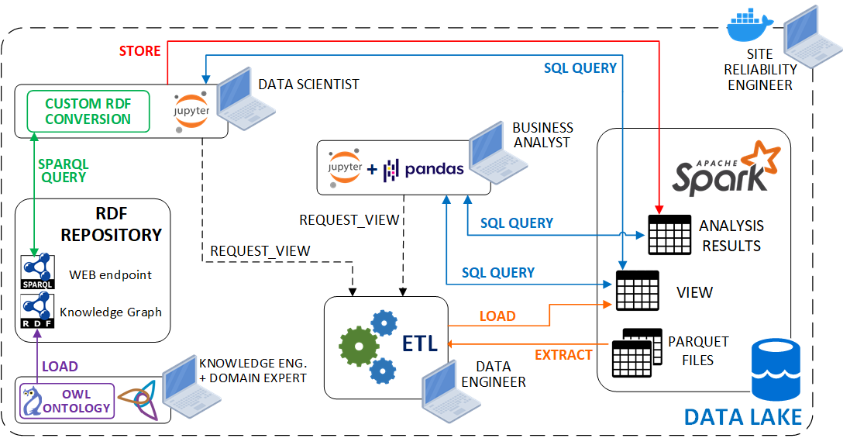
Business Scenario
Semantic and Big Data technologies are separated
Data lakes : store the whole enterprise data. Analysts need custom Extract Transform Load (ETL) jobs to access the data
Knowledge Graphs : queried with SPARQL to extract semantical information
Web Stream Processing with OntopStream 3

Slide 4
Traditional Data Analysis - PROBLEMS
Problem-dependent tasks:
new analytical query → new ETL task from scratch
ETLs require several days of work and meetings
requires a lot of Data Engineers workforce
Semantical analyses persistence in the data lake, for later re-use, is difficult
Solvable using a combination of multiple tools, which increase the required skills
need for single, user-friendly, straightforward tool
Web Stream Processing with OntopStream 4

Slide 5
Ontology-Based Data Access
Ontology-Based Data Access (OBDA) softwares aim to solve data integration problems…
Virtual Knowledge Graph (VKG) approach:
additional semantic layer on top of the data
relational data sources abstraction, exposed as RDF triples
SPARQL queries to access the data
automatic SPARQL → SQL query rewritings
Web Stream Processing with OntopStream 5

Slide 6
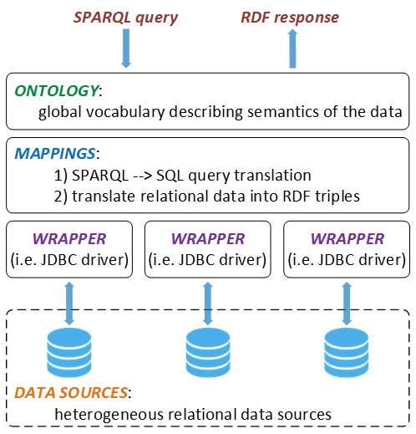



Vitual Knowledge Graph approach
Data Analyst/Scientist
Knowledge Engineer
Data Engineer
Web Stream Processing with OntopStream 6

Slide 7
Virtual Knowledge Graph engines
“traditional” VKG engines (Mastro, Morph-RDB, UltraWrap)
Ontop is considered the state-of-the-art reference VKG engine:
the only one offered as a commercial solution
active Github community (weekly-based issues)
relevant industrial-grade implementations
Statoil (Equinor)
Siemens Electric
Ricerca sul Sistema Energetico s.p.a (OntopSpark, PoliMi work)
However, none of the tool is designed for supporting streams of data
Web Stream Processing with OntopStream 7

Slide 8
Streaming Technologies
Streaming technologies are becoming very popular…
Data Streams can be:
continuously generated
incrementally processed
segmented by their time (window)
Stream Processing engines enables real-time processing and querying of multiple data streams
Web Stream Processing with OntopStream 8

Slide 9







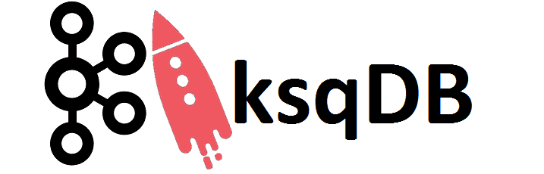

State of the art streaming technologies…
CLOUD-BASED
(proprietary)
OPEN-SOURCE
Web Stream Processing with OntopStream 9

Slide 10
Towards real-time analytics
Stream Processing engines enables real-time processing and querying of multiple data streams
need for a real-time tool leveraging:
State-of-the-art open-source streaming technologies
Apache Flink, Apache Kafka, Apache Calcite
Streaming extensions of semantic technologies
RDF Stream Processing Query Language (RSP-QL)
Streams of Virtual Knowledge Graphs
Web Stream Processing with OntopStream 10

Slide 11
Technologies covered…
CLOUD-BASED
(proprietary)
OPEN-SOURCE
Web Stream Processing with OntopStream 11

Slide 12
OntopStream

Slide 13
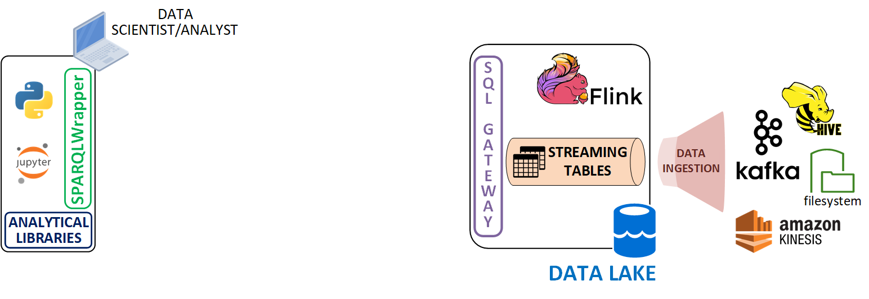
KG-Empowered Continuous Analytics
Web Stream Processing with OntopStream 13

Slide 14
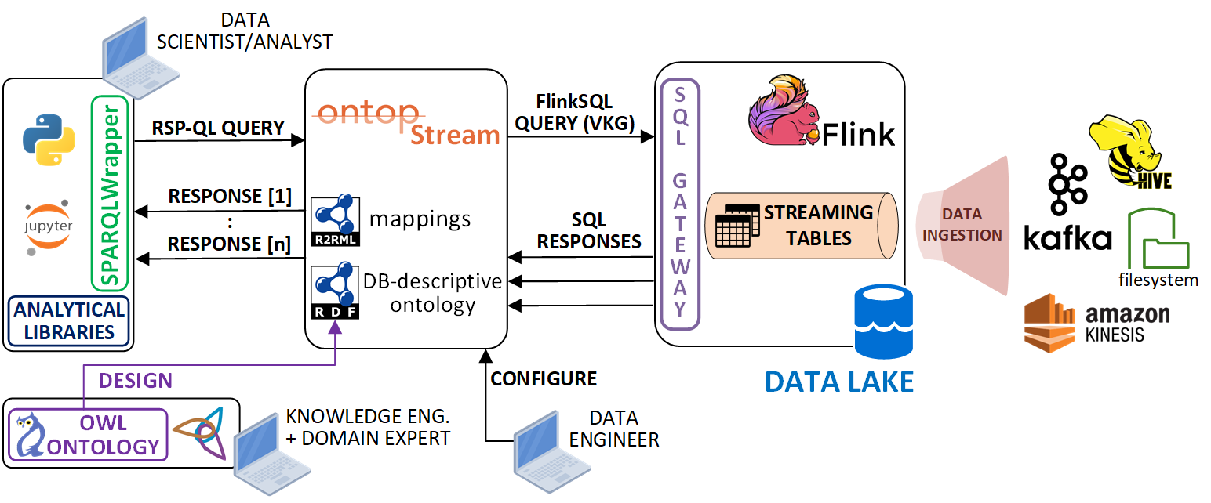
KG-Empowered Continuous Analytics
Streaming-VKGs as a bridge between Stream Processing and Semantic Techs
Web Stream Processing with OntopStream 14

Slide 15
OntopStream
Developed as an extension of the Ontop OBDA system (Java)
Query relational data streams
stored and managed in Apache Flink dynamic tables
with RSP-QL continuous queries ( windowed / not windowed )
Get RDF streams of responses
Two distributions:
OntopStream-CLI
OntopStream-Endpoint (only HTTP calls)
Web Stream Processing with OntopStream 15

Slide 16
OntopStream: design decisions
paradigm shift from traditional OBDA to Streaming-OBDA
design decisions:
extend the Flink JDBC driver
re-design part of the ontop-engine to accept RSP-QL queries
Streaming Virtual Knowledge Graph query rewriting approach
include support for RDF streams of query outputs
Web Stream Processing with OntopStream 16

Slide 17
Ontop extension design
Ontop extenction using a dependency injection mechanism
JAVA classes listed in the sql-default.properties file, loaded on startup
<<INTERFACE>>
SelectFromWhereSerializer
<<INTERFACE>>
SQLRelationVisitor
<<INTERFACE>>
MetadataProvider
<<INTERFACE>>
QuotedIDFactory
FlinkSQLIQTree2nativeNodeGenerator
AbstractDBMetadataProvider
DefaultSelectFromWhereSerializer
DefaultSchemaDBMetadataProvider
SQLStandardQuotedIDFactory
FlinkSelectFromWhereSerializer
FlinkSQLDBMetadataProvider
FlinkSQLQuotedIDFactory
com.ververica.flink.table.jdbc.FlinkDriver
sql-default.properties
ontop.iq.transform.IQTree2NativeNodeGenerator
com.ververica.flink.table.jdbc.FlinkDriver
Web Stream Processing with OntopStream 17

Slide 18
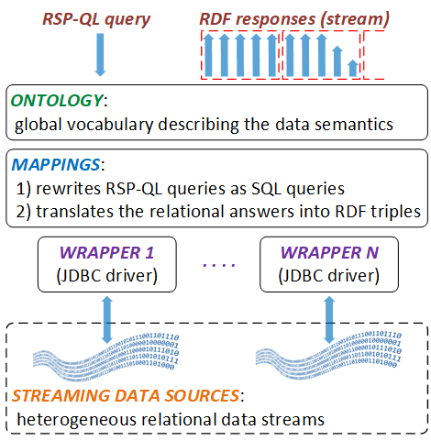
Streaming Virtual Knowledge Graphs in OntopStream
Data Analyst/Scientist
Knowledge Engineer
Data Engineer
Web Stream Processing with OntopStream 18

Slide 19
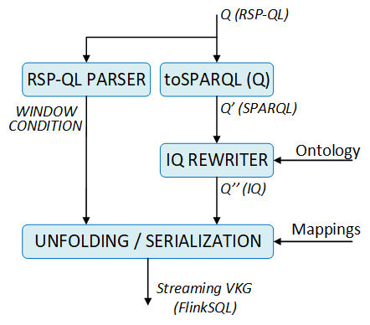
Streaming Virtual Knowledge Graph query rewriter
rsp4j parser to extract window conditions
Intermediate Query rewriter unchanged
IQ representation:
created w.r.t to the Ontology O
unfolded in a Streaming VKG tree
Each tree node corresponds to a pseudo-SQL statement
Streaming VKG serialization in a FlinkSQL query, add window condition W if existing
Web Stream Processing with OntopStream 19

Slide 20
Tutorial: pipeline setup

Slide 21
Business Scenario: Rental Company
A car rental company has recently decided to unify the information systems of two branches using ontology-based data access techniques.
Both the branches:
have a real-time data management infrastructure
store the rental records in Kafka topics
However, they handles the data differently:
Branch A uses two separate Kafka topics for trucks and cars
Branch B stores all the rentals in a single topic, but the users’ data are kept in a sperate topic
Web Stream Processing with OntopStream 21

Slide 22
Business Requirements
The company is booming, and has in plan to acquire soon new branches.
Therefore, the company wants to make the integration process scalable, so that can be easily extended to all its new branches
They need a data integration solution that:
provides an unified logical view of their data
enables to query in real-time their data
can be used with python notebooks for further analyses
Web Stream Processing with OntopStream 22

Slide 23
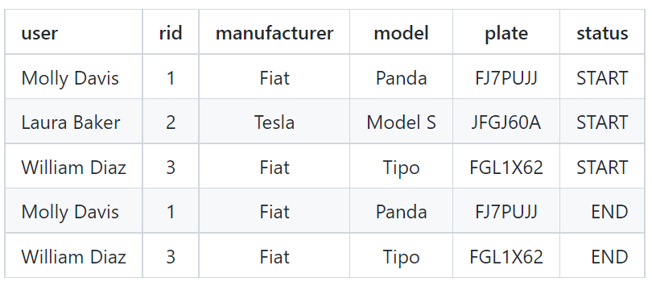
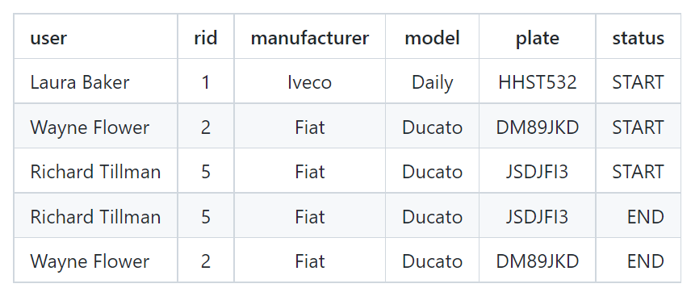
Kafka topics: Branch A
DEALER1_CARS
DEALER1_TRUCKS
Web Stream Processing with OntopStream 23

Slide 24
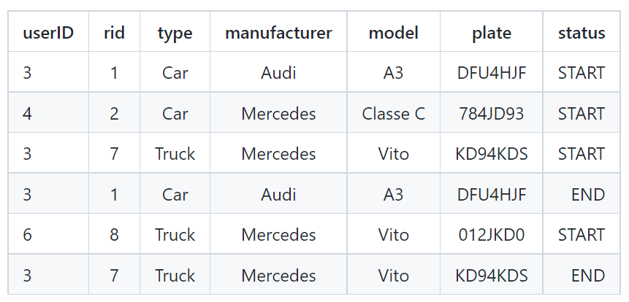
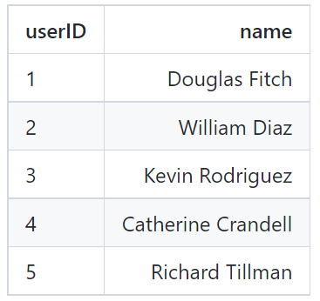
Kafka topics: Branch B
DEALER2_VEHICLES
DEALER2_USERS
Web Stream Processing with OntopStream 24

Slide 25
Kafka topics: Flink ingestion
Data acquisition in Flink can be automated
Design the topics ingestion in Flink:
Flink streaming tables
queried with FlinkSQL continuous queries, recorded in Flink
Kafka connector for Flink (Table & SQL API):
files:
sql-client-conf.yaml: Kafka → Flink
sql-gateway-defaults.yaml: Flink JDBC Gateway
table schema: topics fields, datatypes, watermarks, …
connector properties: Kafka address, schema registry, …
Web Stream Processing with OntopStream 25

Slide 26
Example: DEALER2_VEHICLES topic
- name: D2_VEHICLES
type: source
update-mode: append
schema:
- name: userID
type: BIGINT
- name: rid
type: BIGINT
- name: type
type: STRING
- name: manufacturer
type: STRING
- name: model
type: STRING
- name: plate
type: STRING
- name: status
type: STRING
- name: ts
type: STRING
TABLE NAME
data: SOURCE → FLINK
append new data, when is available from the source (Kafka)
TABLE SCHEMA
Reference: Apache Kafka SQL Connector
Web Stream Processing with OntopStream 26

Slide 27
Example: DEALER2_VEHICLES topic
- name: parsed_timestamp
type: TIMESTAMP
rowtime:
timestamps:
type: "from-field"
from: "ts"
watermarks:
type: "periodic-bounded"
delay: "5"
connector:
property-version: 1
type: kafka
version: universal
topic: DEALER2_VEHICLES
startup-mode: earliest-offset
properties:
- key: bootstrap.servers
value: kafka:9092
format:
property-version: 1
type: json
schema: "ROW(userID BIGINT, rid BIGINT, type STRING, manufacturer STRING,
model STRING, plate STRING, status STRING, ts STRING)"
reference field for time-based operations (WINDOWS)
TABLE SCHEMA
source type
SOURCE
CONNECTOR
source address
topic schema
Web Stream Processing with OntopStream 27

Slide 28
Relational Streaming Data Integration…
Now, we have a Flink streaming table for each Kafka topic
DEALER1_CARS and DEALER1_TRUCKS
DEALER2_VEHICLES and DEALER2_USERS
The data streams are still not integrated!!!
Web Stream Processing with OntopStream 28

Slide 29
Relational Streaming Data Integration…
Now, we have a Flink streaming table for each Kafka topic
DEALER1_CARS and DEALER1_TRUCKS
DEALER2_VEHICLES and DEALER2_USERS
We can use OntopStream to create a unified logical view of the data streams…
Flink relational streams:
exposed to OntopStream using the Flink JDBC Gateway
can be queried with FlinkSQL continuous queries
Web Stream Processing with OntopStream 29

Slide 30
Relational Streaming Data Integration…
Onpstream automates:
RSP-QL → FlinkSQL query rewriting
relational → RDF response streams translation
To use OntopStream for the streaming data integration tasks we need:
Ontology: provides the unified logical view to the user
Classes
Object Properties
Data Properties
Streaming-VKG mappings: bridges the ontology with data streams (Kafka messages in Flink)
JDBC connection configuration
Web Stream Processing with OntopStream 30

Slide 31
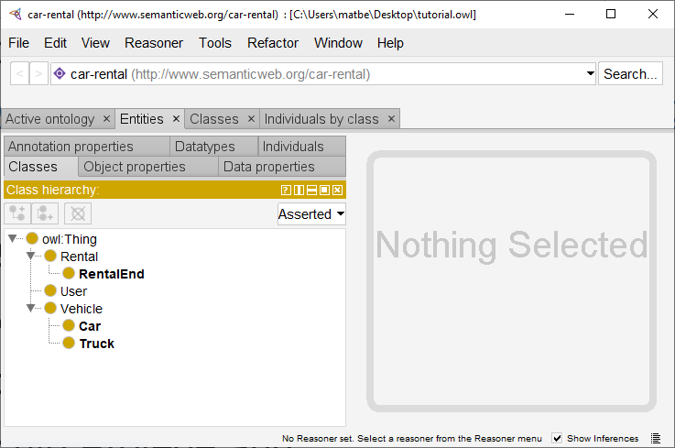
1) Ontology Design
Download Protégé from
https://protege.stanford.edu/products.php#desktop-protege
Launch Protégé
Linux: ./run.sh from the terminal
Windows: click on Protégé.exe
Mac: execute Protégé.app
Change the ontology IRI in
http://www.semanticweb.org/car-rental
Open the Entities tab to start the ontology design
Web Stream Processing with OntopStream 31

Slide 32
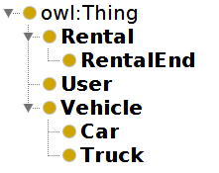
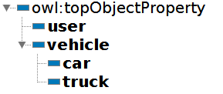
1) Ontology Design
Classes:
express the logical concepts of the unified logical view
The Car and Truck concepts are expressed as subclasses of Vehicle
i.e., a Tesla Model X is a Car, but also a transportation Vehicle
RentalEnd is a specialization of (subclass) Rental
it will be useful later for queries about ended rentals
Object Properties:
ease the mapping process
express implicit domain/range restrictions on Class istances:
the user property range is User
the vehicle property range is Vehicle
Web Stream Processing with OntopStream 32

Slide 33
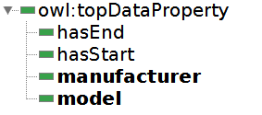
1) Ontology Design
Data Properties:
expose the Kafka messages entries
Vehicle details (manufacturer, model)
Timestamps
Users personal information (name)
To save your ontology (OWL format) go to File > Save As
Name the file rentals.owl, and save it in the ontop/input folder
Web Stream Processing with OntopStream 33

Slide 34
2) Streaming-VKG mappings
OntopStream answers RSP-QL queries with RDF streams of semantically-enriched responses based on:
ontological concepts
relational data streams: retrieved through Streaming VKG queries registered in Flink
Streaming-VKG mapping
binding between a set of RDF statements and FlinkSQL selection query
connects the ontological layer terms to data streams (in this tutorial, Kafka messages in Flink)
consists of:
MappingID: friendly name to identify the mapping
Source: FlinkSQL query for the data extraction from the Flink streaming tables
Target: one or more RDF statements corresponding to the VKG generated by the single entry obtained from the data extracted with the Source query
Web Stream Processing with OntopStream 34

Slide 35
2) Streaming-VKG mappings: Baranch A
Entities:
Rental: each rental ID in the stream
Vehicle: plate numbers
User: client names
Kind of rented vehicle?
D1_CARS table stores Cars data
D1_TRUCKS table stores Trucks data
Start or ended lease?
the status field refers to the rental state
we can use a WHERE clause in the source query to filter out rentals by their status:
status='START' retrieves the starting rentals Kafka messages
status='END' retrieves the ended rentals Kafka messages
Web Stream Processing with OntopStream 35

Slide 36
2) Streaming-VKG mappings: Baranch A
RentalEnd subclass of Rental:
to ease the complexity of queries asking only for ended rentals, we use the subclass specialization
Started rentals [rentals.obda]
mappingId DEALER1-CarRental
target :D1_C{rid} a :Rental; :user :{user}; :hasStart {ts}^^xsd:dateTime; :car :{plate}. :{plate} a :Car; :manufacturer {manufacturer}; :model {model}.
source SELECT rid, user, ts, plate, manufacturer, model FROM D1_CARS WHERE status='START'
mappingId DEALER1-TruckRental
target :D1_T{rid} a :Rental; :user :{user}; :hasStart {ts}^^xsd:dateTime; :truck :{plate}. :{plate} a :Truck; :manufacturer {manufacturer}; :model {model}.
source SELECT rid, user, ts, plate, manufacturer, model FROM D1_TRUCKS WHERE status='START'
Ended rentals [rentals.obda]
mappingId DEALER1-CarRentalEnd
target :D1_C{rid} a :RentalEnd; :hasEnd {ts}^^xsd:dateTime; :car :{plate}.
source SELECT rid,ts,plate FROM D1_CARS WHERE status='END'
mappingId DEALER1-TruckRentalEnd
target :D1_T{rid} a :RentalEnd; :hasEnd {ts}^^xsd:dateTime; :truck :{plate}.
source SELECT rid,ts,plate FROM D1_TRUCKS WHERE status='END''
Web Stream Processing with OntopStream 36

Slide 37
2) Streaming-VKG mappings: Branch B
Entities:
Rental: each rental ID in the stream
Vehicle: plate numbers
User: client names
Kind of rented vehicle?
the type field refers to the kind of vehicle in the D2_VEHICLES table
for starting rentals, we can use a WHERE clause in the source query to determine the vehicle:
type=‘Car' retrieves Car rental entries
type=‘Truck' retrieves Truck rental entries
for ending rentals, since the vehicle class is determined in the starting rental messages:
use the generic vehicle object property (property range is Vehicle)
Start or ended lease? (same as Branch A)
use the WHERE clause in the source query to filter out rentals by their status field
Web Stream Processing with OntopStream 37

Slide 38
2) Streaming-VKG mappings: Branch B
Users are kept in a separate topic:
need to combine the Flink streaming tables D2_VEHICLES and D2_USERS
FlinkSQL source query with a JOIN over the userID field
RentalEnd subclass of Rental: (same as Branch A)
to ease the complexity of queries asking only for ended rentals, we use the subclass specialization
Started/Ended rentals [rentals.obda]
mappingId DEALER2-CarRental
target :D2_{rid} a :Rental; :user :{name}; :hasStart {ts}^^xsd:dateTime; :car :{plate}. :{plate} a :Car; :manufacturer {manufacturer}; :model {model}.
source SELECT rid,name,ts,plate,manufacturer,model FROM D2_VEHICLES,D2_USERS WHERE D2_VEHICLES.userID=D2_USERS.userID
AND type='Car' AND status='START'
mappingId DEALER2-TruckRental
target :D2_{rid} a :Rental; :user :{name}; :hasStart {ts}^^xsd:dateTime; :truck :{plate}. :{plate} a :Truck; :manufacturer {manufacturer}; :model {model}.
source SELECT rid,name,ts,plate,manufacturer,model FROM D2_VEHICLES,D2_USERS WHERE D2_VEHICLES.userID=D2_USERS.userID
AND type='Truck' AND status='START’
mappingId DEALER2-RentalEnd
target :D2_{rid} a :RentalEnd; :hasEnd {ts}^^xsd:dateTime; :vehicle :{plate}.
source SELECT rid,ts,plate FROM D2_VEHICLES,D2_USERS WHERE D2_VEHICLES.userID=D2_USERS.userID AND status='END'
Web Stream Processing with OntopStream 38

Slide 39
3) JDBC connection
OntopStream interacts with Apache Flink:
through JDBC calls
using a custom JDBC driver
Before starting OntopStream, we need to configure the connection to the Flink JDBC Gateway
The configuration must be specified in a property file, passed as input to OntopStream on its startup
rentals.propery
jdbc.url=jdbc:flink://sql-client:8083?planner=blink
jdbc.driver=com.ververica.flink.table.jdbc.FlinkDriver
jdbc.user=
jdbc.name=test-RSE-streaming
jdbc.fetchSize=1
jdbc.password=
Web Stream Processing with OntopStream 39

Slide 40
Starting-up the resources
Requirements: docker and docker-compose
Start the tutorial environment
Streaming resources (Flink, Kafka) and JupyterLab
sudo docker-compose -f flink-kafka.yml up –d
Flink JDBC Gateway:
Note: keep the JDBC endpoint alive until you need the service (don't close the terminal window)
sudo docker-compose -f flink-kafka.yml exec sql-client /opt/flink-sql-gateway-0.2-SNAPSHOT/bin/sql-gateway.sh --library /opt/sql-client/lib
Web Stream Processing with OntopStream 40

Slide 41
Tutorial: OntopStream hands-on

Slide 42
OntopStream startup
The OntopStream docker image is available on DockerHub
hub.docker.com/r/chimerasuite/ontop-stream
We can now start the OntopStream endpoint using the command:
docker-compose -f docker-compose-ontop.yml up –d
If we look at the configuration in the ontop.yml file we can see the three input files:
tutorial.owl: contained the ontology describing the user unified logical view
tutorial.obda: the Streaming-VKG mappings we've designed
tutorial.properties: the JDBC connection properties
Web Stream Processing with OntopStream 42

Slide 43
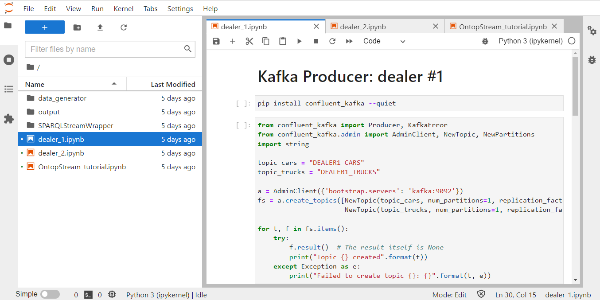
JupyterLab setup
We’re finally ready for querying the streams of data using a python notebook
The platform is accessible from http://<IP-ADDRESS>:8888/lab?token=TEST
Kafka producer #1
Kafka producer #2
OntopStream demo
Web Stream Processing with OntopStream 43

Slide 44
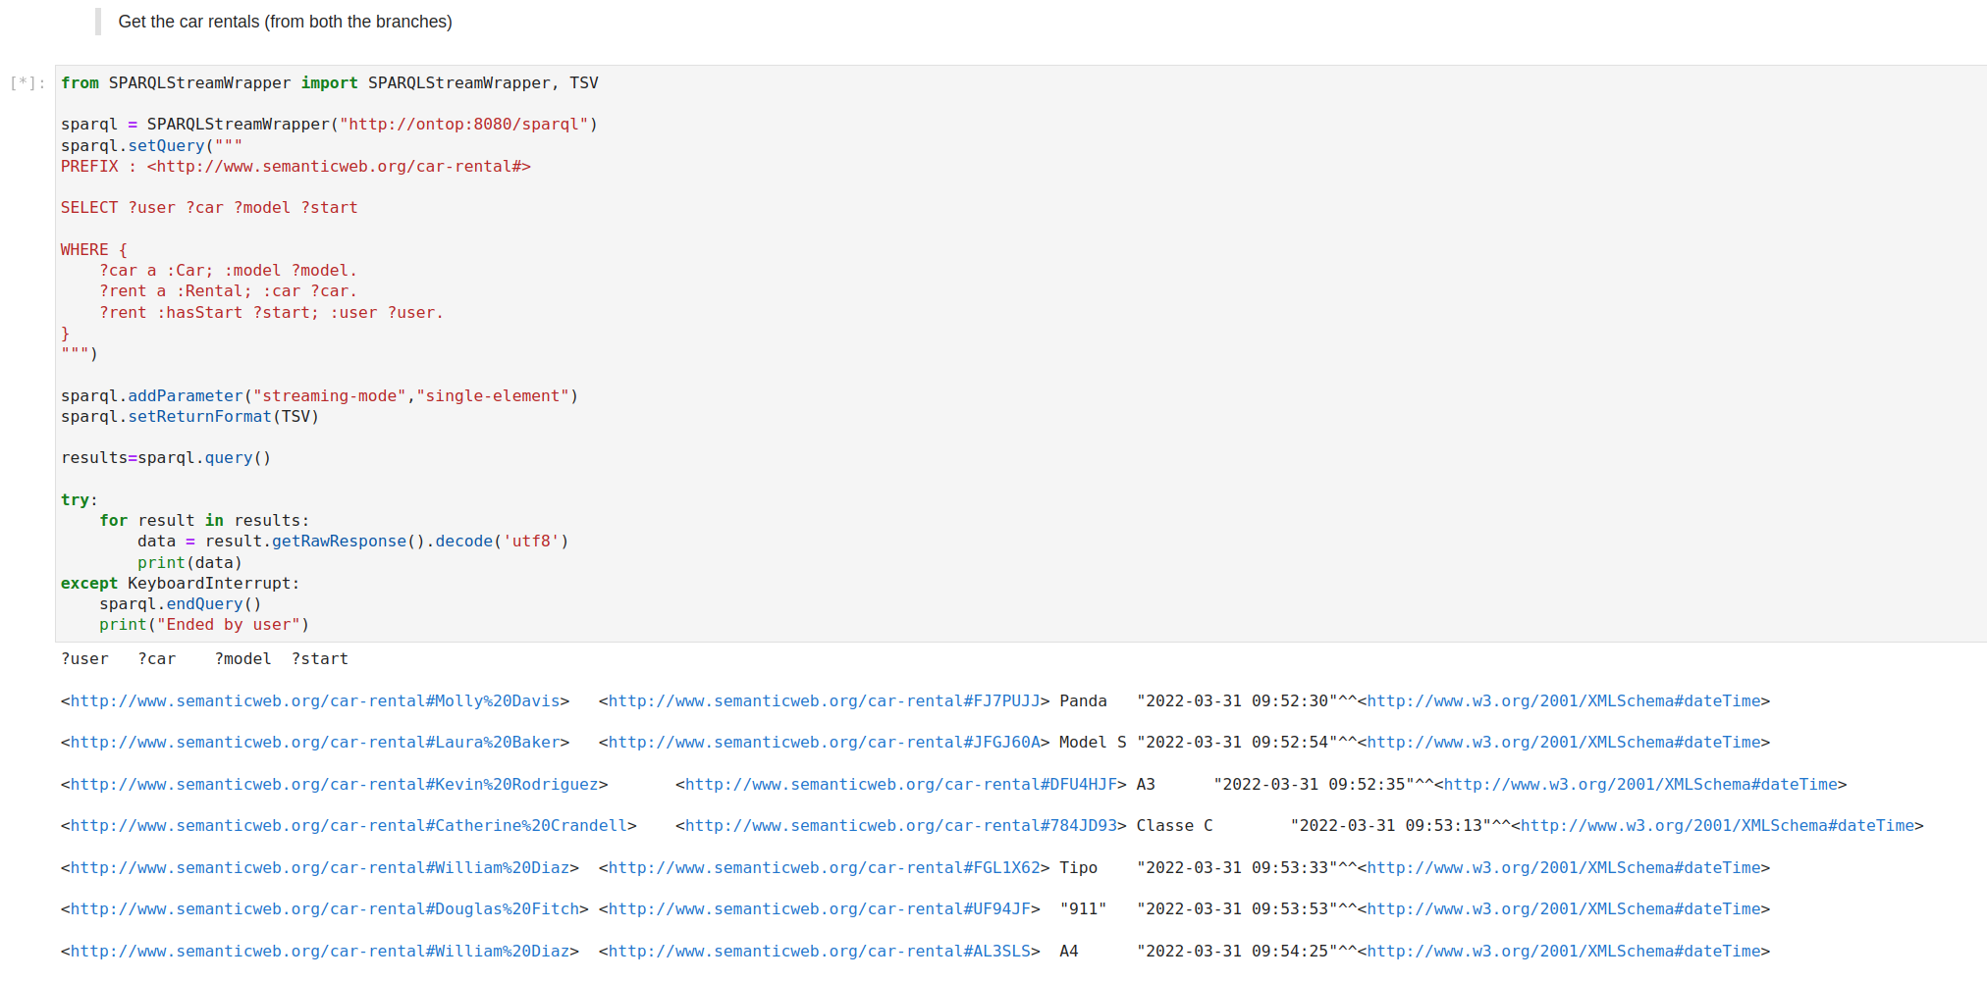
First Query
Web Stream Processing with OntopStream 44

Slide 45
First Query
Web Stream Processing with OntopStream 45

Slide 46
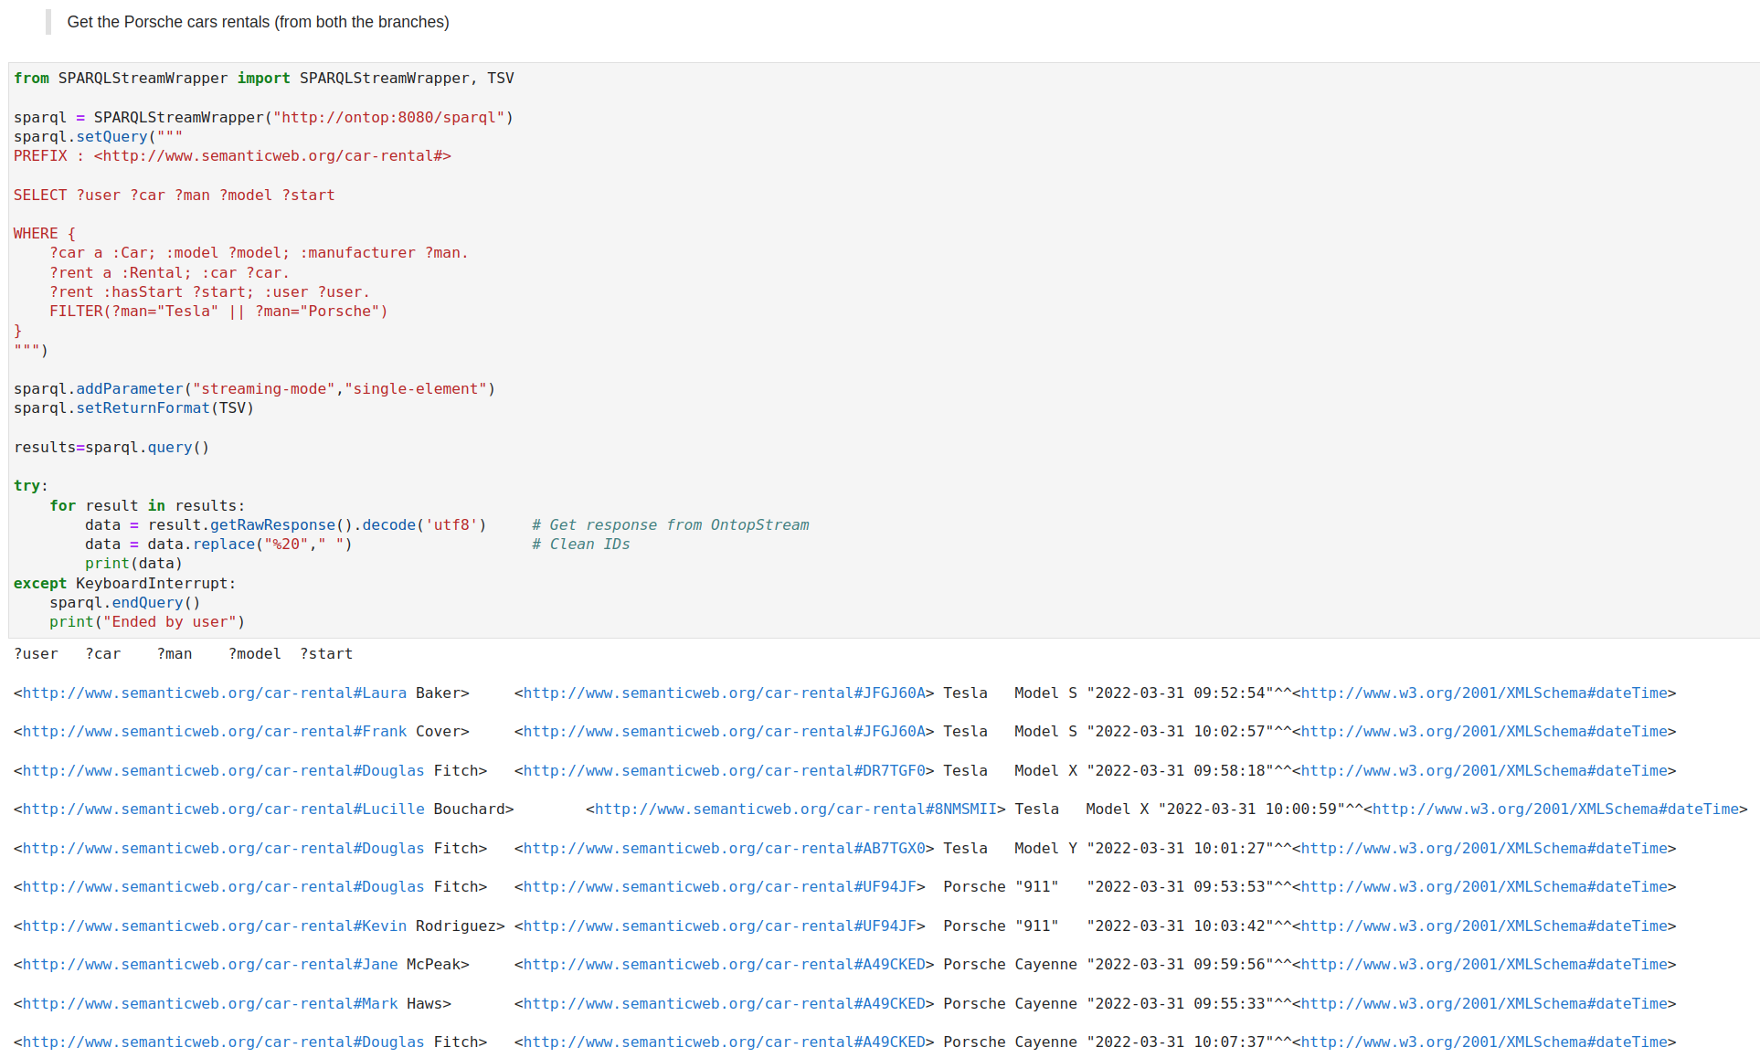
Second Query – Real-Time Filtering
real-time filtering condition, translated in a WHERE clause over the queried Flink Dynamic Tables
Web Stream Processing with OntopStream 46

Slide 47
Second Query – Real-Time Filtering
real-time filtering condition, translated in a WHERE clause over the queried Flink Dynamic Tables
Web Stream Processing with OntopStream 47

Slide 48
Second Query – Real-Time Filtering
real-time filtering condition, translated in a WHERE clause over the queried Flink Dynamic Tables
Web Stream Processing with OntopStream 48

Slide 49
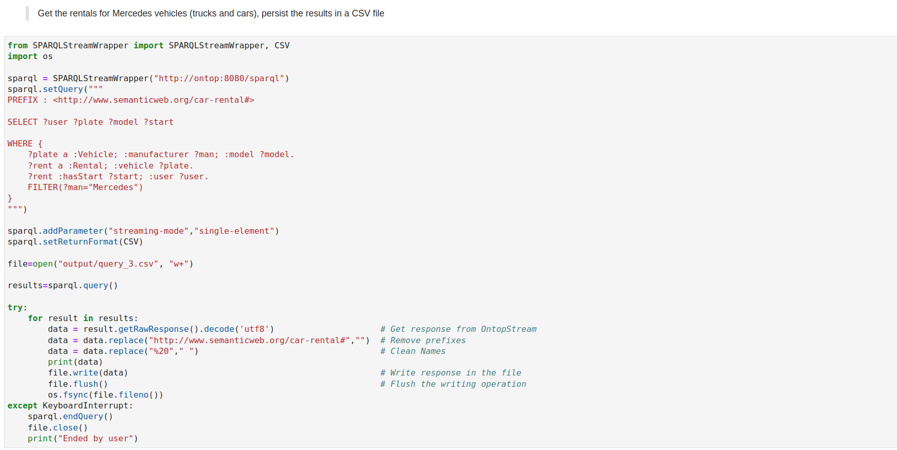
Third Query – Reasoning…
Real-time reasoning, based on the mapping ontology. Cars and Trucks are both vehicles
Query results persistence
Web Stream Processing with OntopStream 49

Slide 50
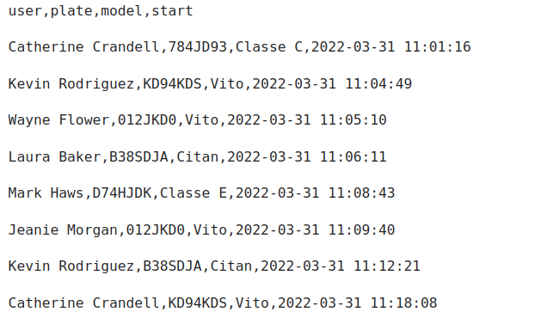
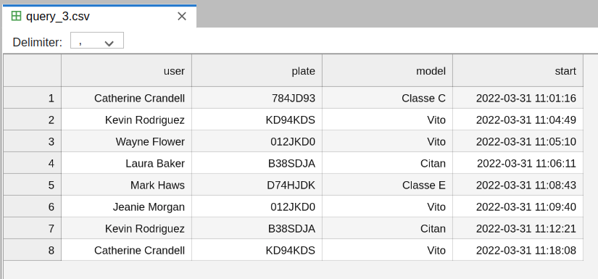
Third Query – Reasoning…
Car (branch 1)
Truck (branch 2)
Web Stream Processing with OntopStream 50

Slide 51
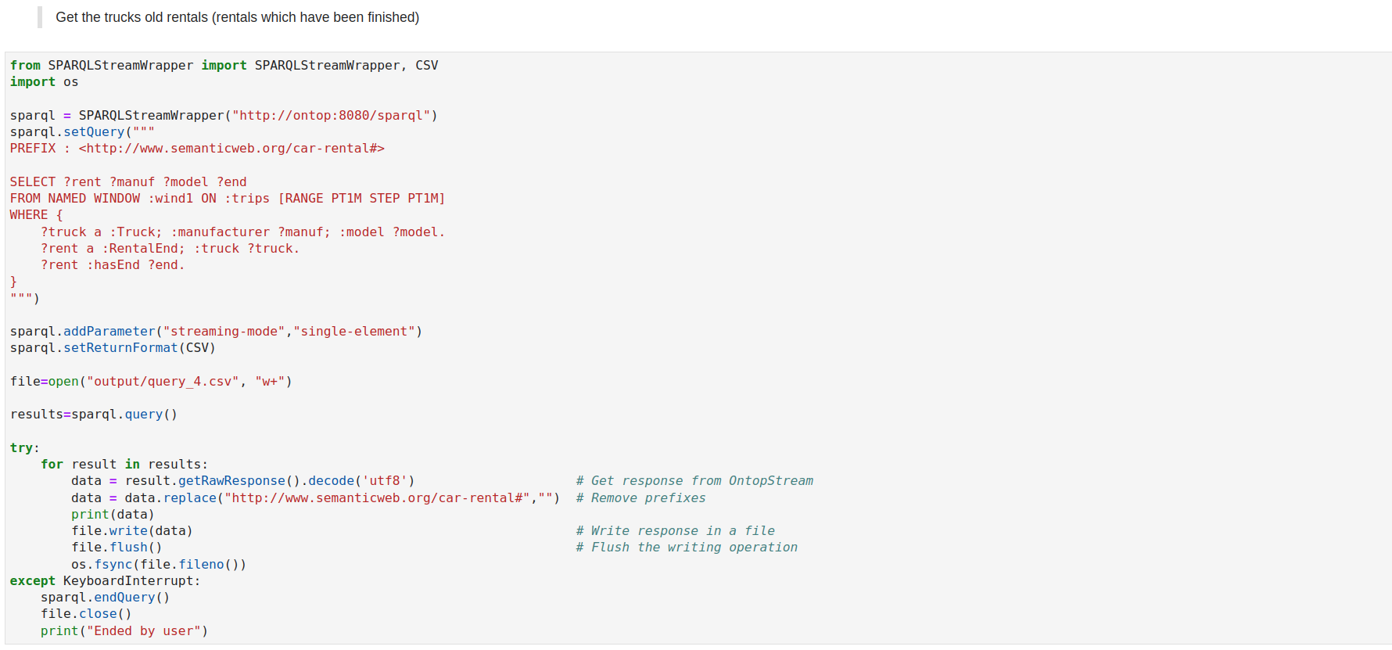
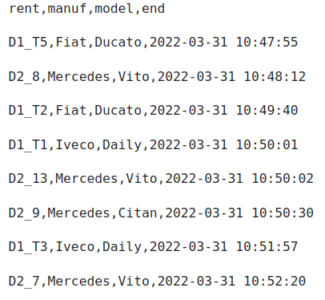
Fourth Query – Windowing (future developments)
Responses @t1
RSP-QL window condition…
Web Stream Processing with OntopStream 51

Slide 52
Fourth Query – Windowing (future developments)
Responses @t2
RSP-QL window condition…
Web Stream Processing with OntopStream 52

Slide 53
Thank you !!

