Slide 1
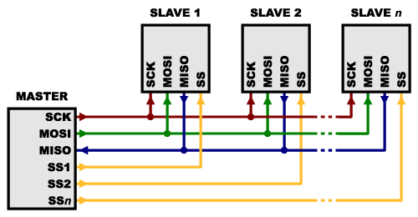
Serial Peripheral Interface (SPI)
Commonly used interface for communication with digital devices
Buses allow multiple devices to share common communication lines
The devices do not need to be the same, so long as they are all designed to run
on SPI
The SPI bus is an infrastructure that facilitates communication, but it does not specify any functionality. The meaning of the bytes it writes must still be agreed upon elsewhere.

Slide 2
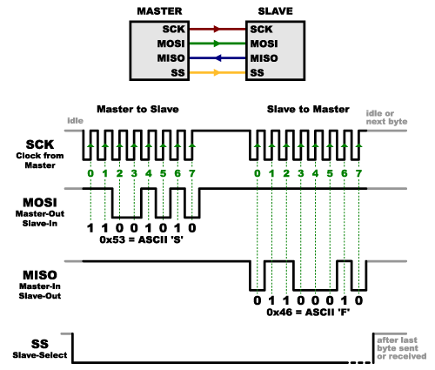
SPI lines
Serial Clock (SCK) – This makes sure that the two devices are sychronized, reading and writing data to the bus at the exact same speed.
Master Out Slave In (MOSI) – This sends data from the master (Arduino) to the slave (BME280).
Master In Slave Out (MISO) – This sends data from the slave (BME280) to the master (Arduino)
Slave Select (SS) – This specifies which device(s) are currently communicating

Slide 3
Signals
Clock line goes from high to low in orderly manner to provide timing
MOSI line can write ones and zeros in the provided spaces
MISO line can write ones and zeros in the provided spaces
SS Line driven low to tell device to communicate

Slide 4
BUS
Many devices can be on the SPI bus. Each one gets its own SS line. If the line is not set to active (low) then the device is effectively disconnected. Typically only one device is talking at a time, and that device talks only to the master.
The SPI bus provides speed and simplicity at the cost of extensibility since it requires more complex wiring than the other bus we will see, I2C.

Slide 5
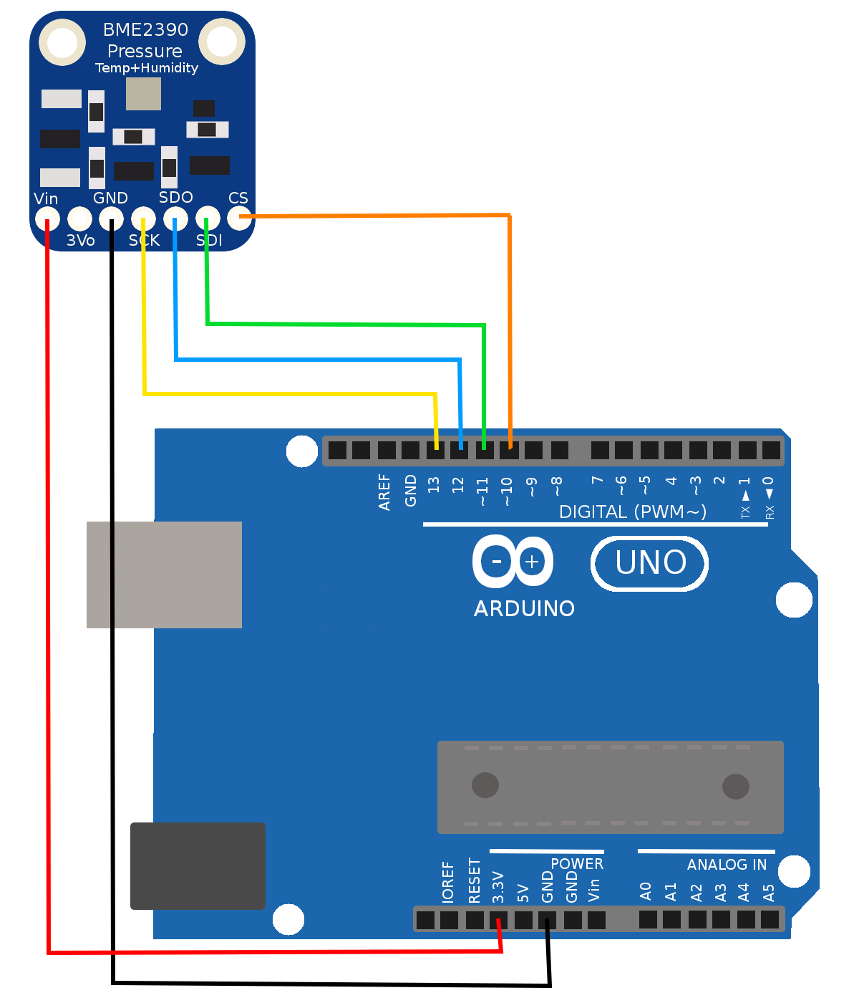
Other Wires
The connect an SPI device, you will likely need to provide more than just the SPI wires. The device is likely to need power and ground, which is not part of the SPI interface. Some devices might require extra reset pins or other special lines not part of the SPI interface.

