Slide 1
REST Services with Sinatra and iOS
Jacob Morris
jacob@codinginertia.com
@jacobsimeon

Slide 2
REST
Representational State Transfer

Slide 3
Constraints
A set of
Resources
For the transmission of
URIs
Through a uniform interface of

Slide 4
Constraints
Client-Server
Stateless
Cacheable
Layered System
Code on Demand
Uniform Interface

Slide 5
Resources
Transmit representations
Pay attention to response status codes.
201 = Created Resource
422 = Unprocessable Entity (invalid)
200 = Ok

Slide 6
URIs
Good
Get /tasks/1
POST /projects/1/tasks
Bad
POST /getTask/1
GET /addTask?title=mytask

Slide 7
The Demo App

Slide 8
User Interface (URIs)

Slide 9
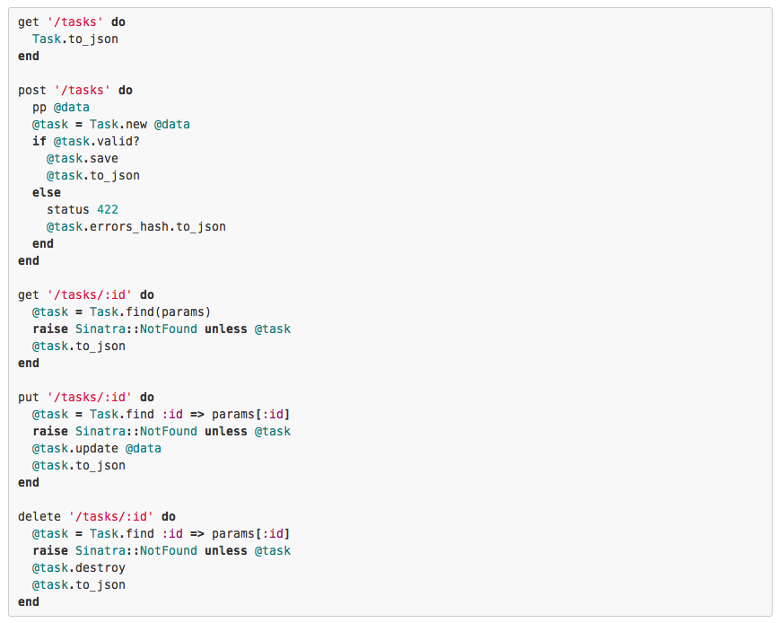

Slide 10
The Client

Slide 11
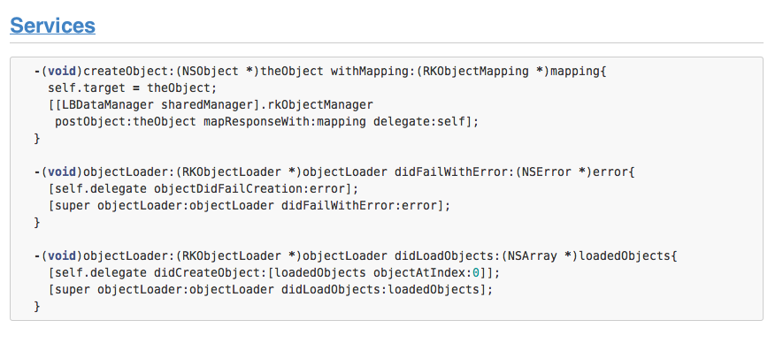

Slide 12
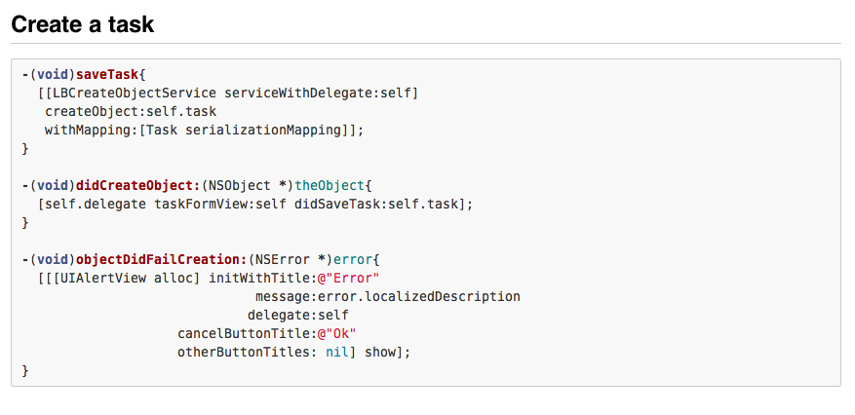

Slide 13
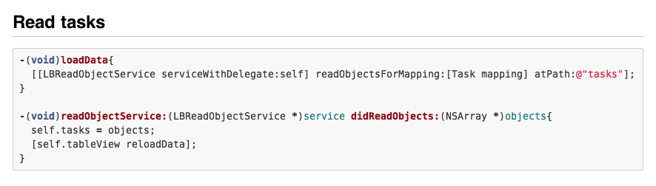

Slide 14
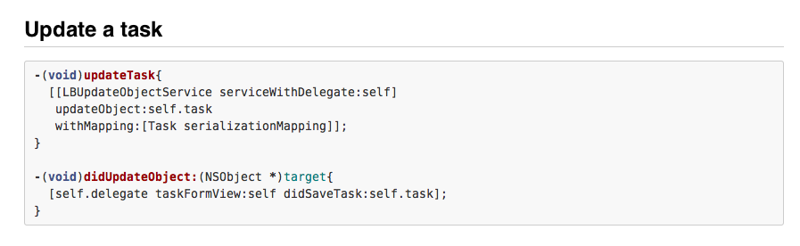

Slide 15
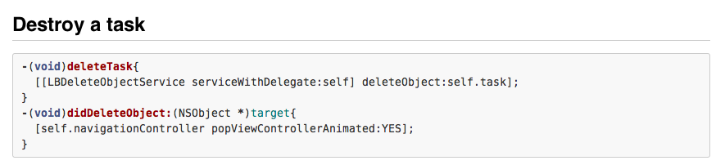

Slide 16
Questions
Jacob Morris
jacob@codinginertia.com
@jacobsimeon
github.com/jacobsimeon

