Slide 1
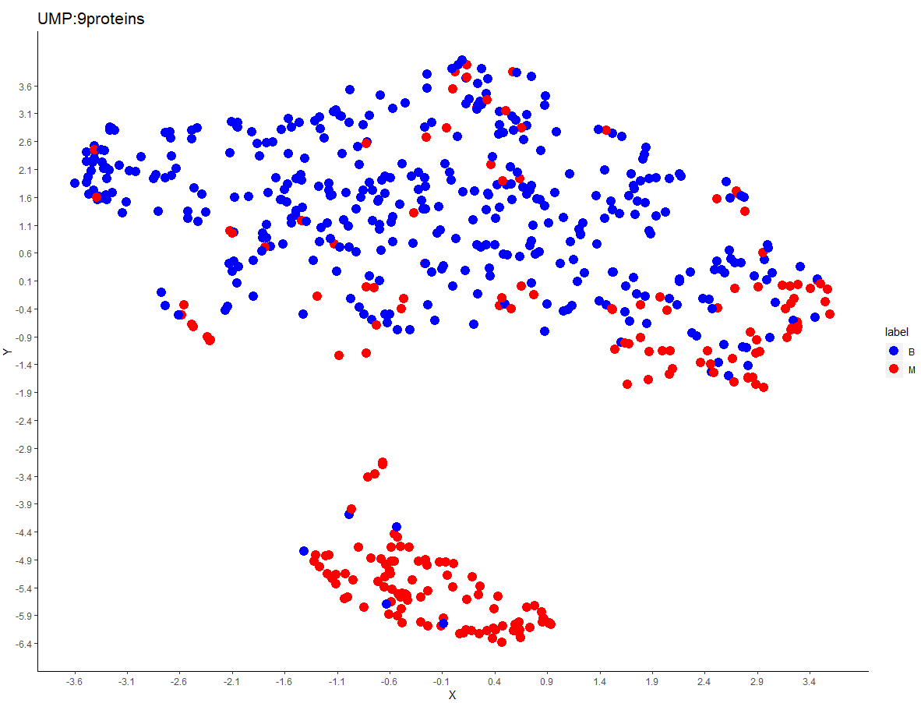
Wrong Labeled:
A
B: new subtype?
C

Slide 2
Wrongly labeled : A
12:PB17957 12:PB18551 12:PB27983 12:PB30638 13:PB21385 13:PB7735 13:PF281
13:PF91 14:PB16339 14:PB23614 14:PB24272 14:PB5790 14:PF1057 15:PB14640
15:PB23051 15:PB4570 15:PF1157 15:PF1197 15:PF14 15:PF305 16:PB18677
16:PB19877 16:PB2496 16:PB9043 16:PF304
New classes in B ? :
12:PB10433 12:PB17418 12:PB20612 12:PB2229 12:PB25462 12:PB25731 12:PB33568
12:PB33759 12:PB34360 12:PB603 12:PB6880 12:PB7080 12:PB7879 12:PB8670
13:PB12997 13:PB13948 13:PB24617 13:PB6502 13:PB9871 13:PF578 13:PF650
14:PB16170 14:PB19968 14:PB23160 14:PB25494 14:PB27404 14:PB5307 14:PF400
14:PF432 15:PB10012 15:PB12782 15:PB13435 15:PB16284 15:PB30834 15:PB31113
15:PF1093 15:PF1122 15:PF1314 15:PF1774 15:PF42 15:PF567 15:PF58
15:PF589 16:PB11954 16:PB12084 16:PB13411 16:PB26672 16:PB387 16:PF1479
16:PF1722 16:PF1919 16:PF510 16:PF625
Wrongly labeled : C
13:PB1304 13:PB14440 13:PB6407 13:PF978 16:PB5357

