Slide 1


Impact of Drought Conditions on Electricity Prices
Team A1 :
Chinar Boolchandani, Cordell Williams, Subhiksha Sivasubramanian, Yapei Xiong, Yuxuan Mei

Slide 2





Meet Our Team:
Subhiksha Sivasubramanian
Yapei Xiong
Yuxuan Mei
Chinar Boolchandani
Cordell Williams

Slide 3
Agenda
Research Methodology
Problem Statement
Business Impact
Community Impact
Data Collection and Dataset Information
EDA and Feature Engineering
Predictive Modeling
Conclusions
Current Challenges and Next Steps
Appendix

Slide 4
Research Methodology
INSIGHTS AND ANALYTICS
INDUSTRY IDENTIFICATION
MODEL
BUILDING
CONDUCT RESEARCH
DATA MUNGING AND EXPLORATION
Notes:
Industry identification: initial background research about the energy production; then we consult experts in ecosystem from Boston University to gain more fundamental knowledge and industrial insight. They helped us to focus on analyze the change of electricity prices and the production for various power plants throughout the northeast states.

Slide 5
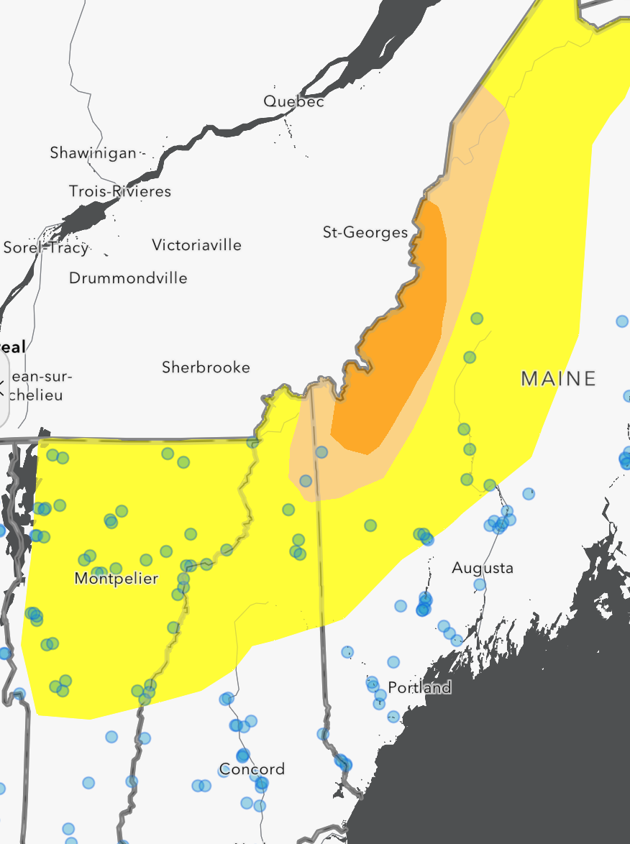
Problem Statement
Understanding the correlation between drought conditions-such as temperature, precipitation and drought severity - and fluctuations in electricity prices.
Northeast states under analysis:
Maine
Vermont
Massachusetts
Connecticut
New York
New Hampshire
Rhode Island
Drought in the North-East States

Slide 6
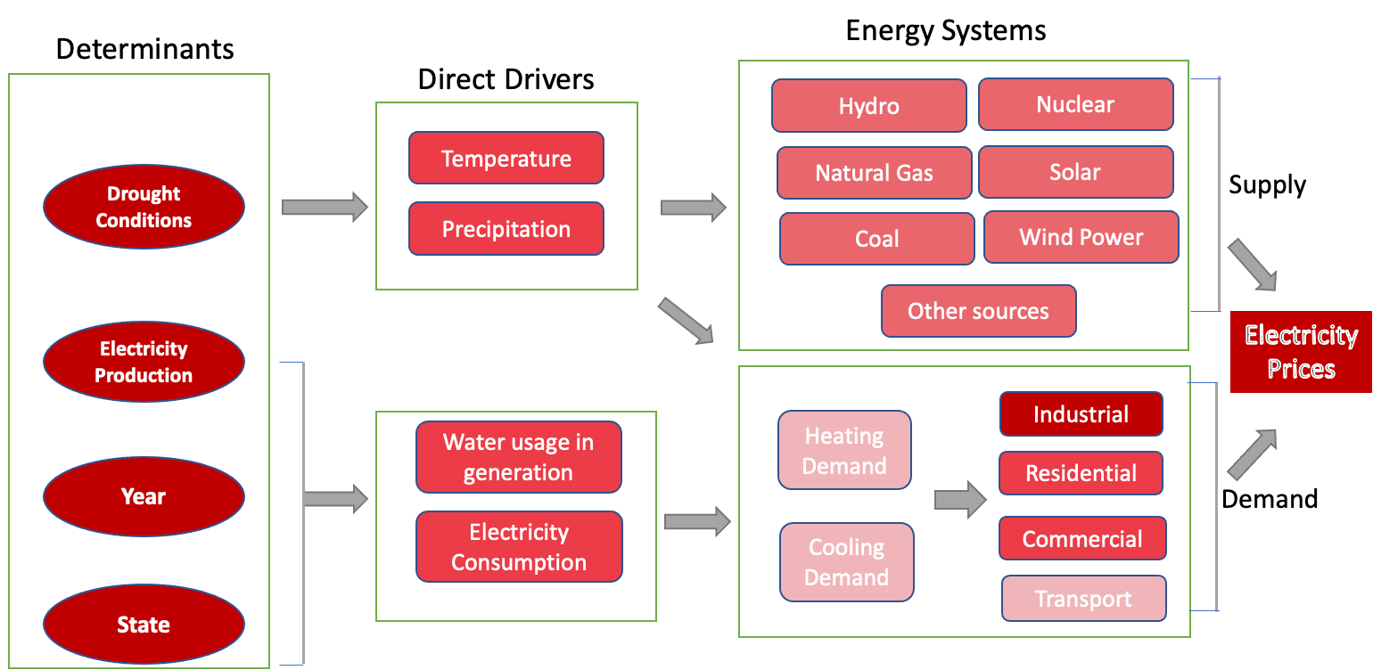
Business Impact
We aim to help electricity generating utilities understand some of the most important aspects of electricity price volatility
Notes:
In power industry, there are many features may affect the electricity prices and generating. We aim to help electricity generating utilities understand the most important aspects of electricity price volatility. The determinants will go through the direct driving features in different kinds of energy systems to look their impacts to electricity prices, in both supply and demand aspects. This will provide generation companies with a powerful tool to understand some of the most important aspects of electricity price volatility and help guide decisions when determining appropriate adjustments to future weather-related prices.

Slide 7

Community Impact: Segmentation
Notes:
For the community Impact,
This increased demand will result in higher energy prices to offset the increase in generation. We want to know determine the impact for these four groups and how could our analysis be able to better served them

Slide 8
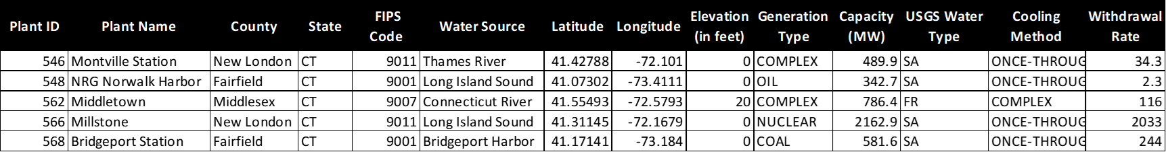
Data Collection: Power Plants
Power Plant Data
Dataset Information
Power plant based data that comprises the following important variables:
Unique power plant ID
County and state
Capacity in MW
Net Generation of each power plant
Cooling method of Power plant
Water source for cooling the power plant
Maximum amount of water withdrawal
Temperature (2011-2021)
Precipitation (2011-2021)
Dimensions:
54 Columns
142 Rows

Slide 9
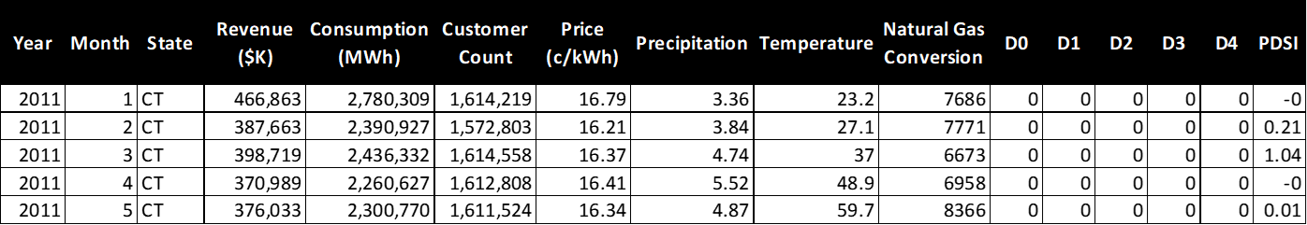
Data Collection: Supply and Demand
Energy Production
Dataset Information
Electricity data with Palmer Drought Severity Index that comprises
of the following important variables collected on a monthly basis::
Revenue from Electricity
Electricity Consumption
Number of customers by state
Precipitation and Temperature
D0,D1,D2,D3,D4 - Drought severity with D0, the least and D4, the highest
PDSI - Palmer Drought Severity Index
Dimensions:
18 Columns
842 Rows
Time Range : 2011 - 2021

Slide 10
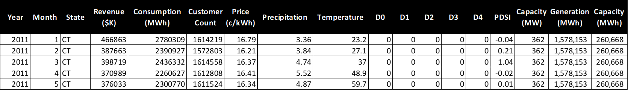
Final Features for Predictive Modeling
Merged Dataset
Sources:
US Energy Information Administration (EIA) https://www.eia.gov/
US Geological Survey (USGS)
https://www.usgs.gov/
National Oceanic and Atmospheric Administration (NOAA) https://www.noaa.gov/
Dimensions:
20 Columns
842 Rows
Time Range : 2011-2020

Slide 11
Exploratory Data Analysis

Slide 12
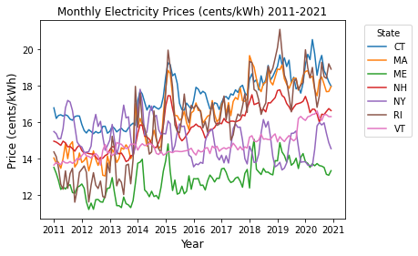
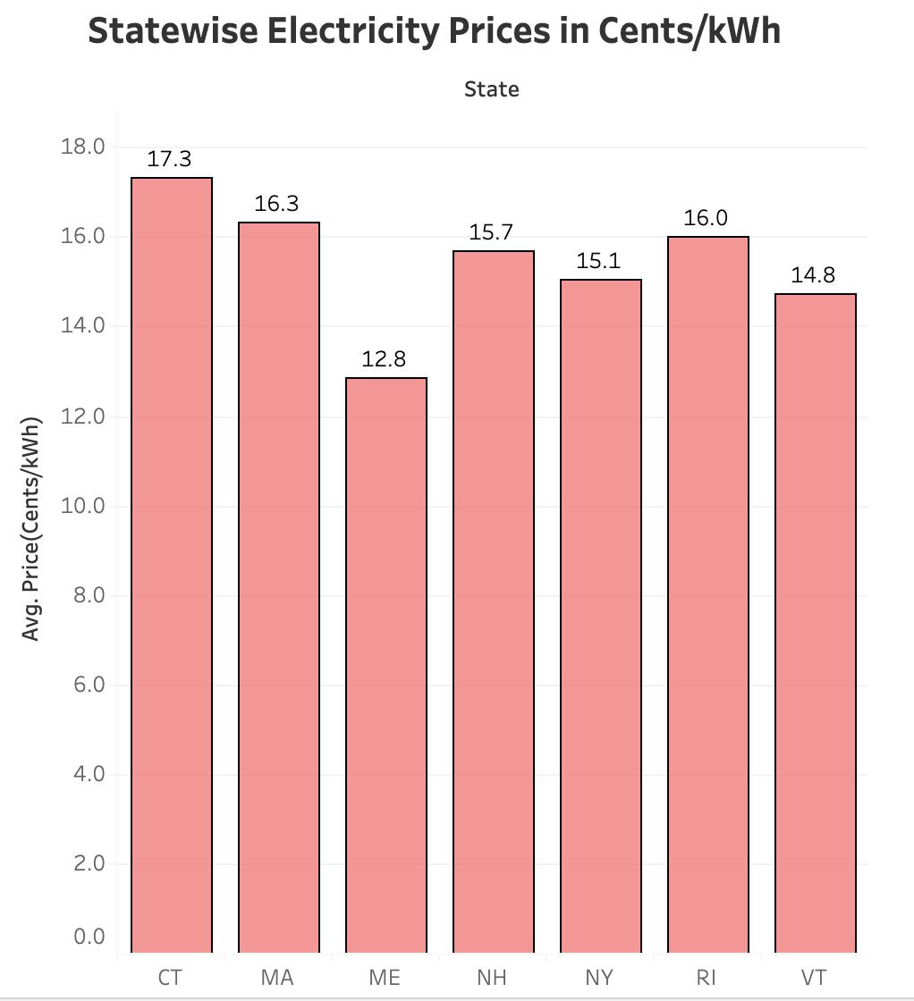
Electricity Price Volatility
Generally, electricity prices have increased over the years for all states. However, the average price has tended to stay within a fairly tight bound.
Interestingly, prices tend to fluctuate seasonally with winter months tending to have higher prices on average than summer months

Slide 13
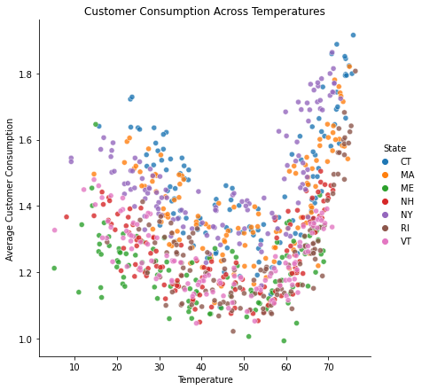
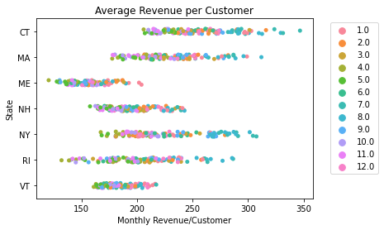
Electricity Revenue and Consumption
Unsurprisingly, the average revenue per customer tends to be highest in the summer and winter months.
This coincides with the greatest energy demand occurring during periods of high or low average temperatures

Slide 14
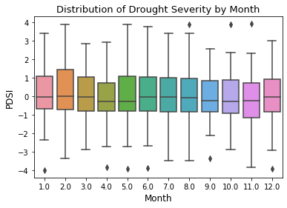
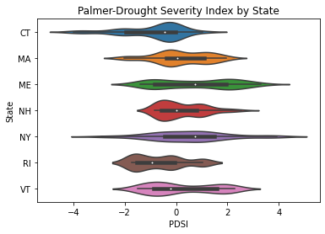
Drought Severity by Month and State
The Palmer Drought Severity Index (PDSI) measures drought conditions where <-4 represents extreme drought conditions, and >4 represents very wet conditions
The Northeast region has generally not experienced drought conditions

Slide 15
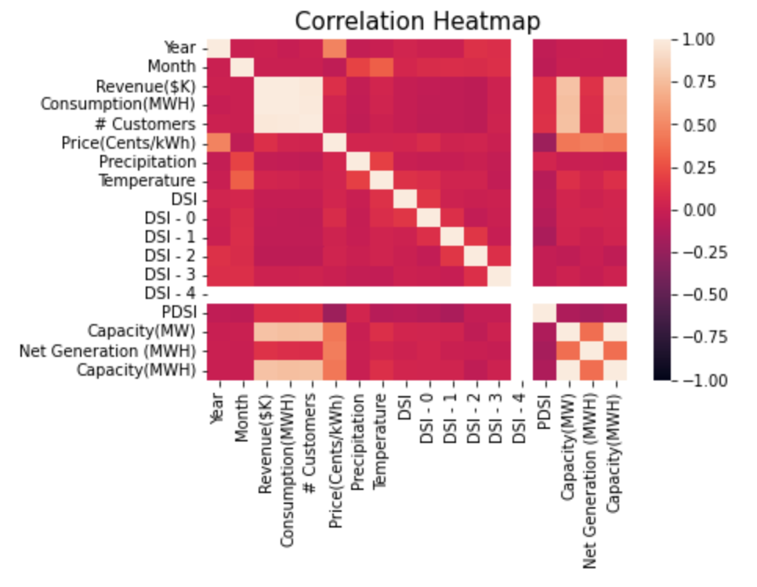
Correlation Heatmap

Slide 16
Model Performance Comparison
Model | MAE( Cents/kWh) | MSE | RMSE | Explained Variance Score
Linear Regression-without hyperparameter tuning | 1.09 | 1.88 | 1.37 | 48.5%
Lasso Regression- with tuning | 1.10 | 1.96 | 1.40 | 46.7%
Random Forest- without tuning | 0.86 | 1.34 | 1.16 | 63.7%
Random Forest- with tuning | 0.85 | 1.32 | 1.15 | 96.0%
XGBoost- with tuning | 1.29 | 4.31 | 2.07 | 66.3%

Slide 17
Feature Engineering
Temperature and Precipitation Lag.
Consumption per customer.
Percentage of power generated by power plants compared to their maximum capacity.
Percentage of electricity consumed by customers compared to net generation by power plants.
We also calculated the top 25% , bottom 25% and top/bottom 25% percentiles for these important engineered features
Calculating Drought Severity Index and Coverage Index
Encoding categorical variables to dummy variables for modeling
Normalizing data using Standard Scaler.
Notes:
We created features using feature combination and feature transformation techniques.
For example, for feature transformation, we created temperature and precipitation lag, which captures the correlation between electricity price and features in the previous period.
For feature combination, we created features to capture the combined effect of two features. For example, temperature/precipitation will capture the combined effect of temperature and precipitation on electricity prices. If we have high temperature and low precipitation, which mimics high drought conditions, the value of this feature will be high, which amplifies the effect of drought comparing to just using the original features alone.
We also engineered features using binning and bucketing techniques.
In the end, we generated 400+ new features, and some of our engineered features actually showed up in the most important features, which suggest that our new features do have good predictive power.

Slide 18
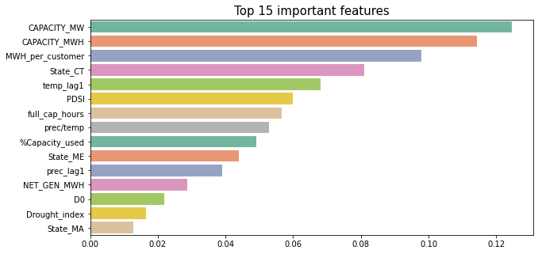
Random Forest Feature Importance
The most Important Features correlated with electricity prices in our dataset are:
Capacity of power plants in MWH
Temperature in the previous period
Palmer Drought Severity Index
Full capacity used hours
Notes:
Based on our best model, random forest, here are the most important features with a descending importance from top to bottom.
We can see that the most important features that is correlated with electricity prices include:
Briefly read through this part and continue with the explanation in the next slide
Capacity of power plants in MWH
Temperature in the previous period
Palmer Drought Severity Index
Full capacity used hours

Slide 19
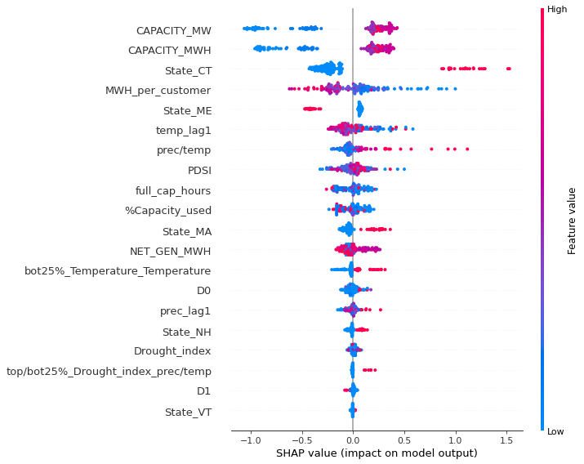
SHAP Explanation
High electricity price is positively
correlated with
High temperature in the previous period
Low electricity consumption per customer
High PDSI value (Palmer Drought Severity Index)
High Precipitation/Temperature
State particular characteristics (ME lower price vs CT higher price)
Notes:
Let’s take a closer look at the most important features with SHAP, which allows us to see each feature’s direction of impact on the energy price.
Color in each feature shows the value of each feature, blue indicates a low value and red indicates a high value.
The x axis shows the direction of impact, a positive value indicates higher predicted electricity price.
From this graph, we can see that a high electricity price is positively correlated with
•High temperature in the previous period
•Low electricity consumption per customer
•High PDSI value (Palmer Drought Severity Index)
•High Precipitation/Temperature
•State particular characteristics (ME lower price vs CT high)

Slide 20
Challenges
Data Sources were spread out and we had to dig into several websites, reach out to different industry experts which delayed the process initially but eventually we were able to gather a comprehensive list of features to solve the business problem
Some of the data had to be collected using API , some was direct download and some was within the maps so it took a lot of time and effort gathering data and merging that into one dataset
Limited number of observations available we had 840 observations across 10 years 2011-2020: we tried to add plant level data to the energy dataset and use both in our EDA and modeling approaches

Slide 21
Conclusions
Model Performance (MAE, in cents/kWh)
3.5 ----> 0.85
Improved model performance to predict price more accurately
Project Impact:
Enables individuals and businesses to better understand and plan for electricity consumption
Enables government organizations to take preventive measures to support low-income communities, if the electricity prices are forecasted to increase due to drought conditions.
Pitfalls:
Correlation vs. Causation, our model results only shows correlation, while it does not imply causation
Notes:
Pitfalls:
our model only shows correlation, not causation. Since we are only investigating which features are correlated with energy price, we need to cautious when making recommendations to businesses and individuals. There’s a complicated system calculating energy price, and some of the results we got could be the effect or outcome of changed energy price. Failing to understand that could be problematic and misleading.
To study causational relationship, we could further the analysis by conducting granger causality test on the top features to investigate causality.

Slide 22
Next Steps
The Project can be scaled up to include socio-economic factors, regulatory factors and snowfall can be made readily available as a front-end tool for energy utilities and communities looking for electricity price forecasting.
The dashboards created can be used to understand trends in electricity pricing levels which can be essential information for grid operators and energy field workers.
This business analysis can be used as a baseline model to develop insights and statistics for the Western states.
As drought is prevalent in the western part of the country, factors like humidity, cost of fuel, water-retention capacity of soil and power plant location can be considered.

Slide 23
Appendix
https://www.eia.gov/electricity/data.php
https://www.drought.gov/sectors/energy#impacts
https://www.drought.gov/sectors/energy#map
http://nedews.nrcc.cornell.edu/
https://www.altexsoft.com/blog/business/price-forecasting-machine-learning-based-approaches-applied-to-electricity-flights-hotels-real-estate-and-stock-pricing/
https://www.sciencebase.gov/catalog/item/58209752e4b080404e6fa8f0

Slide 24
Github and Tableau Dashboard
LinkedIn Profiles
Github Repository
Tableau Dashboard
https://www.linkedin.com/in/yuxuan-mei/
https://www.linkedin.com/in/chinar-boolchandani/
https://www.linkedin.com/in/yapeixiong/
https://www.linkedin.com/in/cordell-williams/
https://www.linkedin.com/in/subhiksha/

Slide 25
Thank You!
Questions?

