Slide 1


Impact of Drought Conditions on Energy Sector
Team A1 :
Chinar Boolchandani, Cordell Williams, Subhiksha Sivasubramanian, Yapei Xiong, Yuxuan Mei

Slide 2





Meet Our Team:
Subhiksha Sivasubramanian
Yapei Xiong
Yuxuan Mei
Chinar Boolchandani
Cordell Williams

Slide 3
Agenda
Research Methodology
Problem Statement
Business Impact
Data Collection and Dataset Information
EDA and Predictive Modeling
Current Challenges and Next Steps
Appendix

Slide 4
Research Methodology
INSIGHTS AND ANALYTICS
INDUSTRY IDENTIFICATION
MODEL BUILDING
CONDUCT RESEARCH
DATA MUNGING/CLEANING

Slide 5
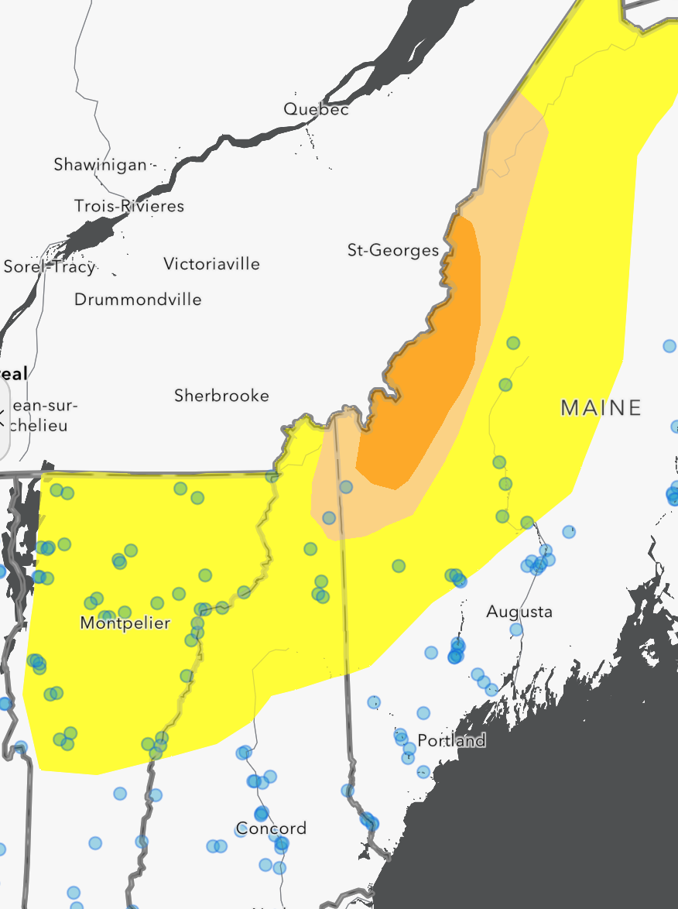
Problem Statement
Understanding the correlation between drought conditions-such as temperature and precipitation with fluctuations in electricity prices.
North-East states under analysis:
Maine
Vermont
Massachusetts
Connecticut
New York
Rhode Island

Slide 6
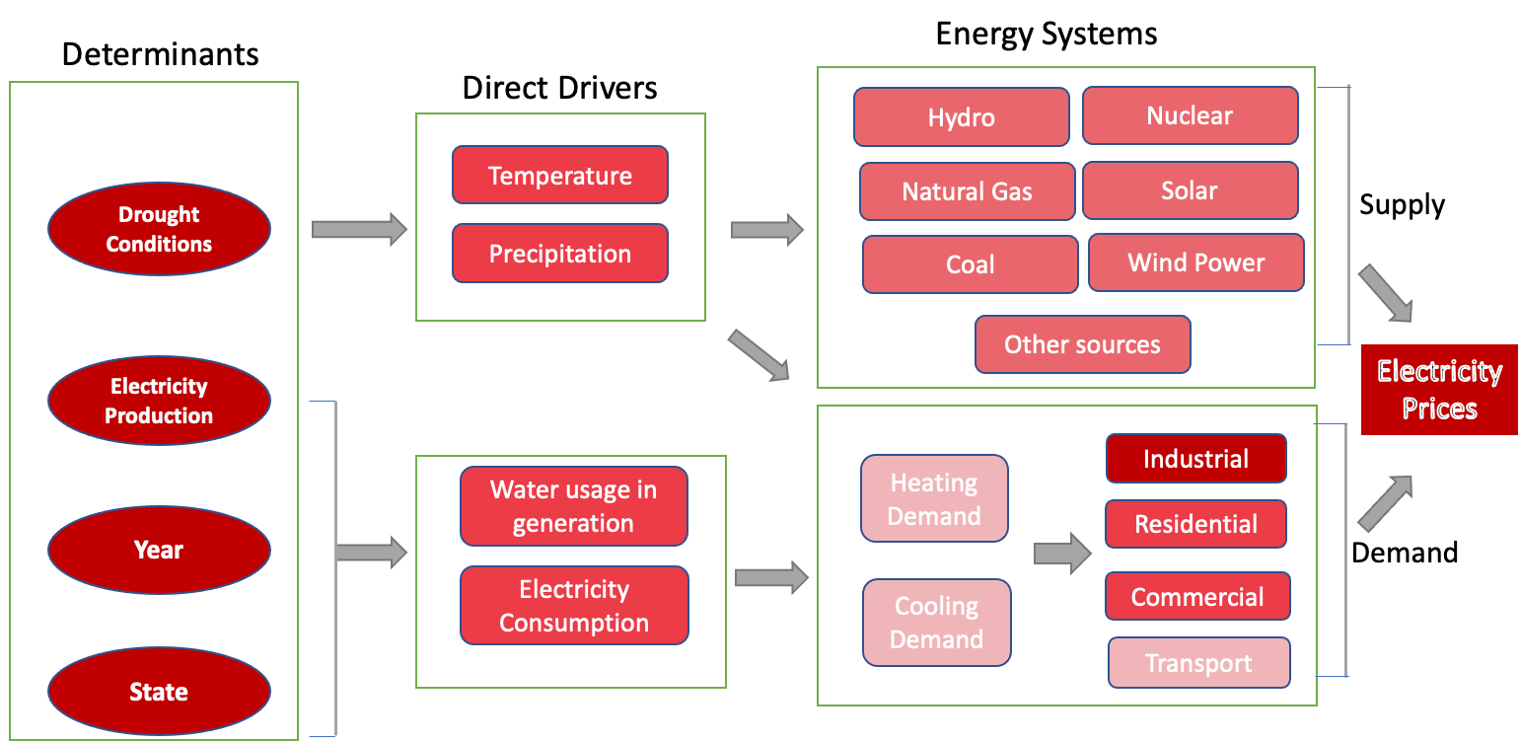
Business Impact
We aim to help electricity generating utilities understand some of the most important aspects of electricity price volatility

Slide 7
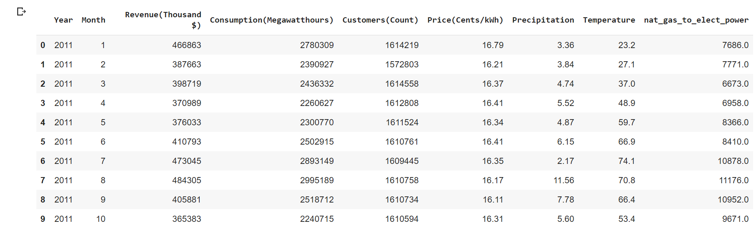
Data Collection
COLUMN | UNITS
Revenue | $ Thousand
Consumption | Megawatt/hour
Precipitation | Inches
Temperature | Fahrenheit

Slide 8
Dataset Information
Dimensions:
50 Columns
840 Rows
Time Range: 2011-2020
Uses of Water：
Public Supply
Domestic
Industrial
Irrigation
Irrigation of Cooperation
Irrigation of Golf
Livestock
Aquaculture
Mining
Thermoelectric
Thermoelectric once-through
Thermoelectric recirculating
Total withdrawals
Irrigation and Thermoelectric.
Sources:
US Energy Information Administration (EIA)
US Geological Survey (USGS)
National Oceanic and Atmospheric Administration (NOAA)

Slide 9
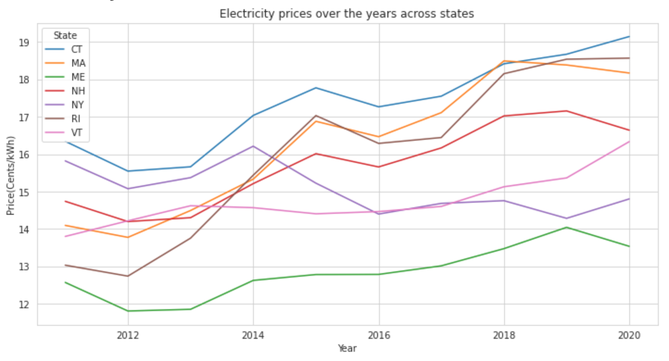
Exploratory Data Analysis
Intuitively Electricity prices have increased over the years for all states

Slide 10
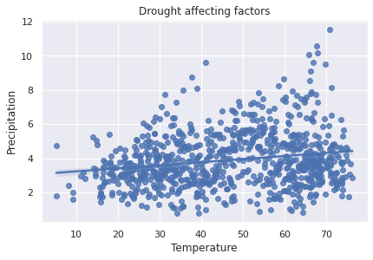
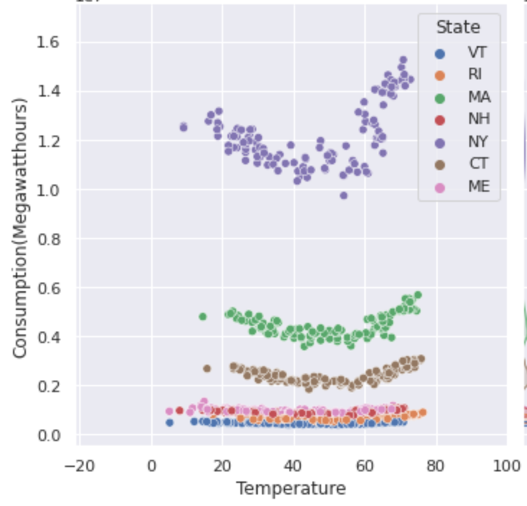
EDA Contd.
Temperature vs Precipitation relationship
Consumption vs Temperature relationship

Slide 11
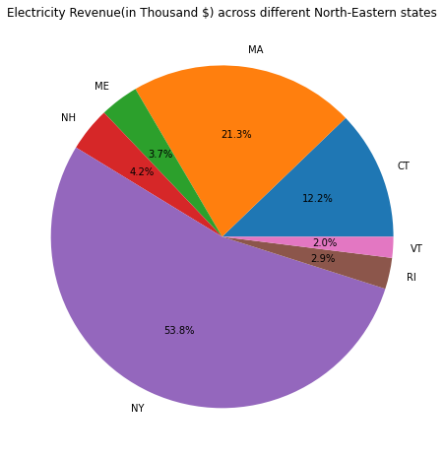
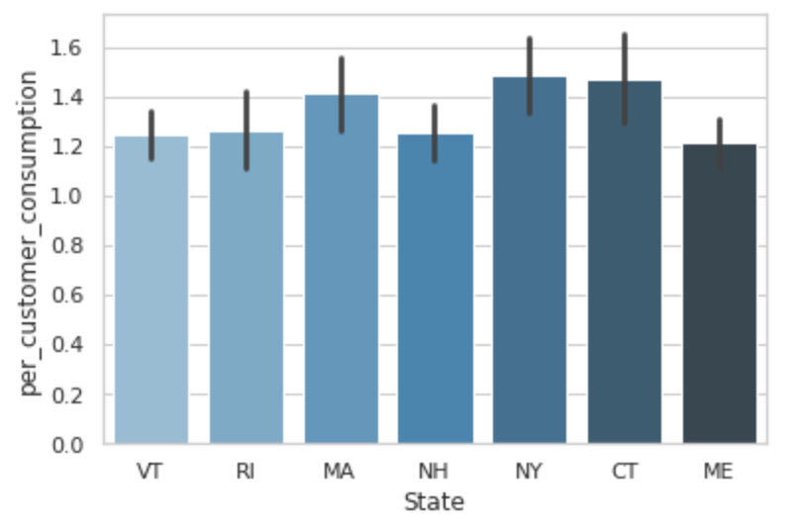
EDA Contd.
State-Wise electricity consumption per customer
State-Wise Revenue from electricity

Slide 12
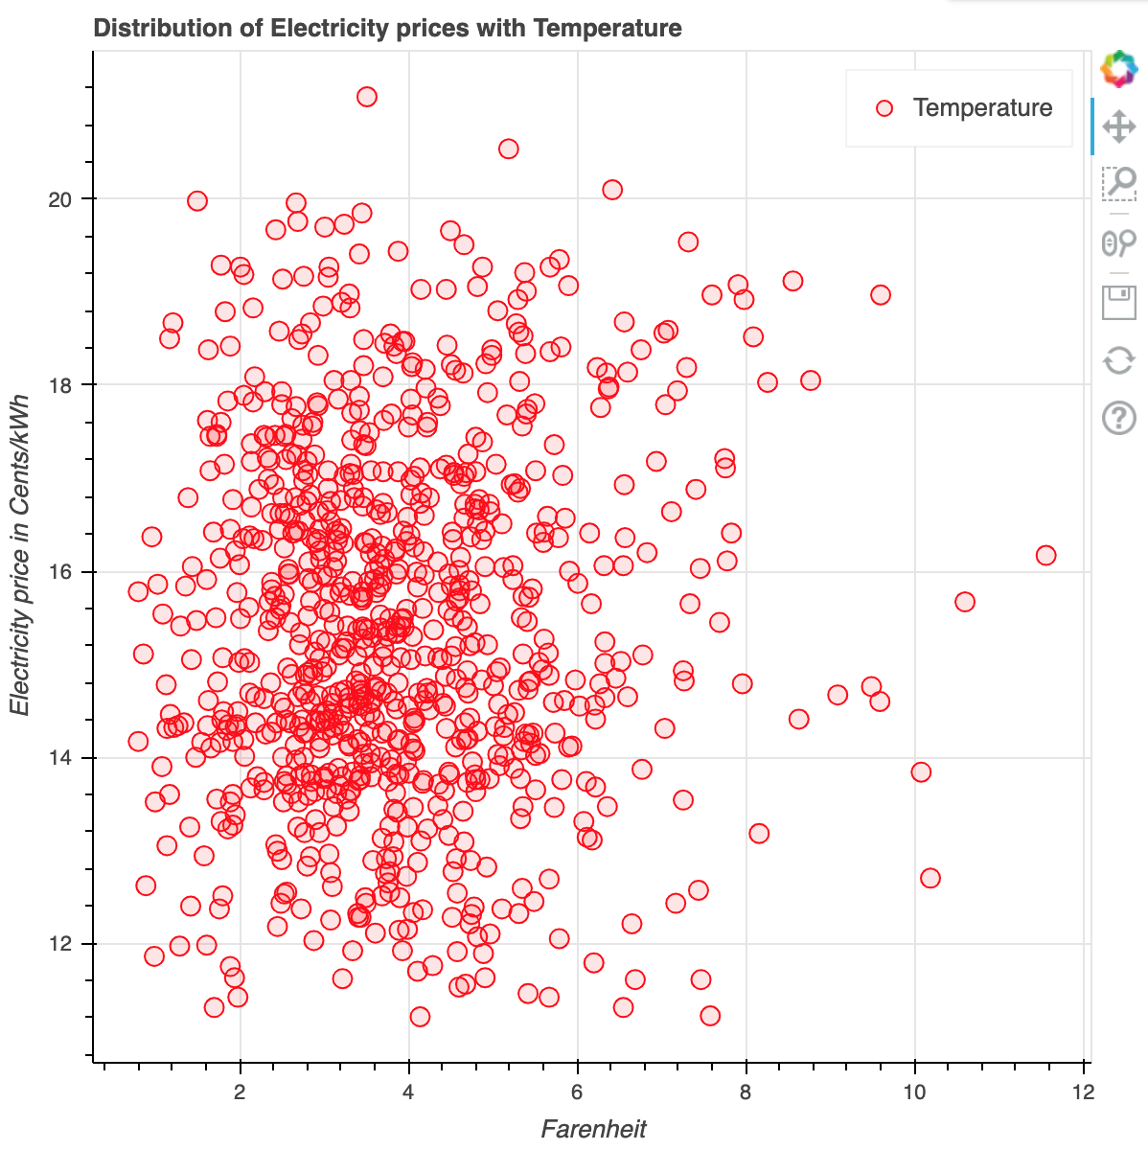
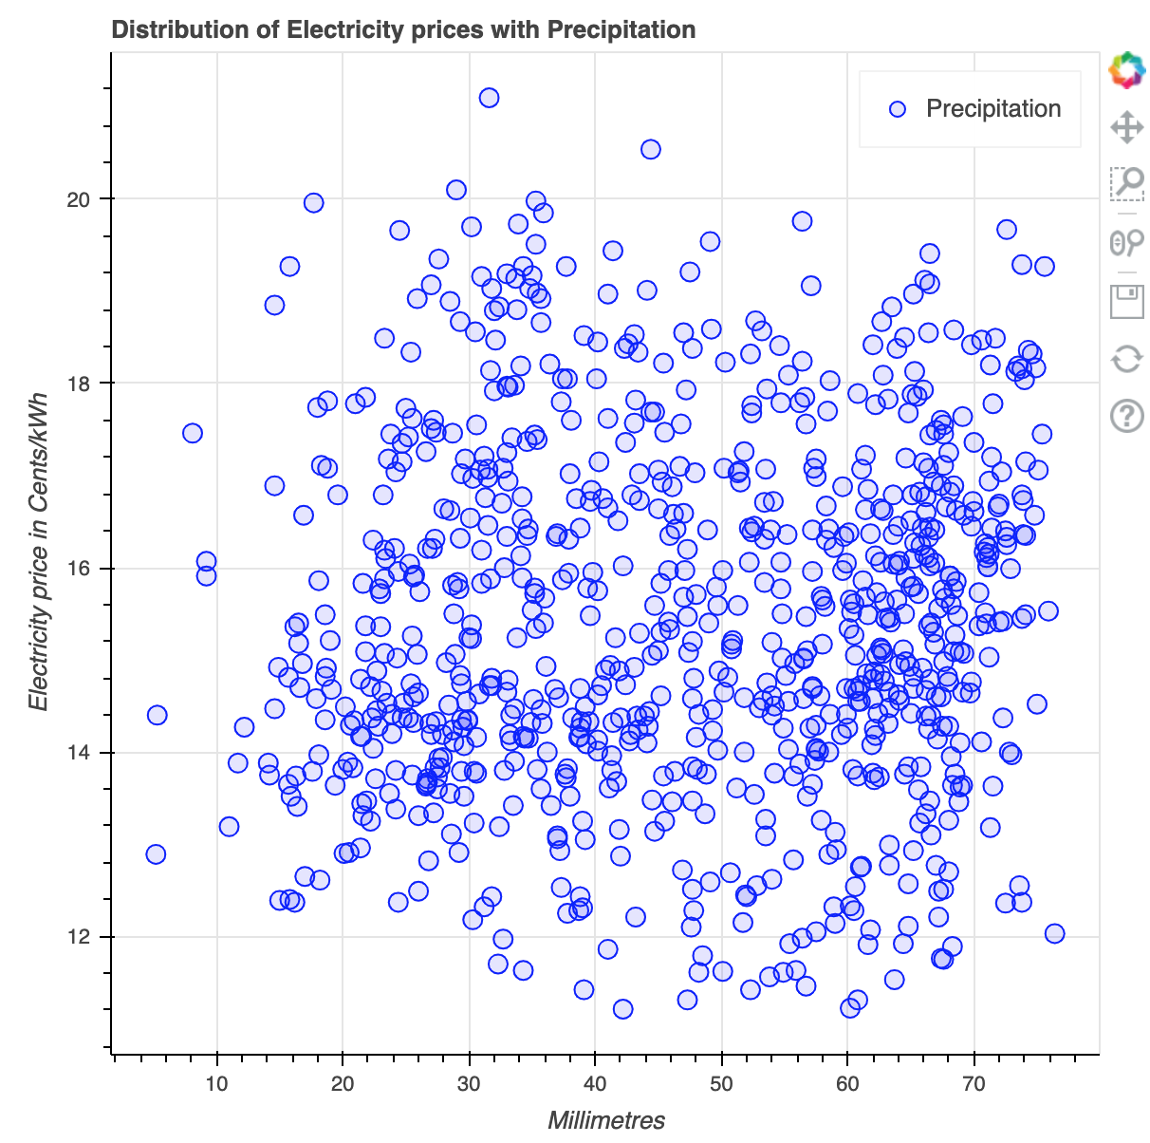
EDA Contd.
Electricity prices vs Precipitation variation
Electricity prices vs Temperature variation

Slide 13
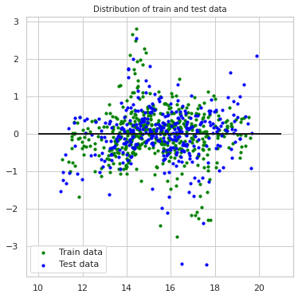
Predictive Modeling
Linear Regression
Variance Score | 86.5%
Mean Absolute Error | 0.573 Cents/kWh

Slide 14
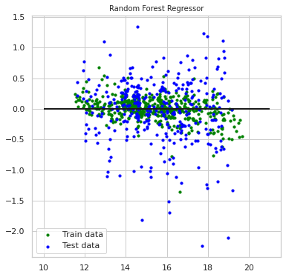
Random Forest Regressor
Variance score | 92.8%
Mean Absolute Error | 0.48 Cents/kWh

Slide 15
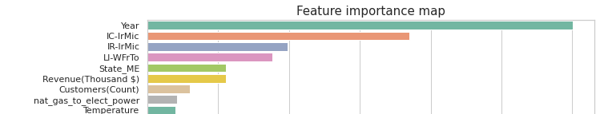
Feature Importance
Feature Importance : Random Forest Regressor
Important Features impacting electricity prices in our dataset are:
Year : 2011-2020
Water Sources like : Irrigation,acres irrigated etc.
Demand- Consumer count
State - Some States have higher prices

Slide 16
Current Challenges
Limited number of observations available
Mismatch of data frequency (yearly vs. monthly) due to limited public data availability, which creates a mismatch with our 1-month prediction window
Missing features that could be important to our analysis

Slide 17
Next Steps
Solution to our challenges
Continue our research into the energy/drought field, and supplement our dataset
Customize data imputation methods to address the data frequency mismatch issue
Use sampling methods to address the sample size problem
Improve model performance
Feature engineering to capture the non-linear interaction relationships between features
Try different models including a Neural Network model with RNN layer, gradient boosted tree model
Final Deliverable
A complete 10-year dataset related to drought and energy in the Northeast region
An interpretable model that predicts the electricity supply price at a monthly level
Easy to understand key statistics and insights for businesses and individuals

Slide 18
Appendix
https://www.eia.gov/electricity/data.php
https://www.drought.gov/sectors/energy#impacts
https://www.drought.gov/sectors/energy#map
http://nedews.nrcc.cornell.edu/
https://www.altexsoft.com/blog/business/price-forecasting-machine-learning-based-approaches-applied-to-electricity-flights-hotels-real-estate-and-stock-pricing/
https://www.sciencebase.gov/catalog/item/58209752e4b080404e6fa8f0

Slide 19
Thank You!
Questions?

