Slide 1
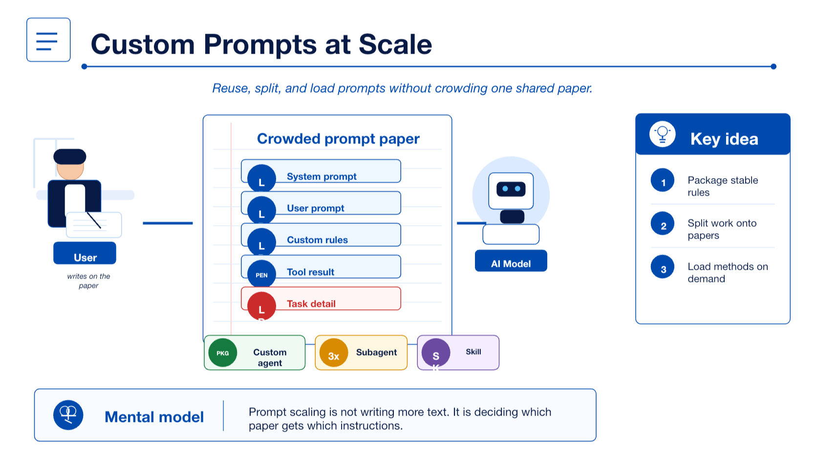
Notes:
Lesson 2 starts where Lesson 1 ended: prompts are written onto a limited paper. This lesson is about scaling prompt-like instructions without crowding the same context.

Slide 2
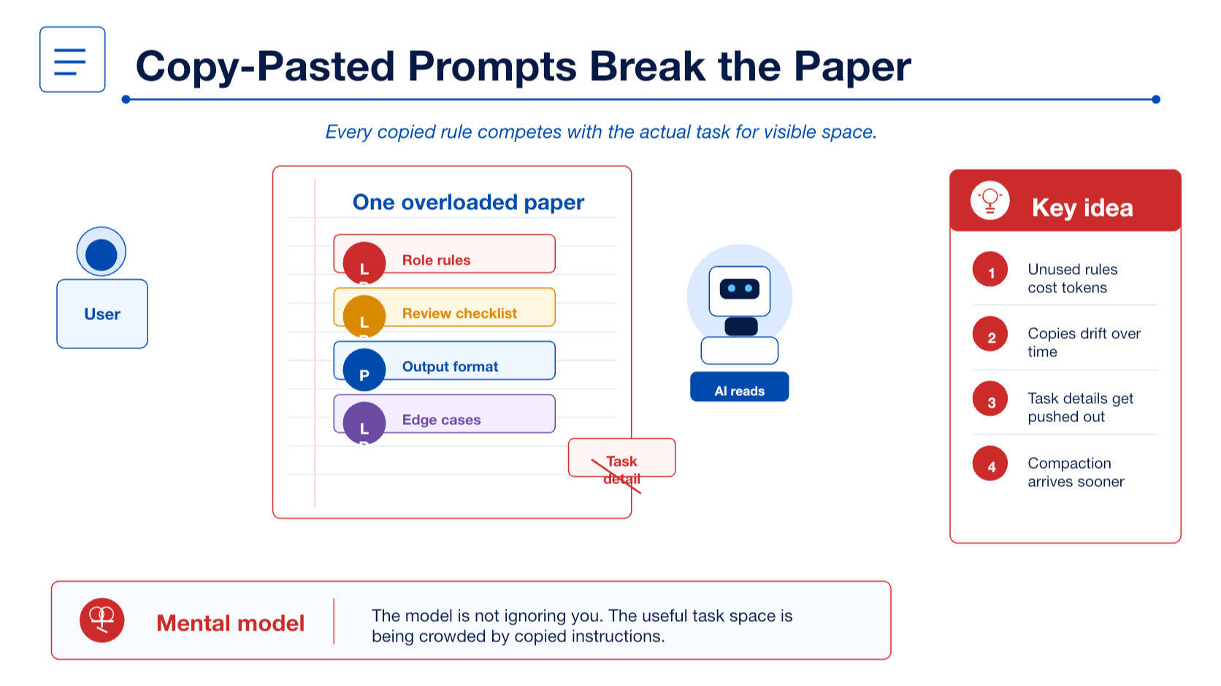
Notes:
Show why copy-pasting custom prompts breaks down. The model still only sees one paper, so duplicated rules compete with the actual task.

Slide 3
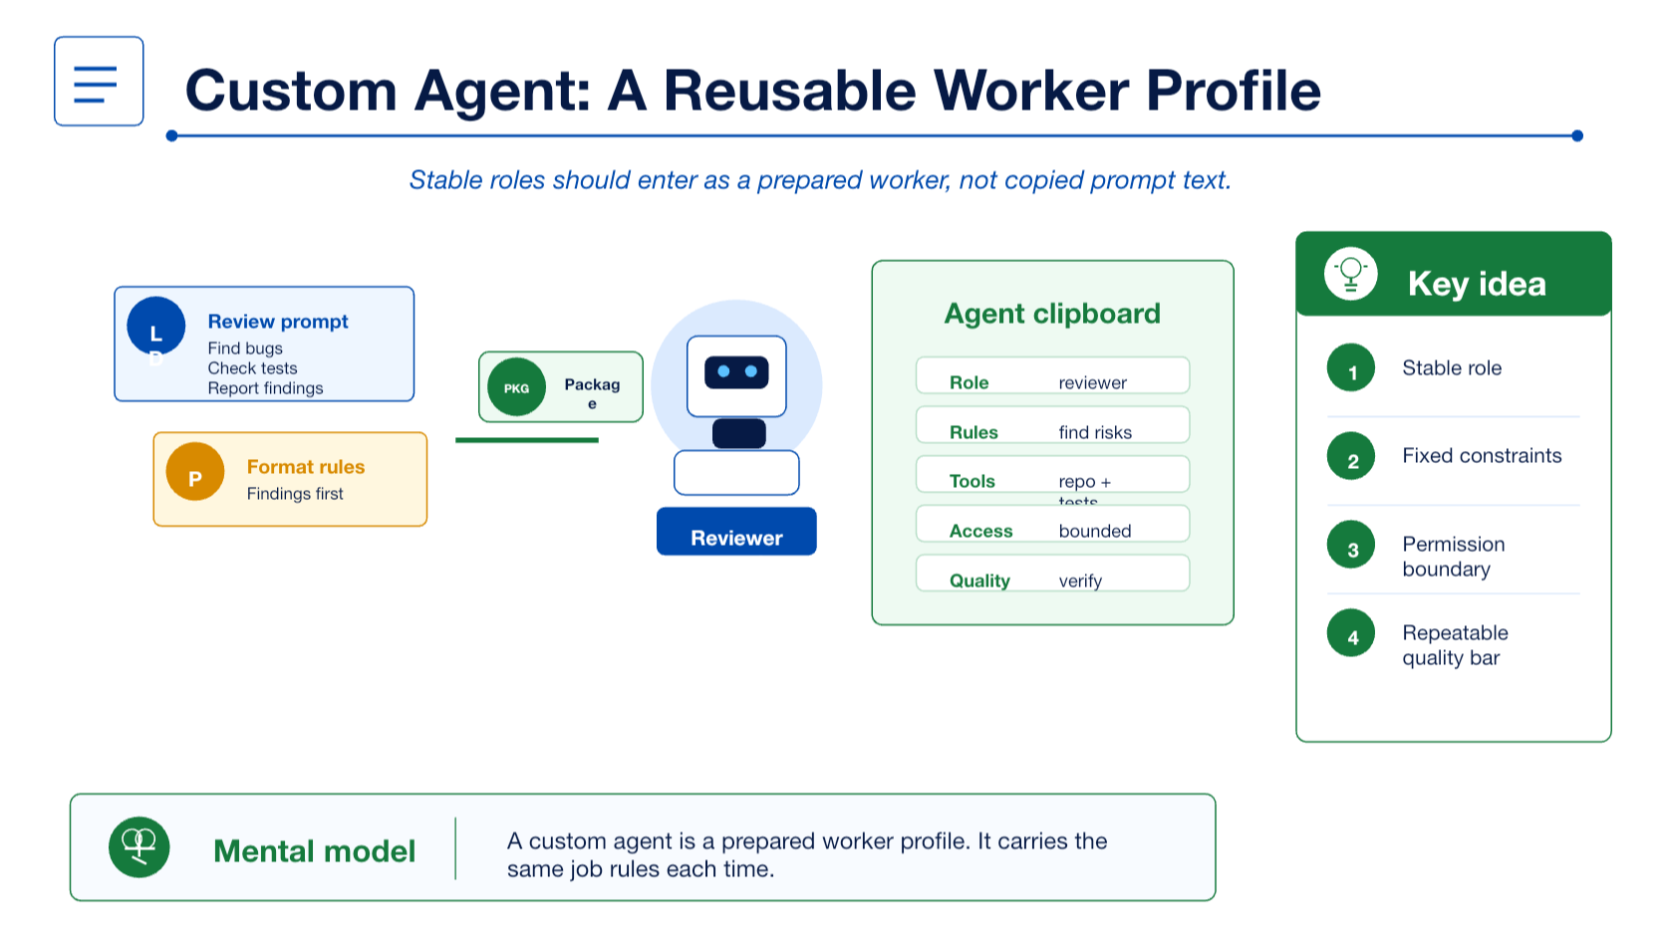
Notes:
A custom agent packages a stable role and working profile. Treat it as a reusable worker identity, not a longer one-off prompt.

Slide 4
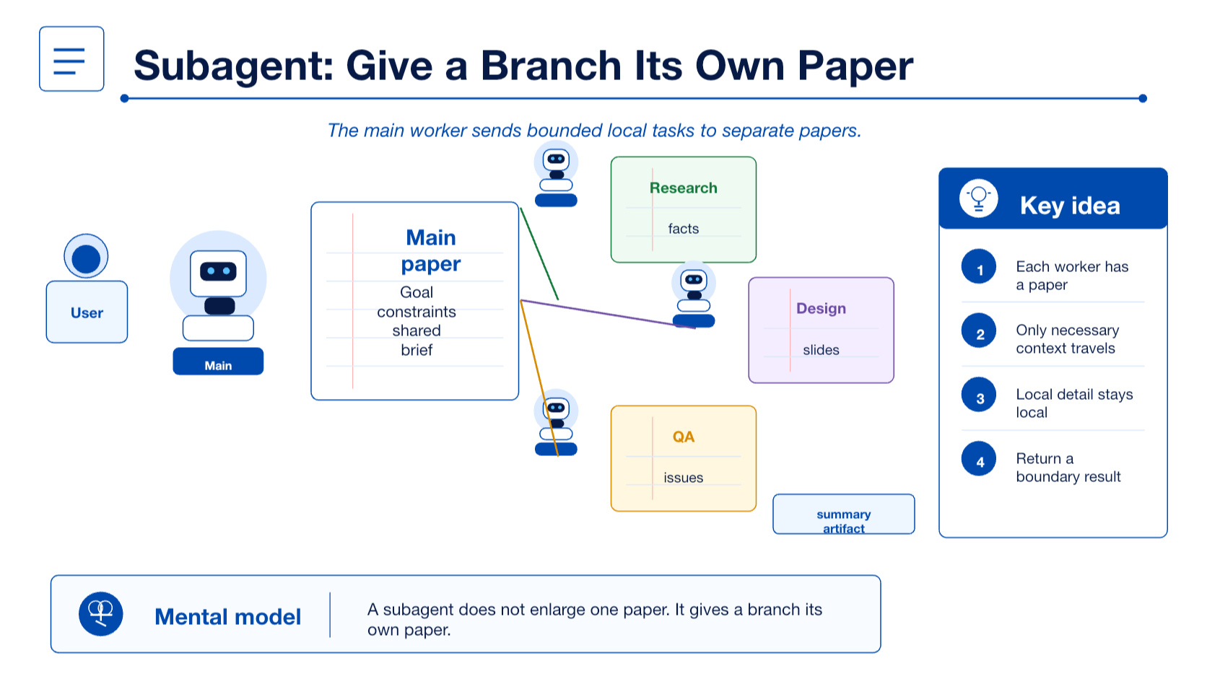
Notes:
A subagent is a delegated worker with its own paper. The main thread sends a bounded brief and receives a summary or artifact back.

Slide 5
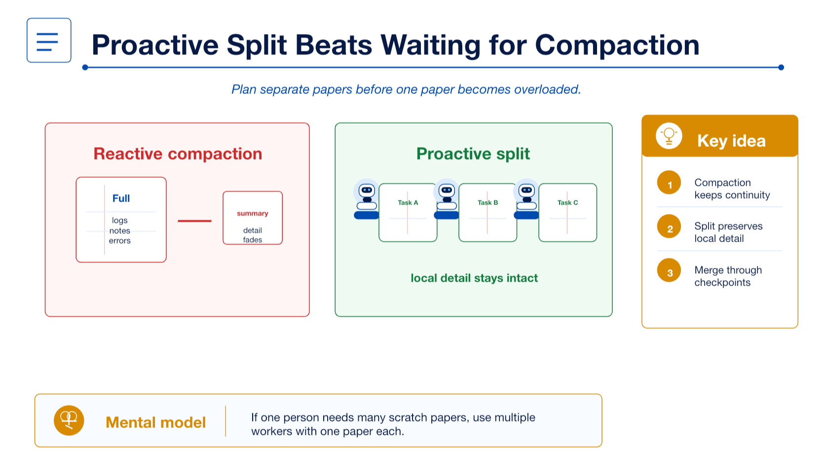
Notes:
Compaction compresses one crowded paper. Subagent decomposition proactively gives weakly coupled branches their own papers before detail is compressed away.

Slide 6
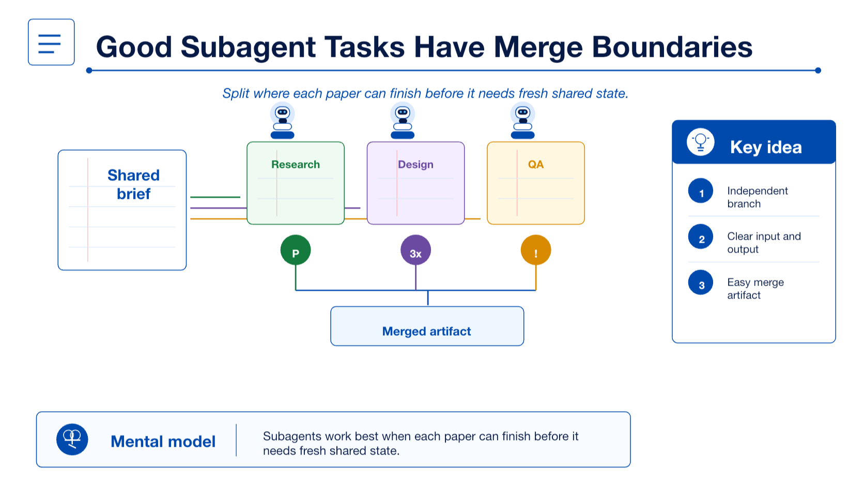
Notes:
Subagents work best when local papers can make progress and rejoin through a clear merge artifact. Coupling is a synchronization question, not an automatic ban.

Slide 7
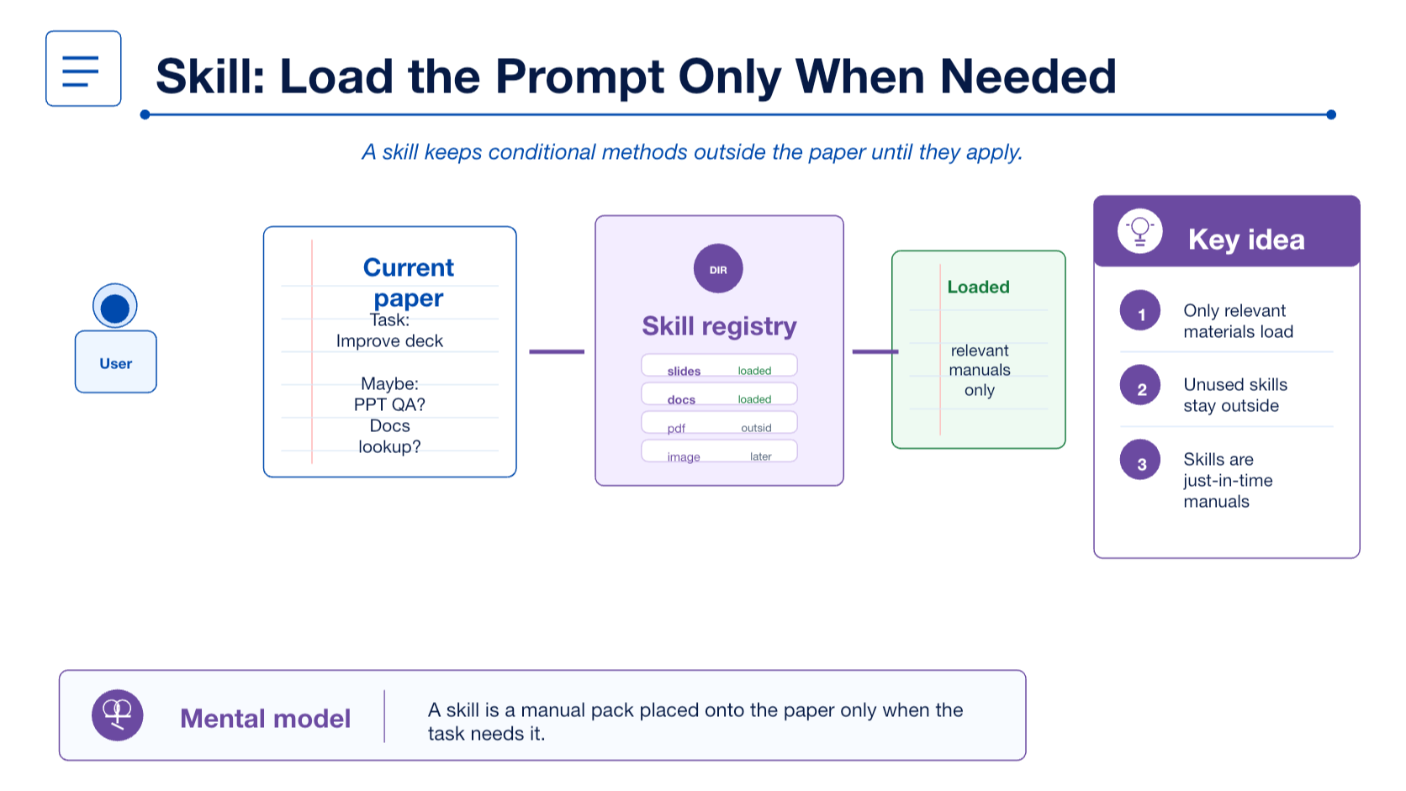
Notes:
Skills solve the conditional-loading problem. Keep a method outside the paper until the task actually needs that manual or checklist.

Slide 8
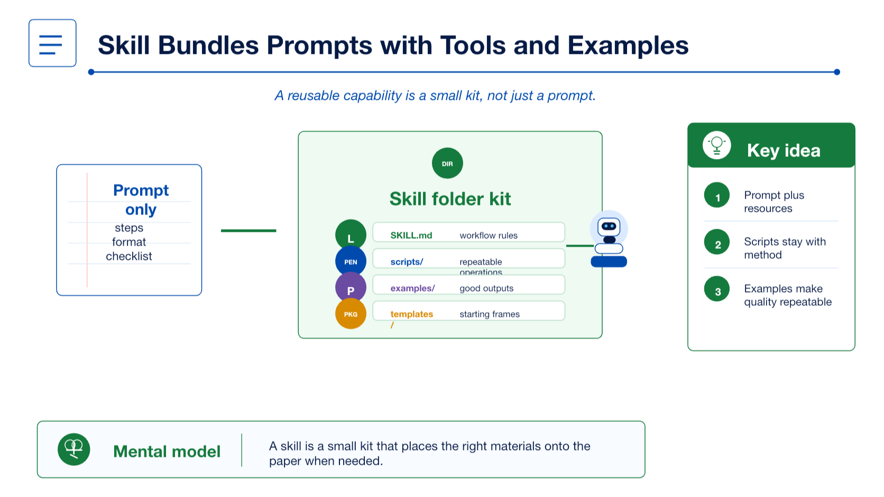
Notes:
A skill can be a small capability kit. It can keep workflow instructions, scripts, examples, templates, and references together.

Slide 9
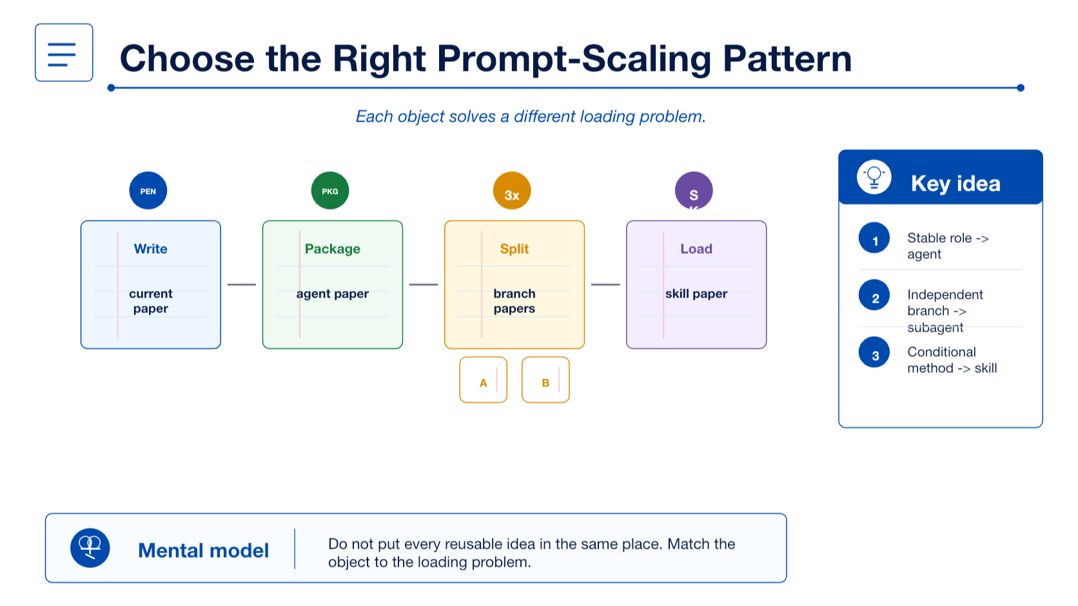
Notes:
This slide gives the selection rule: one-off prompt, custom agent, subagent, and skill each solve a different context-loading problem.

Slide 10
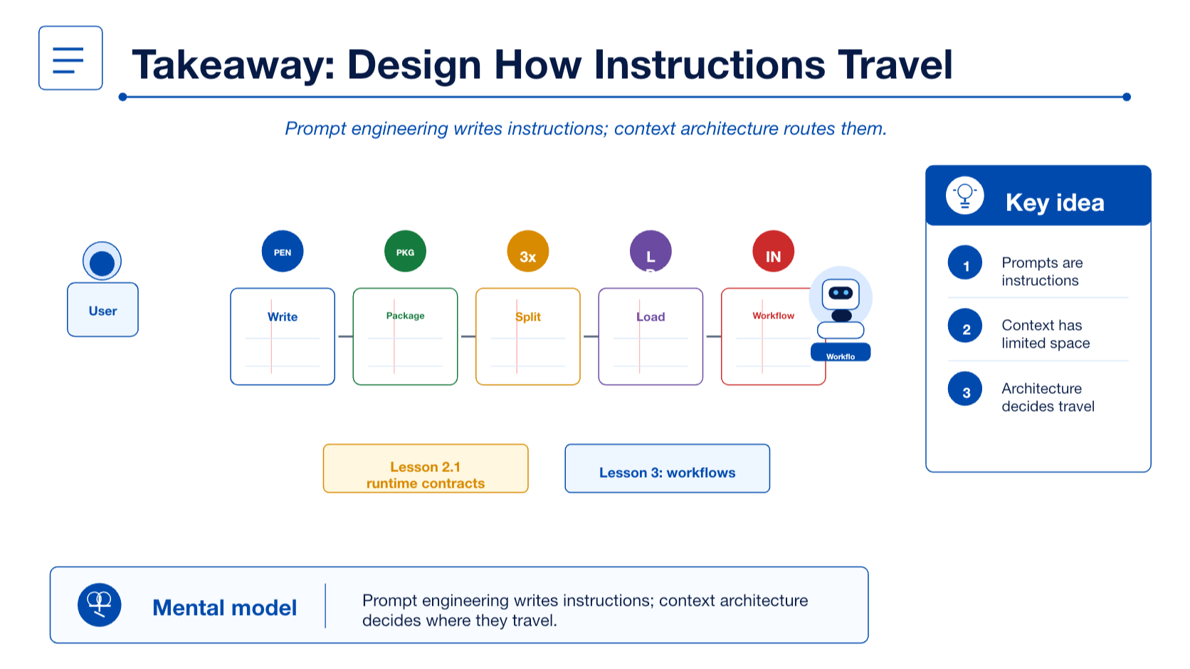
Notes:
Close with the operating model: prompt engineering writes instructions; context architecture decides where those instructions travel.

