Slide 1
ARIMA AND SARIMA TIME SERIES MODELS ON SEaSoNaL DATA AND VAR(Vector Auto regression) ON Multivariate Dataset
Presented by
Chindam saidheeraj
200474009

Slide 2
REFERENCES
Publication from scholarpedia on granger causality
doi:10.4249/scholarpedia.1667
Introduction to Modern Time Series (Book)
https://books.google.ca/books?hl=en&lr=&id=o7jWV67165QC&oi=fnd&pg=PR5&dq=time+series+research+paper&ots=mqjiWUIi_u&sig=avLaNb6mC15BSzoUl-5-tIdfTHA#v=onepage&q&f=false
Machine learning for time series forecasting with python (Book)
https://casls-primo-prod.hosted.exlibrisgroup.com/permalink/f/2k7505/01CASLS_REGINA_ALMA51256598830003476

Slide 3
What IS TIMESERIES AND TIME SERIES FORECASTING?
In mathematics, a time series is a series of data points indexed in time order. Most commonly, a time series is a sequence taken at successive equally spaced points in time.
Time series forecasting is a technique for the prediction of events through a sequence of time.
The technique is used across many fields of study, from the geology to behavior to economics.
The techniques predict future events by analyzing the trends of the past, on the assumption that future trends will hold similar to historical trends.
Time series forecasting is performed in a variety of applications including:
1. Weather forecasting
2. Mathematical finance
Notes:
Reference:https://www.techtarget.com/whatis/definition/time-series-forecasting

Slide 4
WHAT IS arima (AUTO REGRESSIVE INTEGRATED MOVING AVERAGE MODEL)?
y’(t) = c + ϕ1* y′(t−1) +⋯ + ϕp*y′(t−p) + θ1*ε(t−1) +⋯ + θq*ε(t−q) + εt
There are three terms in the equation :
AR : Auto Regression : The time series is regressed with its previous values i.e. y(t-1), y(t-2) etc. The order of the lag is denoted as p.
I : Integration : The time series uses differencing to make it stationary. The order of the difference is denoted as d.
MA : Moving Average : The time series is regressed with residuals of the past observations i.e. error ε(t-1), error ε(t-2) etc. The order of the error lag is denoted as q.
In the above equation, y′t is the differenced series, ϕ1 is the coefficient of the first AR term, p is the order of the AR term, θ1 is the coefficient of the first MA term, q is the order of the MA term and εt is the error.
Notes:
Reference: https://towardsdatascience.com/introduction-to-time-series-forecasting-part-2-arima-models-9f47bf0f476b

Slide 5
Components of time series
Secular Trends (or General Trends)
Seasonal Movements
Cyclical Movements
Irregular Fluctuations
Notes:
Reference:
https://www.emathzone.com/tutorials/basic-statistics/components-of-time-series.html#ixzz7X9YXu0c2

Slide 6
Stationary Time SERIES
A stationary time series will have the same statistical properties i.e. same mean, variance and covariance no matter at what point we measure them, these properties are therefore time invariant.
The series will have no predictable patterns in the long-term. Time plot will show the series to be roughly horizontal with constant mean and variance.
For good predictions time series models should have stationary data.
Notes:
Reference : https://www.machinelearningplus.com/time-series/augmented-dickey-fuller-test/

Slide 7
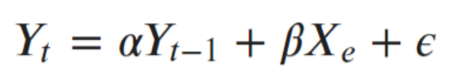
AUGUMENTED DICKEY FULLER TEST
Augmented Dickey Fuller test (ADF Test) is a common statistical test used to test whether a given Time series is stationary or not. It is one of the most commonly used statistical test when it comes to analyzing the stationary of a series.
there is a hypothesis testing involved with a null and alternate hypothesis and as a result a test statistic is computed and p-values get reported
What is a Unit Root Test?
Unit root is a characteristic of a time series that makes it non-stationary. Technically speaking, a unit root is said to exist in a time series of the value of alpha = 1 in the below equation.
The presence of a unit root means the time series is non-stationary. Besides, the number of unit roots contained in the series corresponds to the number of differencing operations required to make the series stationary

Slide 8
Continuation:
The ADF test include high order regressive process in the model.
y(t-1) = lag 1 of time series
delta Y(t-1) = first difference of the series at time (t-1)
Null Hypothesis (H0): alpha=1 indicates presence of root node which means non stationary
Since the null hypothesis assumes the presence of unit root, that is α=1, the p-value obtained should be less than the significance level (say 0.05) in order to reject the null hypothesis. Thereby, inferring that the series is stationary.

Slide 9
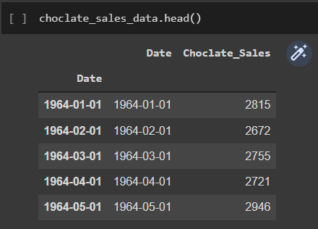
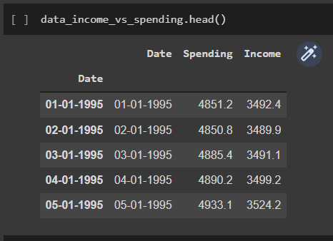
Data setS USED IN THIS PROJECT
Chocolate Sales in millions (1964-1972)
This Dataset is Univariate which has seasonal effect. This dataset is used for ARIMA AND SARIMA
Income and spending data (1995-2015)
This Dataset is multivariate. In this project it is used for analysing vector auto regression.

Slide 10
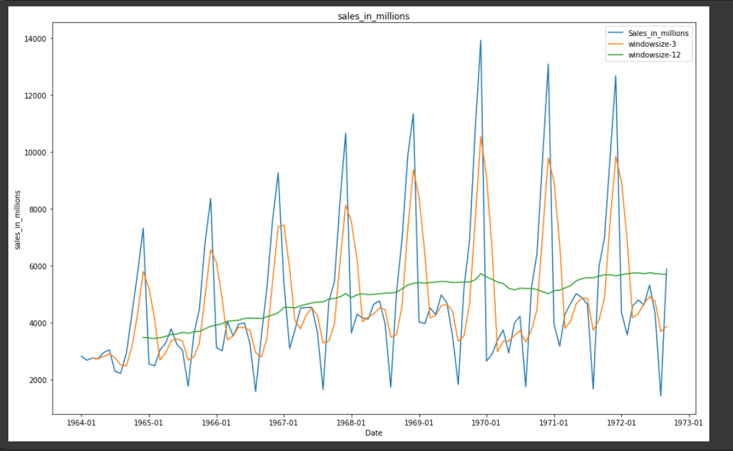
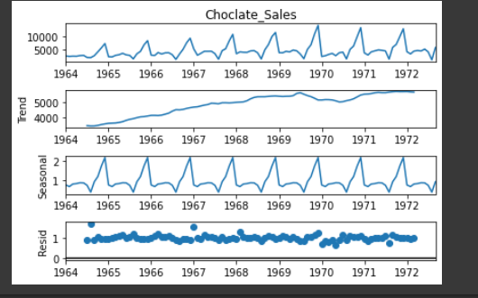
Understanding chocolate sales

Slide 11
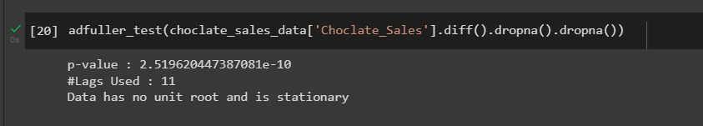
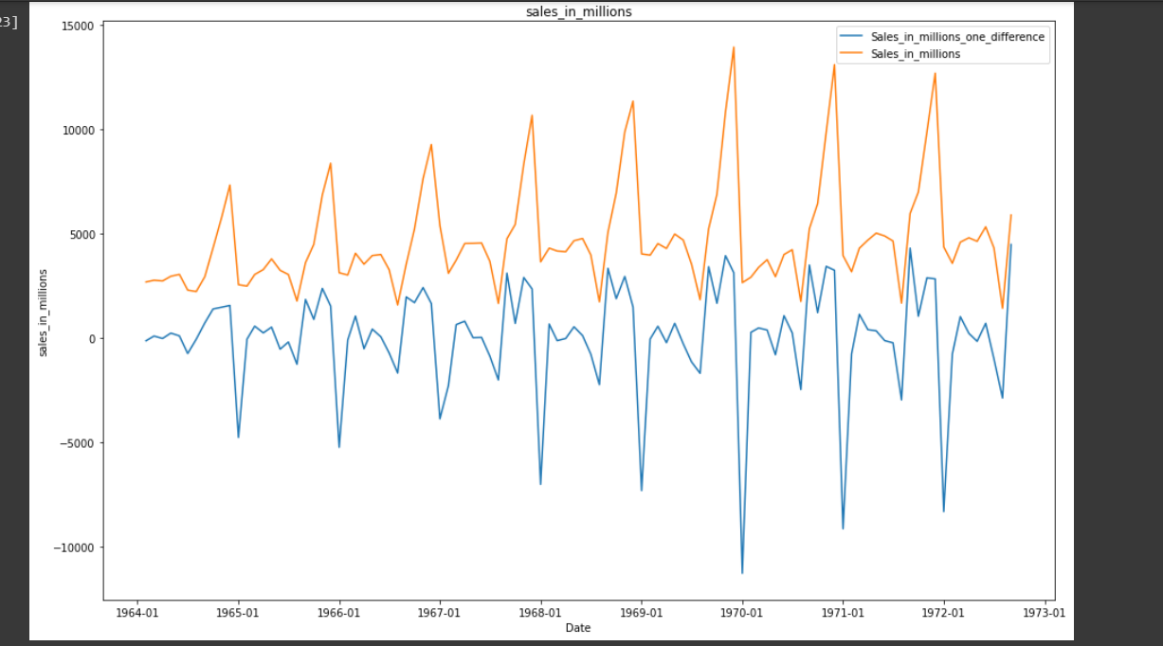
CHECK FOR STATIONARITY
Data is stationary after applying first difference

Slide 12
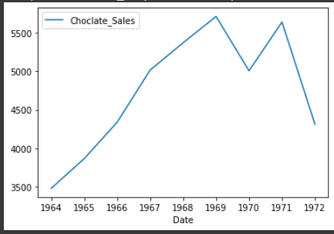
How to remove seasonality?
General approach is by differencing data by multiple time lags
Taking seasonal average in case of this data set if we take seasonal average for 1 year and build model we will be losing lot of data while averaging and while forecasting for months it would be not so accurate.
Below plot is the seasonal average plot.

Slide 13
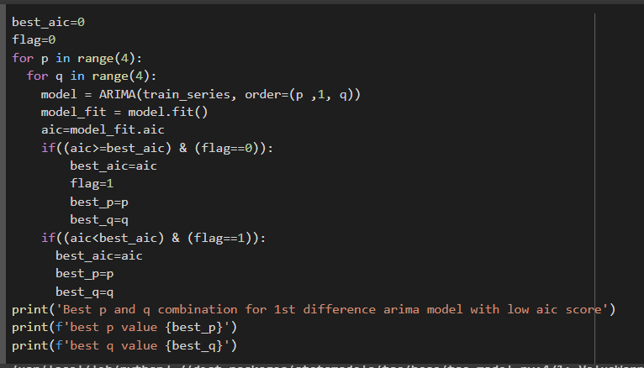

Choosing p and q for ARIMA
AIC Calculation:
AIC=2k-2l
Where
l is log likelihood
k is number of parameters

Slide 14
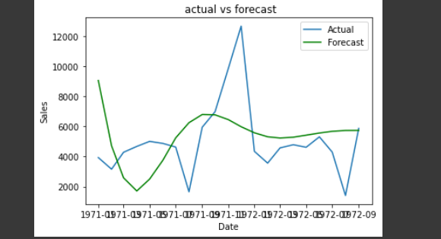
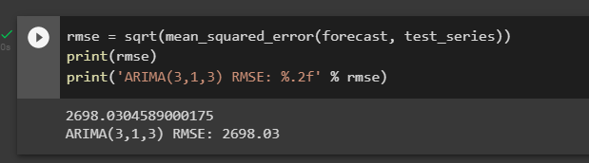
ARIMA(3,1,3) PREDICTIONS ON SEOSONAL DATA

Slide 15
Why Seasonal arima? WHEN WE HAVE arima?
ARIMA does not support seasonal data. For time series that has a significant seasonal pattern, seasonal ARIMA model is used.
How does it differ from ARIMA?
In addition to the three parameters in ARIMA i.e. p, d, q, SARIMA has three more seasonal
parameters (P, D, Q).
The additional three parameters account for Autoregressive component (P), Differencing component (D) and Moving Average Component (Q) at the seasonal level.
It can be expressed as follows: ARIMA (p, d, q) (P, D, Q)m Here m is number of observations per season (In our case, m is 12). The seasonal components of the model are expressed in upper case and non seasonal components of the model are expressed in lower case.
Notes:
https://towardsdatascience.com/introduction-to-time-series-forecasting-part-2-arima-models-9f47bf0f476b

Slide 16
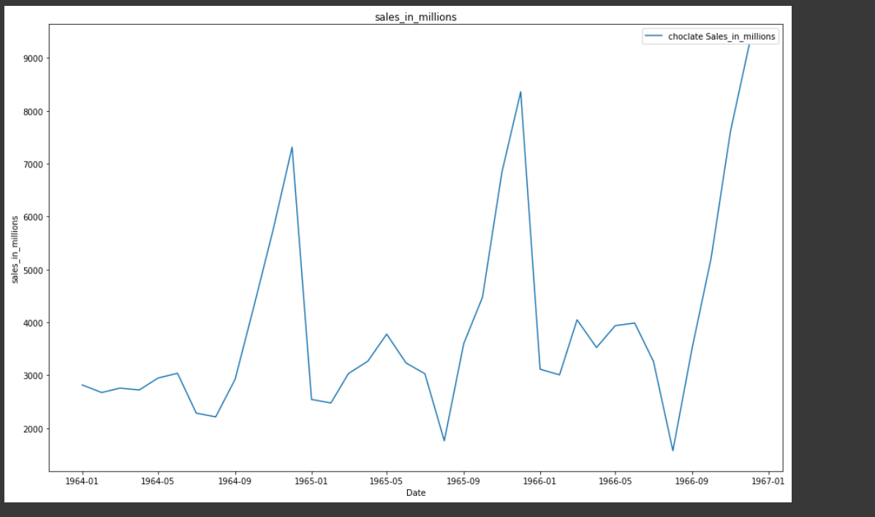
Seasonal arima
Choosing SEASONAL P and Q for SARIMA. Based on below plot I am considering 2 different seasonal durations
4 months
12 months

Slide 17
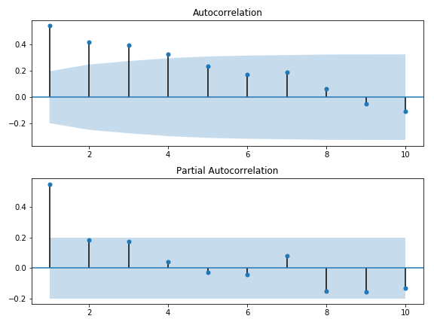
Understanding PACF AND ACF PLOTS
PACF: By this plot we can analyse the direct effect of a particular lagged time series values with current time series values without the intermediate lagged values effect
ACF: By this plot we can analyse the indirect effect of particular lagged time series with current time series
Notes:
https://assets.datacamp.com/production/repositories/4567/datasets/37a49285437ca766609fc8d8569ba0bbd1423d39/earthquakes_pacf.png

Slide 18
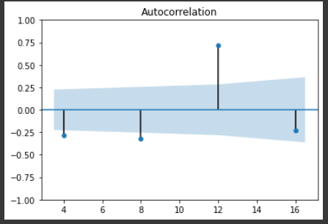
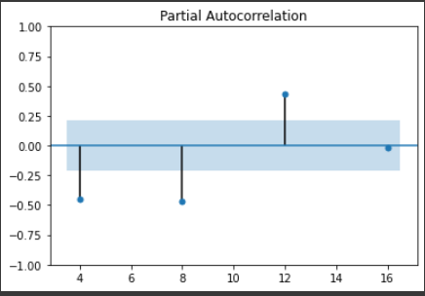
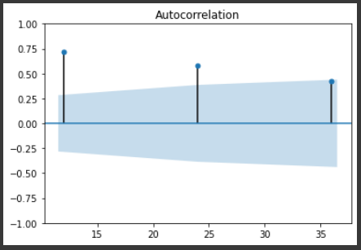
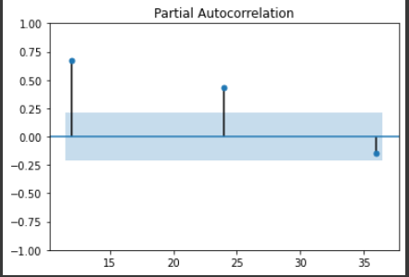
PACF AND ACF on 4 months and 12 months scales
4 months
Seasonality
P=3,Q=3
12 months
Seasonality
P=2,Q=2

Slide 19
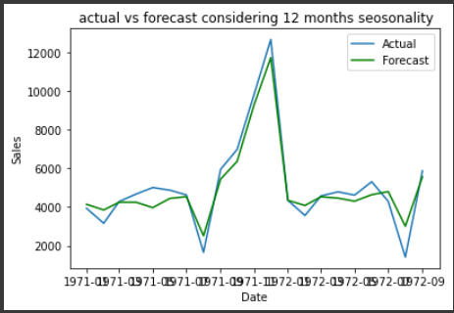
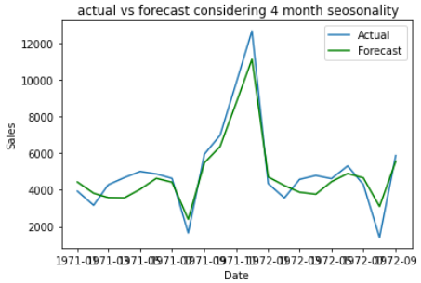
Results
SARIMA(3,1,3,2,0,2,12)
SARIMA(3,1,3,3,0,3,4)
Root Mean Squared error :629.91
Root Mean Squared error : 804.12

Slide 20
Comparison of results
Sno | Model | RMSE
1 | ARIMA(3,1,3) | 2698.03
2 | SARIMA(3,1,3,2,0,2,12) | 629.907
3 | SARIMA(3,1,3,3,0,3,4) | 804.12

Slide 21
VECTOR AUTO REGRESSION For Multivariate time SERIES
In Multivariate time series there will more than one variable varying across time
Each variable depends not only on its past values but also has some dependency on other variables. This dependency is used for forecasting future values. Let us consider below bi variate equation
For calculating y1(t), we will use the past value of y1 and y2. Similarly, to calculate y2(t), past values of both y1 and y2 will be used.
a1 and a2 are the constant terms,
w11, w12, w21, and w22 are the coefficients,
e1 and e2 are the error terms
Notes:
https://www.analyticsvidhya.com/blog/2018/09/multivariate-time-series-guide-forecasting-modeling-python-codes/

Slide 22
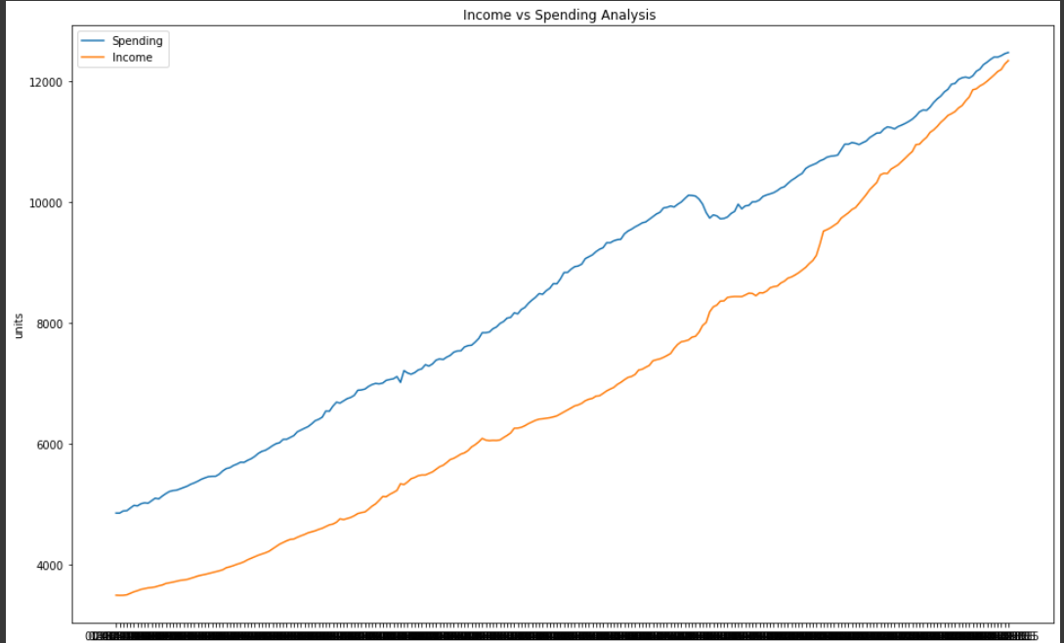
Income vs spending dataset for var

Slide 23
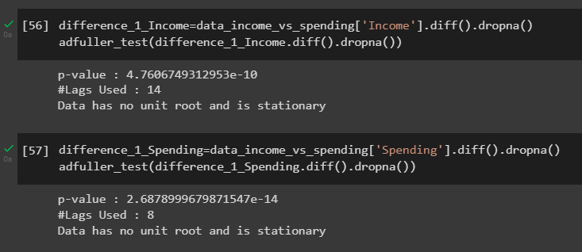
CHECK FOR STATIONARITY
Both columns Income and Spending are stationary after differencing 2 times

Slide 24
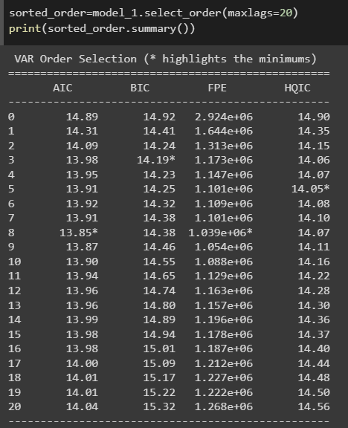
Identifying p value For VAR
Image shows AIC,BIC,FPE,HQIC values for 20 lags.
In this analysis lowest BIC value is considered it is observed at lag 3 so p=3
These values are for vector autoregression model with training data set
Size of training dataset is:237
Size of test dataset is:13
BIC Calculation:
BIC=kln(n)-2l
Where
l is log likelihood
k is number of parameters
n is number of samples used

Slide 25
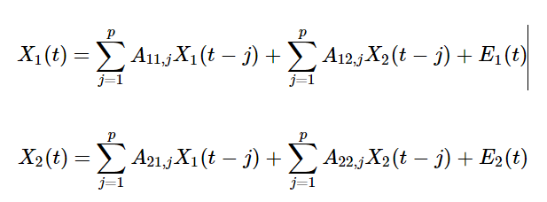
GARNGER CAusALITY TESTS
In 1969 paper in Econometrica Granger introduced his concept of Granger Causality
For illustration, consider a bivariate linear autoregressive model of two variables X1 and X2
Here p is number of lags, Matrix A contains Coefficients of the lagged values(like A1,2)
E1,E2 are prediction errors
If the variance of E1 and E2 is reduced by inclusion of the X2 or X1 in first or second equation then it is said x2 granger cause x1
So in hypothesis for granger causality tests would be A12=0 (x2 does not granger cause x1)or A22=0(x1 does not granger cause x2)
Above hypothesis can be evaluated by statistical tests

Slide 26
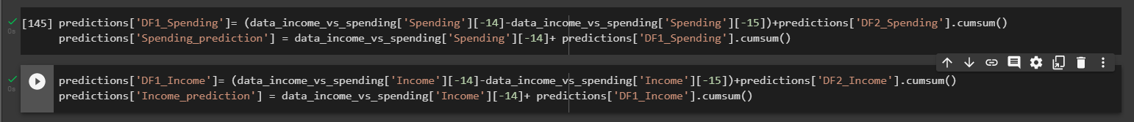
Reverting back the differenced values to original values
Test Dataset size is 13

Slide 27
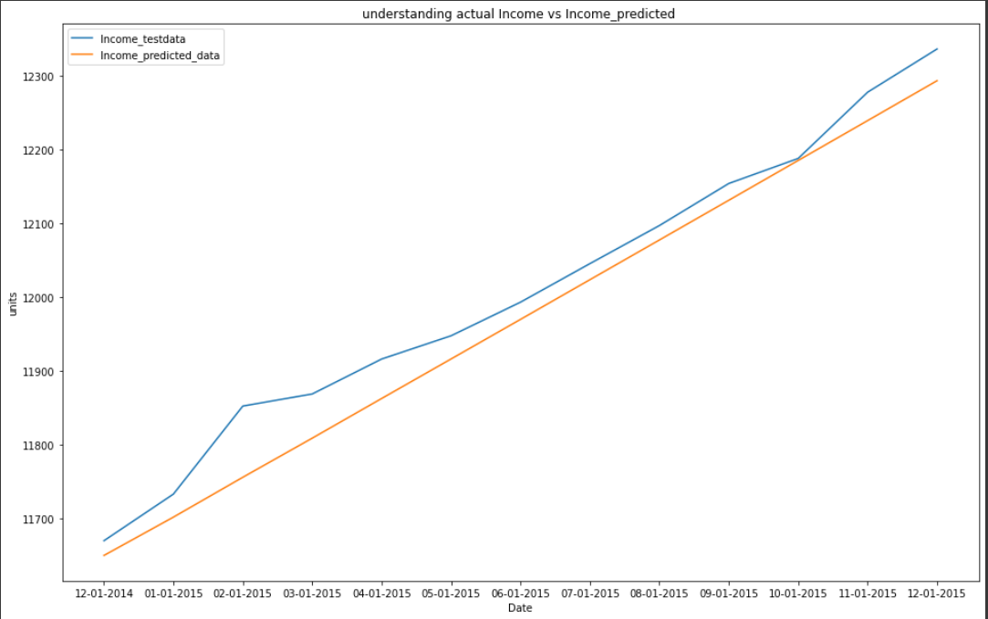
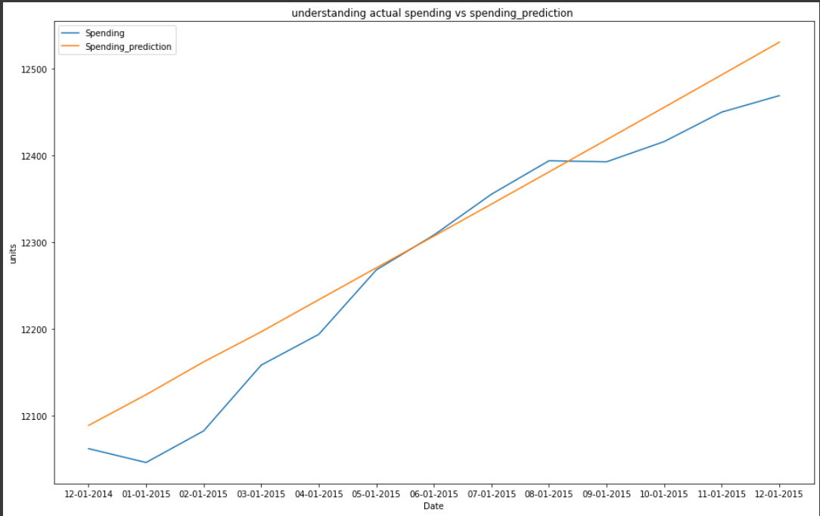
Predictions vs actual plots
Actual income vs income predicted
Actual spending vs spending predicted

Slide 28
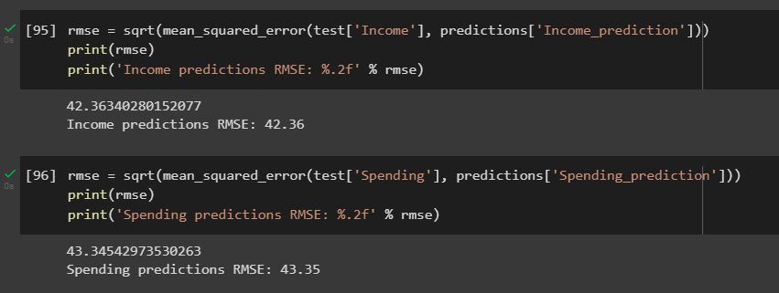
Results

Slide 29
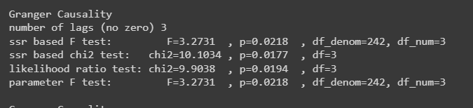
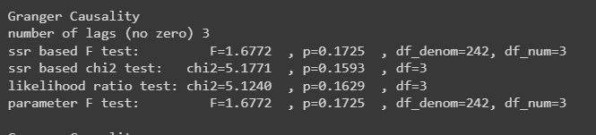
Understanding results using granger causality lagged values
Tests for Spending granger cause Income at lag 3
Tests for Income granger cause Spending at lag 3
Chi square test result for income granger cause spending p value is greater than 0.05 at lag 3 so that means it rejects null hypothesis of alpha=0 and concludes there is effect of income for predicting spending
So by above granger causality test we can conclude at lag 3 income has good effect in predicting
spending. For spending granger cause income test p values at lag 3 are less than 0.05 that means null hypothesis spending doesnot granger cause income is accepted. so spending does not have much impact in income prediction.

Slide 30
THANK YOU

