Slide 1
Azure Monitor Hackathon
Challenge-based Azure Monitoring Workshop

Slide 2
Agenda
8:30 – 9 AM: Kickoff & Introductions
9:00 - 10:30 AM: Azure Monitor Metrics, Alerts & Automation Challenge
10:30 - 10:45 AM: Break
10:45 - Noon: Azure Monitor Application Insights Challenge
Noon – 1 PM: Lunch
1 – 3 PM: Azure Monitor for containers Challenge
3 – 3:15 PM: Break
3:15 – 4 PM: Log Analytics Query Challenge
4 – 5 PM Azure Monitor Dashboard and Analytics Challenge

Slide 3
Monitoring Workshop Setup
Deploy Infra using Bash Cloud Shell and Azure CLI with an ARM Template
Setup Azure CLI https://docs.microsoft.com/en-us/cli/azure/install-azure-cli?view=azure-cli-latest
Install Visual Studio Code and Extensions (depending on your tool of choice)
Azure Resource Manager Tools - https://marketplace.visualstudio.com/items?itemName=msazurermtools.azurerm-vscode-tools
Azure Account and Sign-In (adds the Azure Cloud Shell for Bash) - https://marketplace.visualstudio.com/items?itemName=ms-vscode.azure-account Azure CLI Tools – https://marketplace.visualstudio.com/items?itemName=ms-vscode.azurecli
Download Azure Monitoring Workshop Setup Guide and follow the instructions to deploy.

Slide 4
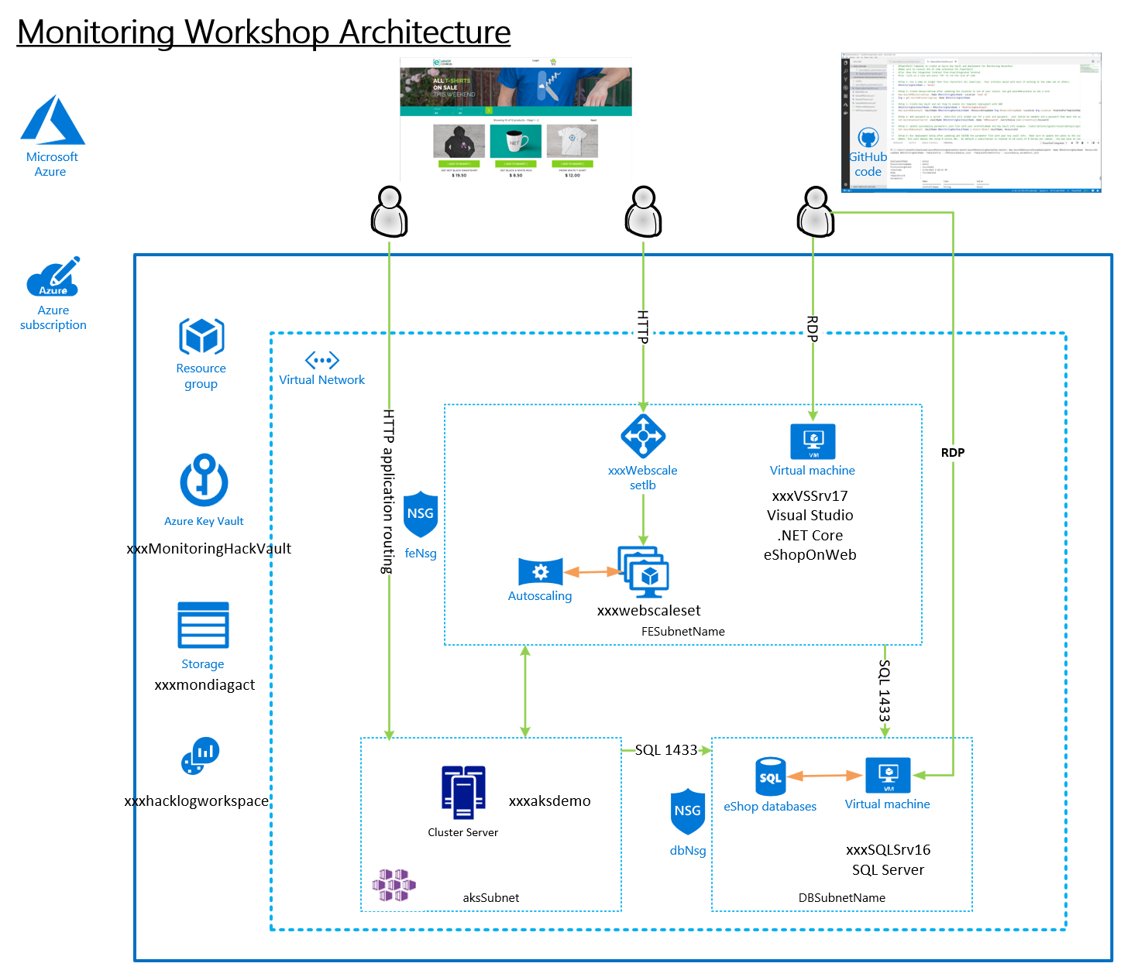
Should look like this ☺

Slide 5
Monitoring and Alert Rule Challenge
Create an empty database called “tpcc” on the SQL Server VM Note: Use SQL Auth with the username being sqladmin and password being whatever you used during deployment
Using AZ CLI, Powershell or ARM template, send the below guest OS metric to Azure Monitor for the SQL Server
Add a Performance Counter Metric for
Object: SQLServer:Databases
Counter: Active Transactions
Instance:tpcc
Hint: https://docs.microsoft.com/en-us/azure/azure-monitor/platform/diagnostics-extension-windows-install#azure-cli-deployment
Download and Install HammerDB tool on the Visual Studio VM (instructions are in your Student\Guides\Day-1 folder for setting up and using HammerDB.
www.hammerdb.com
Use HammerDB to create transaction load
From Azure Monitor, create a graph for the SQL Server Active Transactions and Percent CPU and pin to your Azure Dashboard
From Azure Monitor, create an Action group, to send email to your address
Create an Alert if Active Transactions goes over 40 on the SQL Server tpcc database.
Create an Alert Rule for CPU over 75% on the Virtual Scale Set that emails me when you go over the threshold. Note: In the Student\Resources\Loadscripts folder you will find a CPU load script to use.
First team to post screenshots of alert email notifications win the challenge.
Good luck!

Slide 6
Monitoring and Alert Rule Automation Challenge
Update the parameters file and deployment script for the GenerateAlertRules.json template located in the AlertTemplates folder
Add the names of your VMs and ResouceId for your Action Group
Deploy the GenerateAlertRules.json template using the sample PowerShell script (deployAlertRulesTemplate.ps1) or create a Bash script (look at the example from the initial deployment)
Verify you have new Monitor Alert Rules in the Portal or from the command line (sample command is in the PowerShell deployment script using new Az Monitor cmdlets)
Modify the GenerateAlertsRules.json to include “Disk Write Operations/Sec” and set a threshold of 20
Rerun your template and verify your new Alert Rules are created for each of your VMs
Create a new Action Rule that suppress alerts from the scale set and virtual machines on Saturday and Sunday
First team to post screenshot of the new Alert Rules and Action Rule wins the challenge!!
Good luck!

Slide 7
Application Insights Challenge
In Visual Studio, install the Application Insights SDK in the eShopOnWeb Web Project in the Solution
Collect server-side telemetry
https://docs.microsoft.com/en-us/azure/azure-monitor/app/asp-net-core#enable-application-insights-server-side-telemetry-no-visual-studio
Collect client-side page views
https://docs.microsoft.com/en-us/azure/azure-monitor/app/asp-net-core#enable-client-side-telemetry-for-web-applications
Run the eShopOnWeb Web project locally and check out the App Insights tooling in VS and the Azure Portal
Trip the exception that has been added and setup an alert for it.
Find the exception in App Insights (Hint: Try to change your password)
Create Alerts based on availability and exceptions
First team to post screenshot with email alert of the exception wins the challenge. Good luck

Slide 8
Azure Monitor for Containers Challenge
From your Visual Studio Server, deploy the eShoponWeb application to AKS
Update DB connection strings to use IP addresses instead of hostnames
Add Docker Support to your app in VS (requires Docker Desktop to be installed)
Create an Azure Container Registry
Publish eshop on web app to your Container Registry
Update DB dependencies using connection strings
Update App Insights dependency using instrumentation key
Update and use the provided deployment and service YAML files to deploy app to AKS
From Azure Monitor, view the CPU and memory usage of the containers running the eShoponWeb application
Generate and view an exception in the eShoponWeb application
Hint: Try to change your password
First person to post a screenshot of the live log with the exception message wins the challenge
Notes:
When configuring dependencies for publishing, do not store strings and keys in local secrets, always choose None.

Slide 9
Log Analytics Query Challenge
Write a performance query that renders a time chart for the last 4 hours for both of the Web Servers and the SQL Server for the following perf metrics. Save each query to your favorites.
Processor Utilization: Processor / % Processor Time
Memory Utilization: Memory / % Committed Bytes In Use
Disk Utilization (IO): Disk Reads/sec and Disk Writes/sec
Create a heartbeat query for Web Servers and SQL Server
Write a performance query that renders a time chart for the last hour of the max percentage CPU usage of the AKS Cluster nodes
First team with screenshots of the time charts wins the Challenge

Slide 10
Optional Logs Challenge
Combine infrastructure and application logs to create a single timeseries chart that includes:
CPU usage from the node in your AKS cluster hosting the eshoponweb app
Duration of requests on your eshoponweb app hosted on the cluster

Slide 11
Dashboard & Analytics Challenge
Deploy Grafana using Web App for Container
Hint: http://docs.grafana.org/installation/docker/
Configure the Azure Monitor Data Source for Azure Monitor, Log Analytics and Application Insights
Create a CPU Chart with a Grafana variable used to select Computer Name
Add an Annotation to your chart overlaying Computer Heartbeat
First Team to post a screenshot with your chart wins the challenge. Good luck!

Slide 12
Workbooks Challenge
Create workbook that combines browser, web server and infrastructure performance data for your eshoponweb app on the AKS cluster including:
Web page performance as observed from the client-side browser using Page View records.
Visualizations: Time Selector, Table with columns for Page Titles, Page Views with Bar underneath, Average Page Time with Thresholds and Maximum Page time with Bar underneath.
Request failures reported by the web server using Request records.
Visualization: Table with columns for Request Name, HTTP Return Code, Failure Count with Heatmap and Page Time with Heatmap.
Server response time as observed from the server-side using Request metrics.
Visualization: Line Chart of Average and Max Server Response Time.
Infrastructure performance as observed from the nodes in the AKS cluster on which the application is deployed using Average and Maximum CPU usage metrics.
Visualization: Line Chart of Average CPU usage percentage by AKS cluster node.
Infrastructure performance from AKS nodes showing disk used percentage based on Log Analytics records.
Visualization: Line Chart of Average Disk used percentage by AKS cluster node.
https://docs.microsoft.com/en-us/azure/azure-monitor/app/usage-workbooks

Slide 13
Reference

Slide 14
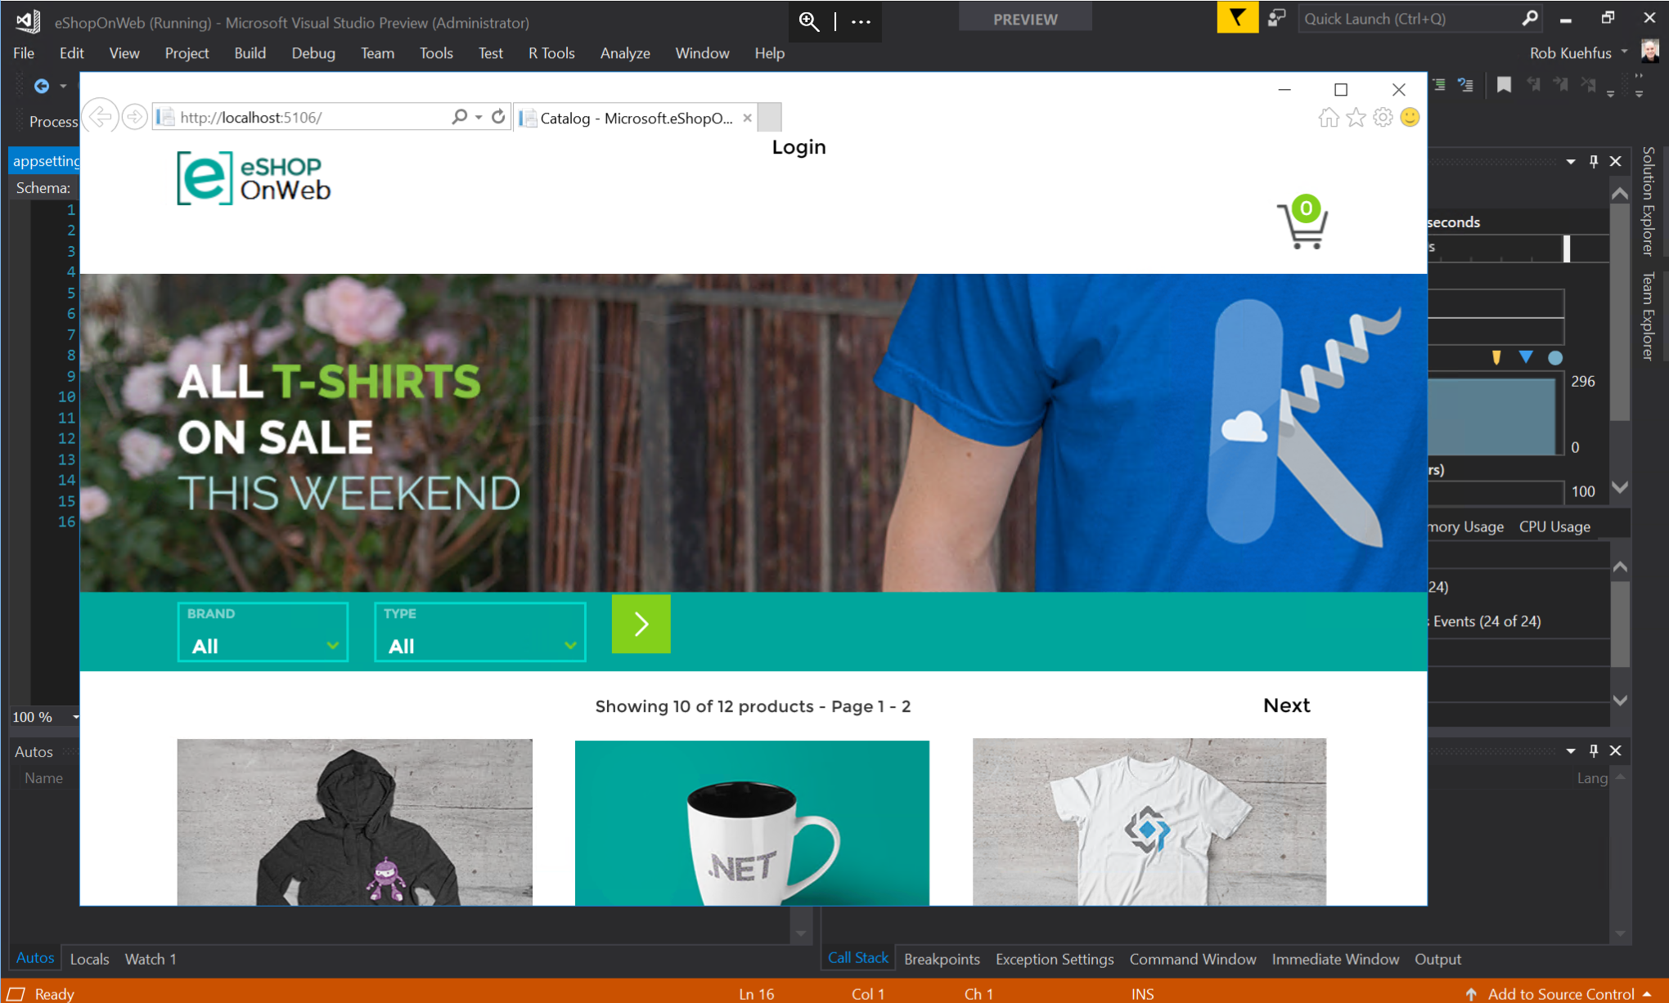
Should look like this ☺

