Slide 1

DATA607: Data Acquisition and Management
Data Science Presentation: Pareto Chart
Chinedu Onyeka

Slide 2
Introduction
Pareto Chart is a chart named for the Pareto Principle which states that for many outcomes, roughly 80% of consequences come from 20% of causes. It is also known as the 80/20 rule, the law of the vital few, or the principle of factor sparsity.
Examples of 80/20 rule
20% of donors make 80% of contributions
20% of time is spent doing 80% of the work
20% of drivers cause 80% of all traffic accidents
20% of employees are responsible for 80% of the results
20% of posts generates 80% of traffic
20% of Data Scientists do 80% of the work
80% of vaccines were administered in 20% of the Provinces in Canada
20% of residents pay 80% of taxes
20% of Machine Learning Models are used in 80% of the cases
80% of profits come from 20% of products.
The Pareto Chart is a combination of a bar graph and a line graph.
It helps to analyze and prioritize issue resolution.
It has extensive applications in quality control.

Slide 3
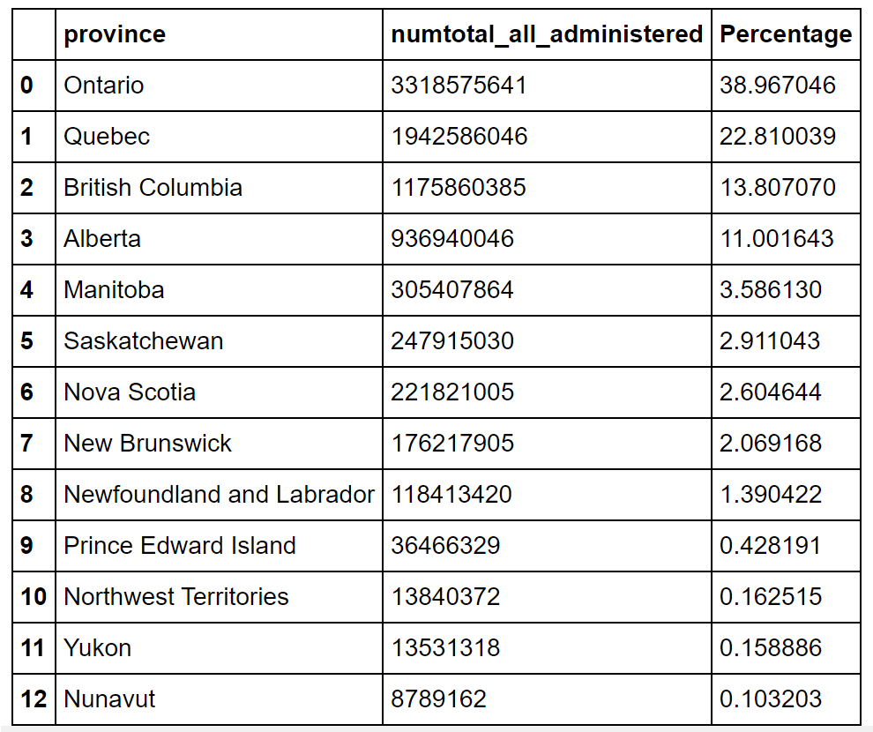
Case Study: Covid vaccines administered in Canada
Ontario has by far administered more vaccines than other provinces.
Source: https://health-infobase.canada.ca/covid-19/vaccine-administration/

Slide 4
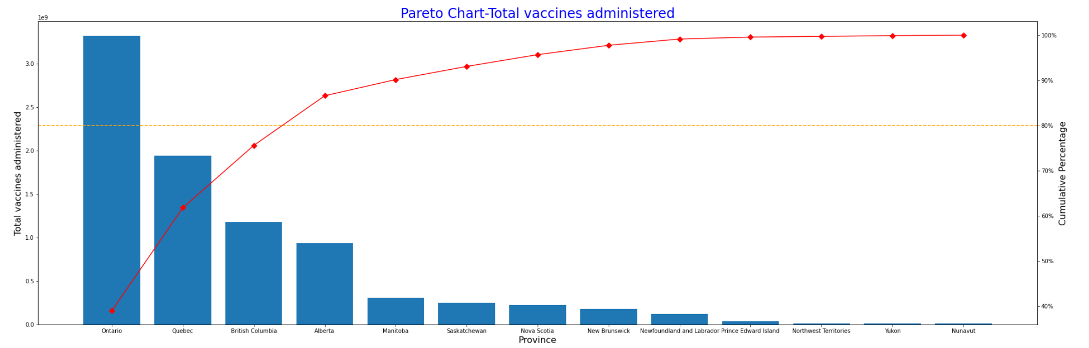
Pareto Chart for Covid Vaccines Administered in Canada

Slide 5
Conclusion
From the pareto chart, about 80% percent of total vaccine doses administered in Canada as of November 5th, 2021, were administered in Ontario, Quebec, and British Columbia, while the remaining 20% were administered in other provinces. This can be explained by the fact that those are the top three(3) most populous provinces in Canada.
References
https://en.wikipedia.org/wiki/Pareto_chart
https://asq.org/quality-resources/pareto
https://www.heflo.com/blog/business-management/pareto-80-20-rule-examples/#:~:text=80%25%20of%20results%20are%20produced,from%2020%25%20of%20all%20factories
Note: The code for the pareto chart can be found here
The YouTube link for the presentation can be found here

Slide 6
Thank You

