Slide 1

DATA1201 Assignment1
DATA DRIVEN ORGANIZATIONS
Chinedu Onyeka

Slide 2
What is a Data driven organization?
These are organizations that uses insights from data to make business decisions.
Examples:
UBER
McDONALD’S
GOOGLE
NETFLIX
FACEBOOK

Slide 3
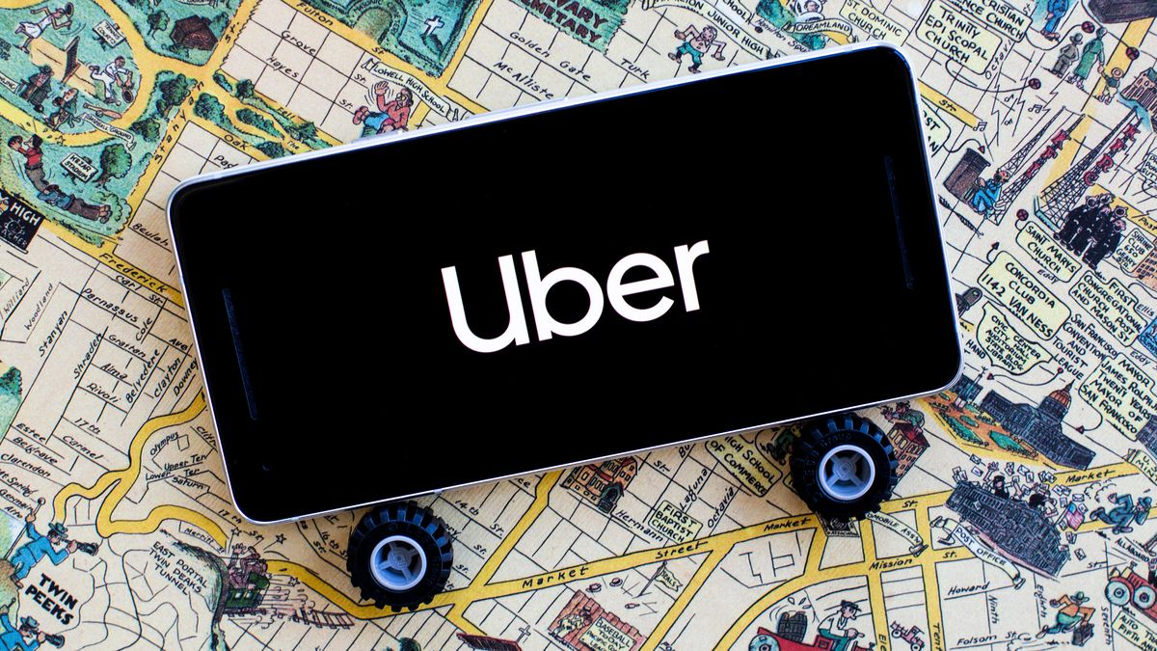
UBER

Slide 4
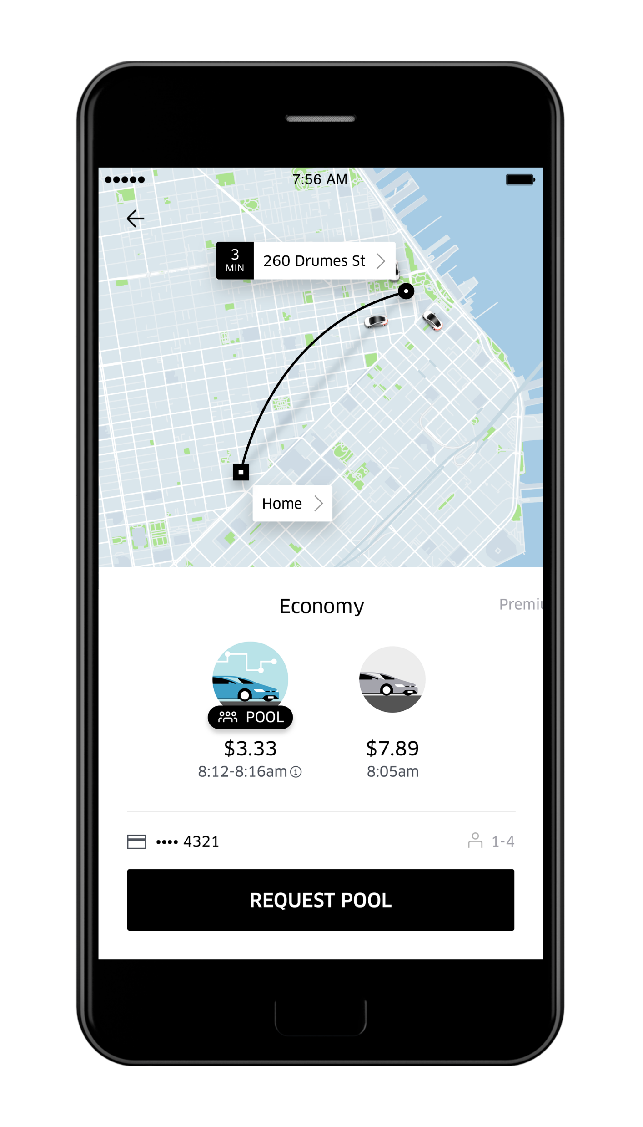
Industry
Ride hailing and food delivery

Slide 5
Business Model
Uses Predictive Analysis to identify high demand areas and advises drivers accordingly
Uses drivers supply, time of day, weather conditions, to determine pricing
Uses passenger demand data to inform drivers to activate app

Slide 6
Data Management Practice
What they do well:
Uber does a good job connecting drivers and riders with their powerful data driven algorithms. One could literally hail a driver anytime of the day. It is convenient, cashless, and relatively safe.
Needs Improvement:
Surge Pricing: During peak periods, this can be double or sometimes triple normal prices, and this does not go well with customers.
Improved driver pick up location: Sometimes the Uber system direct drivers to wrong pickup locations.

Slide 7

Questions?

