Slide 1
Introduction to Error Correction
Yi Tan

Slide 2
Contents
Classical error correction
Stabilizer codes
Quantum LDPC codes

Slide 3
Classical error correction

Slide 4

Model of information transmission
noise n
t
r
s
encoder
channel
decoder
k bits
n bits
Notes:
Over time: memory/storage
Over space-time: communication

Slide 5
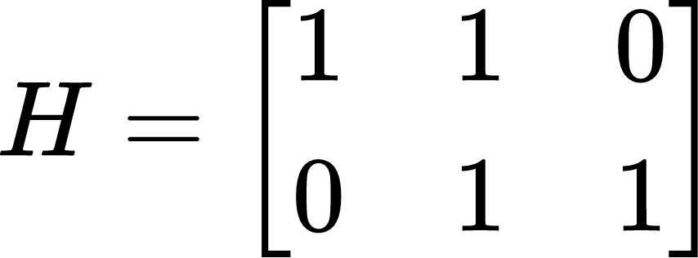


Classical repetition code
check matrix
0
0
1

Slide 6
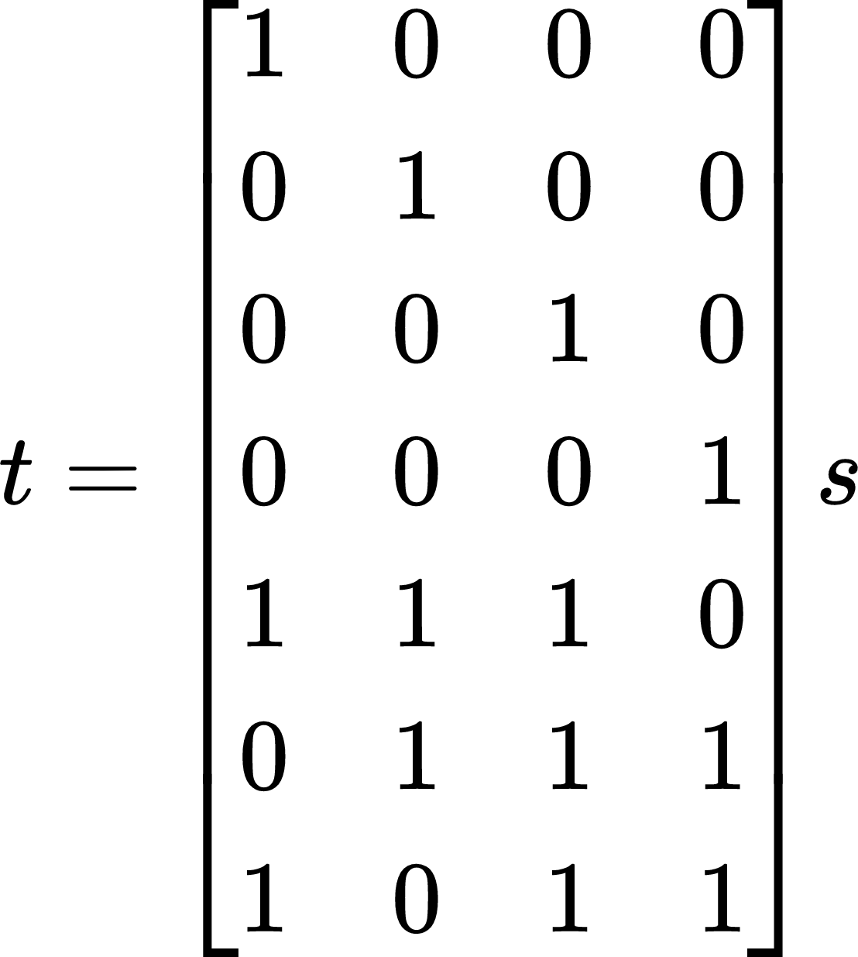
(7, 4) Hamming code
s=s1s2s3s4 -> t=s1s2s3s4t5t6t7
Generating matrix
t5
s1
s2
s3
t6
s4
t7

Slide 7
Syndrome decoding of (7, 4) Hamming code
0
0
1
1
1
0
0
Notes:
No error, OK

Slide 8
Syndrome decoding of (7, 4) Hamming code
syndrome
0
error
0
0*
1
1
0
0
Notes:
1 bit flip error, OK

Slide 9
Syndrome decoding of (7, 4) Hamming code
syndrome
0
error
0
1
0*
1
0
0
Notes:
No error, OK

Slide 10

Syndrome decoding of (7, 4) Hamming code
Decoder error!
0
0
1
0*
0*
0
0
Notes:
2-bit flip errors, NOT OK

Slide 11
Coding theory terminology
[n, k, d] classical linear codes
Code length n: # of physical bits
Code dimension k: # of logical bits
Code rate: k/n
Code distance d: # of single bit errors the code can correct, i.e. min weight of a logical operator
(n-k) x n parity check matrix H
Codespace C = ker H = {x | Hx = 0 (mod 2)}

Slide 12
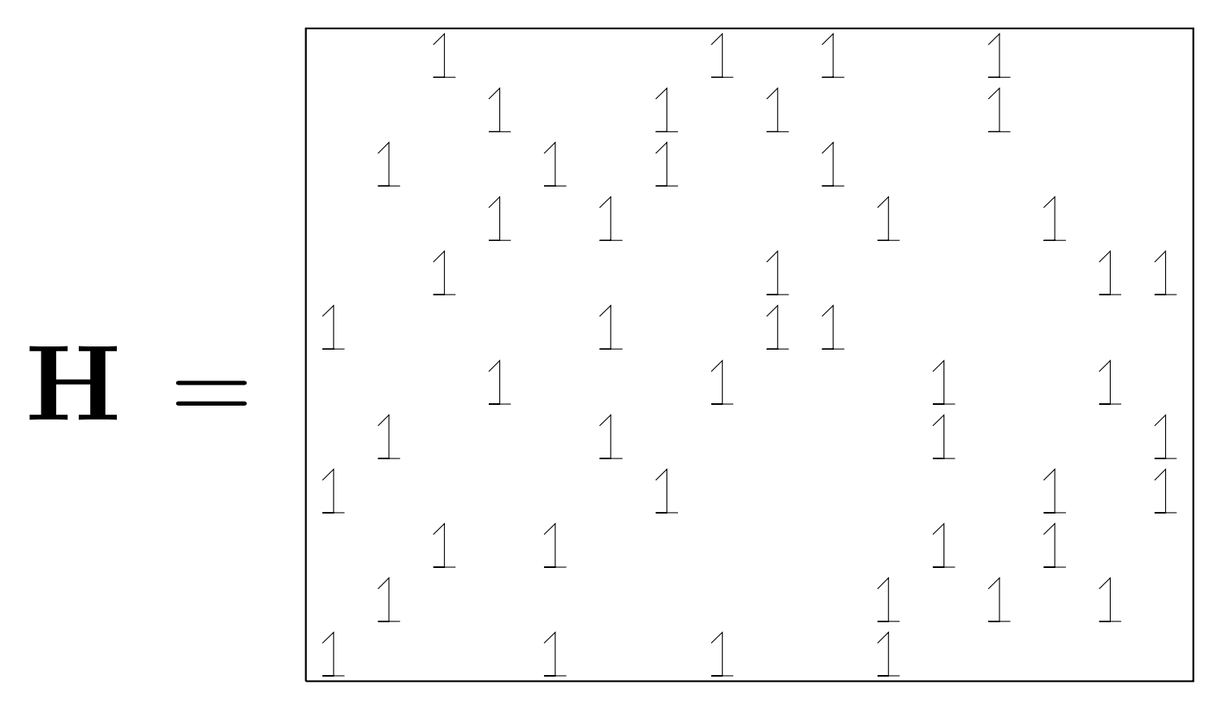
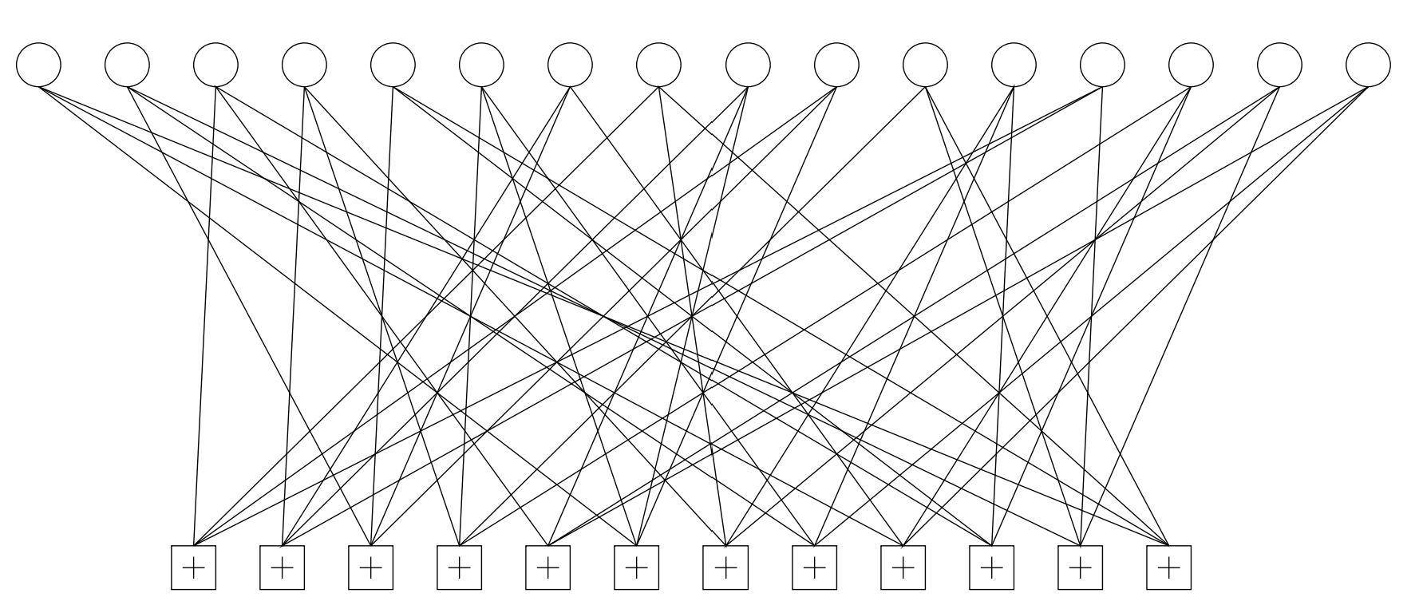
Low-density parity-check (LDPC) codes

Slide 13
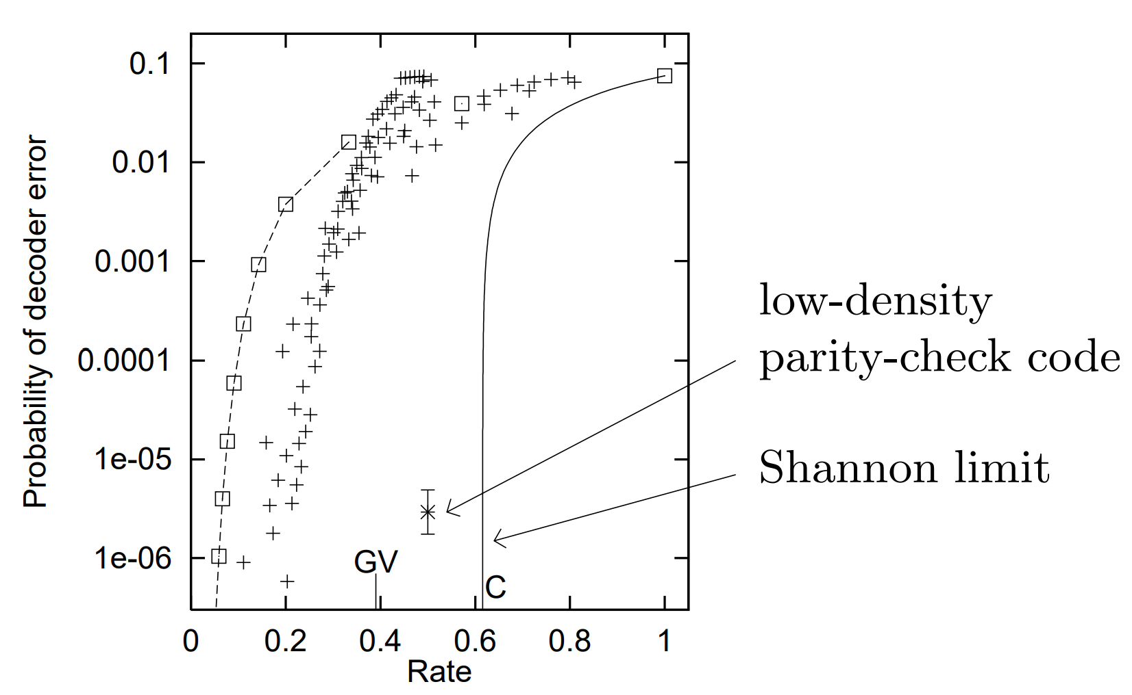
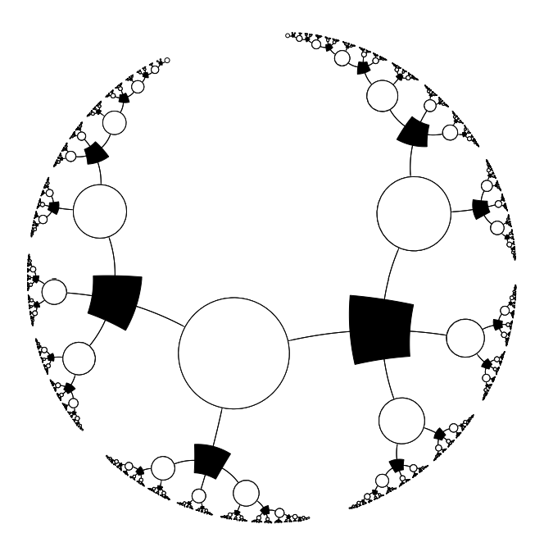
Decoding of LDPC codes

Slide 14
II. Stabilizer codes

Slide 15
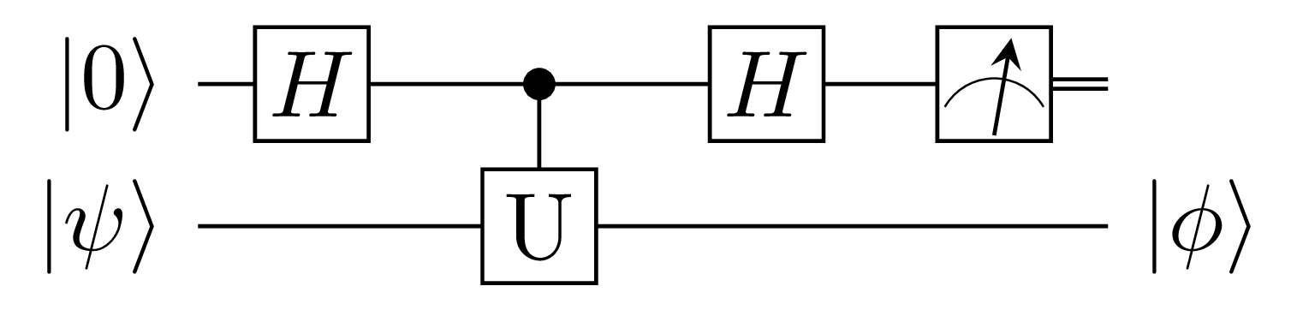
Parity measurement
Notes:
If ancilla measures to 0, it means U|psi>=+|psi>.

Slide 16
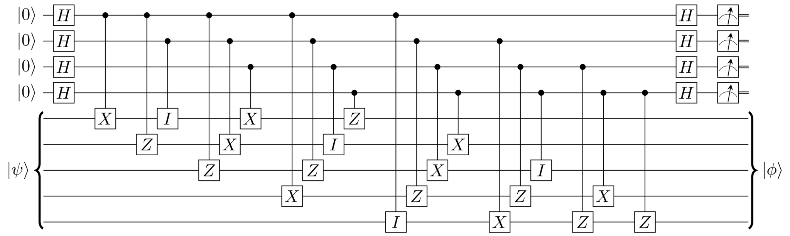
5-qubit code
XZZXI
IXZZX
XIXZZ
ZXIXZ

Slide 17
5-qubit code syndrome decoding
X1 | 0001 | Y1 | 1010 | Z1 | 1011
X2 | 1000 | Y2 | 0101 | Z2 | 1101
X3 | 1100 | Y3 | 0010 | Z3 | 1110
X4 | 0110 | Y4 | 1001 | Z4 | 1111
X5 | 0011 | Y5 | 0100 | Z5 | 0111

Slide 18
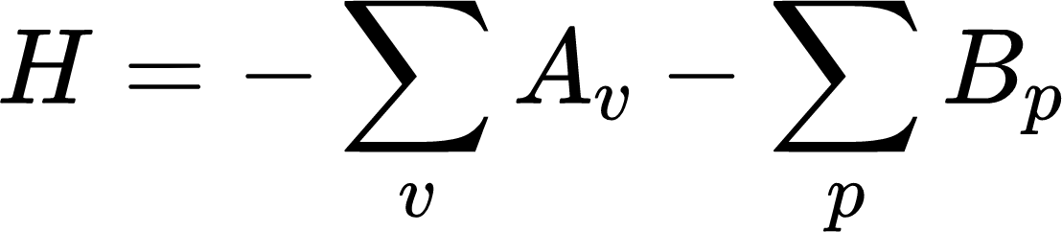
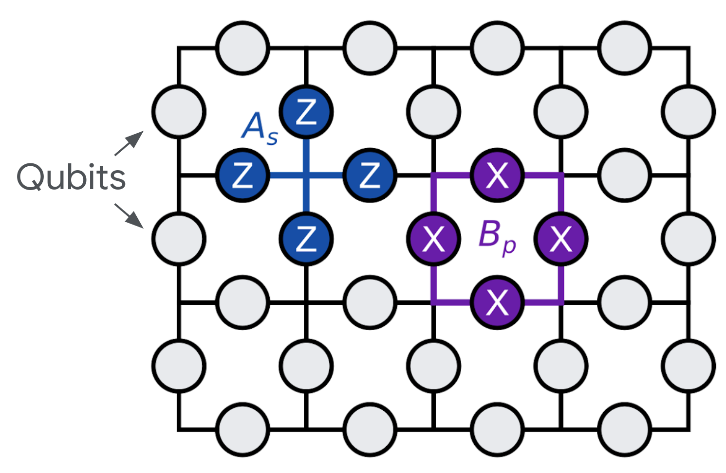
Toric code Hamiltonian

Slide 19
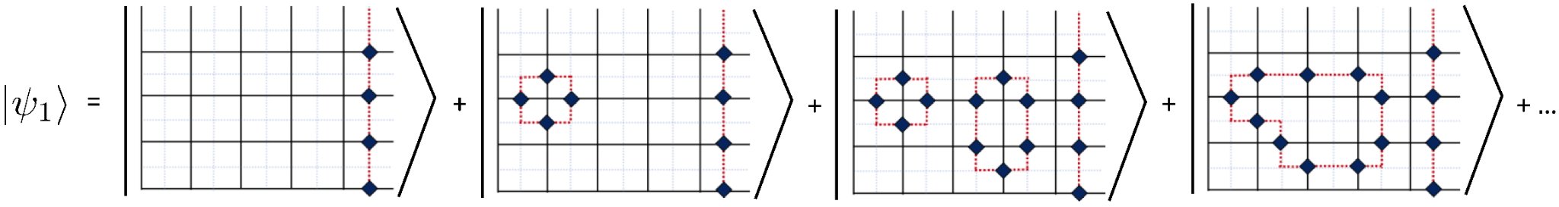
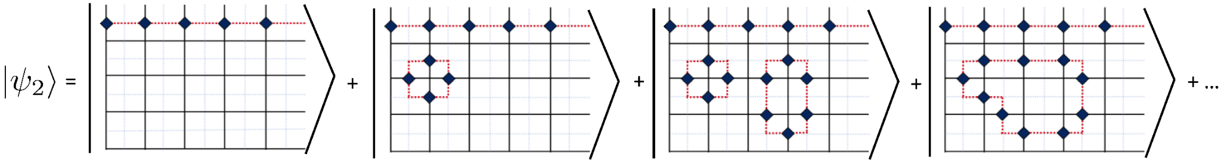
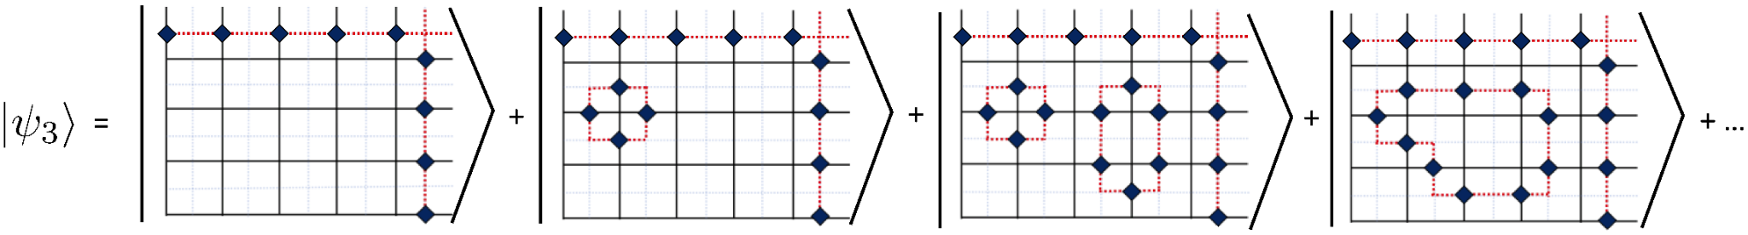
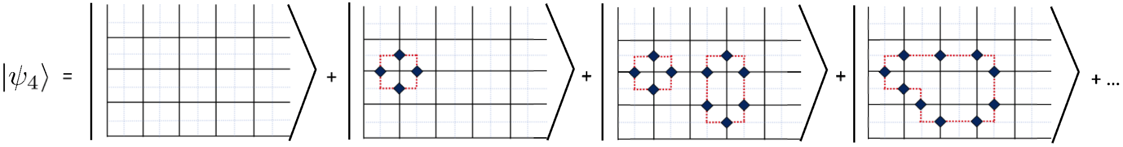
Toric code ground state

Slide 20
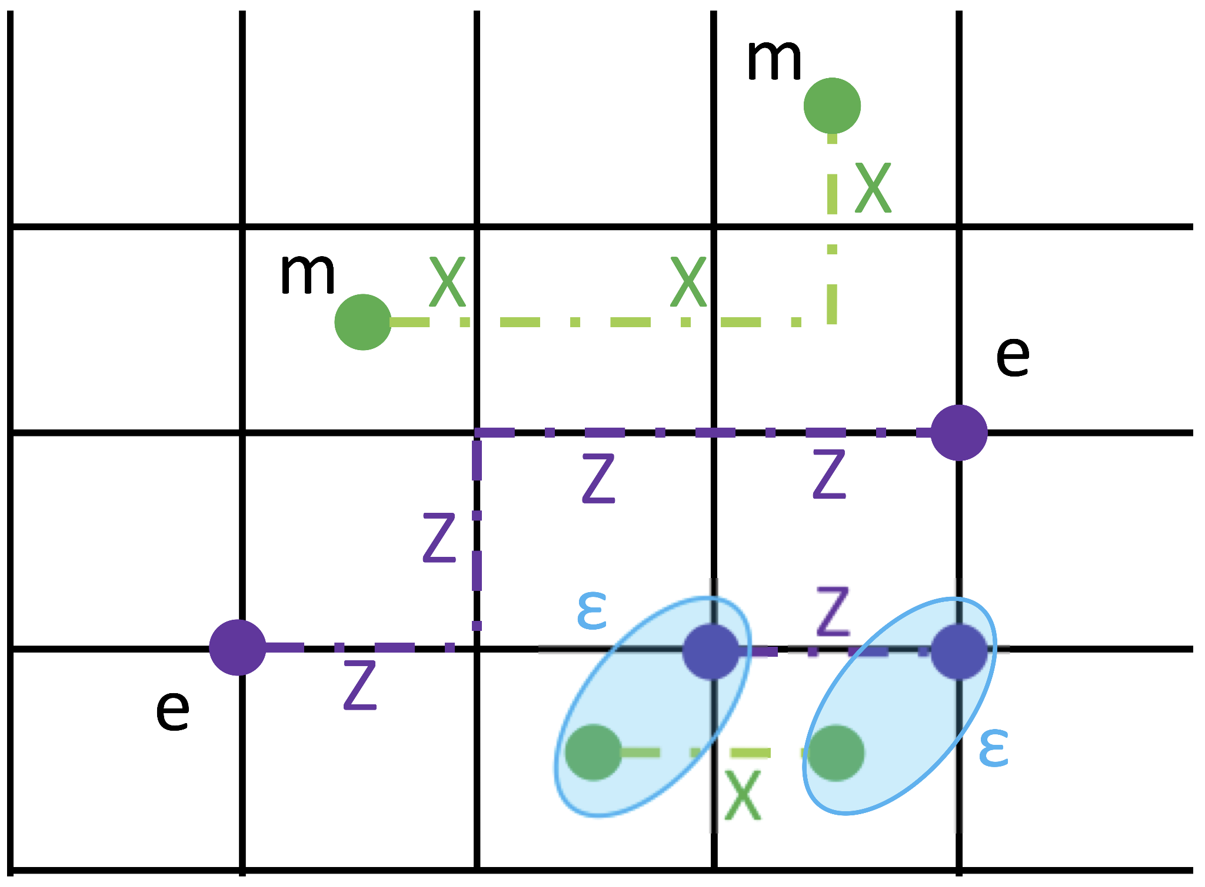
Excitations, errors and syndromes

Slide 21
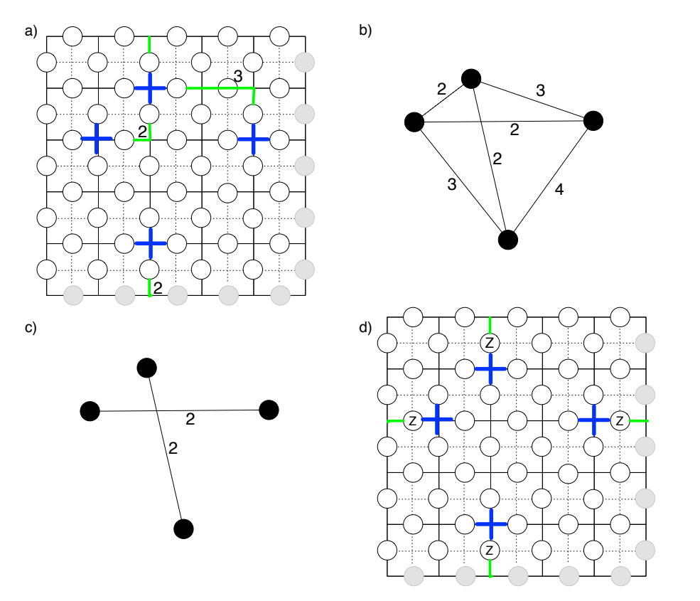
Minimum-weight perfect matching decoding

Slide 22
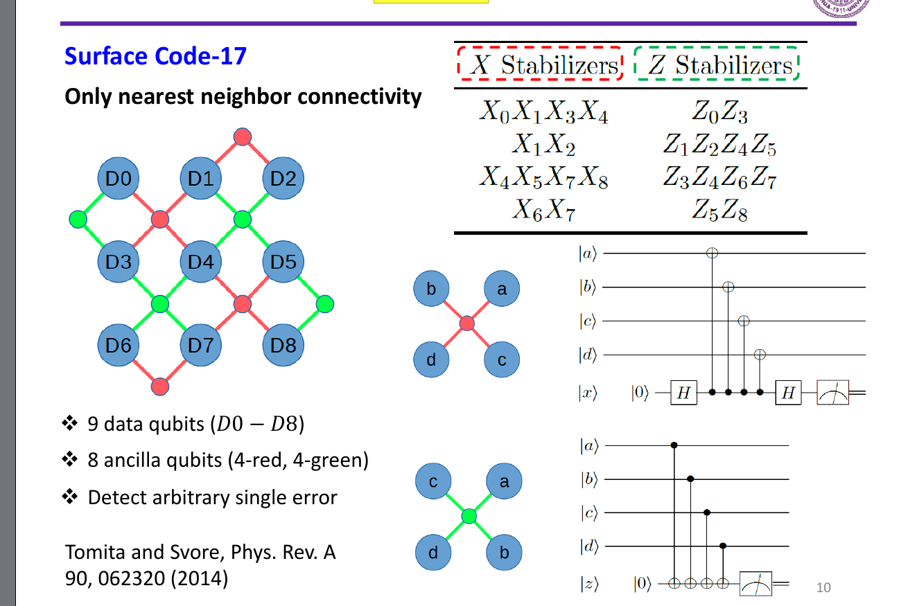
Surface code

Slide 23
III. Quantum LDPC codes

Slide 24
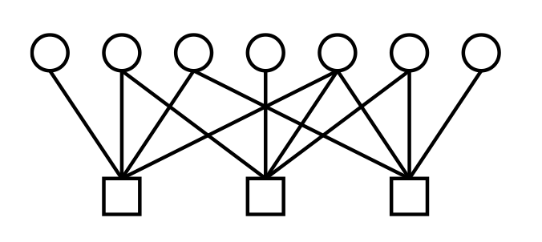
Coding theory terminology
[n, k, d] classical linear codes
Code length n: # of physical bits
Code dimension k: # of logical bits
Code rate: k/n
Code distance d: # of single bit errors the code can correct, i.e. min weight of a logical operator
(n-k) x n parity check matrix H
Codespace C = ker H = {x | Hx = 0 (mod 2)}
Low-Density Parity-Check (LDPC) codes
H has sparse rows -> each check operates on O(1) bits
H has sparse columns -> each bit participates in O(1) checks
Good LDPC codes
High encoding rate k = O(n)
Large code distance d = O(n)
Random sparse H gives a good LDPC code whp
[7,4,3] Hamming code
n bits
n-k checks

Slide 25
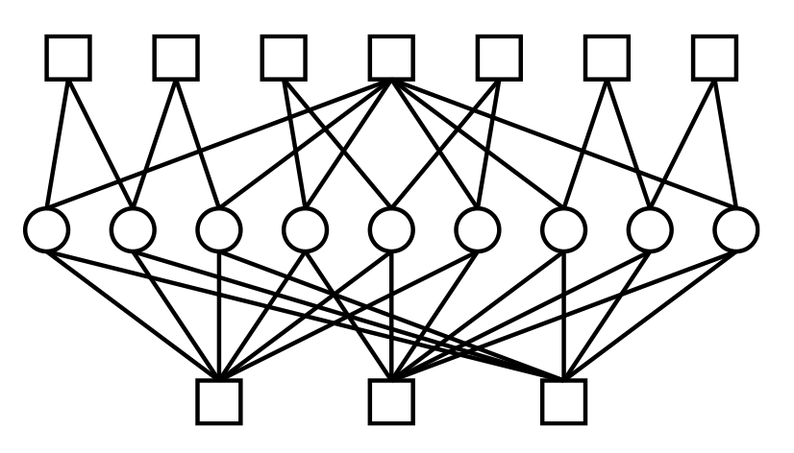
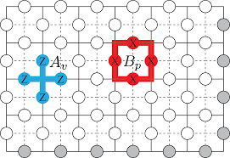
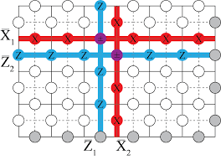
Coding theory terminology
[[9,1,3]] Shor code
Z-checks
[[n, k, d]] quantum codes
Code length n: # of physical (data) qubits
Code dimension k: # of logical qubits
Code rate: k/n
Code distance d: # of single qubit errors the code can correct, i.e. min weight of a logical operator
2 types of error X and Z => (CSS) two check matrixes H_{x} and H_{z}
Commutativity condition: H_{x}H_{z}^{T}=0
Codespace C = +1 eigenspace of all checks
Quantum Low-Density Parity-Check (qLDPC) codes
H_{x} , H_{z} have sparse rows -> each check operates on O(1) qubits
H_{x} , H_{z} have sparse columns -> each qubit participates in O(1) checks
Ex: Toric (surface) code
n qubits
X-checks

Slide 26
Quantum LDPC codes
What people refer to
high rate
Toric Code
Surface Code
Color Code
large distance
qLDPC Codes
Quantum Codes
“Good quantum LDPC codes”: [[n, k=O(n), d=O(n)]]
Why do we care?
Surface codes have low encoding rate (1 logical qubit) -> large overhead
Bravyi-Poulin-Terhal: Planar (local) stabilizer codes can’t have both high rate and large distance, i.e. kd² = O(n) in 2D

Slide 27
Search for good qLDPC codes
k d Year
Topological Codes
Kitaev Toric code 2 √n 1997
Freedman-Meyer-Luo 2 √n [log(n)]^{1/4} 2002
Tensor/Hypergraph products
Tillich-Zemor n √n 2009
High dimensional expanders + distance balancing techniques
Evra-Kaufman-Zemor √n √n log(n) 2020
Kaufman-Tesla √n √n polylog(n) 2020
Tensor products with twist
Hastings-Haah-O’Donnell Fiber Bundle codes n^{3/5}/polylog(n) n^{3/5}/polylog(n) 2020
More complicated product constructions…!
Pantaleev-Kalachev n n 2021

Slide 28
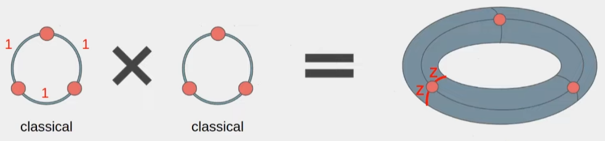
Obtaining qLDPC codes: product constructions
Main insight: Toric code = “product” of two repetition codes
[n, 1, n] ⊗ [n, 1, n] → [[2n², 2, n]]
Hypergraph product code = product of two arbitrary classical codes
[n, k, d] ⊗ [n, k, d] → [[O(n²), O(k²), O(d)]]
LDPC ⊗ LDPC → quantum LDPC
Product of two good LDPC codes: [[n, O(n), O(√n)]]
Ex: Length-3 repetition code
1, 1, 0
H = 0, 1, 1
1, 0, 1
bits
checks

Slide 29
Hypergraph product codes: matrix picture
Take ANY two classical codes
m₁ x n₁ parity check matrix H₁ with parameters [n₁, k₁, d₁]
m₂ x n₂ parity check matrix H₂ with parameters [n₂, k₂, d₂]
Define X and Z parity check matrices
H_{x}= H₁⊗ I_{n2} I_{m1}⊗ H₂^{T} dim: m₁n₂ x (n₁n₂ + m₁m₂)
H_{z}= I_{n1}⊗ H₂ H₁^{T}⊗ I_{m2} dim: n₁m₂ x (n₁n₂ + m₁m₂)
Can easily verify H_{x}H_{z}^{T}= H₁⊗ H₂^{T} + H₁⊗ H₂^{T} = 0
k = n₁n₂ + m₁m₂- m₁n₂ - n₁m₂ = n₁(n₂-m₂) - m₁(n₂-m₂) = (n₁-m₁)(n₂-m₂) = k₁k₂
Result: [[n₁n₂ + m₁m₂, k₁k₂, min(d₁, d₂)]] CSS code

Slide 30
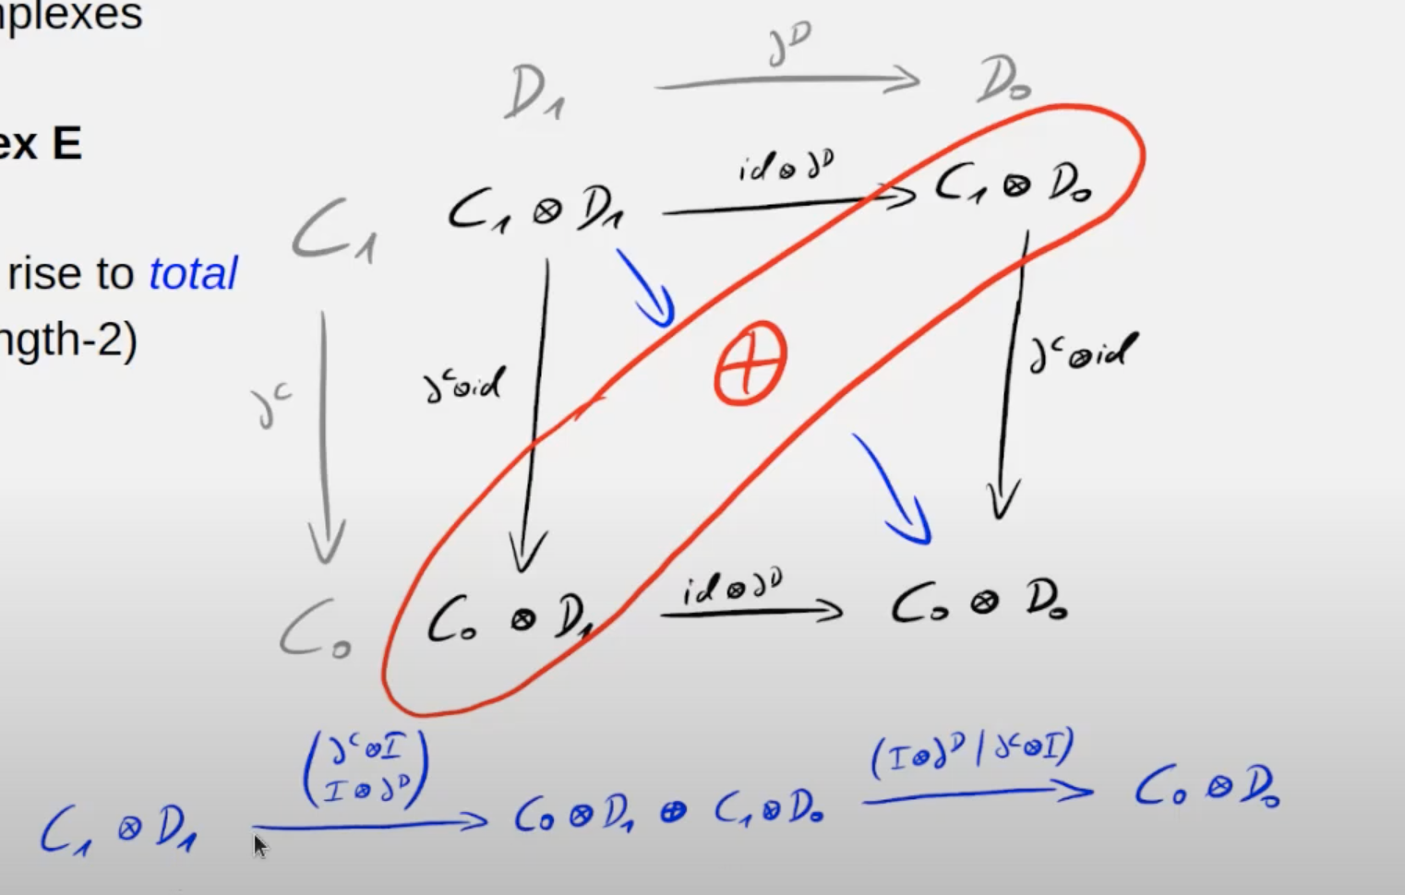
Hypergraph product codes: homology picture
Classical codes:
Length-1 chain complex
Boundary map defines parity check matrix
Quantum codes
Length-2 chain complex
Two parity check matrices define two boundary maps

Slide 31
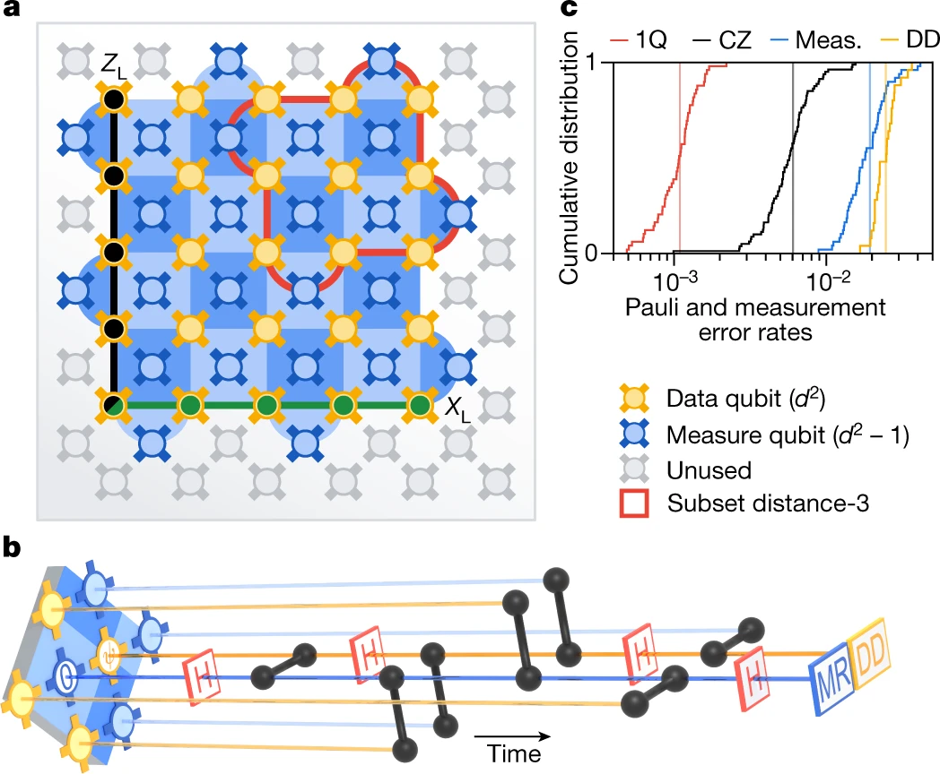
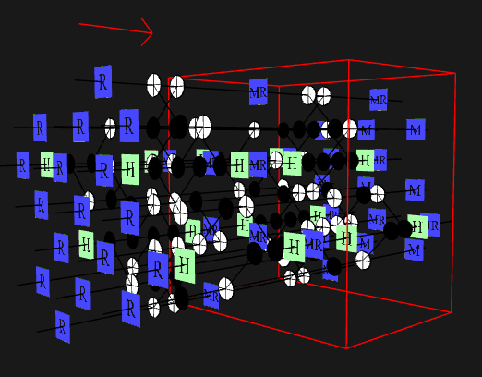
Starting point: planar surface code
dark blue: X checks
light blue: Z checks

Slide 32
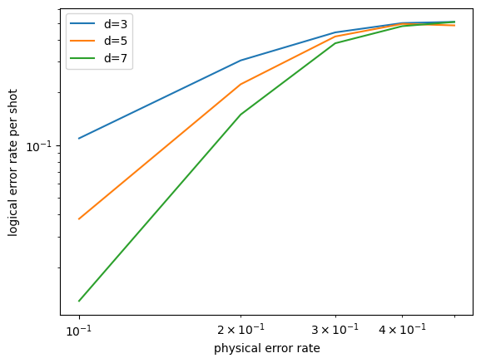
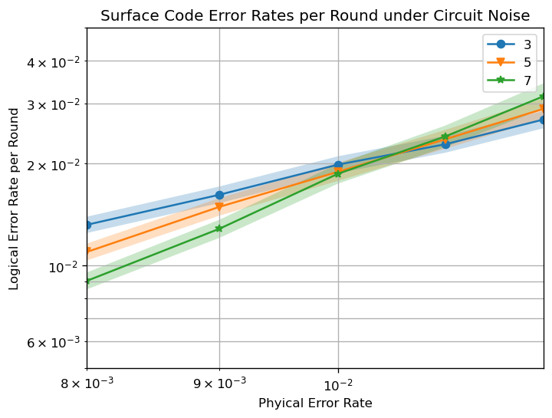
Simulation of threshold

