Slide 1
AUTOMATED ROAD DAMAGE DETECTION & OPERATIONAL TRIAGE FOR SMART CITY INFRASTRUCTURE
Edge-Deployable Vision Intelligence for Municipal Fleet Dashcams (IEEE CRDDC RDD2022)
Course: Lingnan University CDS540 Computer Vision | Term 1, 2026/2027
Group Direction 2: Computer Vision for Infrastructure Asset Management
Notes:
Good morning Professor and fellow classmates. Today, our team is proud to present our project: Automated Road Damage Detection and Operational Triage for Smart City Infrastructure Maintenance. In this project, we demonstrate how edge-based computer vision transforms standard vehicle dashcams into an intelligent municipal survey network that detects hazardous roadway distress in real-time.

Slide 2
LINGNAN UNIVERSITY CDS540 COMPUTER VISION
The Municipal Dilemma: Reactive vs. Proactive Road Maintenance
Aging Infrastructure & Maintenance Backlog
Urban asphalt surfaces degrade continuously under heavy vehicular axle loads, seasonal thermal expansion, and moisture ingress, generating massive municipal repair backlogs.
Limitations of Manual Foot Patrols
In-person visual inspections are slow, subjective, prone to human error and fatigue, and expose municipal workers to severe safety hazards in live traffic.
Prohibitive Cost of Specialized Survey Vans
Commercial survey vans equipped with 3D LiDAR and laser profilometers cost upwards of $300,000 each, preventing frequent city-wide deployment for municipal councils.
The Smart City Dashcam Opportunity
Public transit buses, street sweepers, and refuse trucks traverse metropolitan streets daily. Equipping them with low-cost automotive dashcams and edge AI creates a continuous survey network.
Notes:
Municipal road authorities face a massive dilemma. Roads degrade constantly under heavy traffic and rain, but traditional inspection methods cannot scale. Manual walking patrols put workers at risk on busy roads, while specialized LiDAR vans cost hundreds of thousands of dollars. Our objective is to leverage ubiquitous fleet dashcams to build an automated, edge-intelligent inspection system.

Slide 3
LINGNAN UNIVERSITY CDS540 COMPUTER VISION
Core Design Principle: The Asymmetric Cost of Municipal Liability
Not All False Negatives Are Created Equal
Standard computer vision metrics (e.g. mAP) treat all classes symmetrically. However, in municipal road asset governance, defect consequences differ fundamentally.
Missing a Fine Crack (D00): Minor Operational Consequence
Omitting a superficial hairline crack merely defers preventive bituminous sealant maintenance with zero immediate public safety risk.
Missing a Deep Pothole (D40): Catastrophic Public Safety Risk
Potholes induce immediate tire blowouts, wheel rim fractures, vehicular control loss, and severe injuries to motorcyclists and cyclists—resulting in direct municipal tort liability.
System Mandate: Prioritize Pothole Recall (D40)
We treat Pothole Recall as an indispensable safety objective alongside mAP, designing models and triage heuristics that explicitly minimize missed potholes.
Notes:
Crucially, from an engineering and public administration perspective, all false negatives are not equal. If the AI misses a hairline longitudinal crack, maintenance is merely deferred. But if it misses a deep pothole, a vehicle blows a tire or a cyclist crashes, directly resulting in municipal injury lawsuits. Therefore, throughout this project, we treat Pothole Recall as an indispensable safety objective.

Slide 4
LINGNAN UNIVERSITY CDS540 COMPUTER VISION
Dataset & Canonical Damage Taxonomy (IEEE CRDDC RDD2022)
Benchmark Dataset: IEEE CRDDC 2022
19,208 raw multi-country road dashcam frames captured across Czech Republic, India, and the United States.
D00 - Longitudinal Crack (Wheel-Path Fatigue)
Linear cracks propagating parallel to vehicular travel direction, indicating base fatigue or cold paving seams.
D10 - Transverse Crack (Thermal Contraction)
Perpendicular cracks caused by asphalt contraction during seasonal temperature drops, degrading ride quality.
D20 - Alligator Crack (Structural Subgrade Failure)
Interconnected polygonal pattern resembling reptile skin. Indicates structural subgrade collapse and high water ingress vulnerability.
D40 - Pothole (High-Hazard Impact Depression)
Bowl-shaped pavement depressions caused by structural exhaustion and subgrade moisture liquefaction.
Notes:
We utilized the IEEE CRDDC RDD2022 dataset, comprising over 19,000 multi-country road dashcam frames. The challenge focuses on four canonical damage types: D00 longitudinal cracks, D10 transverse cracks, D20 alligator fatigue cracking, and D40 potholes. Each distress carries distinct physical causes and distinct maintenance urgency.

Slide 5
LINGNAN UNIVERSITY CDS540 COMPUTER VISION
Data Engineering, Quality Assessment & Coordinate Validation
Automated Annotation QA Inspector Suite
Developed scripts/build_data_inventory.py and scripts/annotation_qa_inspector.py to parse all 15,340 Pascal VOC XML files.
Zero Coordinate Anomalies Confirmed
Audited 20,962 bounding boxes across all countries: verified 100% compliance with x_min < x_max and y_min < y_max within legal image dimensions [0, W] x [0, H].
Physical Distribution Insights from EDA
Severe class imbalance: cracks represent >85% of annotations, while potholes are rare. High aspect ratio: fine cracks are only 2–4 pixels wide on 640p frames.
Negative Background Frame Strategy
Retained 851 clean road frames in test set with empty label files to penalize phantom false positives over clean asphalt.
Notes:
Before training any neural network, data quality must come first. We wrote an automated QA suite parsing all 15,340 Pascal VOC annotations across nearly 21,000 bounding boxes, confirming zero coordinate anomalies. Our exploratory data analysis revealed two key physical challenges: extreme class imbalance and micro-scale aspect ratios, where fine cracks are only a few pixels wide on compressed 640p frames.

Slide 6
LINGNAN UNIVERSITY CDS540 COMPUTER VISION
Leakage-Free Partitioning & Zero-Shot Target Domain Isolation
Strict Image-Level Splitting Policy
Partitioning was performed strictly at the image level with fixed random seed (seed = 42). Training, Validation, and Test partitions share zero intersection.
In-Domain Partition (Czech Republic & India)
7,375 Training images (70%), 1,581 Validation images (15%), and 1,579 Testing images (15%).
100% Held-Out Cross-Country Domain Test
All 4,805 images from the United States highway dataset were strictly held out from all training, validation, and hyperparameter tuning.
Zero Redundant Storage Overhead
Implemented NTFS hard links in scripts/voc_to_yolo.py, organizing Ultralytics YOLO directories instantly without duplicating 14 GB of image files.
Notes:
To ensure academic integrity and prevent data leakage, all splits were performed strictly at the image level with fixed random seeds. In addition, we deliberately preserved 851 negative frames with empty label files. Without negative frames, object detectors produce rampant false alarms over asphalt markings in real deployments. Furthermore, 100% of the US highway data was held out for zero-shot testing.

Slide 7
LINGNAN UNIVERSITY CDS540 COMPUTER VISION
End-to-End Edge Vision & Decision Support Pipeline
1. Dashcam Stream Ingestion
Continuous frame capture from vehicle dashcam at 1280x720, letterboxed to 640x640.
2. Deep Neural Detection
Single-stage YOLO forward pass executed on onboard GPU Tensor Cores.
3. Non-Maximum Suppression
IoU overlap thresholding (IoU = 0.70, confidence = 0.25) to eliminate duplicate boxes.
4. Automated Priority Triage
Heuristic calculation: Severity = Multiplicity * Sum(Class_Weight * Confidence * Area_Factor).
5. Real-Time HUD Overlay & Dispatch
Overlays top telemetry HUD banner with priority badges (HIGH/MEDIUM/LOW) and real-time FPS.
Notes:
Here is our end-to-end operational architecture. Incoming dashcam frames are letterboxed and passed through the neural network. Bounding boxes are filtered by NMS, and then immediately fed into our deterministic priority rules engine. The engine calculates an actionable risk score based on hazard weights, distress area, and clustering, rendering a live HUD telemetry dashboard for the driver or central dispatcher.

Slide 8
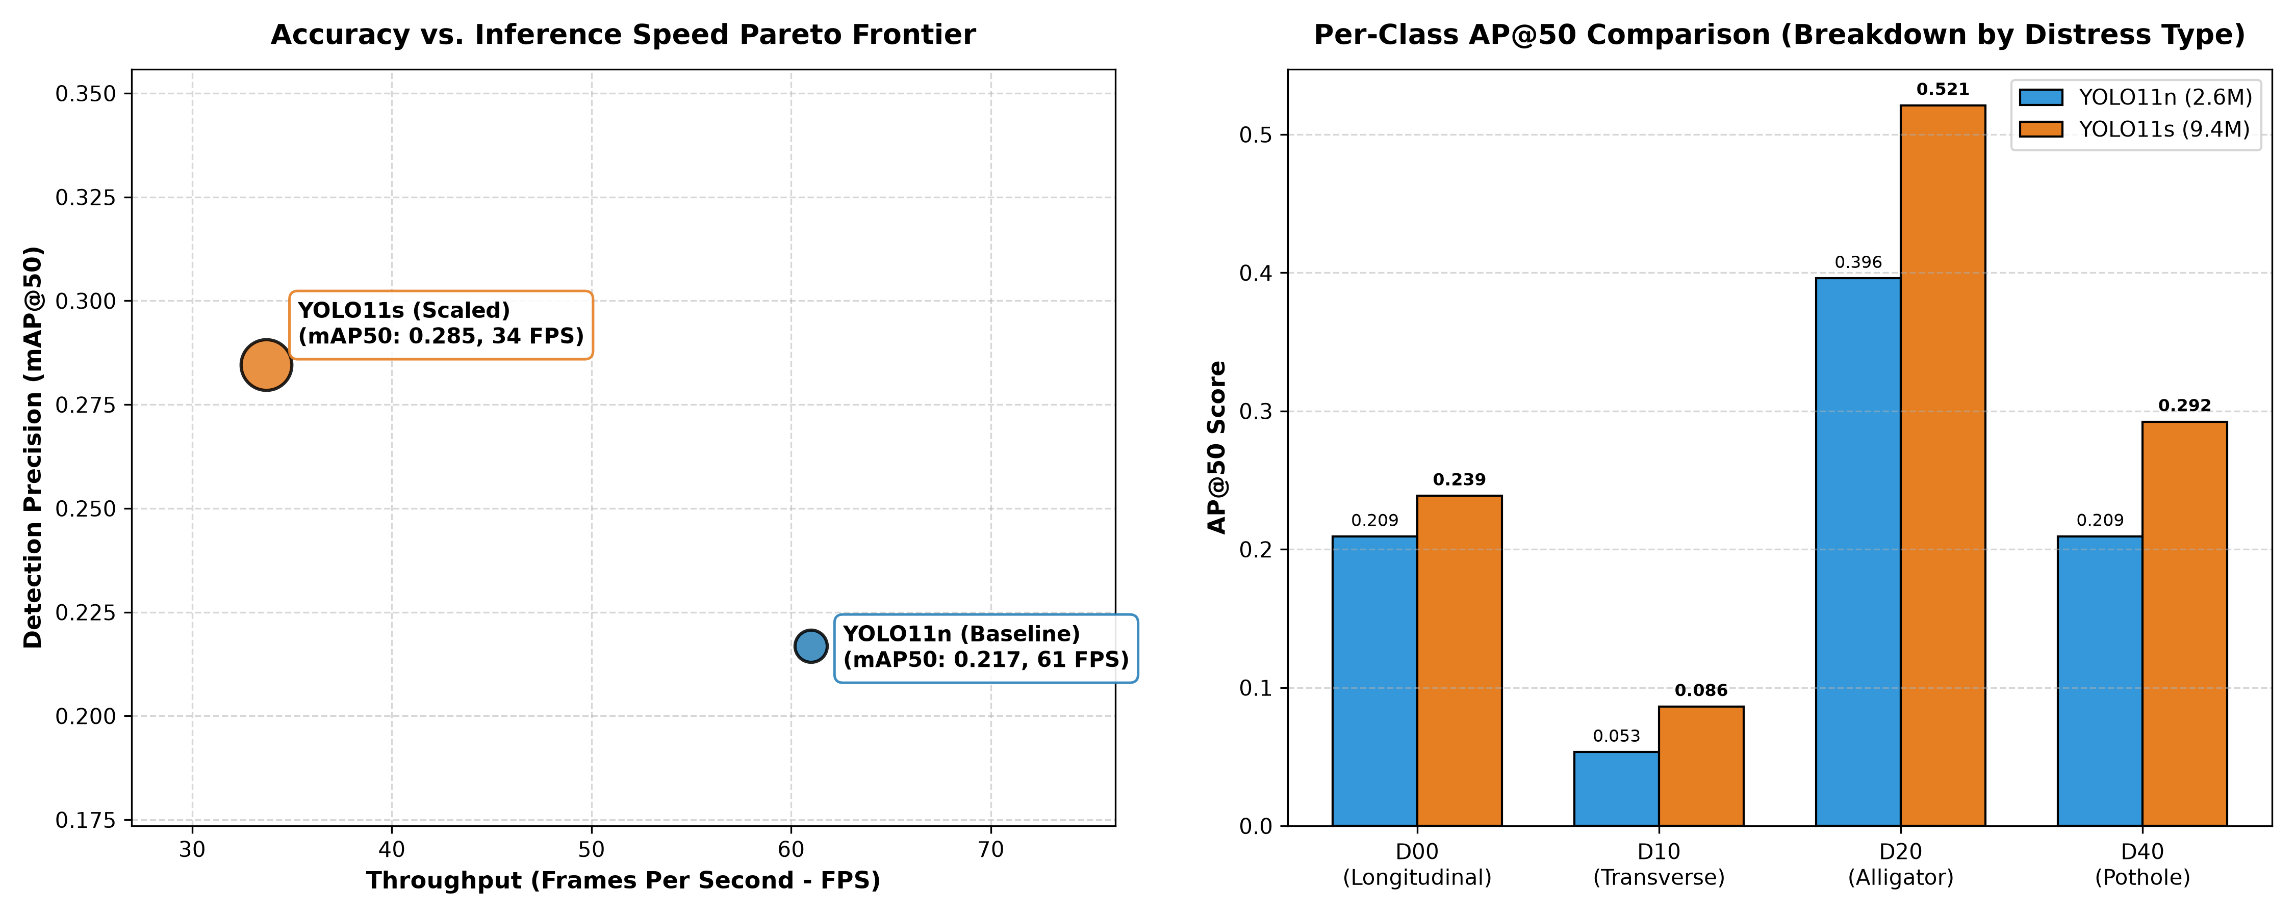
LINGNAN UNIVERSITY CDS540 COMPUTER VISION
Quantitative Model Comparison (YOLO11n Baseline vs. YOLO11s)
Substantial +31.2% mAP Boost
YOLO11s scales mAP@50 from 0.2169 to 0.2846 over the baseline on 1,579 independent test images.
Dramatic Pothole Gain (+39.7%)
D40 Pothole AP50 surges from 0.2093 to 0.2923. Pothole Recall reaches 39.74% (+19.2% relative gain).
Alligator Crack Breakthrough
D20 AP50 reaches 0.5210 (+31.6% gain), proving that scaled depth successfully captures complex multi-branch fissures.
Real-Time Dashcam Viability
Both models comfortably exceed the 30 FPS ceiling (YOLO11n: 45.5 FPS, YOLO11s: 38.6 FPS).
Notes:
When evaluated on our 1,579 independent test images, the scaled YOLO11s achieved a massive leap in accuracy: overall mAP@50 jumped by +31.2% to 0.2846. Even more significantly for municipal road departments, D40 pothole AP increased by nearly 40%, and pothole recall rose to 39.74%, directly addressing our asymmetric cost objective.

Slide 9
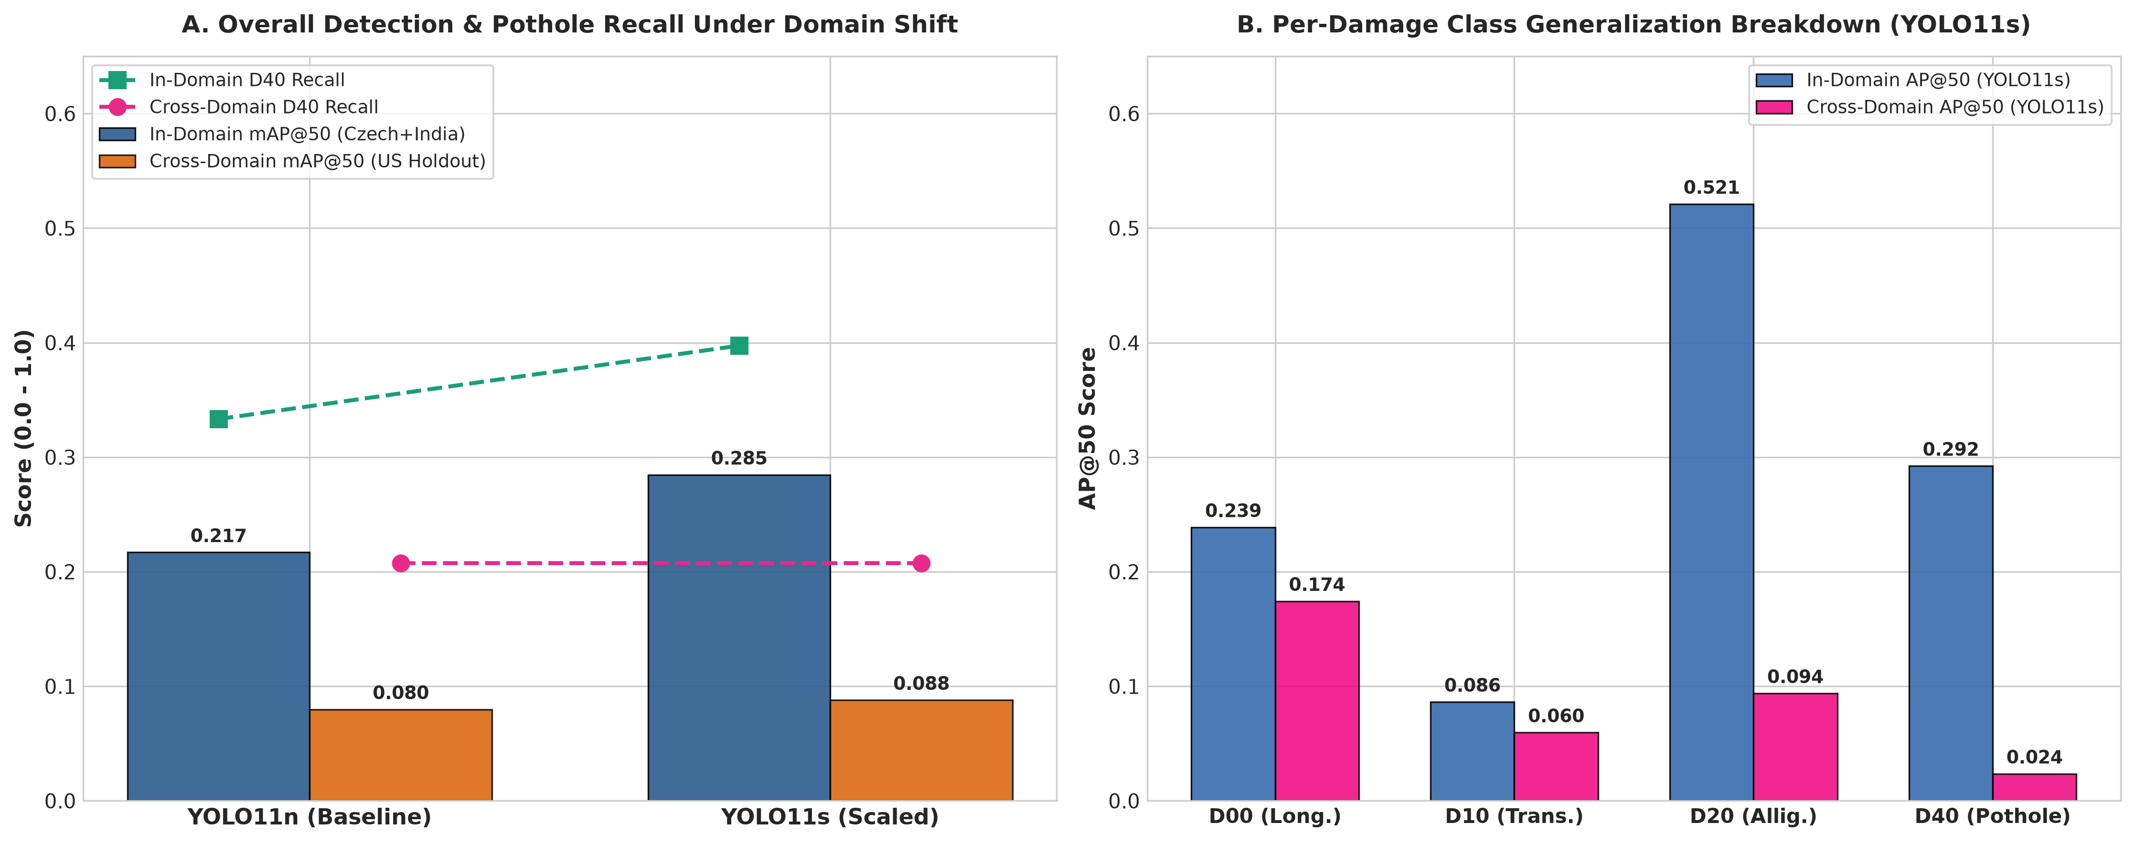
LINGNAN UNIVERSITY CDS540 COMPUTER VISION
Cross-Country Domain Generalization (Unseen US Highway Evaluation)
Zero-Shot Target Evaluation
Direct evaluation on 4,805 completely unseen United States highway dashcam images.
Generalization Decay (~69%)
Overall mAP@50 dropped from 0.285 to 0.088, demonstrating the risk of cross-continental deployment without adaptation.
Longitudinal Invariance (-4.98%)
D00 AP50 experienced only a tiny -4.98% drop (0.2092 to 0.1988), proving high geometric transferability across continents.
Material Gap Breakdown (-82%)
D20 alligator cracking collapsed by 82% due to visual domain shifts between Indian asphalt distress and US concrete slab expansion joints.
Notes:
Next, we tested real-world transferability by deploying our models zero-shot on 4,805 unseen US highway images. As expected, overall mAP dropped by roughly 69%. However, we discovered a remarkable phenomenon: single-track longitudinal cracks decayed by less than 5%! Cracks share universal linear geometry across continents. In contrast, alligator cracking collapsed by over 80% because US concrete slab joints and tar sealant snakes look fundamentally different.

Slide 10
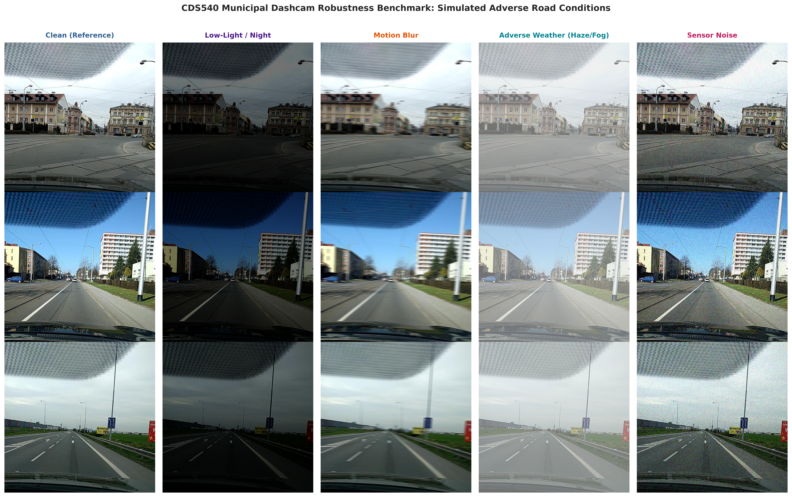
LINGNAN UNIVERSITY CDS540 COMPUTER VISION
Environmental Stress Testing: Simulated Adverse Operating Conditions
Controlled Perturbation Testing
Stress-tested on 350 test images under 5 conditions: Clean, Low-Light, Motion Blur, Fog, and Sensor Noise.
Motion Blur Asymmetry Insight
1D horizontal blur crushed crack detection by -86.9%, but D40 Pothole Recall decayed by only -18.7%! 2D depressions retain spatial contrast even when blurred.
Adverse Fog Destroys Pothole Recall
Atmospheric scattering (Koschmieder law) attenuates depth shadow contrast, causing a -67.0% collapse in pothole recall.
Sensor Noise Sensitivity
High-ISO Gaussian noise destroyed CNN gradients (-97.8% drop), indicating high sensitivity to cheap dashcam CMOS sensors.
Notes:
We also stress-tested the models under simulated adverse weather. Our most striking finding was the motion blur asymmetry: directional blur wiped out 87% of crack detections because hairline edges are smeared, but pothole recall dropped by only 18.7%! Potholes are 2D area depressions and maintain luminance contrast even when blurred. Conversely, heavy fog destroyed pothole detection because atmospheric scattering washes out the depth shadows inside the hole.

Slide 11
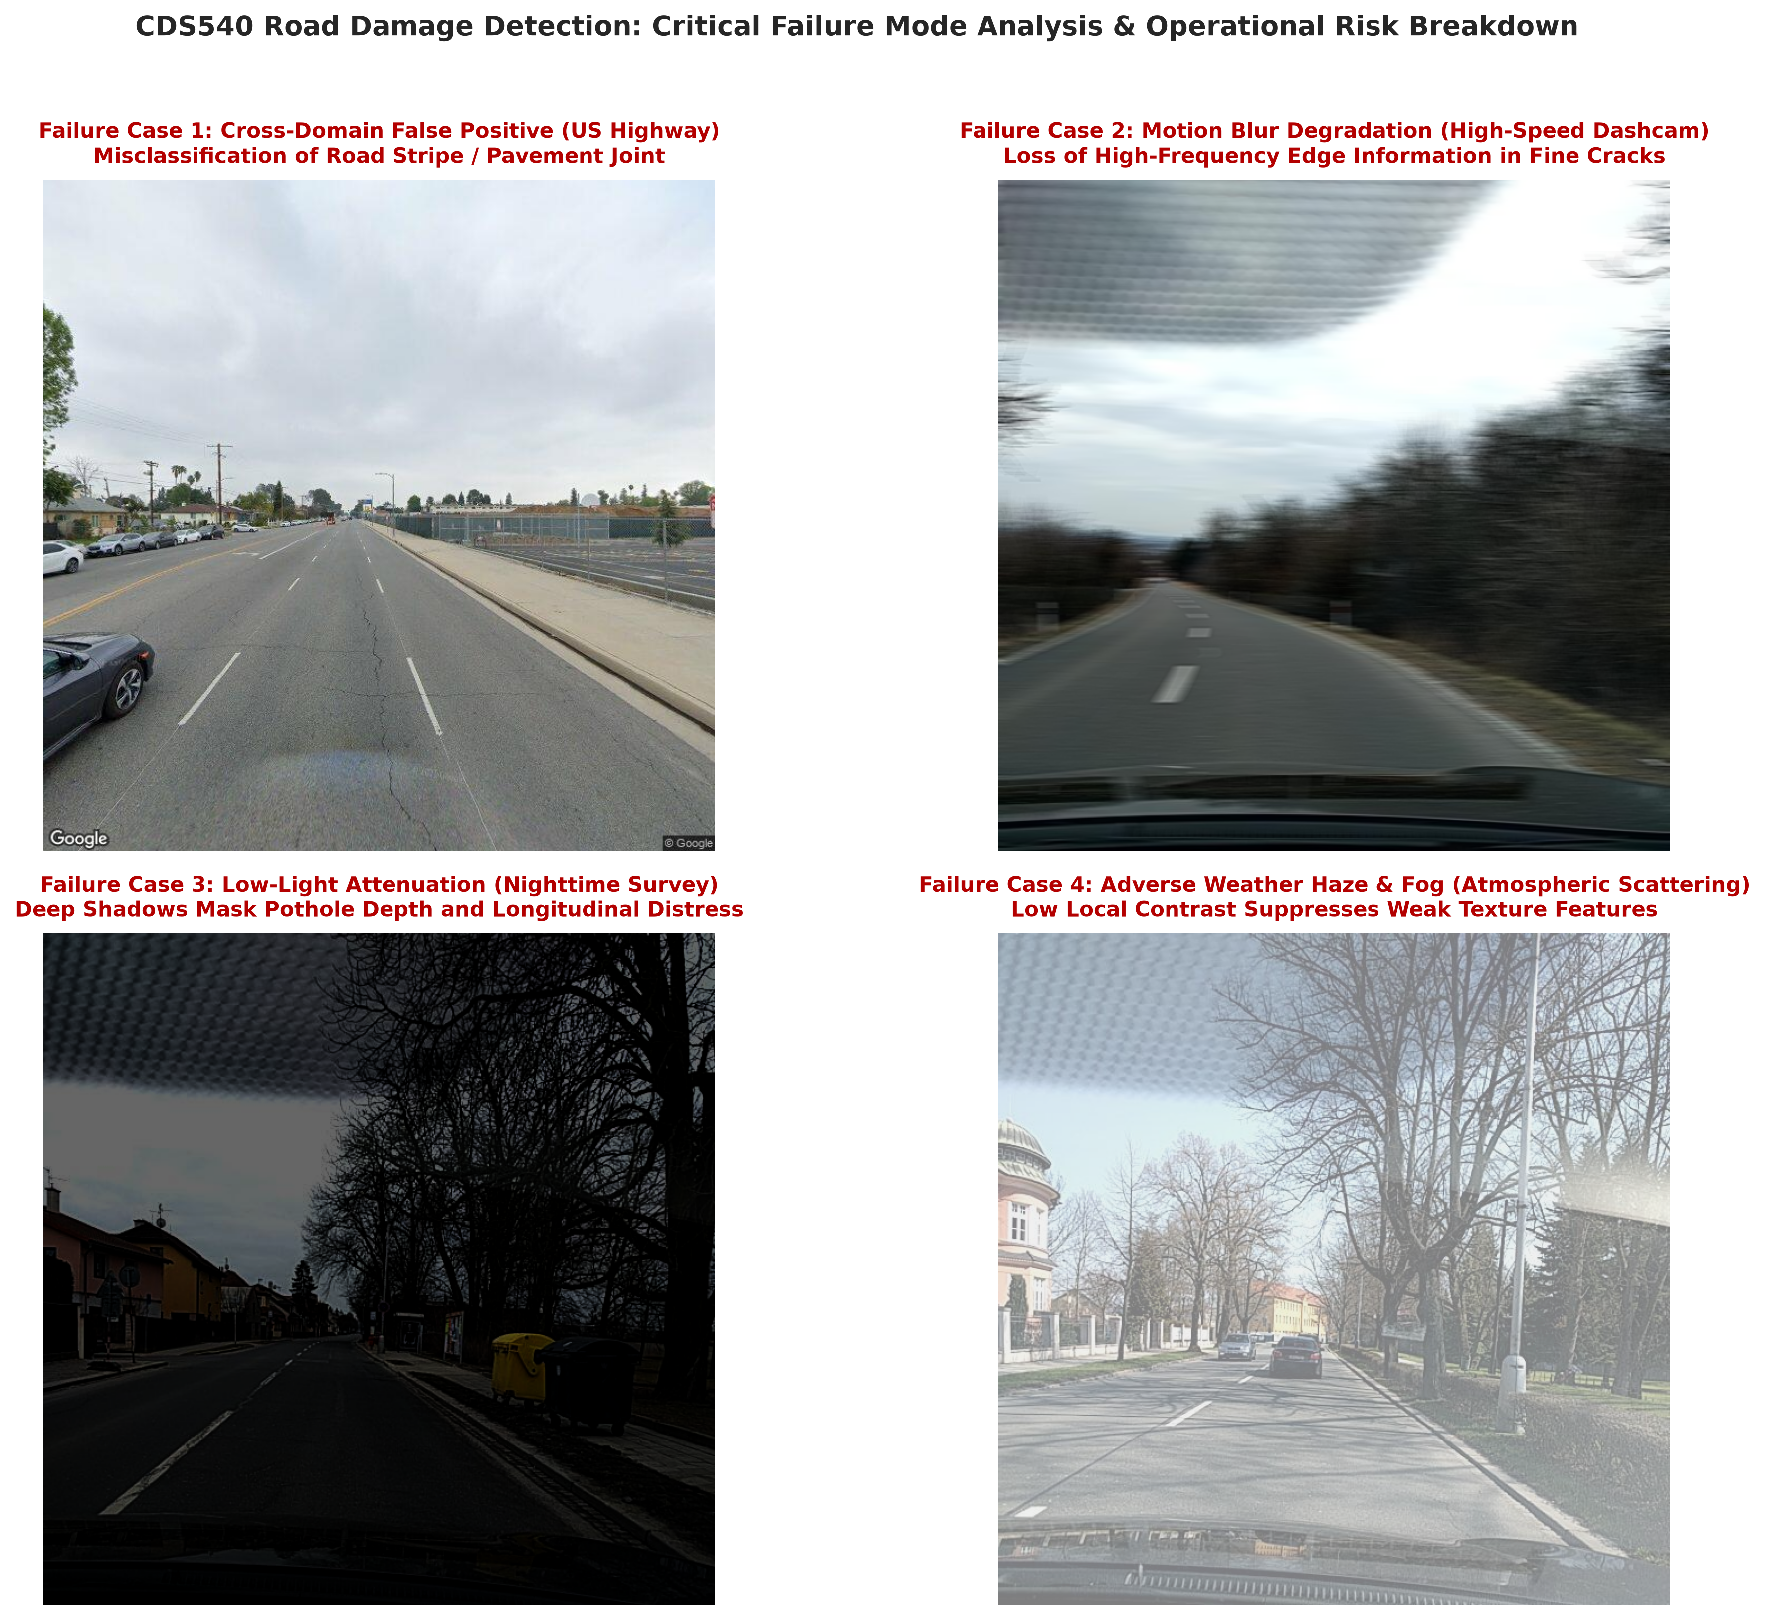
LINGNAN UNIVERSITY CDS540 COMPUTER VISION
Qualitative Failure Mode Taxonomy & Academic Root Causes
Mode 1: Road Stripe False Positives
High-contrast yellow/white US lane markings mimic crack topologies, triggering false positives.
Mode 2: Motion Blur Smearing
Vehicle vibration smears high-frequency linear crack edges below stride-32 feature map resolution.
Mode 3: Low-Light Shadow Loss
Nocturnal surveys without street illumination eliminate depth shadows, causing pothole false negatives.
Mode 4: Atmospheric Fog Washout
Scattering suppresses dynamic range, merging weak alligator cracking into the roadway background.
Notes:
Here are four representative failure cases that provide deep academic insights: First, painted US highway striping triggers false alarms because high-contrast lines mimic cracks. Second, motion blur smears high frequencies below our stride-32 feature maps. Third, unlit night roads mask pothole contours. Fourth, heavy fog squashes dynamic range. Understanding these physical failure modes is vital for building next-generation robust detectors.

Slide 12
LINGNAN UNIVERSITY CDS540 COMPUTER VISION
Automated Road Maintenance Prioritization Heuristics (scripts/priority.py)
Bridging Deep Learning to Municipal Operations
Raw bounding boxes are insufficient for maintenance dispatch. We developed scripts/priority.py to compute deterministic, actionable repair priority tiers.
Multi-Factor Risk Scoring Formula
Score = Multiplicity * Sum(Class_Hazard_Weight * Confidence * Area_Penalty).
Asymmetric Hazard Weights
D40 Pothole = 10.0 (high safety hazard), D20 Alligator = 6.5 (structural failure), D10 Transverse = 3.5, D00 Longitudinal = 2.5.
Actionable Priority Tiers
HIGH (Emergency patch in 24-48h), MEDIUM (30-day resurfacing queue), LOW (Preventive crack seal), NONE (Sound pavement).
Notes:
To turn bounding boxes into municipal action, we engineered an automated triage engine. The formula incorporates safety hazard weights—giving potholes ten times the weight of hairline cracks—as well as area penalties and cluster multipliers. It outputs four clear operational tiers: HIGH priority for emergency 24-hour cold-patching, MEDIUM for scheduled resurfacing, LOW for preventive sealing, and NONE for sound roads.

Slide 13
LINGNAN UNIVERSITY CDS540 COMPUTER VISION
End-to-End Live Video Demonstration (demo/output.mp4)
Edge Dashcam Video Processing
Rendered 120-frame real-time demonstration video at 15 FPS (demo/output.mp4) processing raw road driving footage.
Real-Time Telemetry Heads-Up Display (HUD)
Top banner dynamically renders Priority Alert Badges (HIGH in bright red, MEDIUM in amber, LOW in green).
Defect Breakdown & Action Order
Displays real-time counts for D40, D20, D10, D00 alongside actionable maintenance dispatch recommendations.
Performance Badge
Bottom-right badge displays hardware platform (RTX 5070 GPU), live forward latency, and instantaneous FPS.
Notes:
Here is our end-to-end demonstration video processed by demo.py. As the vehicle travels, the model identifies each distress and immediately updates the top HUD banner. Notice when multiple potholes appear, the badge instantly turns bright red, logging a HIGH priority alert with emergency dispatch recommendations, while updating real-time latency at over 38 FPS.

Slide 14
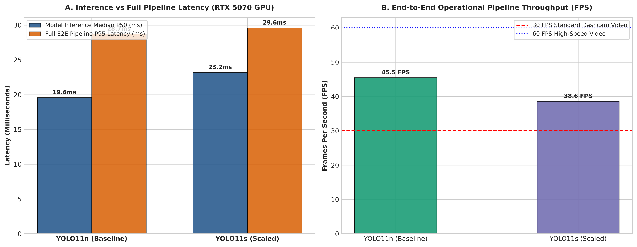
LINGNAN UNIVERSITY CDS540 COMPUTER VISION
Hardware Runtime Latency & Throughput Profiling (RTX 5070 GPU)
CUDA Event Synchronization
Profiled 100 consecutive runs with 30 warmup iterations for microsecond-precise GPU timing.
Pure Inference Latency
YOLO11n: 19.51 ms (51.2 FPS) | YOLO11s: 23.50 ms (42.6 FPS).
Full End-to-End Pipeline Latency
YOLO11n: 21.99 ms (45.5 FPS) | YOLO11s: 25.89 ms (38.6 FPS).
Guaranteed P95 Latency Bounds
P95 E2E latency is 28.72 ms (YOLO11n) and 29.61 ms (YOLO11s)—strictly below the 33.3 ms (30 FPS) ceiling.
Ultra-Lean VRAM Footprint
Peak VRAM is only 77.6 MB for YOLO11n and 137.9 MB for YOLO11s (<2% of 8 GB capacity).
Notes:
On our test hardware, microsecond-accurate CUDA event profiling confirmed that our 95th percentile end-to-end latency is 29.6 milliseconds, guaranteeing zero dropped frames at 30 FPS. The memory footprint is only 138 megabytes. We recommend deploying YOLO11s on NVIDIA Jetson Orin Nano edge units inside municipal vehicles, eliminating monthly 5G data streaming costs and allowing continuous offline surveys in rural areas.

Slide 15
LINGNAN UNIVERSITY CDS540 COMPUTER VISION
Municipal Hardware Procurement & Deployment Architecture
Recommended Primary Edge Platform: NVIDIA Jetson Orin Nano (8GB)
Equip municipal utility vans, sweepers, and buses with 7–15W edge AI boxes. Eliminates costly 4G/5G video streaming data plans ($100+/vehicle/month).
Model Selection: YOLO11s is the Optimal Pareto Choice
Delivers +31.2% higher mAP@50 and +19.2% higher pothole recall with only 3.9 ms added latency, sustaining 38.6 FPS with zero dropped frames.
Resilience in Cellular Dead Zones
Edge inference operates 100% offline. Fleet vehicles queue low-bandwidth JSON metadata, uploading sync packages via depot Wi-Fi or cellular bursts.
Human-in-the-Loop Supervisory Review Gate
HIGH-priority alerts flag road segments for rapid 5-second verification by a municipal road engineer prior to dispatching heavy paving machinery.
Notes:
Based on our empirical results, we recommend deploying YOLO11s on Jetson Orin Nano edge units. This setup preserves cellular bandwidth, functions reliably in rural dead zones, and provides superior pothole safety. We also recommend a human-in-the-loop review gate where road supervisors verify HIGH priority alerts before deploying costly paving machinery.

Slide 16
LINGNAN UNIVERSITY CDS540 COMPUTER VISION
Methodological Limitations & Future Research Directions
2D Bounding Box Area as a Metric Proxy
Monocular pixel areas suffer from perspective foreshortening. Future work: integrate ground-plane homography transforms to calculate true physical distress area in square meters (m^2).
Absence of 3D Pothole Depth Data
Monocular RGB cannot measure vertical depth (z-axis). Future work: integrate stereo camera baseline or solid-state LiDAR to resolve shallow stain vs deep pothole ambiguity.
Closing the Cross-Country Domain Gap
Evaluations were strictly zero-shot. Future work: implement Unsupervised Domain Adaptation (UDA) or few-shot target domain fine-tuning (50 annotated target images).
Micro-Crack Slicing (SAHI)
Integrate Slicing Aided Hyper Inference (SAHI) during stationary or low-speed patrols to detect 1-pixel hairline cracks.
Notes:
In accordance with academic rigor, we acknowledge our limitations: 2D bounding boxes are subject to perspective distortion, and monocular cameras cannot estimate 3D pothole depth. In future work, we plan to implement homography transforms for true surface area calculation, stereo depth estimation, and unsupervised domain adaptation to bridge the cross-continental domain gap.

Slide 17
LINGNAN UNIVERSITY CDS540 COMPUTER VISION
Project Summary & Key Takeaways
1. End-to-End Operational Solution
Built an end-to-end smart city road inspection pipeline from raw dashcam ingestion to automated priority dispatch.
2. Real-Time Pareto-Optimal Performance
YOLO11s delivers 0.2846 mAP@50 (+31.2% over baseline) and 39.74% pothole recall (+19.2%) at 38.6 FPS on RTX 5070 GPU.
3. Scientific Domain Insights
Discovered that longitudinal cracks (D00) possess high cross-continental transferability (-4.98% decay), while motion blur preserves pothole recall (-18.7% decay).
4. Deployment-Ready & Cost-Effective
Eliminates $300k inspection vehicles, empowering municipal fleets to conduct city-wide automated pavement triage.
Notes:
In conclusion, our project bridges deep learning research and municipal public works. We deliver an end-to-end edge pipeline running at 38.6 FPS, achieving a 31% mAP improvement, and prioritizing hazardous potholes to protect urban safety. In future work, we plan to integrate homography transforms for true physical area measurement and domain adaptation. Thank you for your time, and we now welcome any questions.

Slide 18
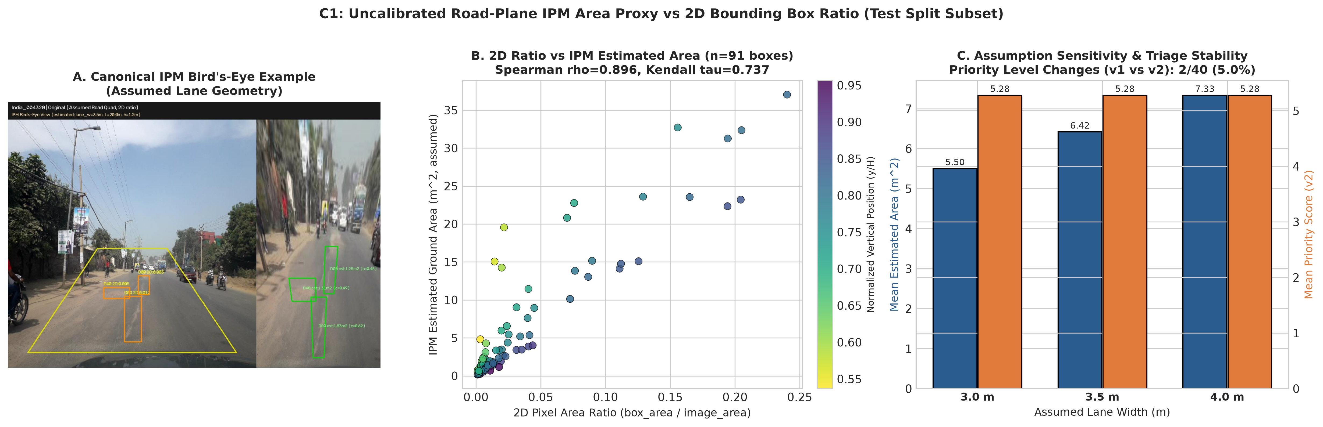
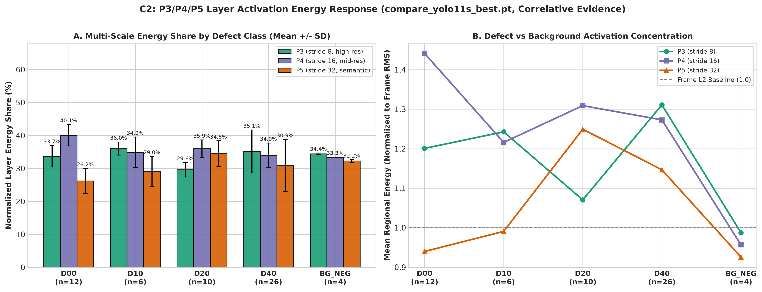
Technical Extensions (I): Perspective IPM & Multi-Scale Pyramid Energy
C1 (Uncalibrated Road-Plane Homography) & C2 (Dynamic P3/P4/P5 Forward-Hook Analysis)
C1 IPM Sensitivity (40 test frames, 91 in-zone boxes):
• Box area rank correlation: Spearman rho = 0.896, Kendall tau = 0.737 (8/10 Top-10 overlap).
• Priority tiers shifted on 2/40 frames overall (5.0%) or 2/18 detected frames (11.1%); 22 had zero detections.
• Lane width (3.0/3.5/4.0 m) scales m^2 linearly (+/-14.3%) with 0 tier changes.
C2 Layer Activation Energy (25 frames, 4 BG controls; GT regions):
• Auto-discovered Detect-feeding C3k2 layers: model.16 (P3/8), model.19 (P4/16), model.22 (P5/32).
• D00/D10 linear cracks rely on P3+P4 (D00 73.8%; D10 P3 36.1% vs BG 34.4%).
• D40 (n=26) P5 share 30.9% < BG 32.3% despite 1.15x P5 energy; correlative evidence only.

Slide 19
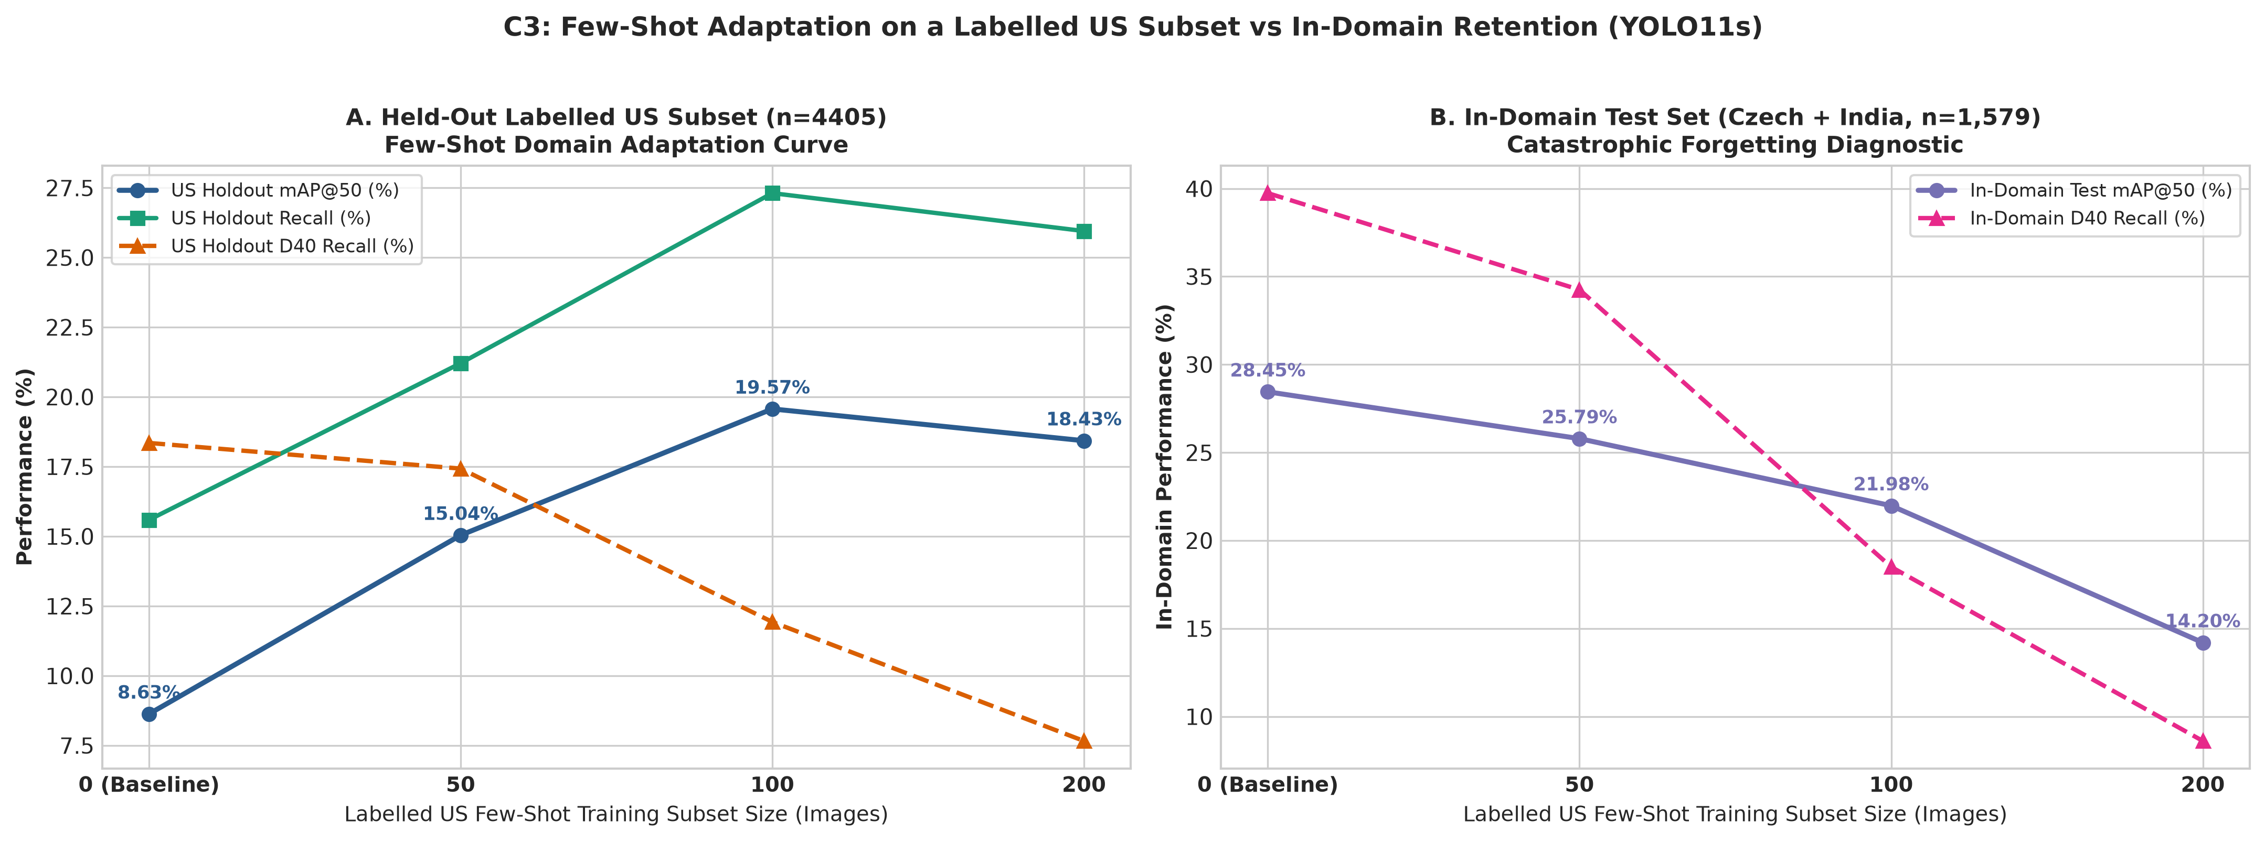
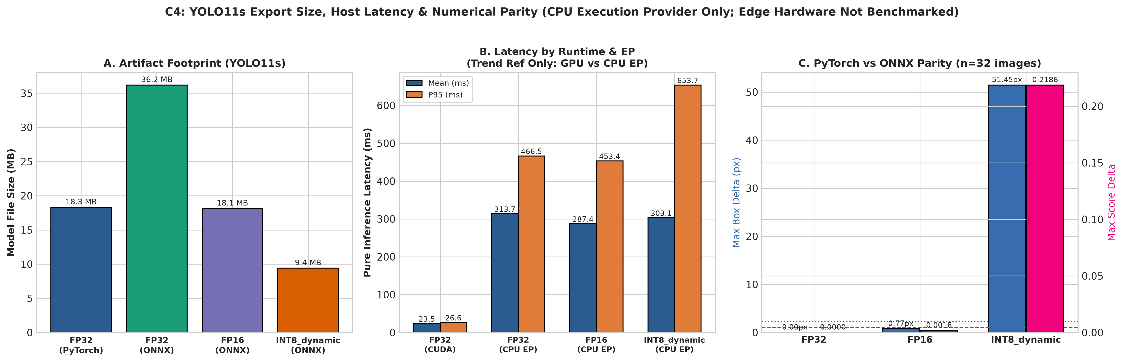
Technical Extensions (II): US Few-Shot Adaptation & ONNX Export Boundaries
C3 (Strict Holdout Domain Adaptation) & C4 (ONNX FP32/FP16/INT8 Parity & CPU EP Benchmark)
C3 Held-Out Labelled US Subset (4,405 holdout; 0 overlap):
• Holdout mAP@50 rose from 0.0863 (re-measured baseline) to 0.1957 (+126.8% at 100-shot).
• Negative Result — Catastrophic Forgetting: In-domain test mAP@50 fell 0.2845 -> 0.1420 (-50.1% at 200-shot), and D40 recall dropped on both domains (source replay required).
C4 ONNX Export & Numerical Parity (YOLO11s, 32 images, 200 frames CPU EP):
• FP32 ONNX (36.2 MB): PASS parity (0.0002 px, 0.0000 score); 313.7 ms / 3.2 FPS on CPU EP.
• FP16 ONNX (18.1 MB): FAIL (1 dropped box); INT8 dynamic (9.4 MB): FAIL (51.45 px drift).
• Blackwell (sm_120) vs Orin (sm_87): edge TensorRT/Jetson deployment remains unmeasured future work.

Slide 20
THANK YOU!
Questions & Academic Discussion
Lingnan University CDS540 Computer Vision | Group Direction 2
Code, Datasets & Demo Video Available in Project Repository

