Slide 1
“WHY DO WE PRONOUNCE ….”
“ FORE FATHERS…or
shouldn’t it be “4” Father.”

Slide 2
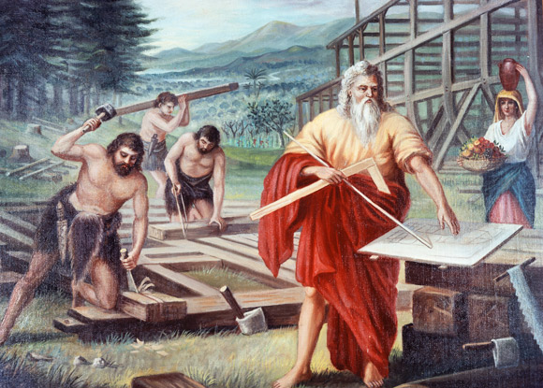
“ THE FOUR FATHERS”
“NOAH AND HIS 3 SONS ….”

Slide 3
“ THE FOUR FATHERS”
“Genesis 9:1
Then God blessed Noah and his sons, saying to them, "Be fruitful and increase in number and fill the earth.”
“Genesis 9:7
As for you, be fruitful and increase in number; multiply on the earth and increase upon it."

Slide 4
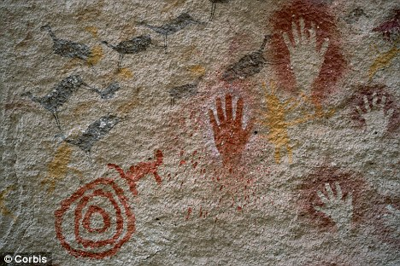
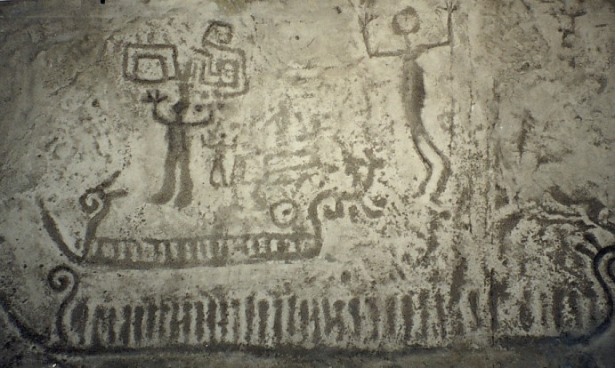
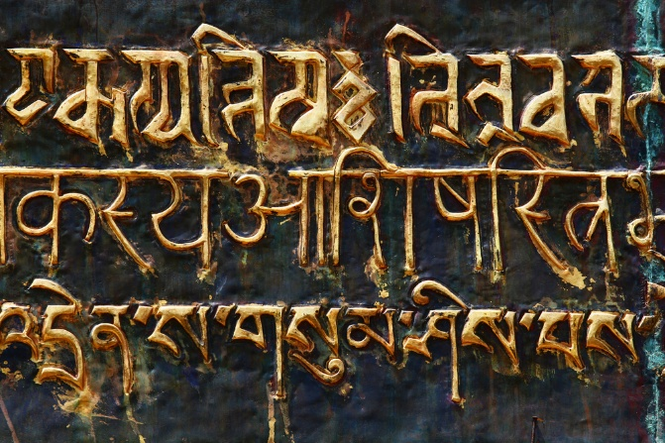
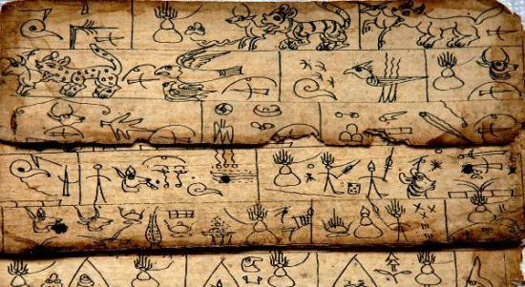
“LEGACY LEFT BEHIND FROM ANCESTORS”
“2 dimensional drawing and writing”

Slide 5
“ BUT WOULDN’T IT BE EASILY…
MISINTERPRETED
AND
MISUNDERSTOOD”

Slide 6
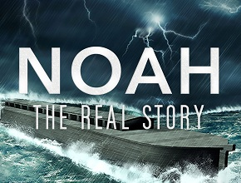
What Happened During the Start of the Flood. ISA 24 Describes the destruction of the flood. ISA 24:18 Whoever flees at the sound of terror will fall into a pit; whoever climbs out of the pit will be caught in a snare. The floodgates of the heavens are opened, the foundations of the earth shake.
ISA 24:19 The earth is broken up, the earth is split asunder, the earth is violently shaken.
ISA 24:20 The earth reels like a drunkard, it sways like a hut in the wind; so heavy upon it is the guilt of its rebellion that it falls—never to rise again.
ISA 24:21: In that day the Lord will punish the powers in the heavens above and the kings on the earth below.

Slide 7
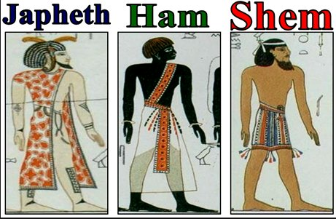
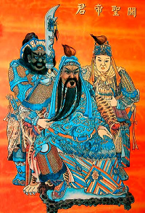
SIMILIARITIES??? OR COINCIDENCES?

Slide 8
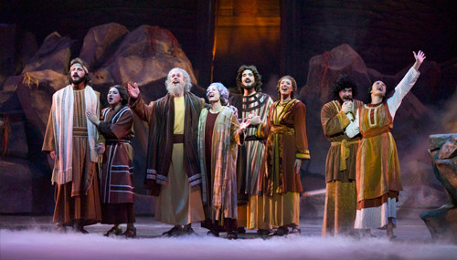
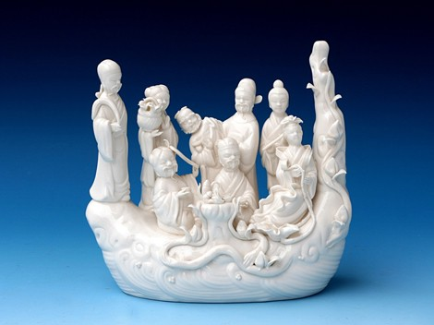
NOAH AND HIS FAMILY TOTAL 8 PERSON
SIMILIARITIES??? OR COINCIDENCES?
THE “8” IMMORTAL CROSSING THE SEA

Slide 9
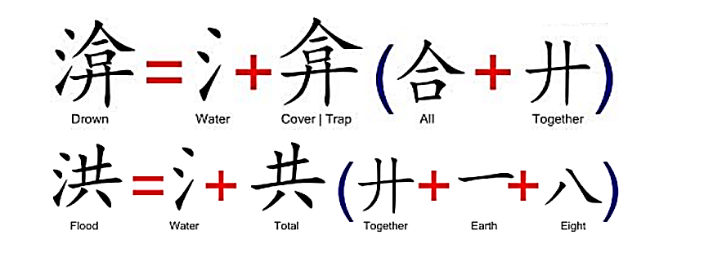
Hidden Chinese Character Secrets

Slide 10
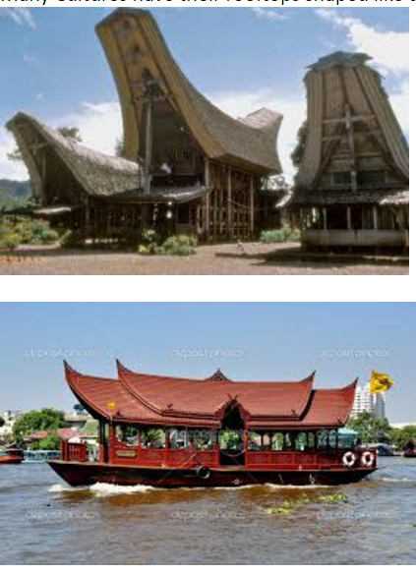
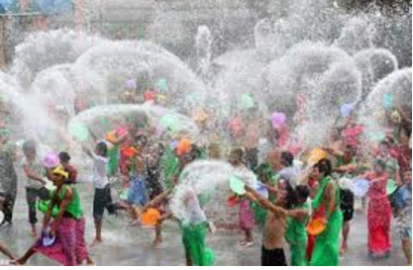
Many cultures have a water festival to remember the flood. The Flood happened because people were too proud. So the water Festival is to remind people why the flood happened and not to let it happen again.
Many Cultures have their rooftops shaped like upside down boats.

