Slide 1
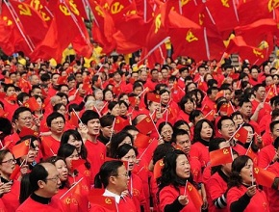
THE GREAT CHINESE RACE.

Slide 2
JOB 1:3 and he owned seven thousand sheep, three thousand camels, five hundred yoke of oxen and five hundred donkeys, and had a large number of servants. He was the greatest man among all the people of the East.
GEN 25:
5 Abraham left everything he owned to Isaac.
6:But while he was still living, he gave gifts to the sons of his concubines and sent them away from his son Isaac to the land of the east.
7 Abraham lived a hundred and seventy-five years.
ISA 46
11:From the east I summon a bird of prey; from a far-off land, a man to fulfill my purpose. What I have said, that I will bring about; what I have planned, that I will do.

Slide 3
GEN 28
13:There above it stood the Lord, and he said: “I am the Lord, the God of your father Abraham and the God of Isaac. I will give you and your descendants the land on which you are lying.
14:Your descendants will be like the dust of the earth, and you will spread out to the west and to the east, to the north and to the south. All peoples on earth will be blessed through you and your offspring.
15:I am with you and will watch over you wherever you go, and I will bring you back to this land. I will not leave you until I have done what I have promised you.”
JOB was a Chinese and from his 3 daughters came the most beautiful women of all the land or in the whole world. That is why the there is a lot of beautiful women in the Chinese race compared to other races.
JOB 42
13:And he also had seven sons and three daughters.
14:The first daughter he named Jemimah, the second Keziah and the third Keren-Happuch.
15:Nowhere in all the land were there found women as beautiful as Job’s daughters, and their father granted them an inheritance along with their brothers.
16:After this, Job lived a hundred and forty years; he saw his children and their children to the fourth generation.

Slide 4
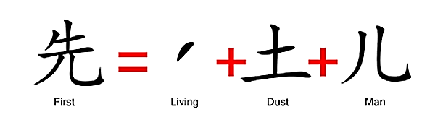
Hidden Chinese Character Secrets

Slide 5
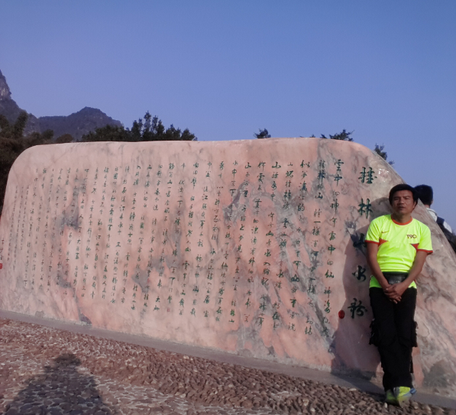
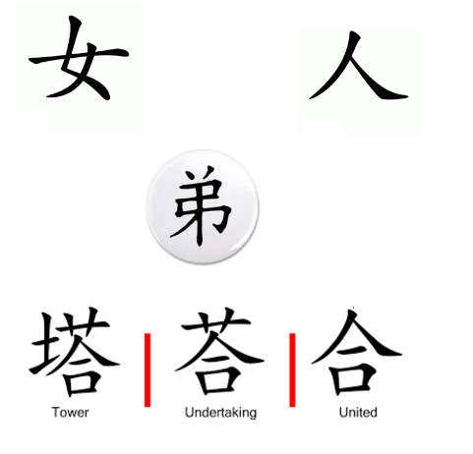
Hidden Chinese Character Secrets

