Slide 1
DIFFERENT COUNTRY'S FLAGS
AND
OTHER OBJECTS WITH 3 DIFFERENT COLORS.

Slide 2
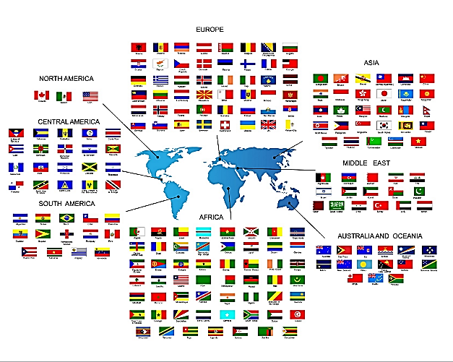

Slide 3
MOST FLAGS OF THE WORLD ARE MADE OF 3 DIFFERENT COLORS.
The 3 different colors are our Ancestors way to remind us that we are from Noah 3 sons who are 3 different colors.
Most are comprised of
Red = Noah's eldest son Japheth.
Yellow or White = Noah's 2nd son Shem where the Messiah came from.
Black, Blue, Green = Noah's 3rd son Ham.
China's Flag is Red only because the MAIN REASON is because they want to be covered by the blood of the lamb. That is why all Chinese temple is red and all Door and Door Posts are RED.
Because being Protected by the Blood of the Lamb in Satan's world is very important, so that they will not be deceived or enslaved.
Exodus 12:12-13 God will Passover and strike dead all the 1st Born.
Exodus 12:22 Paint the blood of the Lamb over your door post.

Slide 4
OTHER OBJECTS WITH COLORS IN THIS WORLD ALSO REPRESENT NOAH'S 3 SONS.

Slide 5
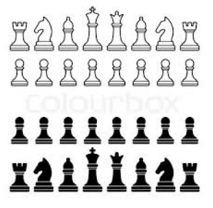
CHESS PIECES.

Slide 6
The 8 Pieces in the Western Chess Pieces represents the 8 people in Noah's Arch.
The King and Queen is definitely Noah and his wife.
The Bishop represents the 1st Born or Eldest Son, Japheth for the eldest son is the spokes man for the family. He is the Pastor or Bishop of the family. Travel in Diagonals.
The Horse is the Ma word in Chinese though the Westerners do not have this word. Ma is also the sound for the horse, but it is not the horse that is important but the Ma sound, for the Ma sound represents all of God's workers. The hardest working of all is the Messiah. The True Ma that we are all waiting for. For other Ma words, See the Ma word section. The horse represents Shen the 2nd Child. Travel in L shapes and can jump over others.
The Rook mean black and is the 3rd Son, Ham and travels in a straight line.
From the color of the Chess pieces we can tell which color represents which brother and his family. The Red Brother uses his white Brother to fight against the Black brother. And Vice Versa for the White Brother as can be seen in the Chinese Chess Pieces.

Slide 7
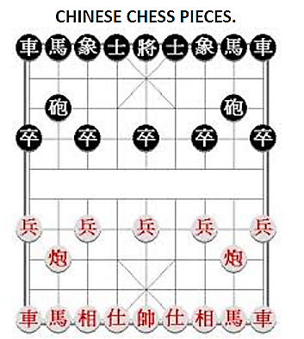

Slide 8
The 9 Pieces in the Chinese Chess Pieces definitely have been altered compared to the Western Chess Pieces. The extra Piece is God but then there are 2 Kings and no Queen. But Generally all the Main Pieces are the same and move in the same ways. As can be seen from the colors of the Chess pieces, the white brother (Chinese People) use the Red brother to fight against the Black brother.
From the Chess pieces, it further confirms that the 3 main colors are the 3 colors of Noah's sons.

Slide 9
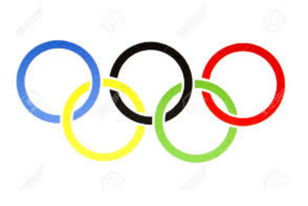

Slide 10
OLYMPIC SIGN
This also represent the 3 types of colors in the whole world.
There are more than the 3 colors but the 3 primary colors can clearly be seen and mixed together, makes 2 more colors.
Which is to represent all people, tongues and nations.

Slide 11
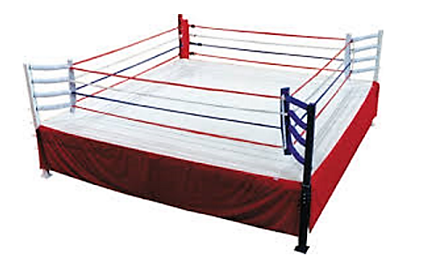

Slide 12
THE BOXING RING.
There are 3 colors for the Ropes.
Red, White and Blue.
There are 2 colored corners,
one is called the Red corner and one is called the Blue corner.
Notice again the same 3 colors.
And here, the Red brother fights with the Black brother.

