Slide 1

Hidden Chinese Character Secrets

Slide 2
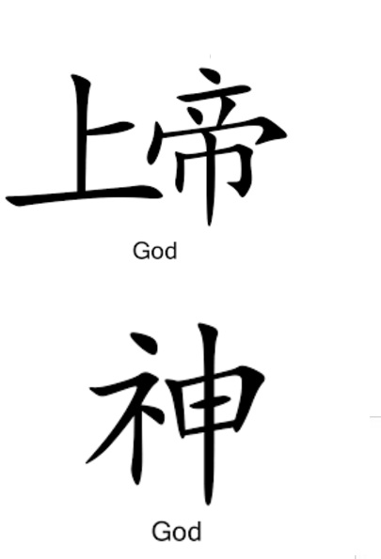
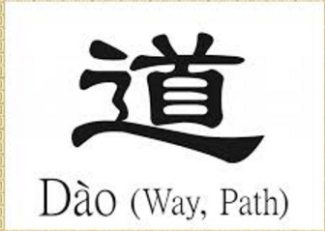
Hidden Chinese Character Secrets

Slide 3
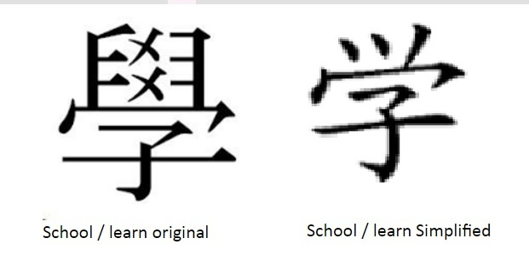
Hidden Chinese Character Secrets

Slide 4
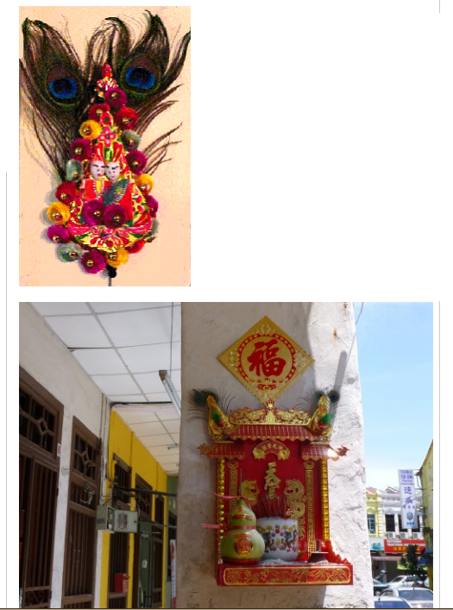
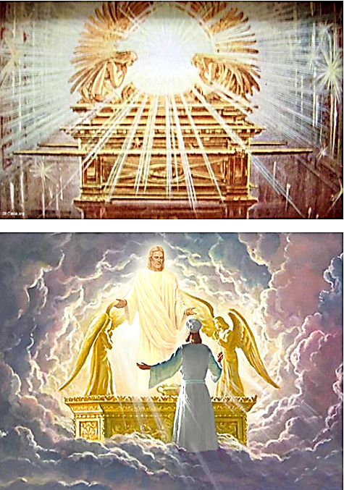

Slide 5
