Slide 1
Appendix D: Introduction to HRHIS

Slide 2


HRHIS
Operational Training
&&
Introduction to HRHIS Development and Implementation in Tanzania

Slide 3
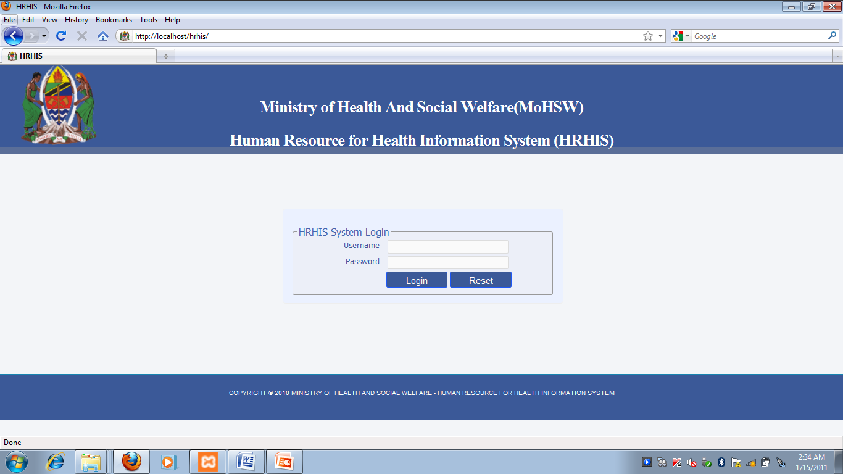

Slide 4
HRHIS Overview
Introduction to HRHIS
Why HRHIS
Inception and Development of HRHIS
Target Group – Key stakeholders
HRHIS Piloting
Rollout Approach
What is special with HRHIS
Possible challenges

Slide 5
1. Introduction to HRHIS
Specific tool to facilitate;
collection, collation or organizing, analysis and presentation of HRH data
An open Source Computer Software (what is Open Source SW?)
Developed using open source packages
Tanzanian initiative;
Owned by the MoHSW
Resources support from JICA (infrastructure, Financial, technical support, etc)
Developed from scratch by experts from UDSM after intensive study and requirements gathering
MoHSW leads the implementation process supported by UDSM
Development and Implementation of HRHIS has been forced by the need of the MoHSW to address HRH Information System challenges and strengthen the existing systems;

Slide 6
2.Challenges with Existing HRH information
Unreliability of existing HRH information
Timeliness: Managers from all levels to get timely data
Correctness: The system enhances correctness of HRH Information
Completeness: The system also enhances completeness
Difficulties in Accessing of HRH information
Difficulties in Sharing of HRH information within MoHSW and from outside
Storage of HRH data and information – poor storage facilities

Slide 7
…Challenges
Confidentiality of HRH information – is not guaranteed
Technical capacity in handling HRH information – poor Capacity in collection, storing, analyzing and presenting
Infrastructure and supporting equipments – poor or not exist
Unclear format for presenting HRHIS data
Various offices to report to and with different formats and frequency of reporting
Redundancy in collection of HRH information – same thing done by different authorities since what is collected can not be shared

Slide 8
3. WHY HRHIS?
HRHIS aims at;
To use the state of art technology (yet simple) for handling HRH information
To establish a national database standard for collection of HRH information
To enable timely availability of updated HRH information
To make possible accessibility of HRH information without difficulties both within MoHSW and outside
To enable the nation to understand the status of HRH personnel in Health Sector
Saving cost incurred to collection the same information every now and them by keeping relevant HRH information
Make available information for decision making and Planning
To enable proper allocation of health personnel

Slide 9
4. Inception and Development of HRHIS
The initiative started in 2009…development started after requirements gathering from different stakeholders
The first version was piloted in coast region from July 2009 and then Dar es Salaam from December 2009
Development is done using Open Source Software Technologies
We are using participatory development approach whereby users are part and parcel of the development process and software quality improvement
More requirements can still be accommodated as deemed necessary

Slide 10
5. Why using Open Sources Technologies
Advantages of using Open Source developing tools;
Low cost for development – no need of purchasing development tools
Use of local experts for development hence easy transfer of knowledge – easy to train new developers and system users
Possible to accommodate the dynamic and changing data requirements
Development takes into account our local settings hence facilitate acceptance of system to users

Slide 11
6. Target HRHIS Users
Health facilities personnel for providing detailed Individual information
CHMTs at which all data are entered into HRHIS computer
RHMTs – linked with councils databases to make records from districts available at the regional office
Referral hospitals
MoHSW – synchronizing data from all regions in the country and make it available at the MoHSW for use

Slide 12
7. Who to Train?
For Operation Training;
DMO – as Health manager within the district, should be informed of the initiative and support its operations
District Health Secretary – Responsible of HRH personnel management at district/council level
HMIS FP – Involved in data management hence can be resourceful in data collection, entry and management
For the region
RMO – Regional Health Manager – informed of the initiative and provide necessary support.
Regional HS – responsible for HRH within the regional – making sure HRHIS is functional (data entry, report generations, data use, etc)
Regional HMIS FP – Assists in HRH Data management
Regional IT personnel – Potential in Providing immediate technical support to computers and the system

Slide 13
8. Training and Support Approach
Training - 3days
On site setup of the system at each site
First Supportive Supervision – one month after training
Second supportive supervision – one month after first visit
On-call support and followup on data entry and data use
Possibility of data use training /Refresher training – panned by MoHSW/JICA

Slide 14
9. Rollout Approach
Phase One: December 2009 – February 2010
Dar es Salaam Region
Referral Hospitals – Muhimbili, MOI, ORCI
Phase Two: May – October 2010
Regions: Tanga, Kilimanjaro AND Morogoro
Referral Hospitals: Mirembe, KCMC, Mbeya and Kibong’oto
Phase Three: December 2010 to March 2011
Regions: Lindi, Mtwara and Dodoma
Phase Four: May 2011 – March 2012
13 Regions: Iringa, Ruvuma, Rukwa, Mbeya, Arusha, Manyara, Singida, Shinyanga, Tabora, Kigoma, Mwanza, Mara, Kagera
Hospitals: Bugando Referral
Possibly Phase Five: May 2012 -
Newly Formulated Regions

Slide 15
10. What is special with HRHIS
Locally Developed
Easy to support, guaranteed for technical support from within
Developed with local settings consideration
Ensure technical sustainability
Can accommodate changing requirements of HRH information
Build with Open source philosophy hence a platform from improvement and further development
Operating Environment
Work in both windows and Linux operating system
Requires low computer specifications to work
Accessed through the web browser as accessing the Net

Slide 16
…
Usefulness
Very simple to learn
Requires basic computer knowledge to use
Can accommodate a big number of records
Can generate different reports as per requirements
Possibility of manipulation of reports/ customizing
Graphical reports
Information Sharing
Can easily share data with other related system
Export data to HMIS – DHIS
Export import functions to enable transfer of data from one level to another
Records keeping
Staff information
In service trainings
Staff History

Slide 17
11. Expected Challenges
Require enough computer skills to use
Some Health personnel don’t have computer literacy skills
Power supply can be a problem to some of the sites without reliable electricity supply
The need of other computer accessories like printer for reports generation
On time technical support for all sites
Computer breakdown
System failure
Transfer of trained staff like you to different locations
Internet communication is still unreliable to ost of the districts for data sharing

Slide 18
HRHIS
&&
The System

Slide 19
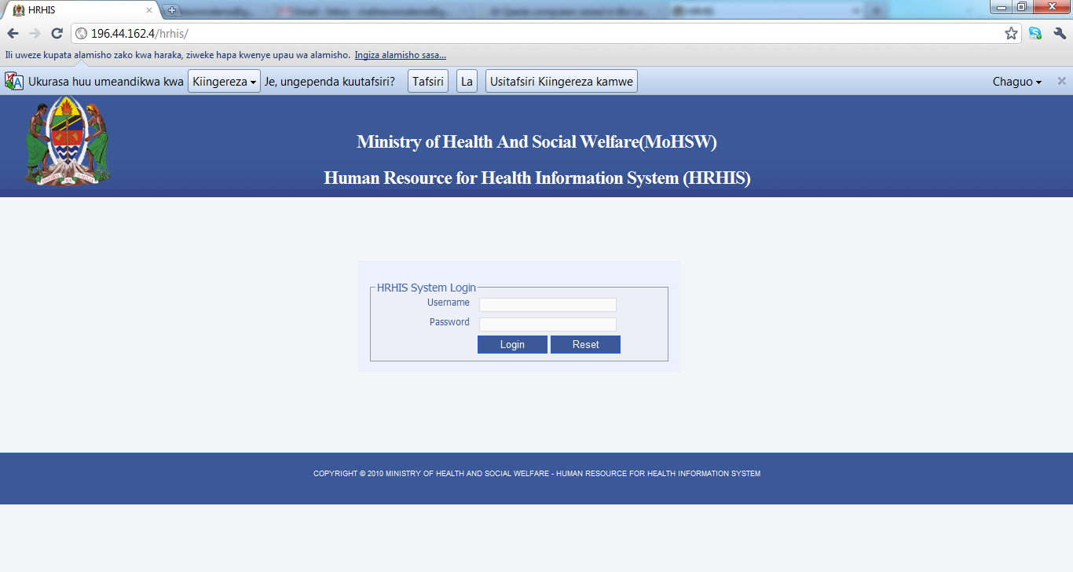
1. Log in Screen

Slide 20
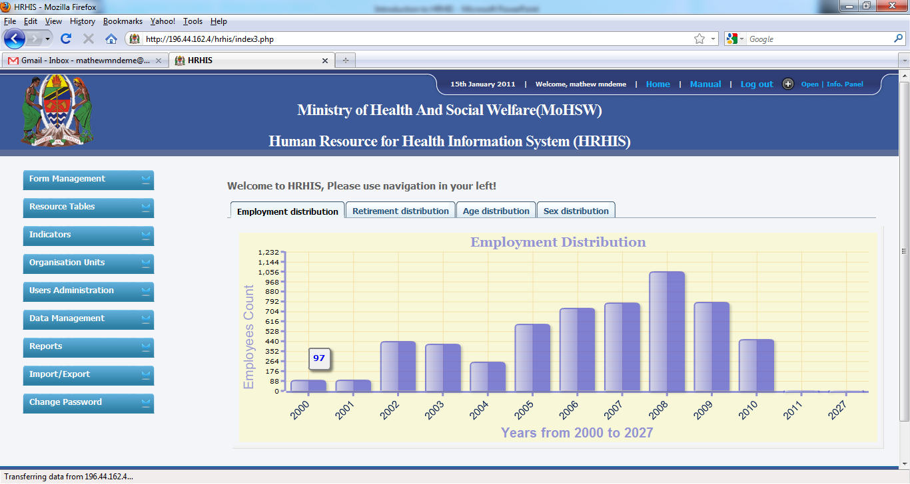
2.HRHIS Dashboard

Slide 21
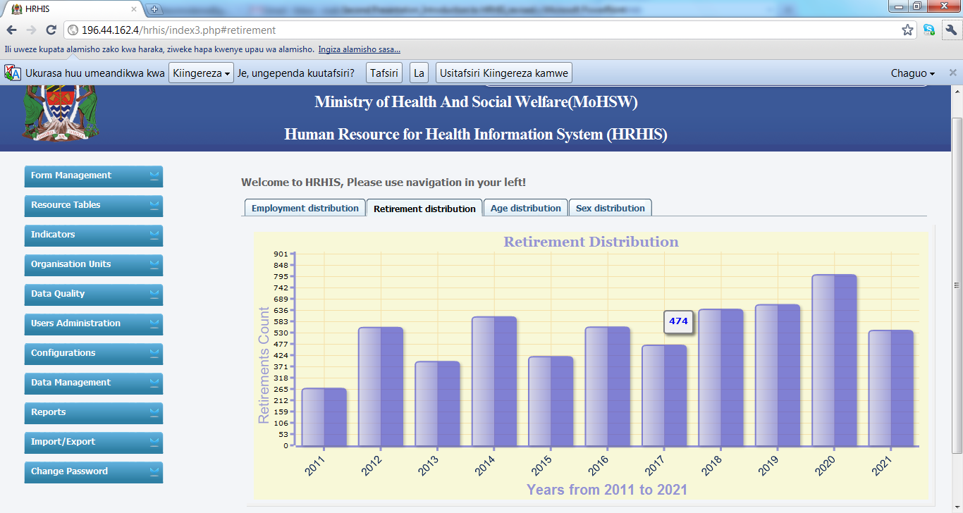
3. HRHIS Dashboard

Slide 22
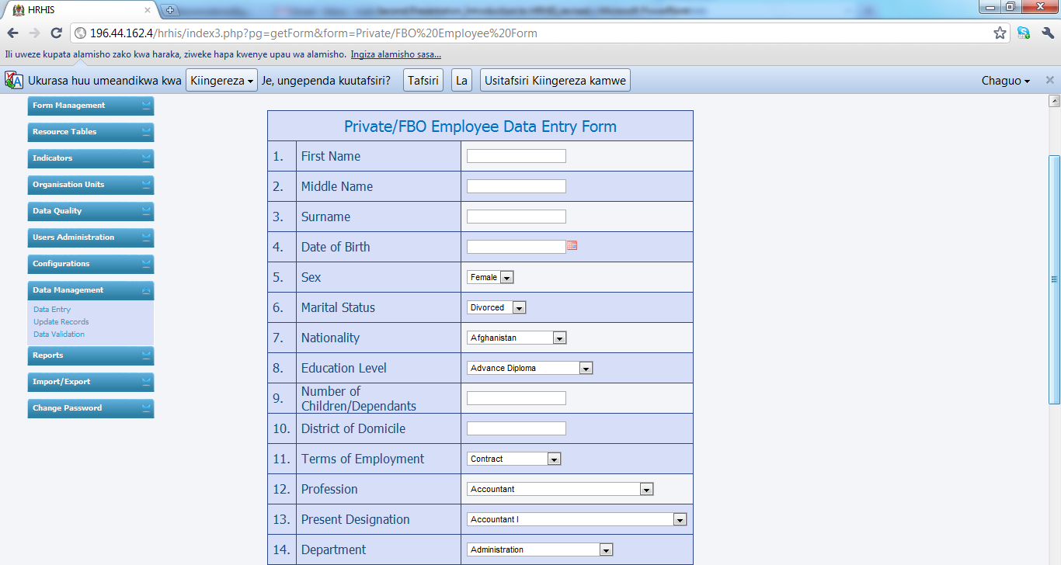
4. Data entry Screen

Slide 23
5. Main Madules
From management
For managing data entry form: editing, adding elements, deleting, etc
Resource tables
For generating excel reports
Indicators
For Indicators calculations
Organization Unit
Adding, editing and deleting organization units
Data Quality
For identifying wrongly entered data for correction
User Administration
For defining different users roles/responsibilities in the system (Access Level)
For creation users login accounts

Slide 24
…modules
7. Configuration
Server Configuration
8. Data Management
Gives access to Data entry form
Updating/ editing entered records
Data Validation – gives a list of wrongly entered data as per defined criteria
9. Reports
Produces data completeness reports
Gives graphical (pie, line and bar charts) and excels aggregated reports
Shows reports for the entered records
Shows staff history reports
Shows in service reports
Make possible to export graphical reports to excel
Gives excel report with arrangement by cadre/designation

Slide 25
…Modules
10. Import/Export
Enables export of entered data in xml format (small size file) to be transferred into another computer to kept for backup
Enables import of data from another HRHIS computer – say importing data from district server to the regional server. Also import back data that has been exported as backup
Export data to other system like DHIS/HMIS
Exporting system data structure
11. Change password
Gives room for users to change password in case the one in use has been exposed

Slide 26

Questions

