Slide 1
Appendix E: Introduction to Ubuntu

Slide 2


HRHIS Operational Training
Introduction to UBUNTU OS

Slide 3
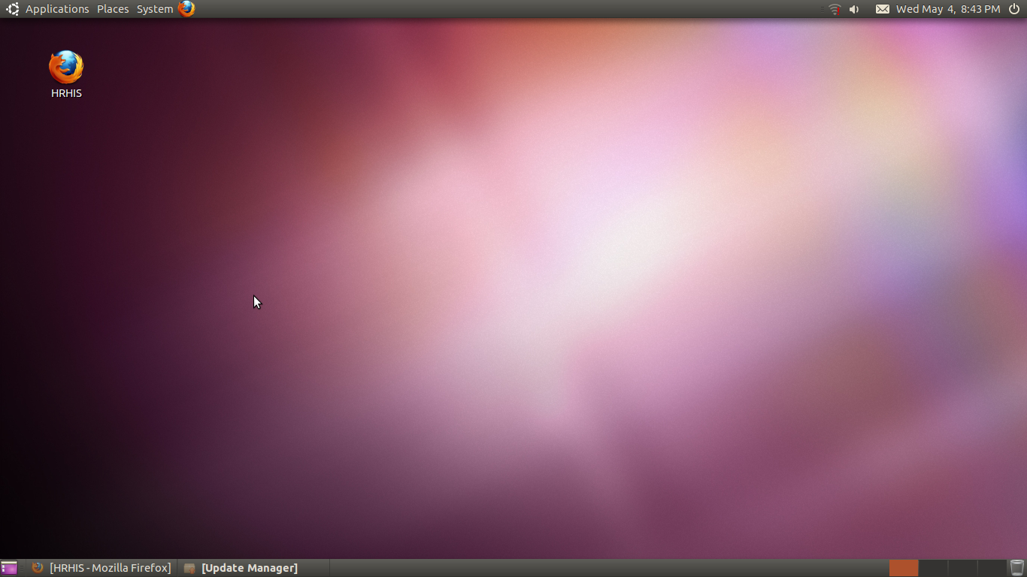

Slide 4
Introduction
Ubuntu is a popular Linux distribution operating system, designed with the intent of overthrowing Microsoft Windows as the world's most widely-used operating system.
The name Ubuntu is derived from Zulu and Xhosa word for humanity, which has been incorporated into South African culture as “humanity toward others”. Another translation could be : “The belief in universal bond of sharing that connects all humanity”
Ubuntu is seen as a traditional African concept, is regarded as one of the founding principles of the new republic of South Africa and is connected to the idea of an African Renaissance.

Slide 5
Introduction
"A person with ubuntu is open and available to others, affirming of others, does not feel threatened that others are able and good, for he or she has a proper self-assurance that comes from knowing that he or she belongs in a greater whole and is diminished when others are humiliated or diminished, when others are tortured or oppressed.”
Archbishop Desmond Tutu

Slide 6
Why Introduced to Ubuntu?
HRHIS deployment is done using computers installed with Ubuntu OS.
Operating system of choice because of its stability that ensure a reliable working system.
You should not be a strange of your own system when you go for sites visits.
Its a potential OS as an alternative for MS OS so been introduced to it might be a starting point to taste something new.

Slide 7
…….
Ubuntu is an entirely open source operating system built around the Linux family (kernel)
The Ubuntu community is built around the Philosophy:
that software should be available free of charge
that software tools should be usable by people in their language of choice and despite any disabilities
and that people should have the freedom to customize and alter their software in whatever way they see fit.

Slide 8
Ubuntu OS Vs MS OS
Open Source ...Available for free
You can download it from the net..no keys
All software are available for free
Need very little computer resources to work (Ram,HD,etc)
Virus Free
Closed Source/Licensed...proprietary
You need keys
You need to purchase most of the software
Requires enough computer resources
Vulnerable to all type of virus attach

Slide 9
....
New releases after every six months
Insured of support from development community
Contains most of the drivers for different devices like printers
It reads all windows packages
Compatible with Windows applications, you can open, edit and share Microsoft Office documents.
No frequent release of new versions
Only MS knows what to do with his releases
You need separate drivers for most of devices connected to it
Work with windows packages only
Not compatible with ubuntu applications.

Slide 10
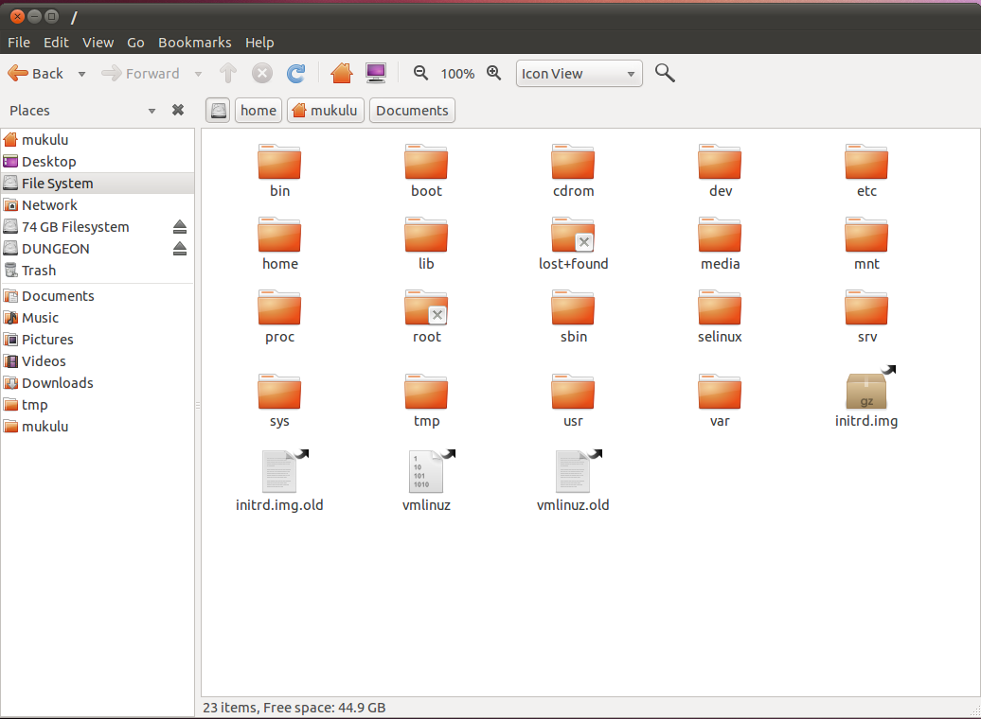

Slide 11
Ubuntu features
Introduce basic packages in OpenOffice.org
Word Processor
Spreadsheet
PowerPoint
Files storage, delete and desktop environment
File saving options (save as MS office files, etc)
Introduce the browser (how to set home page, how to locate folder for downloaded files, etc)
Places

Slide 12
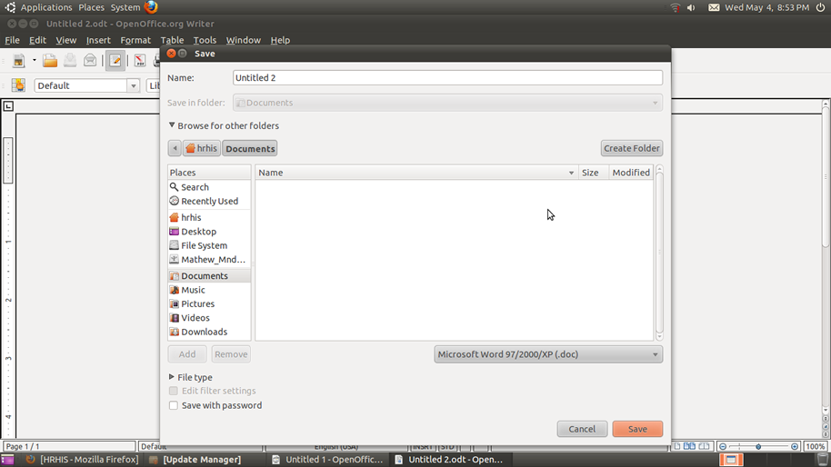
Saving a Word Document into MS word Format

Slide 13
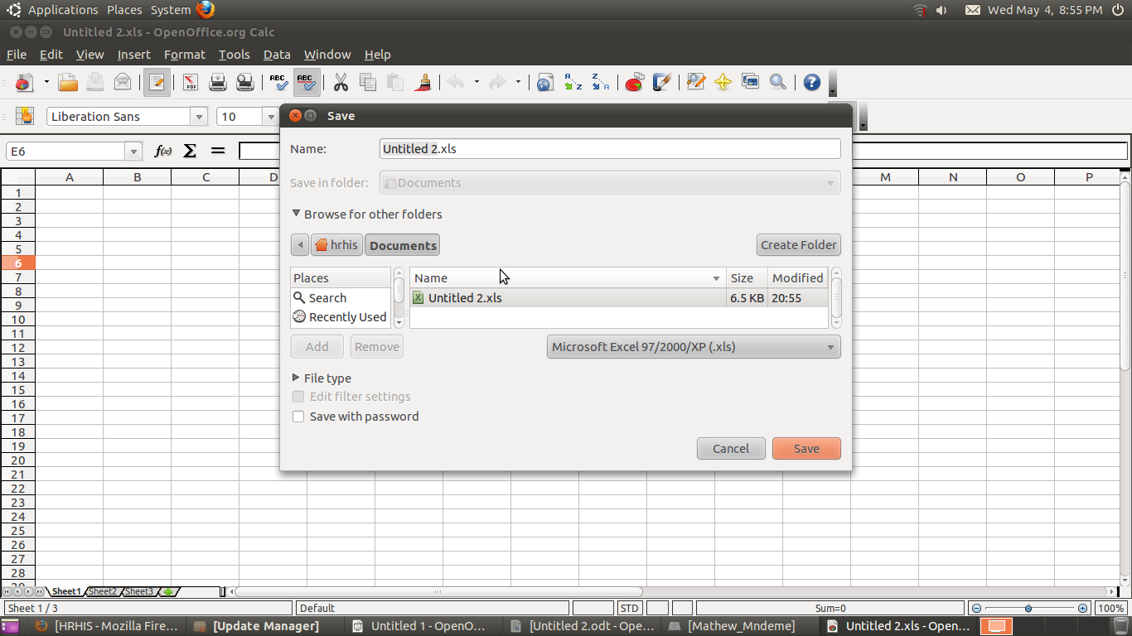
Saving a Spreadsheet File into MS Excel Format

