Slide 1



DEVELOPMENT, IMPLEMENTATION, AND SUSTAINABILITY OF HUMAN RESOURCE FOR HEALTH (HRH) INFORMATION SYSTEM (HRHIS) IN TANZANIA (2009-2014)
MINISTRY OF HEALTH AND SOCIAL WELFARE
DEPARTMENT OF HUMAN RESOURCE DEVELOPMENT
Progress of HRHIS roll out
(July 2009- March, 2011)
HRHIS Coordinator
Dr. Honest C. Kimaro
University of Dar es Salaam
College of ICT
Computer Science& Engineering Dept

Slide 2
Presentation Outline
Objectives and Key players
Challenges to be addressed and Steps taken
Evolvement of HRHIS
Methodology used to introduce HRHIS
HRHIS : Features & Architecture
HRHIS Implementation: Data flows, data entry, data analysis and system use
HRHIS Implementation and System use challenges
Recommendations
Conclusion

Slide 3
1. Objectives
Overall objective:
To improve health service delivery through utilization of appropriate human resources for health (in terms of quality and quantity)
Specific objective:
To develop flexible and easy to use tool for effective planning, management and development of Human resource for Health

Slide 4
Key Players
Ministry of Health and Social Welfare
Department of Computer Science, University of Dar es salaam (Technical Support)
Japan International Co – operation Agency (JICA) (Technical and Financial Support)
Local Government: RMOs and DMOs
Other Development Partners

Slide 5
Challenges to be addressed by Project
Absence of a relevant system to track HRH information in the country.
Incomplete and uncorrelated HRH data.
Existence of multiple, uncoordinated and un-harmonized data sources
Difficulty experienced in making intelligent forecast on demand and supply of HRH.

Slide 6
Steps taken to solve these challenges
Policy deliberations.
Concrete decision as a priority area, 2008
Development and Implementation of HRHIS
  Three phases (July, 2009, April, 2011)
    8 regions (and their respective districts) out of 21 ({Dar es Salaam, Pwani}; {Tanga, Morogoro,K’njaro}; {Lindi, Mtwara, Dodoma})
    7 Consultant hospitals out of 8 (MOI, Ocean Road, Muhumbili, Mbeya, Mirembe, KCMC, & Kibong’oto)

Slide 7
Evolvement of HRHIS
Developed in stages through inputs and feedbacks from stakeholders and users
Involvement of all levels of health service delivery
Integral part of a Health Management Information System in the health sector
Designed to communicate with other systems such as DHIS, TIIS

Slide 8
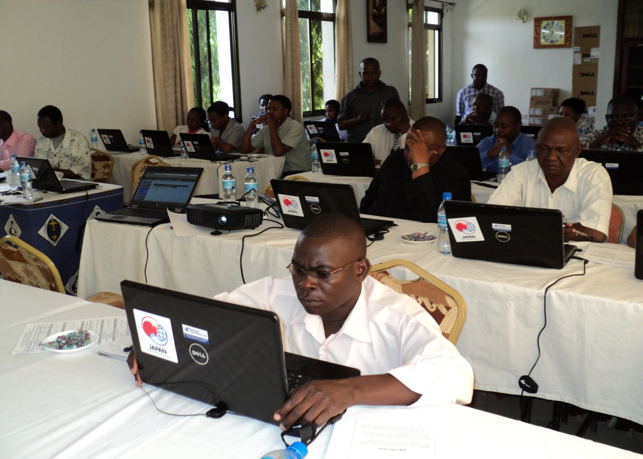
7.Methodology used to introduce the HRHIS
Iterative and Incremental development
User Participation (Testing & design)
Hands on Training of system operators
(learning by practice)
Manual for self - learning and practice
Onsite supportive supervision missions
Promotion of system and information use
by Health Managers
Electronic consultations for quick solutions
Online user support system (Redmine): http://196.44.162.4/redmine
HRHIS Operational Training in Dodoma
Taken by Mndeme in Jan, 2011

Slide 9
HRHIS Salient features
Built with free and open source, web based technologies (MOHSW owns the source code)
Flexible and open ended architecture to cope with future changes
Flexibility to allow local adaptation
  Fields definitions and form design
  Organization units
  Calculated fields generated automatically
User friendly; easy to learn and use with minimal computer knowledge
Tabular and graphic reports
Security measures for data protection
  In built security measures to limit access

Slide 10
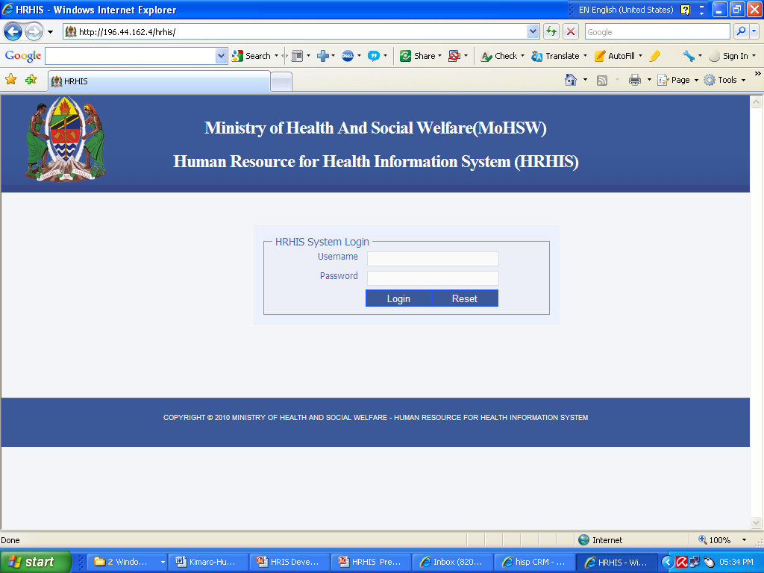
System Architecture-Login page

Slide 11
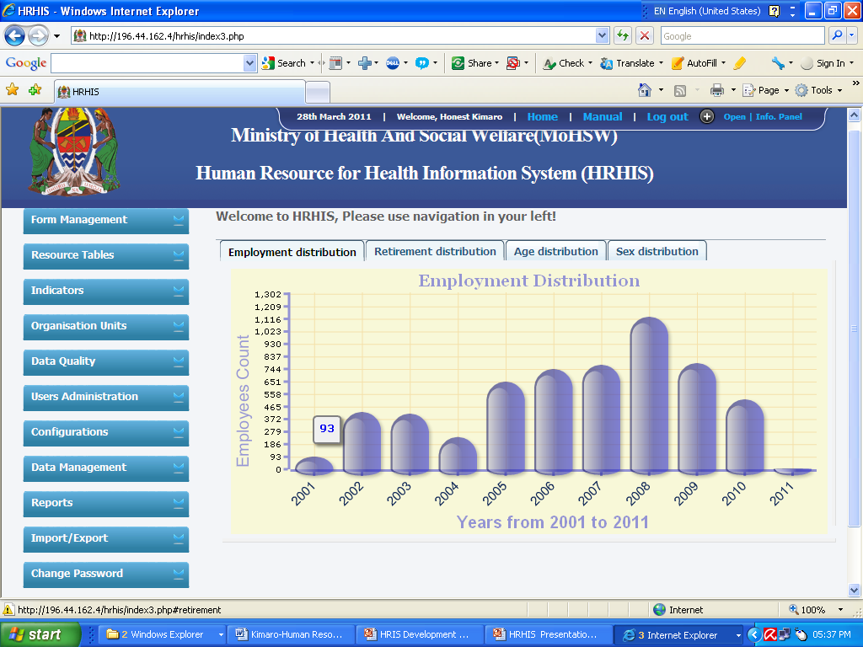
System Architecture-Logged in

Slide 12
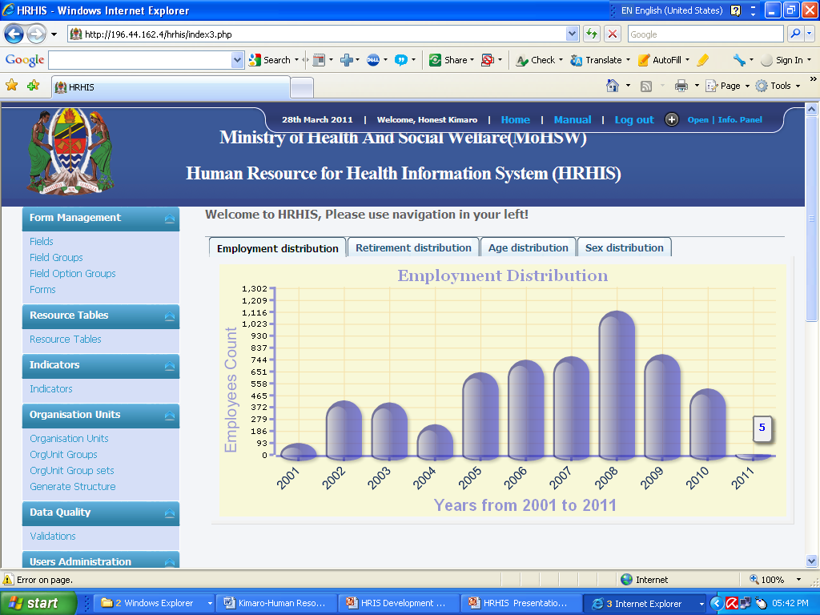
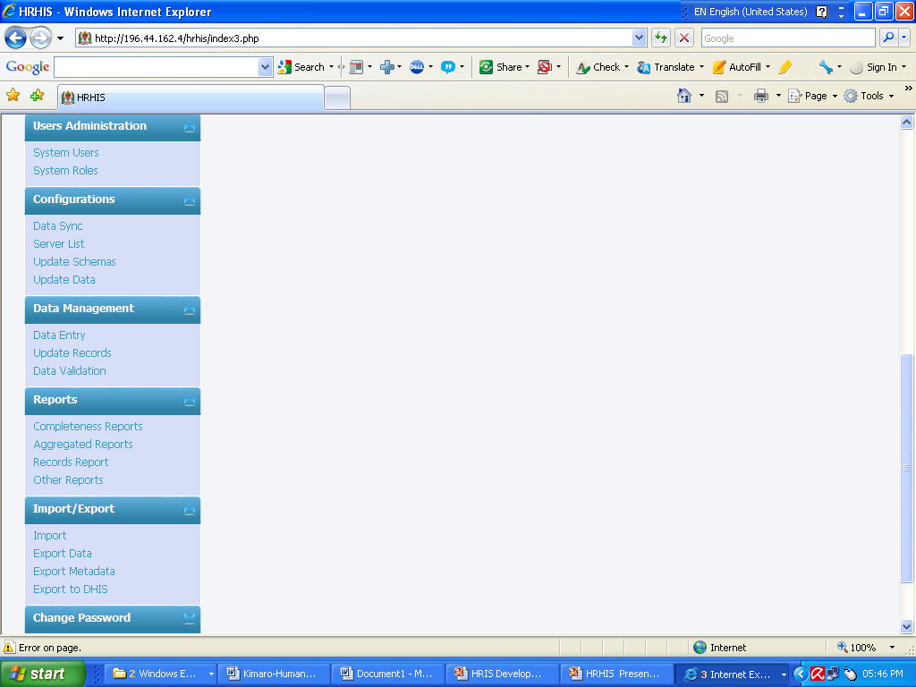
System Functionalities

Slide 13
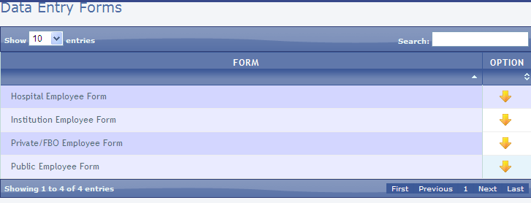

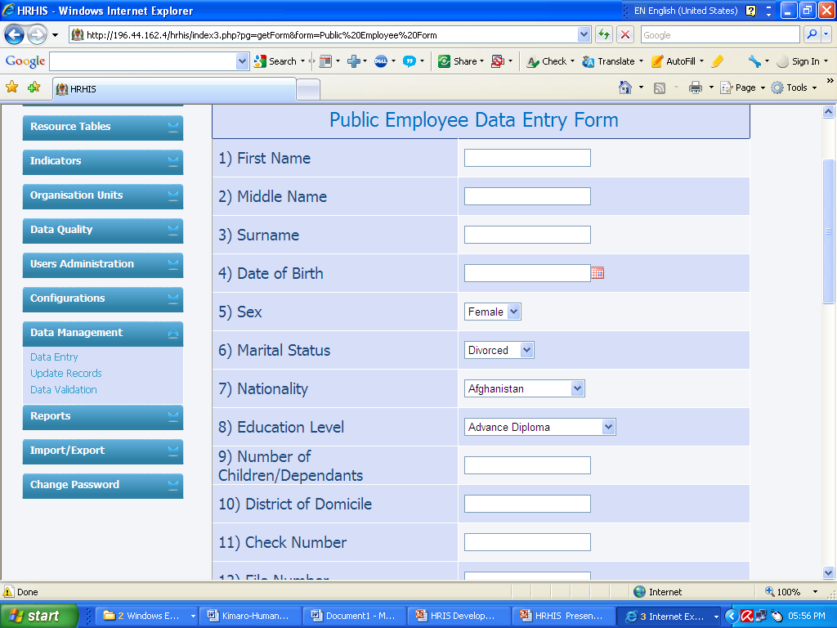
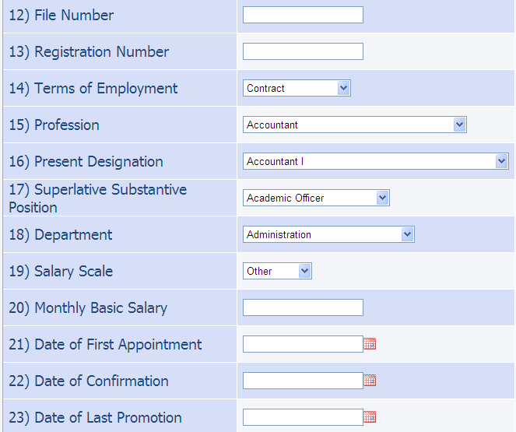
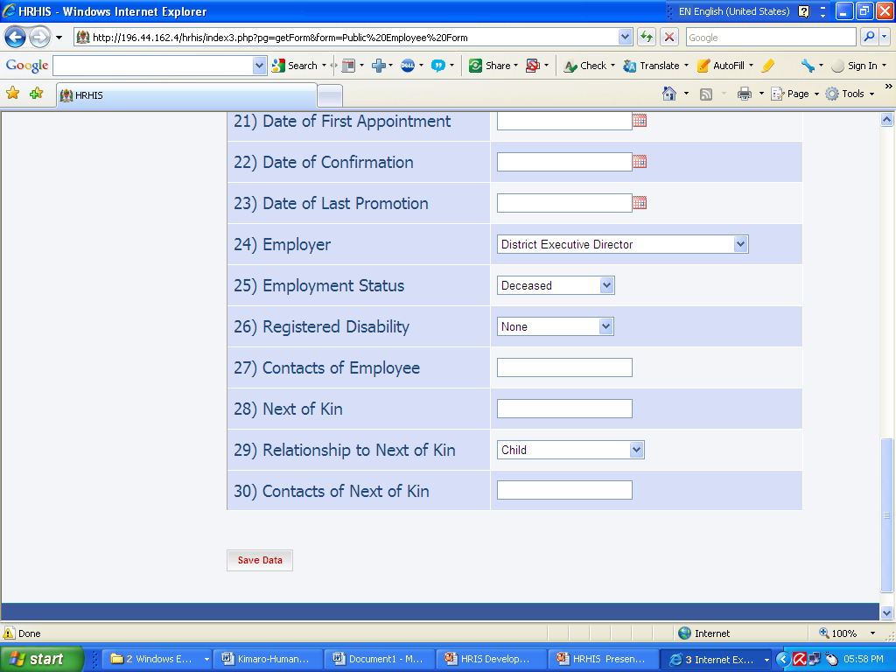
Data Management: Data Entry for Public HFs

Slide 14
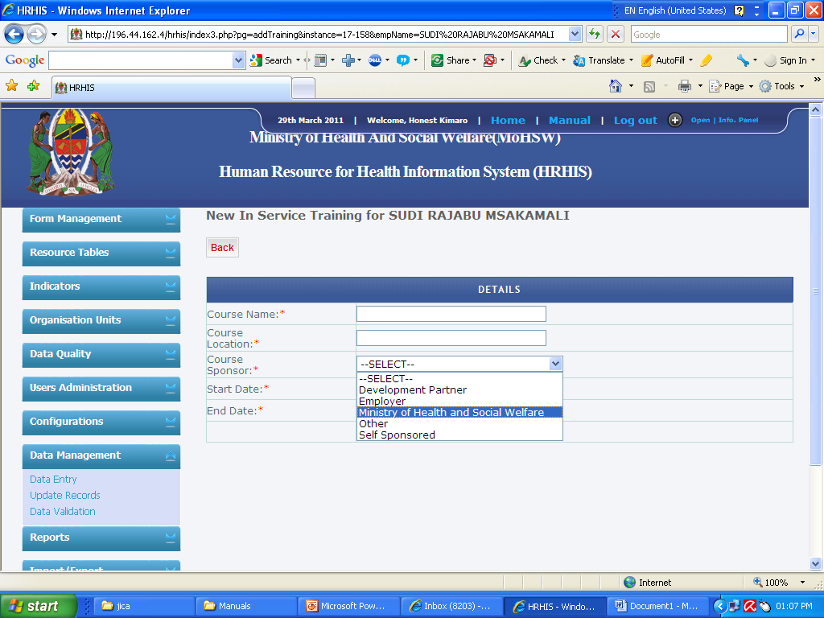
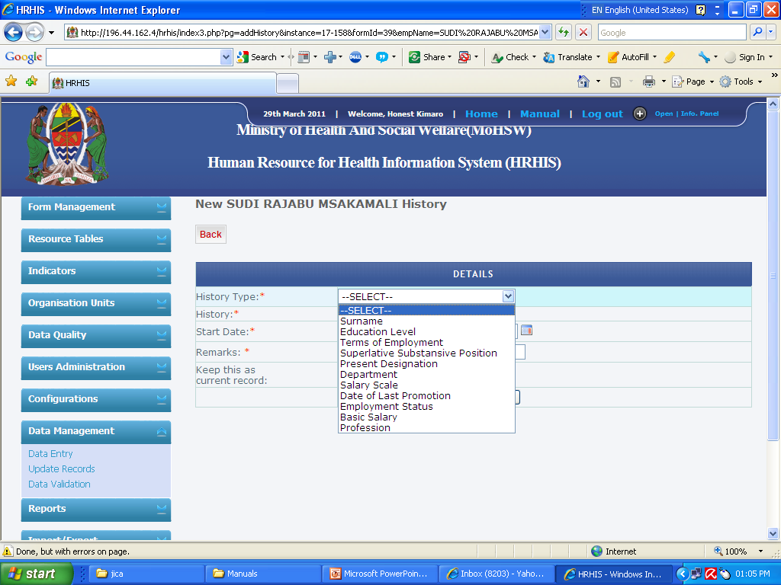
Other System Capabilities
Keeping track of in-service training records for each individual employee
Keeping track of history for each data element value (salary scale, education level, transfer, etc)

Slide 15
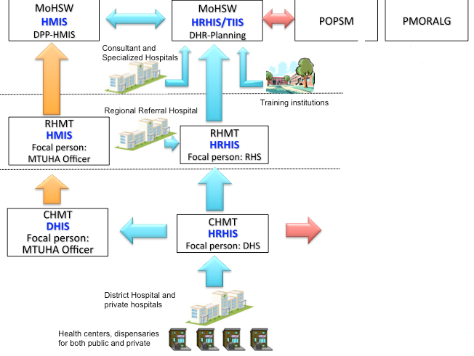
Implementation: Data flows

Slide 16
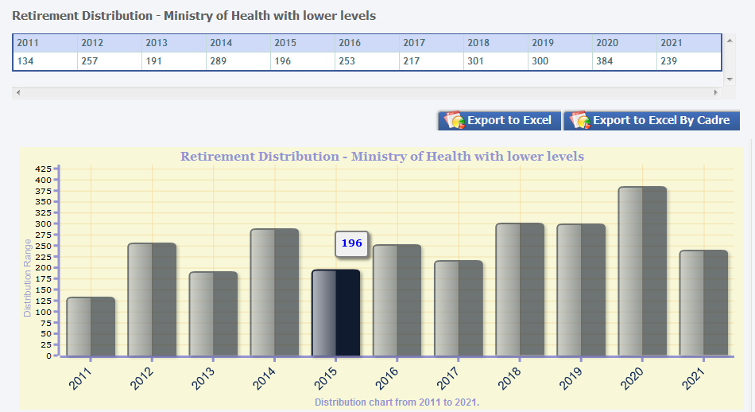
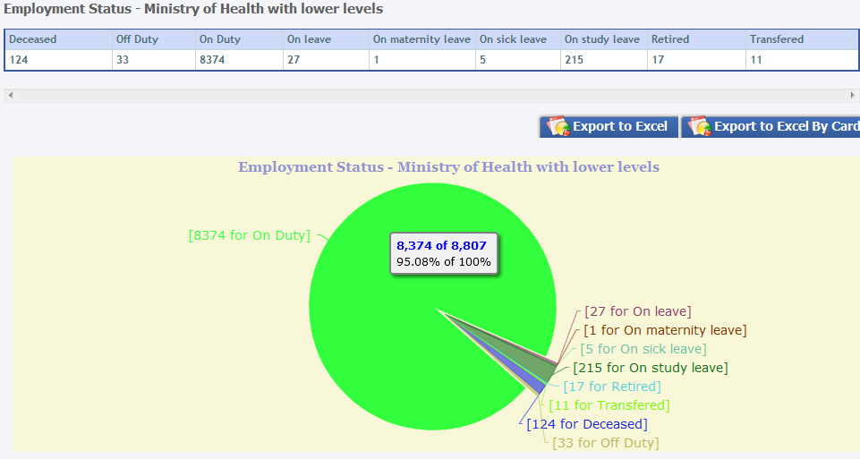
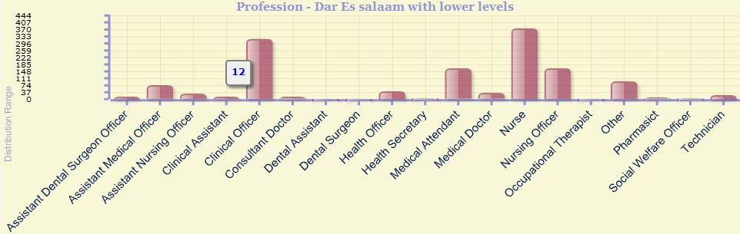
System Use: Data Analysis
Various reports can be generated using HRHIS, e.g.
  A retirement distribution report
  An aggregated report for Employment Status, which provides number of employees on duty and those who are off duty due to various reasons
  Report on number of employee going for training in each year

Slide 17
System Use
So far the concentration has been much on collecting individual employee details from all public and private facilities
For districts which had entered all records on the HRHIS, it was helpful tool during HR auditing by POPSM (January - March 2011)
Some have been using it to forecast new recruitment and retirement status

Slide 18
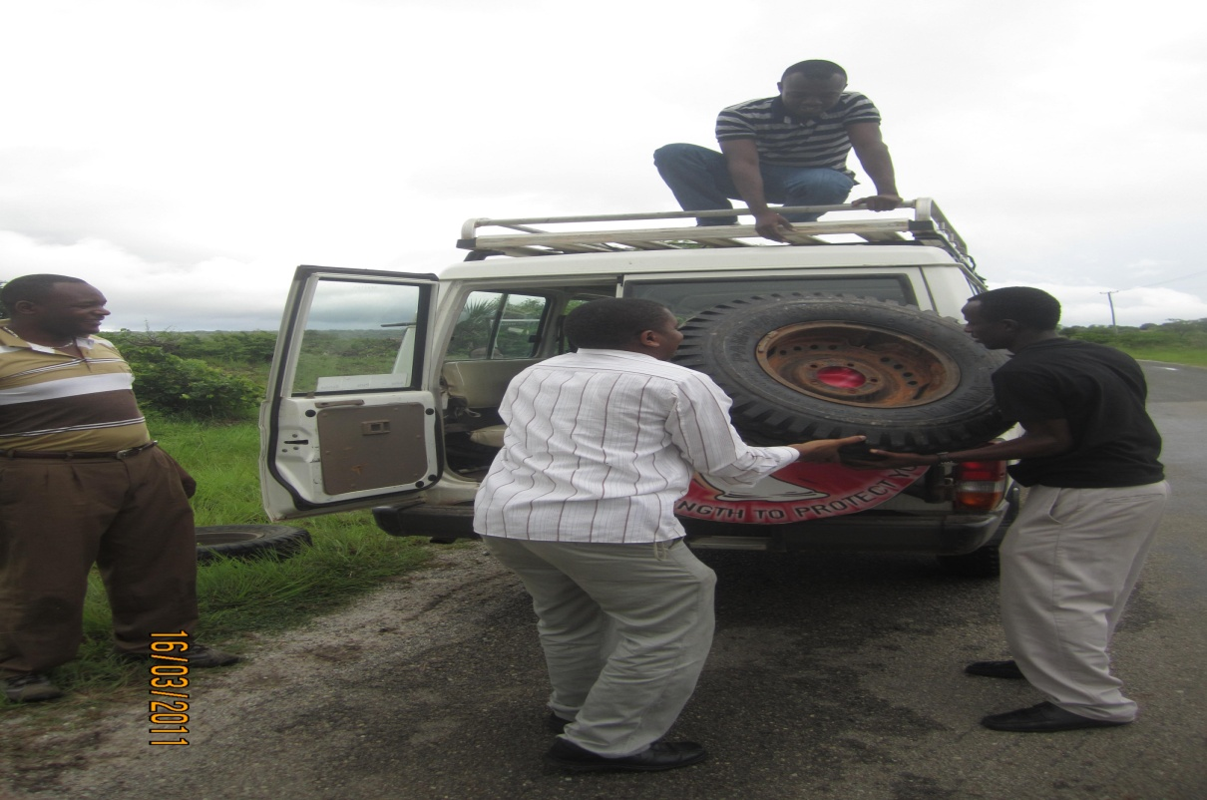
Implementation and system use Challenges
Lack of basic computer literacy
Absence of key R/CHMT members during training
Missing of HRHIS key users on sites during supervision
Lack of motivation and influences from DMOs on data collection from facilities (especially from private facilities)
Lack of punctuality during training
Power, Transportation & Logistics problems
Lack of effective system use
  Register all employees data
  Update employee data on
  daily basis and generate reports
Laxity in data entry
  Wrong field values
Fixing burst tire during HRHIS supportive supervision in Mtwara Region
(Rough and muddy roads)

Slide 19
Recommendations
Periodic progress review meetings
Site visits with MOHSW staff
Item within the National supportive supervision guideline.
Experience sharing sessions
Establish proper communication with RMOs to secure their involvement for thorough implementation of HRHIS and ensure HRHIS produces the expected results
Conduct refresh training for the HRHIS users to enforce system usage and data collection
Establish standard reporting requirements and formats by districts and regions to enforce system use and information use
Quality and Reliability of each employee data (record) is measured by correctness of each constituent data element/field/attribute value
  Each field value needs to be entered correctly and verification mechanisms is required at each level
Improve Information Dissemination: Website (www.hrhis.moh.go.tz), Leaflets, etc

Slide 20
Sustainability Measures
Continual system maintenance and user support
Online data entry at MOHSW
Capacity building
Commitment and ownership of key stakeholders
Financial and partnership consolidation

Slide 21
Conclusion
The system is useful and powerful tool as acknowledged by users and managers at various levels
Commitment is needed to deal with identified challenges by all parties
Every actor involved in the processes of collection, data entry, data analysis, reporting, and use has a key role to play to make HRHIS a success in the health sector
Scaling up the achieved results is necessary
  HRHIS country roll out is planned from April 2011 covering all remaining regions and their respective districts

Slide 22
Together we can make a difference, even in Tanzania; do your part, it is a joint effort

