Slide 1
Drawing and Recognizing Chinese Characters with RNN
陳謙慶
4105053118

Slide 2
Content
Introduction
Discriminative model
Experiments on recognizing chinese characters
Generative model
Experiments on drawing chinese characters

Slide 3
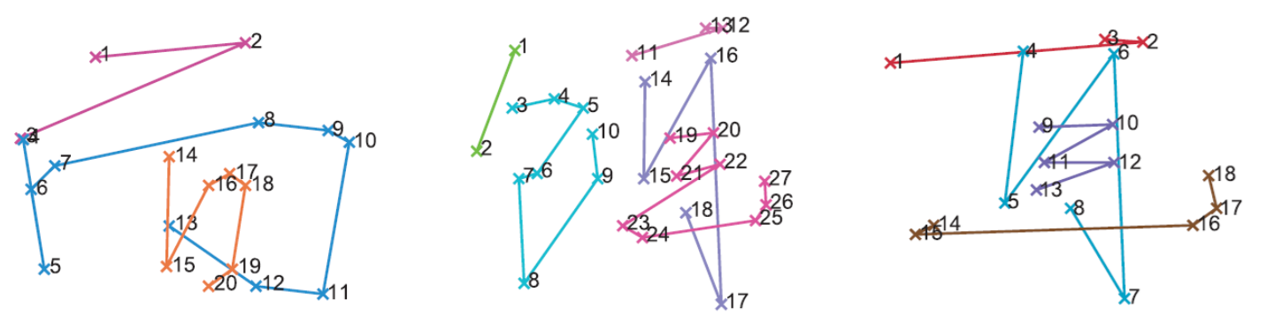

Introduction
Representation: ${[[x}_{1 },y_{1},s_{1}],\left[x_{2},y_{2},s_{2}\right],…,[[x_{n},y_{n},s_{n}]]$
Removing redundant points
Normalization

Slide 4











Discriminative model
Char 1
Char 2
……
Char 3755
$L_{i}=\left[\begin{aligned}\begin{matrix}x_{i} \\ y_{i} \\ ∆x_{i}\end{matrix} \\ ∆y_{i} \\ I\left(s_{i}\text{=}s_{i+1}\right) \\ I(s_{i}\text{≠}s_{i+1})\end{aligned}\right]$
$$logistic regression$$
Full layer and dropout
Mean pooling and dropout
$h_{k}$’
$h_{k−1}$’
$h_{1}$’
LSTM/GRU
LSTM/GRU
……
LSTM/GRU
LSTM/GRU
LSTM/GRU
……
LSTM/GRU
$$h_{1}$$
$$h_{2}$$
$$h_{k}$$
LSTM/GRU
LSTM/GRU
……
LSTM/GRU
LSTM/GRU
LSTM/GRU
……
LSTM/GRU
$$L_{1}$$
$$L_{2}$$
$$L_{k}$$

Slide 5
Recognizing result
GRU is much better than LSTM
The improvement is not significant when more layers being stacked.

Slide 6
Recognizing result

Slide 7













Generative model – training
[$d_{i},s_{i}$]$=$[[$∆x_{i}$, $∆y_{i}$], $s_{i}$], where $s_{i}=\left\{\begin{aligned}\left[1,0,0\right], pen−down \\ &\left[0,1,0\right], pen−up \\ \left[0,0,1\right],end−of−char\end{aligned}\right.$
Gaussian Mixture model:
$$P_{d}\left(d_{t+1}\right)=\sum_{j=1}^{M}{π^{j}N\left(d_{t+1} | μ_{x}^{j}, μ_{y}^{j},δ_{x}^{j},δ_{y}^{j}\right)}=\sum_{j=1}^{M}{π^{j}N\left(∆x_{t+1} | μ_{x}^{j}, δ_{x}^{j} \right)}N\left(∆y_{t+1} | μ_{y}^{j}, δ_{y}^{j} \right)$$
$$,where N\left(x | μ,δ\right)=\frac{1}{δ\sqrt{2π}}\exp\left(−\frac{{\left(x−μ\right)}^{2}}{2δ^{2}}\right)$$
-----------------------------------------------------------------------------------------------------------------------
$$\left({\left\{{\hat{π}}^{j}, {\hat{μ}}_{x}^{j},{\hat{μ}}_{y}^{j},{\hat{δ}}_{x}^{j},{\hat{δ}}_{y}^{j}\right\}}_{j=1}^{M}\right)∈R^{5M}=W_{GMM}×O_{t}+b_{GMM}$$
$$π^{j}=\frac{\exp\left({\hat{π}}^{j}\right)}{\sum_{j}{\exp\left({\hat{π}}^{j}\right)}}→π^{j}∈\left(0,1\right),\sum_{j}{π^{j}}=1,$$
$$μ_{x}^{j}={\hat{μ}}_{x}^{j}∈R, μ_{y}^{j}={\hat{μ}}_{y}^{j}∈R,$$
$$δ_{x}^{j}=\exp\left({\hat{δ}}_{x}^{j}\right)>0, δ_{x}^{j}=\exp\left({\hat{δ}}_{x}^{j}\right)>0$$
Softmax model:
$$P_{s}\left(s_{t+1}\right)=\sum_{i=1}^{3}{s_{t+1}^{i}p_{t+1}^{i}}, where s_{t+1}^{i}=[s_{t+1}^{1},s_{t+1}^{2},s_{t+1}^{3}]$$
-----------------------------------------------------------------------------------------------------------------------
$$\left({\hat{p}}_{t+1}^{1},{\hat{p}}_{t+1}^{2},{\hat{p}}_{t+1}^{3}\right)∈R^{3}=W_{softmax}×O_{t}+b_{softmax}$$
$$p_{t+1}^{i}=\frac{\exp\left({\hat{p}}_{t+1}^{i}\right)}{\sum_{j}{\exp\left({\hat{p}}_{t+1}^{i}\right)}}∈\left(0,1\right)→\sum_{i=1}^{3}{p_{t+1}^{i}}=1,$$
loss
loss
$$d_{t+1}$$
$$s_{t+1}$$
$$d_{t+2}$$
$$s_{t+2}$$
GMM
softmax
GMM
softmax
$$h_{t−1}$$
$$h_{t}$$
$$h_{t+1}$$
……
GRU
GRU
……
Char C
$$d_{t},s_{t}$$
$$d_{t+1},s_{t+1}$$

Slide 8

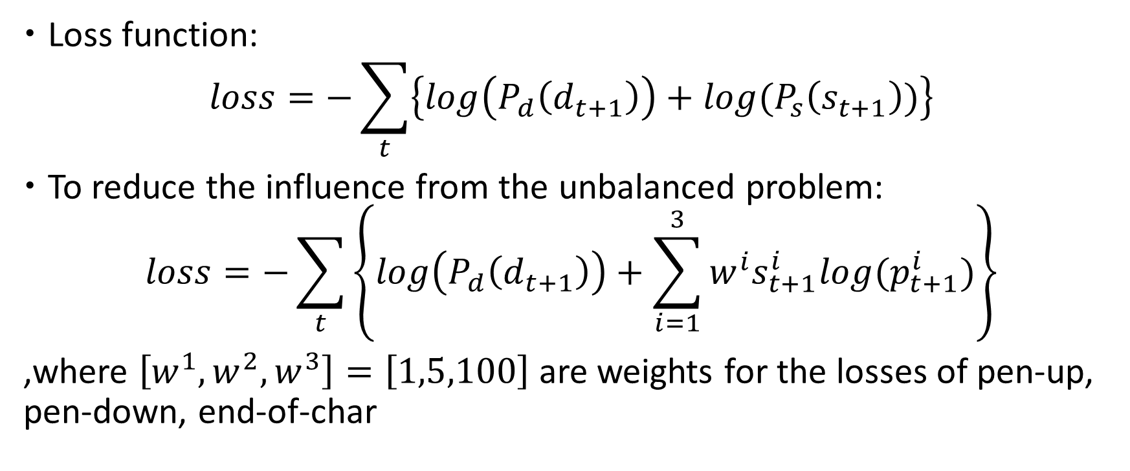

Generative model - training
Loss function:
$$loss=−\sum_{t}{\left\{log\left(P_{d}\right.\left.\left(d_{t+1}\right)\right)+log⁡(P_{s}\left(s_{t+1}\right))\right\}}$$
To reduce the influence from the unbalanced problem:
$$loss=−\sum_{t}{\left\{log\left(P_{d}\right.\left.\left(d_{t+1}\right)\right)+\sum_{i=1}^{3}{w^{i}s_{t+1}^{i}log⁡(p_{t+1}^{i})}\right\}}$$
,where $\left[w^{1},w^{2},w^{3}\right]=\left[1,5,100\right]$ are weights for the losses of pen-up, pen-down, end-of-char
$$\overline{ \text{GMM} }$$
$$\overline{ \text{Softmax} }$$

Slide 9

Generative model - drawing
[$d_{i},s_{i}$]$=$[[$∆x_{i}$, $∆y_{i}$], $s_{i}$], where $s_{i}=\left\{\begin{aligned}\left[1,0,0\right], pen−down \\ &\left[0,1,0\right], pen−up \\ \left[0,0,1\right],end−of−char\end{aligned}\right.$
[0,0,1]?
End
$$d_{t+1}$$
$$s_{t+1}$$
$$d_{t+2}$$
$$s_{t+2}$$
GMM
softmax
GMM
softmax
GMM
softmax
$$h_{t−1}$$
$$h_{t}$$
$$h_{t+1}$$
……
GRU
GRU
……
GRU
Char C
$$d_{t},s_{t}$$
$$d_{t+1},s_{t+1}$$

Slide 10
Drawing result

Slide 11
Drawing result

Slide 12
Reference
Xu Yao Zhang, Fei Yin, Yan Ming Zhang, Cheng Lin Liu, and Yoshua Bengio, “Drawing and recognizing Chinese characters with recurrent neural network,” TPAMI, vol. 40, no. 4, pp. 849–862, 2018.
A. Graves, “Generating sequences with recurrent neural networks, ” arXiv:1308.0850, 2013.

