Slide 1
Drawing and Recognizing Chinese Characters with RNN
陳謙慶
4105053118

Slide 2
Content
Data Preprocessing
Model Construction
Experiment Result

Slide 3
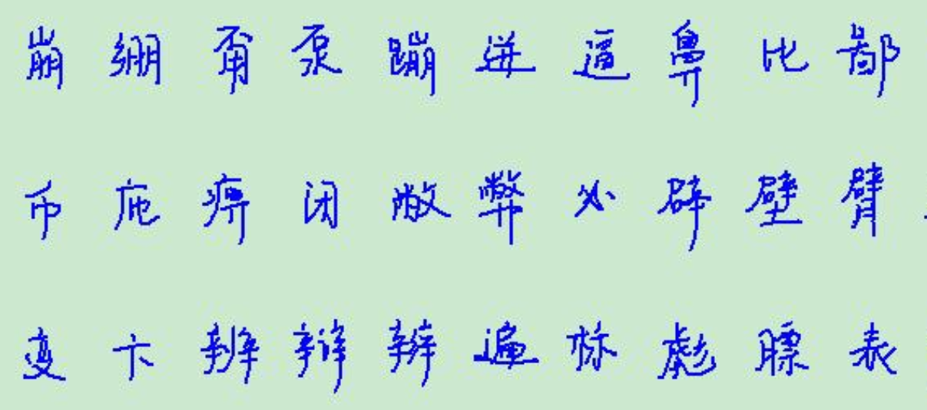
Data Preprocessing
Dataset: Total 50 kinds of character
Chinese character picture :
Training set | Testing set
16970 | 4199

Slide 4
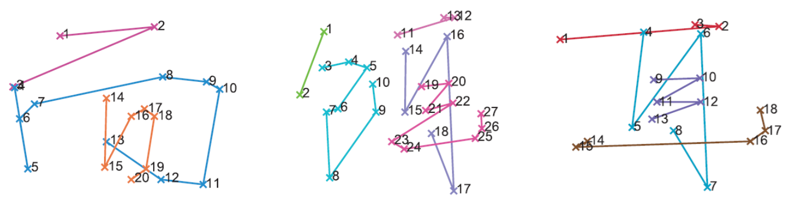
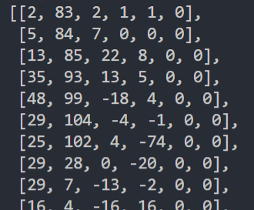

Data Preprocessing
Representation: $\left[\begin{matrix}\begin{matrix}x_{i} & y_{i}\end{matrix} & \begin{matrix}∆x_{i} & ∆y_{i}\end{matrix} & \begin{matrix}I\left(s_{i}\text{=}s_{i+1}\right) & I(s_{i}\text{≠}s_{i+1})\end{matrix}\end{matrix}\right]$

Slide 5

Data Preprocessing
Removing redundant points:
$$\sqrt{{\left(x_{i}−x_{i−1}\right)}^{2}+{\left(y_{i}−y_{i−1}\right)}^{2}}<T_{disc}$$
$$\frac{∆x_{i−1}∆x_{i}+∆y_{i−1}∆y_{i}}{{\left(∆x_{i−1}^{2}+∆y_{i−1}^{2}\right)}^{0.5}{\left(∆x_{i}^{2}+∆y_{i}^{2}\right)}^{0.5}}>T_{cos}$$

Slide 6

Data Preprocessing
$$p_{x}\left(L\right)=\int_{L}^{ }{x}dL=\frac{1}{2}len\left(L\right)\left(x_{1}+x_{2}\right) → μ_{x}=\frac{\sum_{LεΩ}{p_{x}(L)}}{\sum_{LεΩ}{len(L)}}$$
$$p_{y}\left(L\right)=\int_{L}^{ }{y}dL=\frac{1}{2}len\left(L\right)\left(y_{1}+y_{2}\right) → μ_{y}=\frac{\sum_{LεΩ}{p_{y}(L)}}{\sum_{LεΩ}{len(L)}}$$
$$d_{x}\left(L\right)=\int_{L}^{ }{{\left(x−μ_{x}\right)}^{2}dL} →δ_{x}=\sqrt{\frac{\sum_{LεΩ}{d_{x}(L)}}{\sum_{LεΩ}{len(L)}}}$$
$$x_{new}=\frac{x−μ_{x}}{δ_{x}}, y_{new}=\frac{y−μ_{y}}{δ_{x}}$$
Normalization:

Slide 7




Discriminative model
Char 1
Char 2
……
Char 50
$$softmax$$
Full layer and dropout
Mean pooling and dropout
LSTM/GRU
LSTM/GRU
……
LSTM/GRU
LSTM/GRU
LSTM/GRU
……
LSTM/GRU
LSTM/GRU
LSTM/GRU
……
LSTM/GRU
LSTM/GRU
LSTM/GRU
……
LSTM/GRU
$$L_{1}$$
$$L_{2}$$
$$L_{k}$$

Slide 8
Experiment Result
Validation = 0.3
Batch size = 200
Epochs=10
Recurrent type | Train Time | Train Acc. | Val acc.
GRU [100] | 840s | 84.42% | 82.24%
GRU [500] | 1489s | 91.76% | 88.31%

Slide 9
Next…
Compare LSTM with GRU
Testing 2 and 3 layers RNN
Test Accuracy from sub-sequence by Random Dropout
Try to build a generative model to generating the Chinese character

