Slide 1
First Mini Program
Multi-client Chatroom
10/28

Slide 2



Introduce
A multiclient chatroom. When clients login, clients can send some command to server, and server will execute correspond action.
./client <SERVER IP> <SERVER PORT>
./server <server port>

Slide 3

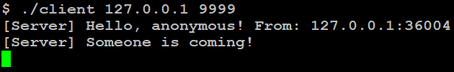
Hello Message
When a client login, server will send message to inform client login success and announce other users a new user is coming.
In Client A terminal
In Client B terminal

Slide 4
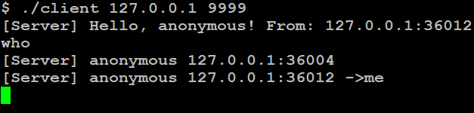
Who Message - who
Command that can list all users online. The response message need to tag which user is the client.

Slide 5
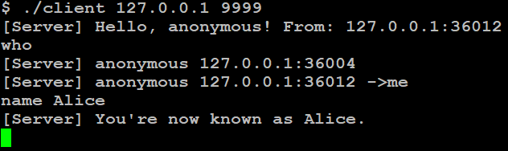
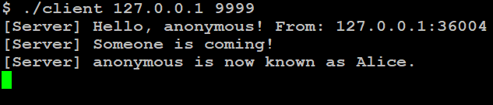
Change Username Message - name
Command to change user name. Server will broadcast other users when a user change its name successfully. (New name has some limitation)
In Client A terminal
In Client B terminal

Slide 6
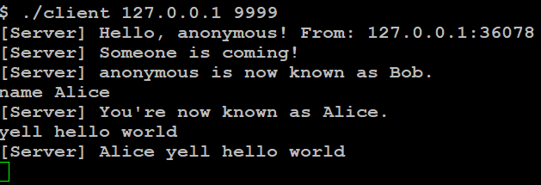
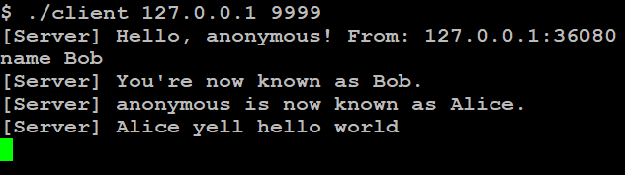
Broadcast Message - yell
User can use this command to broadcast message. Server will send the message to every user (including sender).
In Client A terminal
In Client B terminal

Slide 7
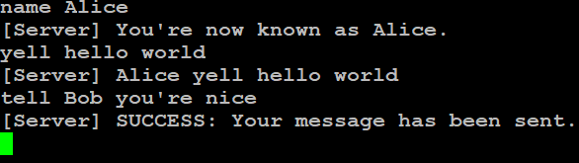
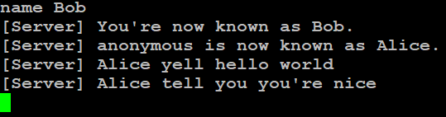
Private Message - tell
User can use this command to send private message to specific user.
In Client A termianl
In Client B termianl

Slide 8
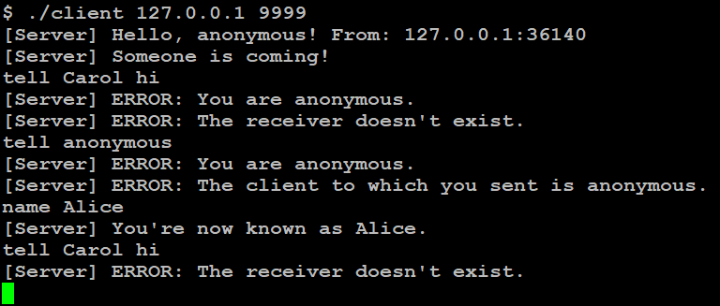
Wrong tell
The names of sender and receiver must not be anonymous.

Slide 9
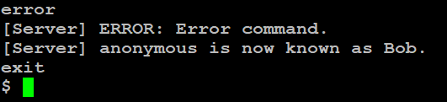
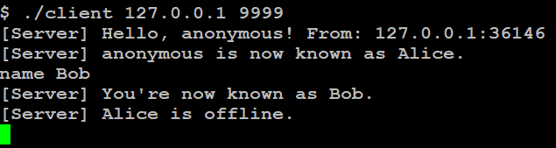
Log Out Message - exit
Clients type “exit” to logout. Server will broadcast to other users when someone logout.
In Client A termianl
In Client B termianl

Slide 10

Error Command
If server receive command not mention above, it will response an error message.

Slide 11
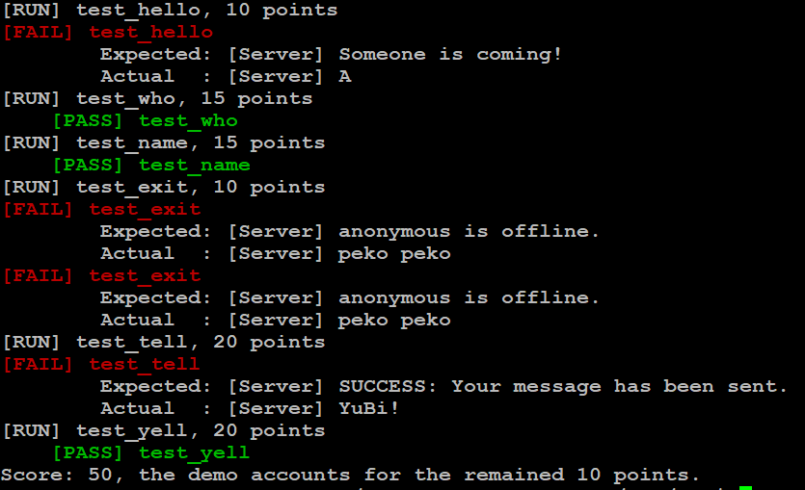
test.c
make test
It just help you find error, but won’t test all possible situation.

Slide 12
Requirement
All messages transmitted between a server and a client should end with a newline ('\n').
Client should sends message received from stdin to server directly without modification.
Client won't generate any message by itself!!! Every message which is printed on client's screen is from server. Client only needs to make sure whether it has received every message from server.
Server/Client should NOT crash or be hanged.
##Hint: You can use select() for constructing the Server/Client program

Slide 13
Attention
Due Date: 2021/11/15 23:59
Please upload your server.c/cpp, client.c/cpp, and Makefile separately (see the next page).
GNU make (makefile) should be used to compile your codes. If TAs are unable to compile your codes with a single `$ make` command, you are not allowed to demo.
Each problem that leads to fail to run (compile) your code will discount your score by 0.75.
If you have any questions, please discuss with TAs and classmates in hw1 forum.
Demo will be announced later. Please remember to select your demo time after we announce! If your name doesn't exist on our demo form, you won’t be allowed to demo your homework.

Slide 14
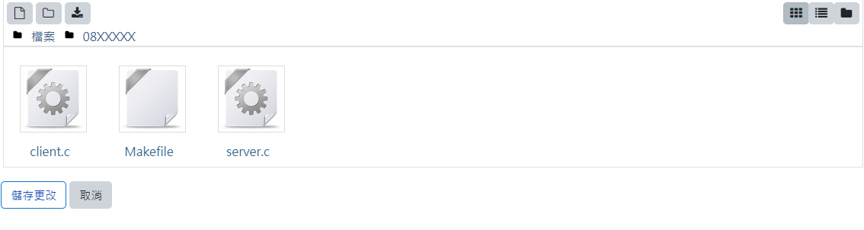
Attention

Slide 15
Attention
Please make yourself get accustomed to look functions up in official linux manual page and cppreference.
Only these three domains will be authorized to be used while hand-on exam
https://linux.die.net/man/
https://en.cppreference.com/w/
https://www.cplusplus.com/

Slide 16
Q&A

