Slide 1

Interim Project Presentation

Slide 2
Team Members (Data Diviner)
Name
(1) DAVID CHING
(2) JAMIE
(3) RAJ
(4) SETH

Slide 3
Agenda
Introduction
Issues and Objectives
ETL Process Flow
Python Modules
Dataset Understanding
Entity Relationship Diagram
Analyzed Result
Conclusion

Slide 4




Introduction

Slide 5
Introduction
HDB flat is a type of public housing in Singapore, built and managed by the Housing & Development Board (HDB). These flats are home to over 80% of Singapore’s residents, providing affordable and well-designed housing options ranging from studio apartments to executive flats. They are a key part of Singapore’s urban planning, promoting community living while ensuring quality and affordability for residents.
In this project, we will assess and measure the affordability of the HDB flats (3, 4 & 5 room) based on gross monthly income.
In addition, we will also calculate the additional subsidy in order to achieve Mortgage Servicing Ratio (MSR) not exceeding 30% of gross monthly salary by HDB standard.

Slide 6

Issues & Objectives

Slide 7
Issues & Objectives
issues
objectives
HDB price has been rising fast and furious on a yearly basis, many are concerned if HDB is still affordable to average Singaporeans
Many first timers with low if not zero CPF savings and personal savings are concerned about servicing their monthly mortgages for the BTO flats, what is the additional subsidy that the SG government could provide to lessen their burden.
Measure the affordability of the HDB flats (3, 4 , 5 room) based on gross monthly income.
Calculate the additional subsidy in order to achieve Mortgage Servicing Ratio (MSR) not exceeding 30% of gross monthly salary by HDB standard.
Data Analytic Objective
To import the relevant data entities and datasets from relevant SG Gov agency websites and import them into PostgreDB.
Apply the appropriate data science functionality of Pandas and Seaborn on Python to dissect and achieve the objectives for this interim project.

Slide 8
ETL Process Flow

Slide 9
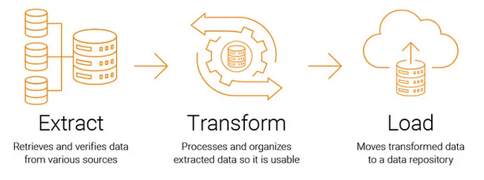
ETL Process Flow
Extract - Data is collected from multiple SG Gov sources (csv, pdf files).
Transform - The data is cleaned, formatted, aggregated, and validated.
Load - The processed data is stored in a target system (PostgreDB).

Slide 10
Python Modules

Slide 11
Python Modules
These Python modules are required for the Interim Project
 | Python Module
(1) | numpy
(2) | matplotlib
(3) | os
(4) | pandas
(5) | pathlib
(6) | psycopg2
(7) | PyPDF2
(8) | requests
(7) | seaborn
(8) | selenium
(9) | shutil
(10) | sqlalchemy
(11) | time
(12) | tabula
(13) | zipfile

Slide 12
Data Understanding

Slide 13
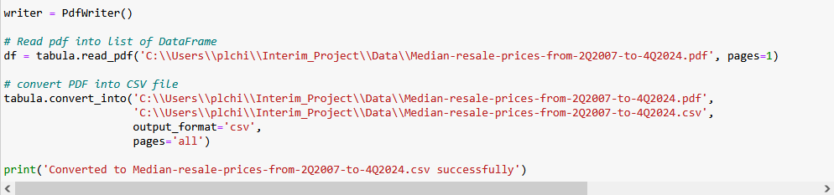
Data Files (Gov SG Sources)
Data File | Data description | Resource URL
BTOPriceRangeofHDBFlatsOffered.csv | Constitutes different transacted prices of BTO flats in SG offered by HDB for the past decade | https://data.gov.sg/datasets?topics=housing&page=1&resultId=d_2d493bdcc1d9a44828b6e71cb095b88d
Median-resale-prices-from-2Q2007-to-4Q2024.csv | Constitutes different transacted prices of resale flats in SG for the past decade | https://www.hdb.gov.sg/-/media/doc/EAPG-CSC/Median-resale-prices-for-registered-resale-applications-from-2Q2007-to-4Q2024_.ashx
GrossMonthlyIncomeFull-TimeEmployedResidents_Final.csv | Constitutes different gross monthly income for the past decade | https://stats.mom.gov.sg/iMAS_Tables1/CSV/mrsd_43_FT_Res_income.zip
EHG-amount-Couples-and-Families-Aug-2024_Final.csv | Constitutes different enhanced housing grant for various monthly housing income for the past decade | https://www.hdb.gov.sg/cs/infoweb/-/media/doc/EAPG-CSC/EHG-amount-Couples-and-Families-Aug-2024.ashx

Slide 14
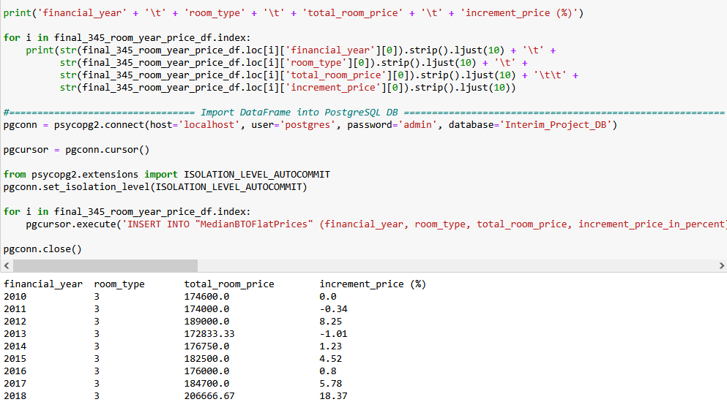
DB Entity After Data Extraction & Transformation
DB Entity to be used (PostgreDB) | Description
MedianBTOFlatPrices | Constitutes different transacted prices of BTO flats (3, 4, 5 room) and appreciation of the prices in percentage in SG for the past decade
MedianResaleFlatPrices | Constitutes different transacted prices of resale flats (3, 4, 5 room) and appreciation of the prices in percentage in SG for the past decade
GrossMonthlyIncomeFullTime | Constitutes appreciation in percentage for the gross monthly income for the past decade
Enhanced_CPF_Housing_Grant | Constitutes enhanced housing grant for different monthly housing income for the past decade

Slide 15
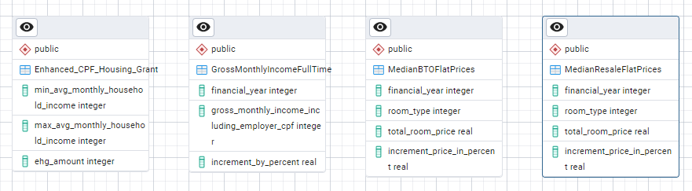
Entity Relationship Diagram (PostgreDB)

Slide 16
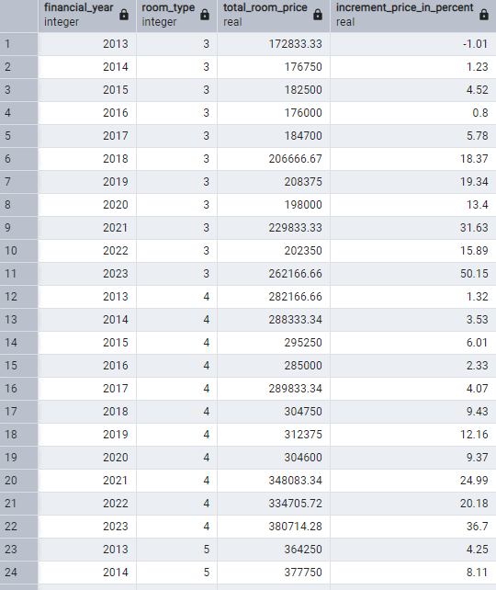
MedianBTOFlatPrices Table

Slide 17
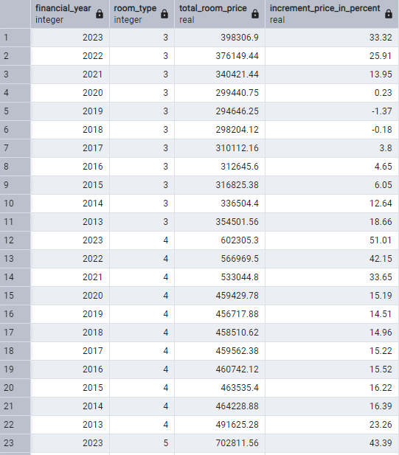
MedianResaleFlatPrices Table

Slide 18
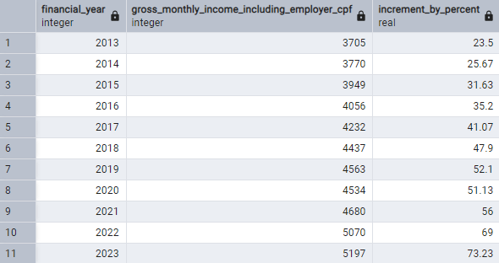
GrossMonthlyIncomeFullTime Table

Slide 19
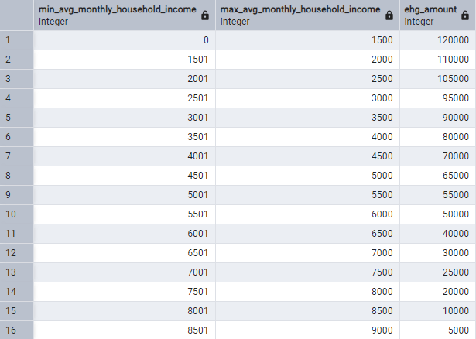
Enhanced_CPF_Housing_Grant Table

Slide 20
Analyzed Result

Slide 21
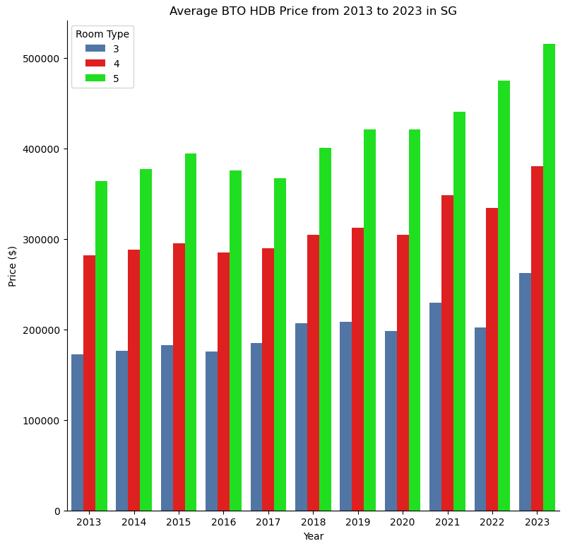
Average BTO HDB Price from 2013 to 2023 in SG

Slide 22
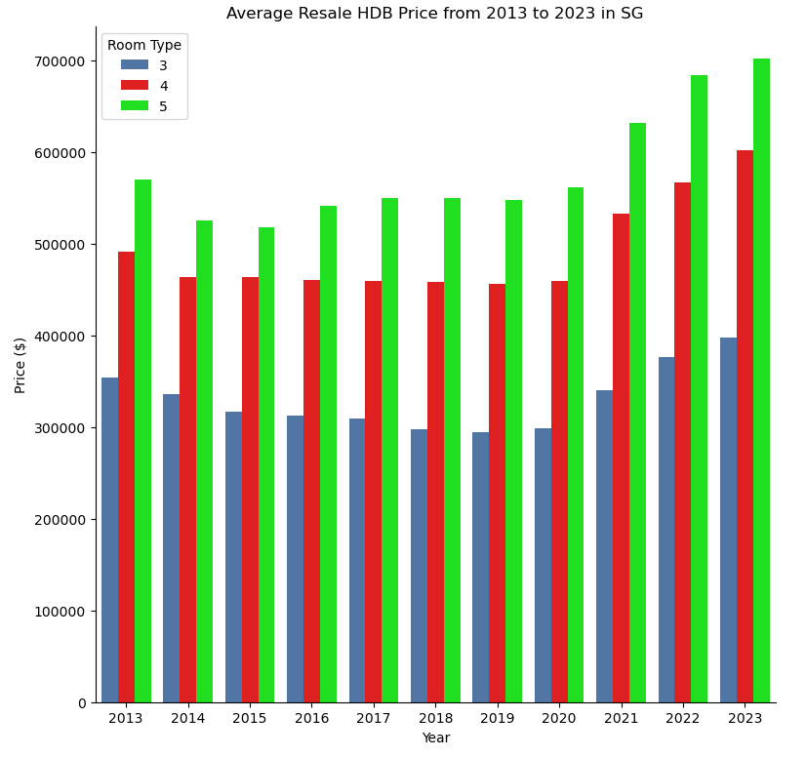
Average Resale HDB Price from 2013 to 2023 in SG

Slide 23
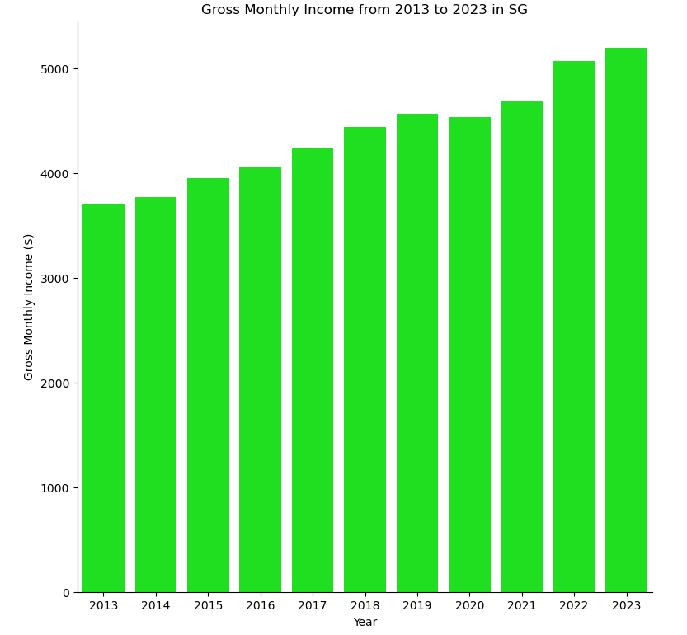
Gross Monthly Income from 2013 to 2023 in SG

Slide 24
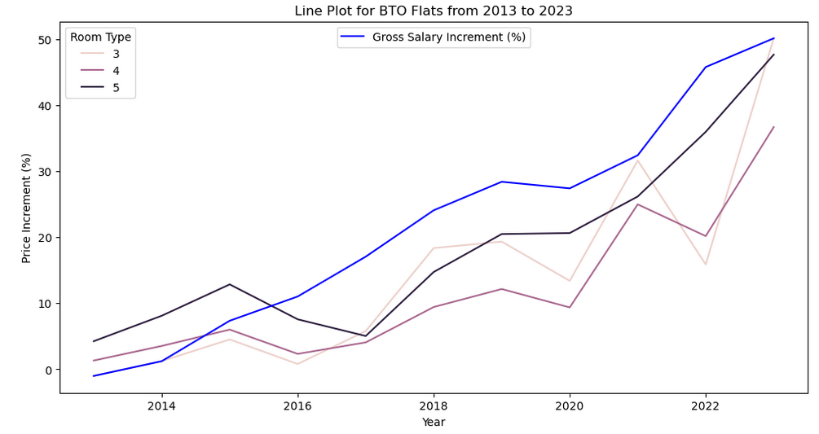
BTO Flat Price Appreciation VS Gross Salary Increment

Slide 25
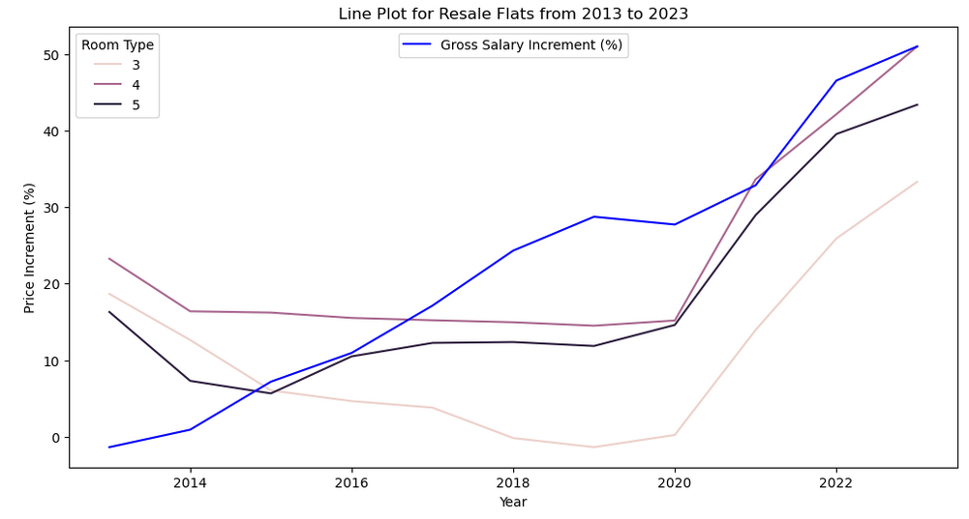
Resale Flat Price Appreciation VS Gross Salary Increment

Slide 26
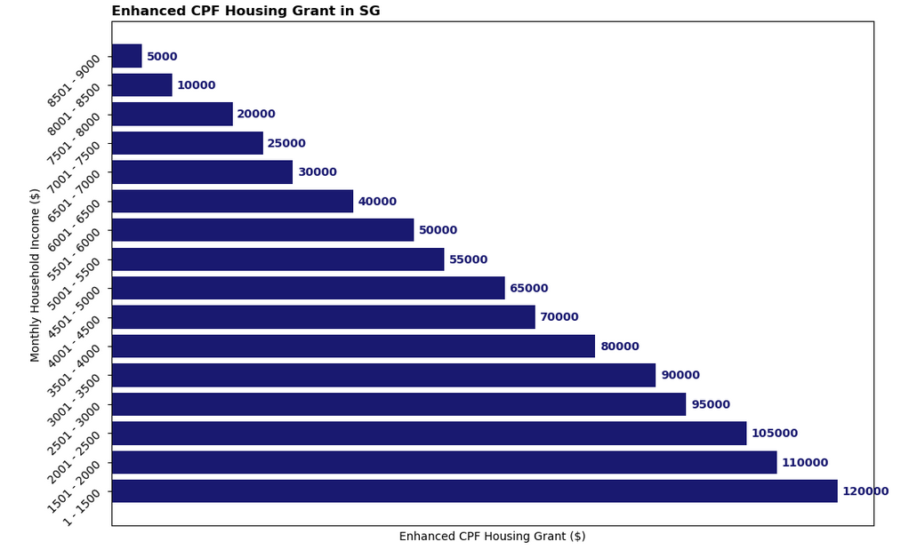
Enhanced CPF Housing Grant

Slide 27
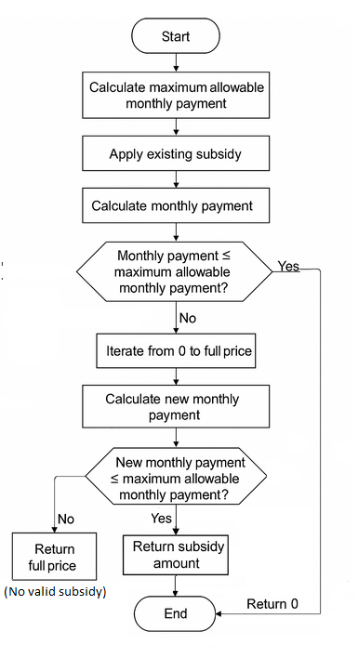
Additional Subsidy Computation Logic Flow

Slide 28
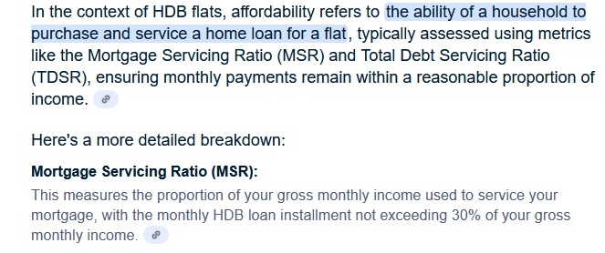
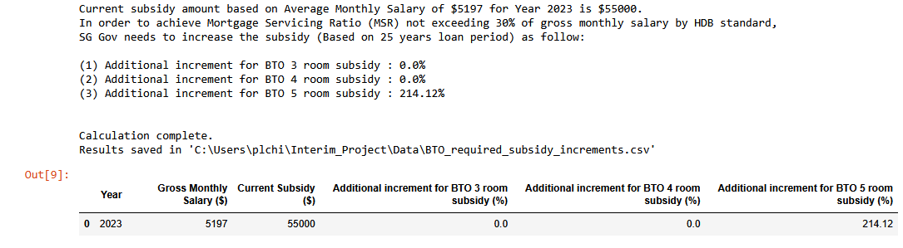
Compute Additional Subsidy SG Gov Could Provide for BTO Flats
To achieve Mortgage Servicing Ratio (MSR) not exceeding 30% of gross monthly salary (Based on 25 years loan period)
CSV file attachment of the calculated result

Slide 29
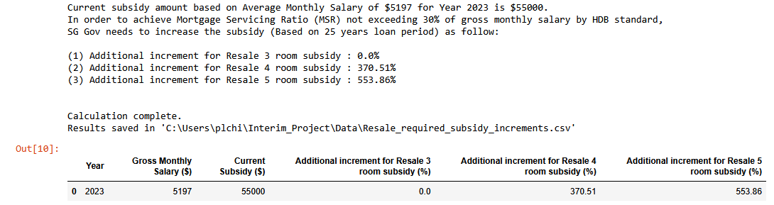
Compute Additional Subsidy SG Gov Could Provide for Resale Flats
To achieve Mortgage Servicing Ratio (MSR) not exceeding 30% of gross monthly salary (Based on 25 years loan period)
CSV file attachment of the calculated result

Slide 30
Analyzed Result
HDB Room Type (BTO) | Results from Analysis (Python, PostgreDB)
3 Room | Thru the data analysis, it was found that BTO 3 room HDB flat Price appreciation has been fast and furious between 2021 and 2023 Still remain affordable to the general public in SG No additional subsidy is required
4 Room | Thru the data analysis, it was found that BTO 4 room HDB flat Price appreciation has been fast and furious between 2021 and 2023 Still remain affordable to the general public in SG No additional subsidy is required
5 Room | Thru the data analysis, it was found that BTO 5 room HDB flat Price appreciation has been fast and furious between 2021 and 2023 Addition subsidy of 214.12% would lessen the burden of young couples to maintain monthly mortgage loan at less than 30% of their monthly income This is due to the fact that some BTO 5 room flats in certain areas are selling above $500K or higher in the recent years

Slide 31
Analyzed Result
HDB Room Type (Resale) | Results from Analysis (Python, PostgreDB)
3 Room | Thru the data analysis, it was found that Resale 3 room HDB flat Price appreciation has been fast and furious between 2021 and 2023 Still remain affordable to the general public in SG No additional subsidy is required
4 Room | Thru the data analysis, it was found that Resale 4 room HDB flat Price appreciation has been fast and furious between 2021 and 2023 Addition subsidy of 370.51% would lessen the burden of young couples to maintain monthly mortgage loan at less than 30% of their monthly income This is due to the fact that some BTO 5 room flats in certain areas are selling above $500K or higher in the recent years
5 Room | Thru the data analysis, it was found that Resale 5 room HDB flat Price appreciation has been fast and furious between 2021 and 2023 Addition subsidy of 553.86% would lessen the burden of young couples to maintain monthly mortgage loan at less than 30% of their monthly income This is due to the fact that some BTO 5 room flats in certain areas are selling above $700K or higher in the recent years

Slide 32

Conclusion

Slide 33
Conclusion
From this project, we discovered the following by using data analysis to assess HDB affordability:
Price appreciation of HDB flats (3, 4, 5 room) is in tandem with the gross monthly income of population in SG.
SG Gov and HDB need to monitor and control the prices of BTO 5 room HDB flats to ensure that they remain affordable to the general public in SG.
SG Gov and HDB need to do more to control the prices of Resale 4 and 5 room HDB flats to ensure that they remain affordable to the general public in SG.

Slide 34


The End

