Slide 1

Interim Project Singapore
Housing Affordability

Slide 2
Agenda
Introduction
Business Issues and Objectives
Challenges
ETL Process Flow
Python Modules
Dataset Understanding
Entity Relationship Diagram
Analysis
Conclusion

Slide 3




Introduction

Slide 4
Introduction
Conclusion
Analysis
Goal
Housing is affordable in Singapore
Issues
Scope
Problem
With rising housing prices, is Singapore housing still affordable?

Slide 5
Introduction - Problem
With rising housing prices, is housing in Singapore still affordable?
Public housing are home to over 80% of Singapore’s residents -hdb.gov.sg
Housing & Development Board (HDB) develops public housing to provide Singaporeans with affordable, quality homes, and a better living environment. - hdb.gov.sg
Types of public housing (aka flats)
HDB Flat Types | % of HDB Stock | No. Of Units | Estimated Coverage | Population Coverage
1-Room | 10% | ~110,000 | 1-2 pax | ~0.15 million
2-Room
2-Room Flexi
Short-Lease 2-Room Flexi
3-Room | 30% | ~330,000 | 2-4 pax | ~1.0 million
4-Room | 40% | ~440,000 | 3-5 pax | ~1.6 million
5-Room | 20% | ~220,000 | 4-6 pax | ~1.0 million
Executive
From HDB’s Annual Report (2022/23), DeepSeekAI finds the distribution of 1.1M HDB flats to be as such

Slide 6

Introduction - Problem
With rising housing prices, is housing in Singapore still affordable?
Affordability based on Mortgage Servicing Ratio (MSR), a key indicator used by HDB to determine whether a borrower could afford a loan -mas.gov.sg
MSR is the maximum percentage of a borrower’s gross monthly income (≤30%) that can be used to service a property loan -mas.gov.sg
Gross Monthly Income = basic + fixed allowances + CPF contributions
Calculation

Slide 7
Introduction - Scope
With rising housing prices, is housing in Singapore still affordable?
Housing
Herein, refers to majority of HDB flats: 3-Room, 4-Room, 5-Room
Includes both government-direct (BTO) and public-market (resale)
Affordability
Herein, refers to monthly mortgage repayment at ≤30% of gross monthly income
Eligibility to housing loans and subsidy based on MSR
Final Scope of the Problem
Analysis to determine the rising prices of housing, and to measure the affordability of housing based on gross monthly income

Slide 8

Business Issues & Objectives

Slide 9
Business Issues & Objectives
Issues
Determine the rising prices of housing on a year-on-year increment (2013-2023)
Determine the trend of gross monthly income on a year-on-year increment (2013-2023)
Determine the possibility of loan and subsidy based on Mortgage Servicing Ratio (MSR)
Objectives
Prove the affordability of the housing based on gross monthly income, where monthly mortgage repayment at ≤30% of gross monthly income
Calculate the additional subsidy in order to achieve Mortgage Servicing Ratio (MSR)

Slide 10
Task - Data-level
Tasks
Extract relevant data entities and datasets from Singapore government agencies
Import data into PostgreDB
Apply data science functionality of Pandas and Seaborn
Dissect data to solve issues and achieve objectives at project-level
Utilise data visualisation to showcase statistical trends
Take data-driven approach into understanding housing trends

Slide 11
Challenges

Slide 12
Challenges - Member-level
Difficulty
Knowledge
Using seaborn & matplotlib to plot charts
Execution
Converting PDF File to CSV file
Experience
Varying experience within the group
Overcome
Research
Kagga, ChatGPT, Stack Overflow
Experiment
Tried various python libraries
Norming
Division of labour, complementary strengths

Slide 13
ETL Process Flow

Slide 14
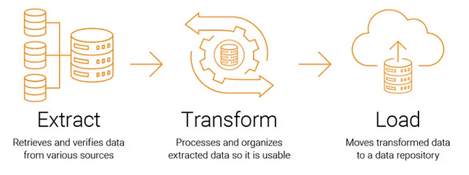
ETL Process Flow
Extract - Data is collected from multiple SG Gov sources (csv, pdf files).
Transform - The data is cleaned, formatted, aggregated, and validated.
Load - The processed data is stored in a target system (PostgreDB).

Slide 15
Python Modules

Slide 16
Python Modules
These Python modules are required for the Interim Project
 | Python Module
(1) | numpy
(2) | matplotlib
(3) | os
(4) | pandas
(5) | pathlib
(6) | psycopg2
(7) | PyPDF2
(8) | requests
(7) | seaborn
(8) | selenium
(9) | shutil
(10) | sqlalchemy
(11) | time
(12) | tabula
(13) | zipfile

Slide 17
Data Understanding

Slide 18
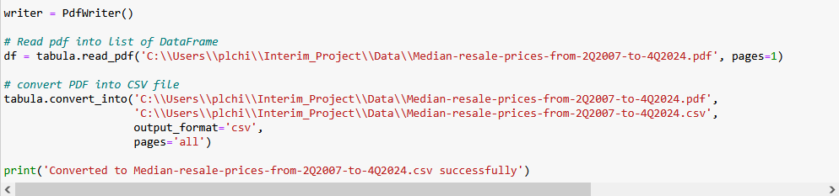
Data Files (Gov SG Sources)
Data File | Data description | Resource URL
BTOPriceRangeofHDBFlatsOffered.csv | Constitutes different transacted prices of BTO flats in SG offered by HDB for the past decade | https://data.gov.sg/datasets?topics=housing&page=1&resultId=d_2d493bdcc1d9a44828b6e71cb095b88d
Median-resale-prices-from-2Q2007-to-4Q2024.csv | Constitutes different transacted prices of resale flats in SG for the past decade | https://www.hdb.gov.sg/-/media/doc/EAPG-CSC/Median-resale-prices-for-registered-resale-applications-from-2Q2007-to-4Q2024_.ashx
GrossMonthlyIncomeFull-TimeEmployedResidents_Final.csv | Constitutes different gross monthly income for the past decade | https://stats.mom.gov.sg/iMAS_Tables1/CSV/mrsd_43_FT_Res_income.zip
EHG-amount-Couples-and-Families-Aug-2024_Final.csv | Constitutes different enhanced housing grant for various monthly housing income for the past decade | https://www.hdb.gov.sg/cs/infoweb/-/media/doc/EAPG-CSC/EHG-amount-Couples-and-Families-Aug-2024.ashx

Slide 19
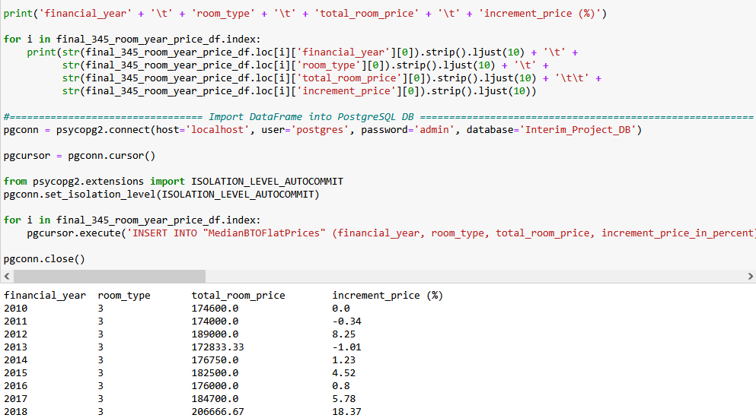
DB Entity After Data Extraction & Transformation
DB Entity to be used (PostgreDB) | Description
MedianBTOFlatPrices | Constitutes different transacted prices of BTO flats (3, 4, 5 room) and appreciation of the prices in percentage in SG for the past decade
MedianResaleFlatPrices | Constitutes different transacted prices of resale flats (3, 4, 5 room) and appreciation of the prices in percentage in SG for the past decade
GrossMonthlyIncomeFullTime | Constitutes appreciation in percentage for the gross monthly income for the past decade
Enhanced_CPF_Housing_Grant | Constitutes enhanced housing grant for different monthly housing income for the past decade

Slide 20
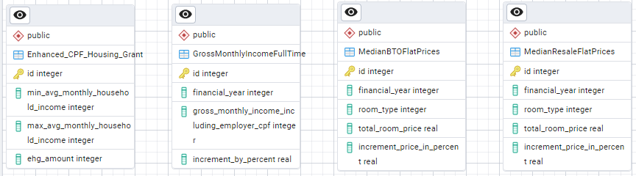
Entity Relationship Diagram (PostgreDB)

Slide 21
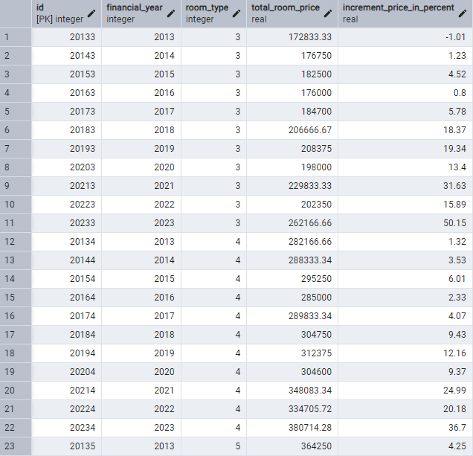
MedianBTOFlatPrices Table

Slide 22
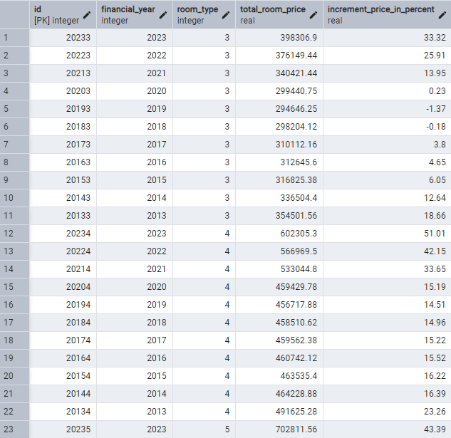
MedianResaleFlatPrices Table

Slide 23
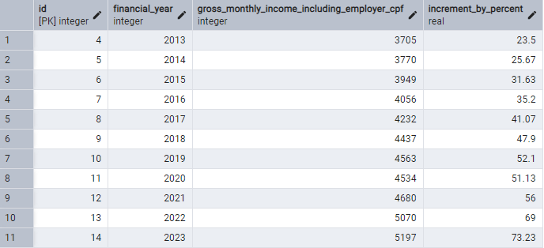
GrossMonthlyIncomeFullTime Table

Slide 24
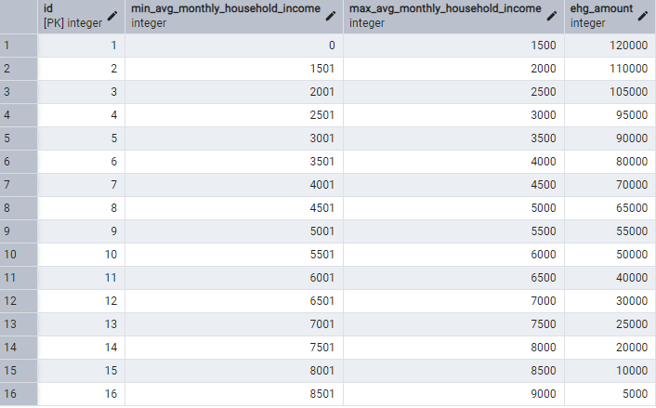
Enhanced_CPF_Housing_Grant Table

Slide 25
Analysis

Slide 26
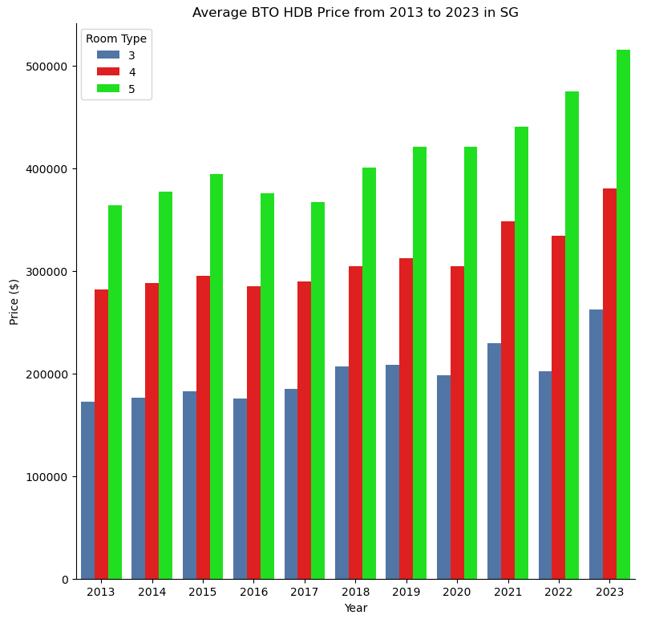
Average BTO HDB Price from 2013 to 2023 in SG

Slide 27
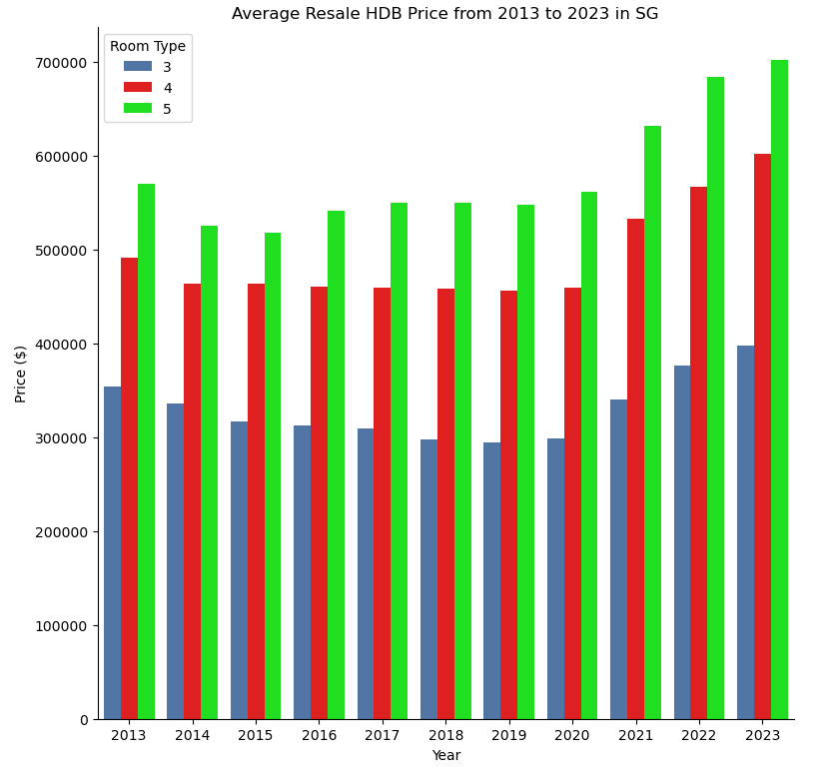
Average Resale HDB Price from 2013 to 2023 in SG

Slide 28
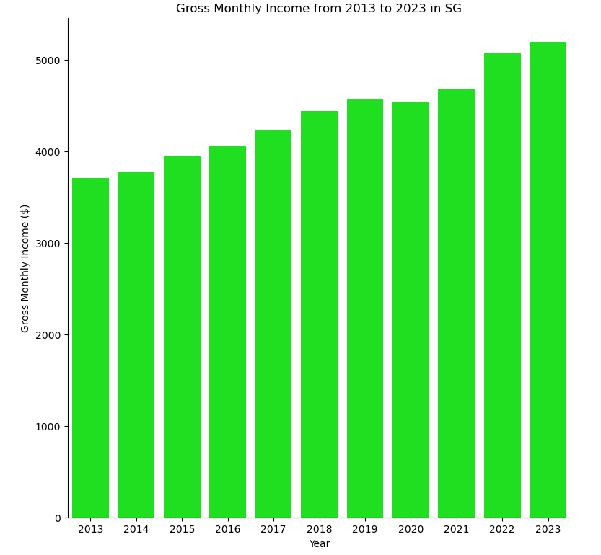
Gross Monthly Income from 2013 to 2023 in SG

Slide 29
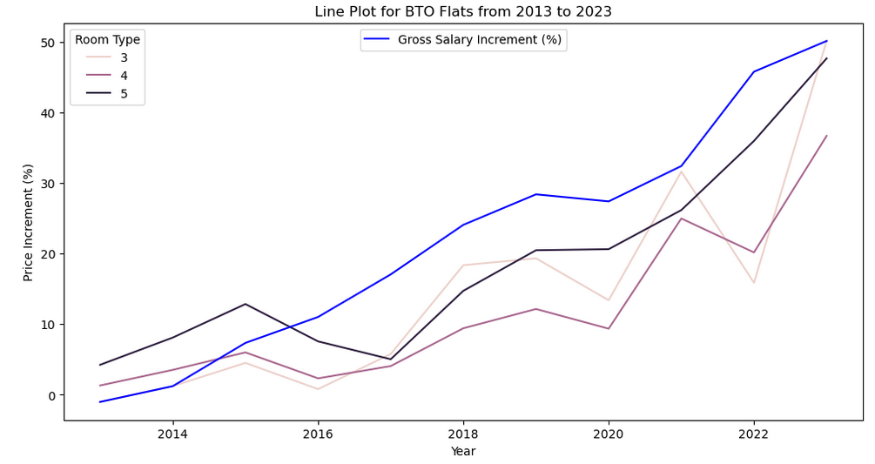
BTO Flat Price Appreciation VS Gross Salary Increment

Slide 30
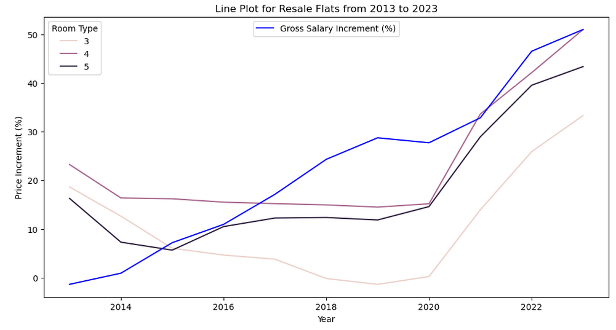
Resale Flat Price Appreciation VS Gross Salary Increment

Slide 31
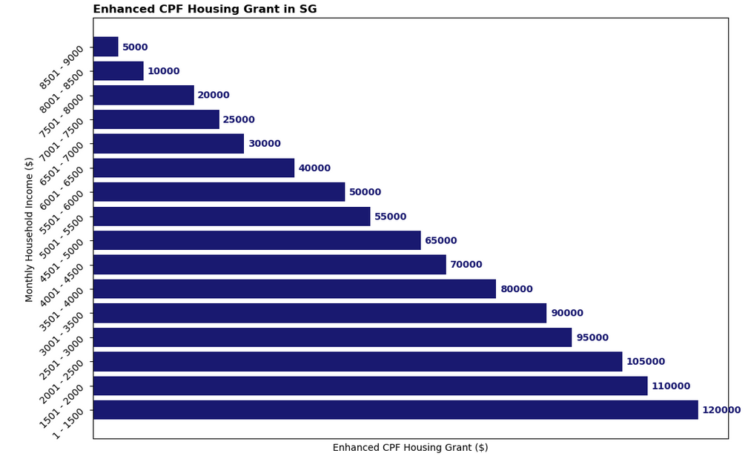
Enhanced CPF Housing Grant

Slide 32
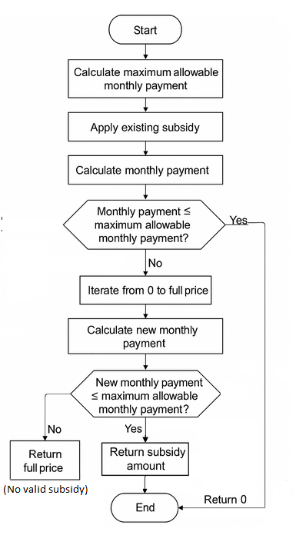
Additional Subsidy Computation Logic Flow

Slide 33
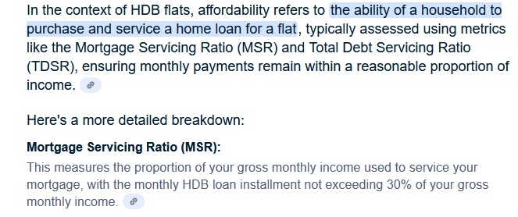
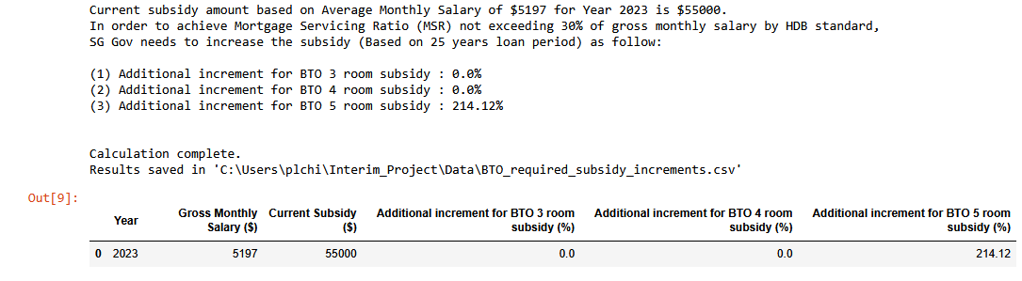

Compute Additional Subsidy SG Gov Could Provide for BTO Flats
To achieve Mortgage Servicing Ratio (MSR) not exceeding 30% of gross monthly salary (Based on 25 years loan period)
CSV file attachment of the calculated result

Slide 34
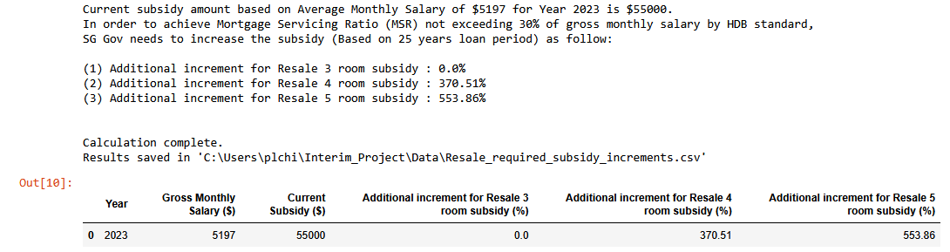
Compute Additional Subsidy SG Gov Could Provide for Resale Flats
To achieve Mortgage Servicing Ratio (MSR) not exceeding 30% of gross monthly salary (Based on 25 years loan period)
CSV file attachment of the calculated result

Slide 35
Analyzed Result
HDB Room Type (BTO) | Results from Analysis (Python, PostgreDB)
3 Room | Thru the data analysis, it was found that BTO 3 room HDB flat Price appreciation has been fast and furious between 2021 and 2023 Still remain affordable to the general public in SG No additional subsidy is required
4 Room | Thru the data analysis, it was found that BTO 4 room HDB flat Price appreciation has been fast and furious between 2021 and 2023 Still remain affordable to the general public in SG No additional subsidy is required
5 Room | Thru the data analysis, it was found that BTO 5 room HDB flat Price appreciation has been fast and furious between 2021 and 2023 Addition subsidy of 214.12% would lessen the burden of young couples to maintain monthly mortgage loan at less than 30% of their monthly income This is due to the fact that some BTO 5 room flats in certain areas are selling above $500K or higher in the recent years

Slide 36
Analyzed Result
HDB Room Type (Resale) | Results from Analysis (Python, PostgreDB)
3 Room | Thru the data analysis, it was found that Resale 3 room HDB flat Price appreciation has been fast and furious between 2021 and 2023 Still remain affordable to the general public in SG No additional subsidy is required
4 Room | Thru the data analysis, it was found that Resale 4 room HDB flat Price appreciation has been fast and furious between 2021 and 2023 Addition subsidy of 370.51% would lessen the burden of young couples to maintain monthly mortgage loan at less than 30% of their monthly income This is due to the fact that some BTO 5 room flats in certain areas are selling above $600K or higher in the recent years
5 Room | Thru the data analysis, it was found that Resale 5 room HDB flat Price appreciation has been fast and furious between 2021 and 2023 Addition subsidy of 553.86% would lessen the burden of young couples to maintain monthly mortgage loan at less than 30% of their monthly income This is due to the fact that some BTO 5 room flats in certain areas are selling above $700K or higher in the recent years

Slide 37

Conclusion

Slide 38
Conclusion
From this project, by using data analysis to assess HDB affordability, we discovered the following :
It offers a data-driven approach to understanding housing trends and their impact on residents.
By analyzing the historical BTO and resale prices, household income levels and loan interest rates, we can identify patterns and make informed decisions.
Through data visualization and statistical analysis, we can evaluate whether housing prices are
keeping pace with income growth
detect areas of rising unaffordability
calculate subsidy rate to achieve Mortgage Servicing Ratio (MSR)
This will aid policymakers in designing effective housing policies and ensure a more equitable and sustainable housing market by aligning housing costs with the financial realities of Singaporeans.

Slide 39


The End

