Slide 1

Interim Project Presentation

Slide 2
Agenda
Introduction
Issues and Objectives
ETL Process Flow
Python Modules
Dataset Understanding
Entity Relationship Diagram
Analysis
Conclusion
Challenges

Slide 3




Introduction

Slide 4
Introduction
HDB flat is a type of public housing in Singapore, built and managed by the Housing & Development Board (HDB). These flats are home to over 80% of Singapore’s residents, providing affordable and well-designed housing options ranging from studio apartments to executive flats. They are a key part of Singapore’s urban planning, promoting community living while ensuring quality and affordability for residents.
In this project, we will assess and measure the affordability of the HDB flats (3, 4 & 5 room) based on gross monthly income.
In addition, we will also calculate the additional subsidy in order to achieve Mortgage Servicing Ratio (MSR) not exceeding 30% of gross monthly salary by HDB standard.

Slide 5

Issues & Objectives

Slide 6
Issues & Objectives
issues
objectives
HDB price has been rising fast and furious on a yearly basis, many are concerned if HDB is still affordable to average Singaporeans
Many first timers with low if not zero CPF savings and personal savings are concerned about servicing their monthly mortgages for the BTO flats, what is the additional subsidy that the SG government could provide to lessen their burden.
Measure the affordability of the HDB flats (3, 4 , 5 room) based on gross monthly income.
Calculate the additional subsidy in order to achieve Mortgage Servicing Ratio (MSR) not exceeding 30% of gross monthly salary by HDB standard.
Data Analytic Objective
To import the relevant data entities and datasets from relevant SG Gov agency websites and import them into PostgreDB.
Apply the appropriate data science functionality of Pandas and Seaborn on Python to dissect and achieve the objectives for this interim project.

Slide 7
ETL Process Flow

Slide 8
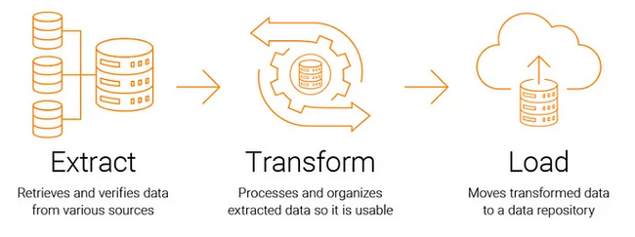
ETL Process Flow
Extract - Data is collected from multiple SG Gov sources (csv, pdf files).
Transform - The data is cleaned, formatted, aggregated, and validated.
Load - The processed data is stored in a target system (PostgreDB).

Slide 9
Python Modules

Slide 10
Python Modules
These Python modules are required for the Interim Project
 | Python Module
(1) | numpy
(2) | matplotlib
(3) | os
(4) | pandas
(5) | pathlib
(6) | psycopg2
(7) | PyPDF2
(8) | requests
(7) | seaborn
(8) | selenium
(9) | shutil
(10) | sqlalchemy
(11) | time
(12) | tabula
(13) | zipfile

Slide 11
Data Understanding

Slide 12
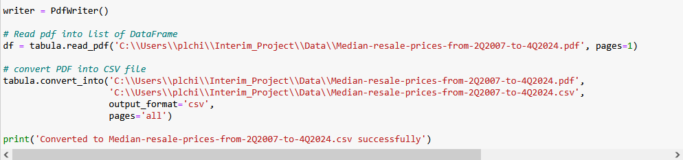
Data Files (Gov SG Sources)
Data File | Data description | Resource URL
BTOPriceRangeofHDBFlatsOffered.csv | Constitutes different transacted prices of BTO flats in SG offered by HDB for the past decade | https://data.gov.sg/datasets?topics=housing&page=1&resultId=d_2d493bdcc1d9a44828b6e71cb095b88d
Median-resale-prices-from-2Q2007-to-4Q2024.csv | Constitutes different transacted prices of resale flats in SG for the past decade | https://www.hdb.gov.sg/-/media/doc/EAPG-CSC/Median-resale-prices-for-registered-resale-applications-from-2Q2007-to-4Q2024_.ashx
GrossMonthlyIncomeFull-TimeEmployedResidents_Final.csv | Constitutes different gross monthly income for the past decade | https://stats.mom.gov.sg/iMAS_Tables1/CSV/mrsd_43_FT_Res_income.zip
EHG-amount-Couples-and-Families-Aug-2024_Final.csv | Constitutes different enhanced housing grant for various monthly housing income for the past decade | https://www.hdb.gov.sg/cs/infoweb/-/media/doc/EAPG-CSC/EHG-amount-Couples-and-Families-Aug-2024.ashx

Slide 13
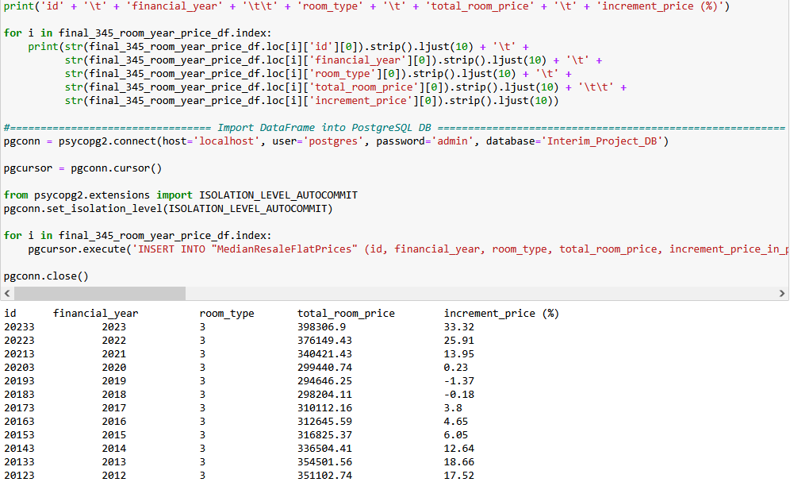
DB Entity After Data Extraction & Transformation
DB Entity to be used (PostgreDB) | Description
MedianBTOFlatPrices | Constitutes different transacted prices of BTO flats (3, 4, 5 room) and appreciation of the prices in percentage in SG for the past decade
MedianResaleFlatPrices | Constitutes different transacted prices of resale flats (3, 4, 5 room) and appreciation of the prices in percentage in SG for the past decade
GrossMonthlyIncomeFullTime | Constitutes appreciation in percentage for the gross monthly income for the past decade
Enhanced_CPF_Housing_Grant | Constitutes enhanced housing grant for different monthly housing income for the past decade

Slide 14
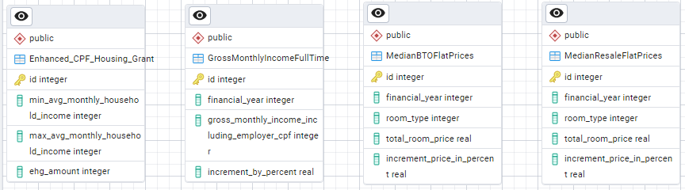
Entity Relationship Diagram (PostgreDB)

Slide 15
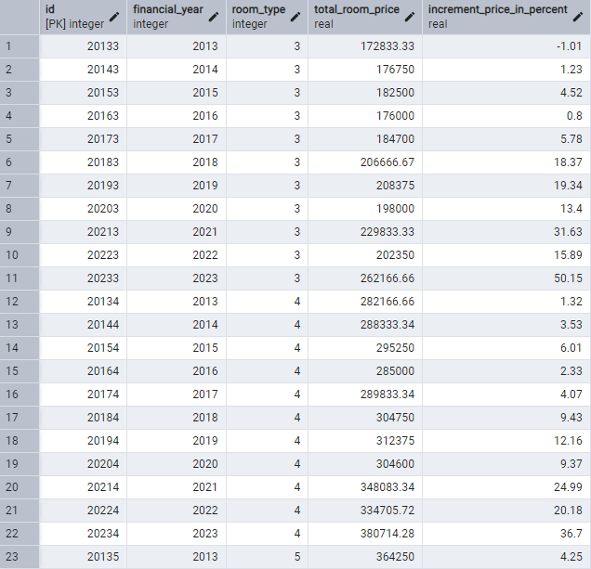
MedianBTOFlatPrices Table

Slide 16
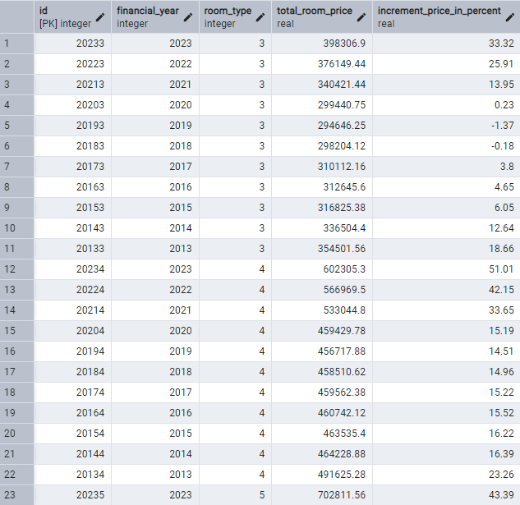
MedianResaleFlatPrices Table

Slide 17
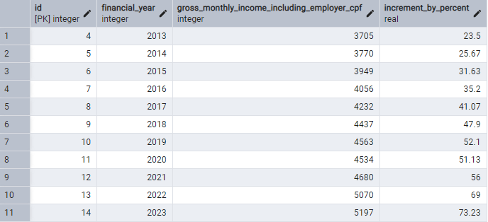
GrossMonthlyIncomeFullTime Table

Slide 18
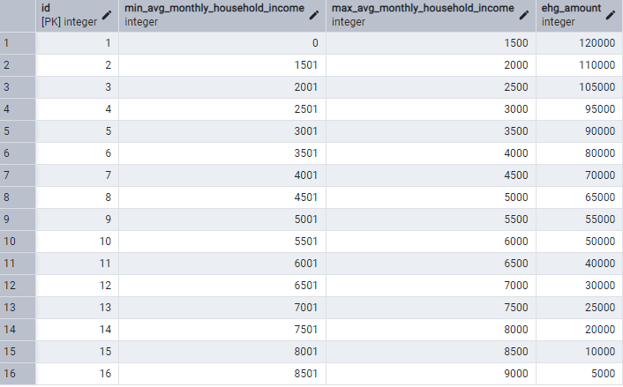
Enhanced_CPF_Housing_Grant Table

Slide 19
Analysis

Slide 20
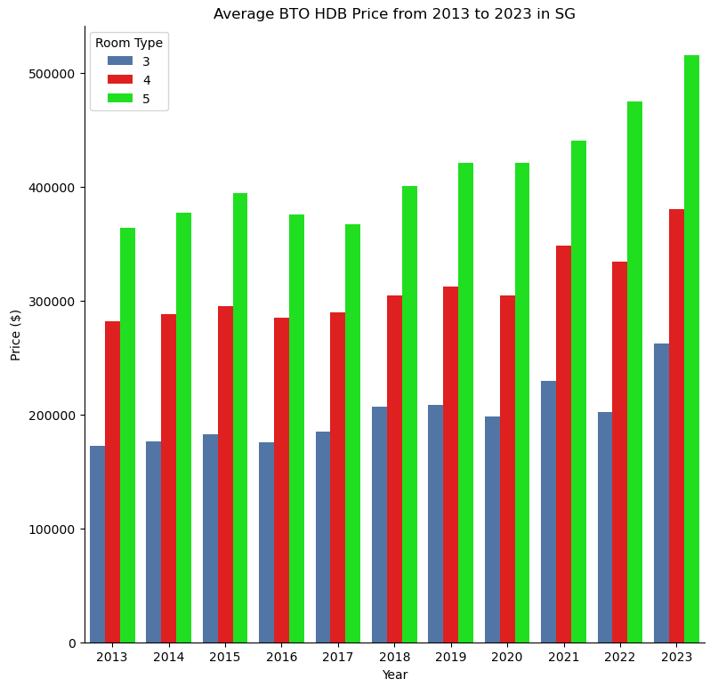
Average BTO HDB Price from 2013 to 2023 in SG

Slide 21
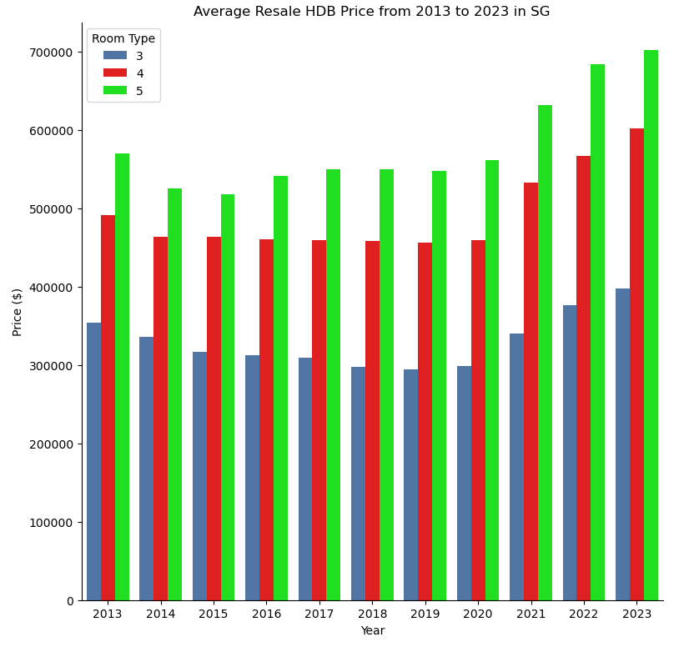
Average Resale HDB Price from 2013 to 2023 in SG

Slide 22
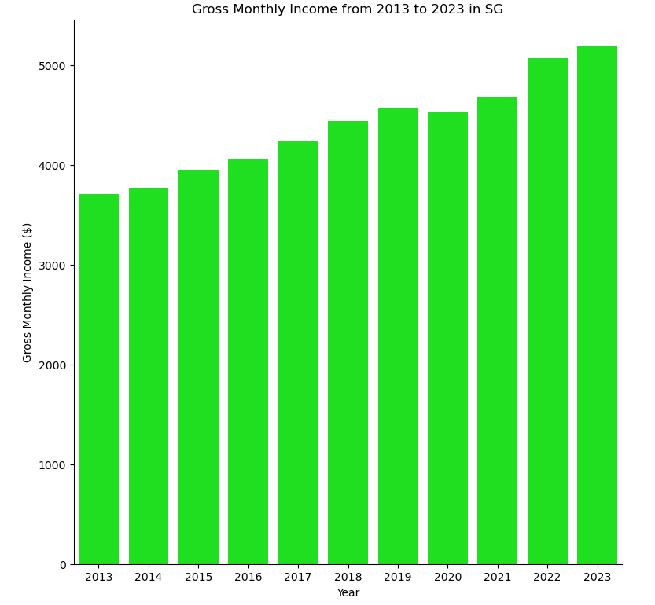
Gross Monthly Income from 2013 to 2023 in SG

Slide 23
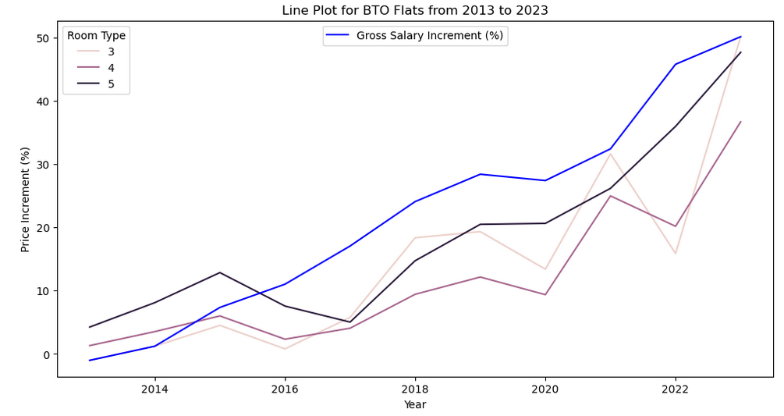
BTO Flat Price Appreciation VS Gross Salary Increment

Slide 24
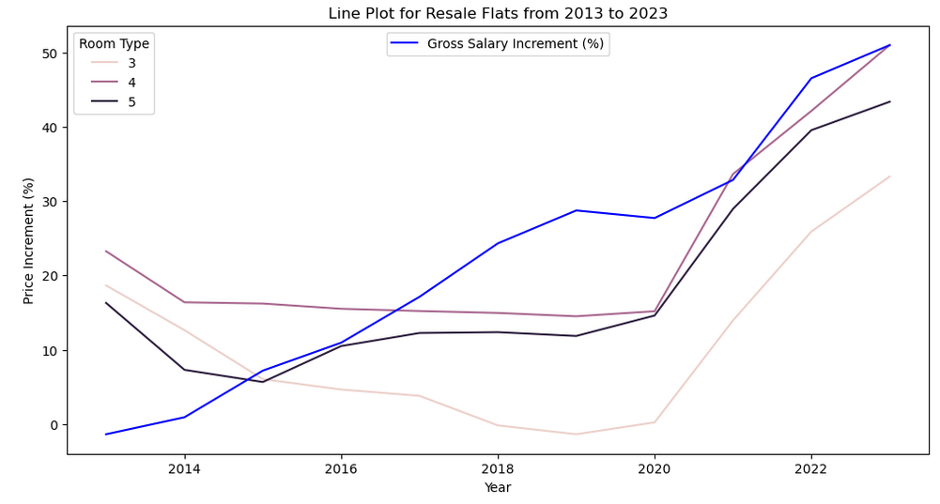
Resale Flat Price Appreciation VS Gross Salary Increment

Slide 25
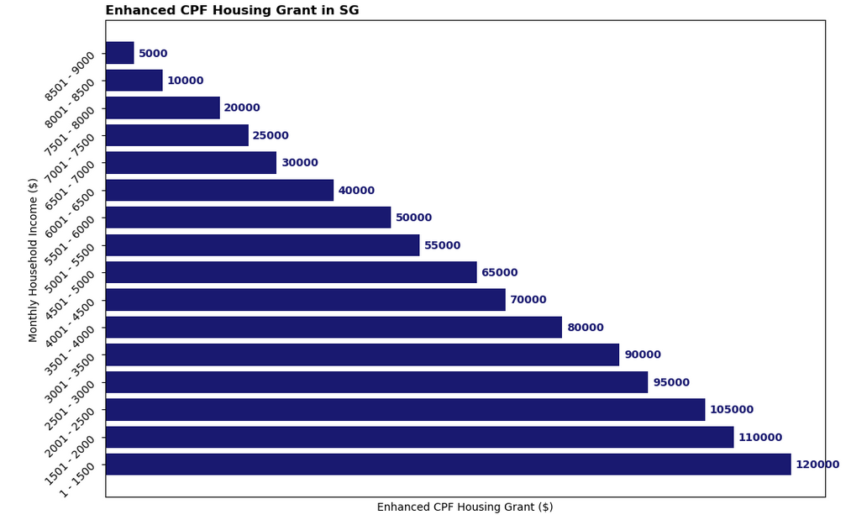
Enhanced CPF Housing Grant

Slide 26
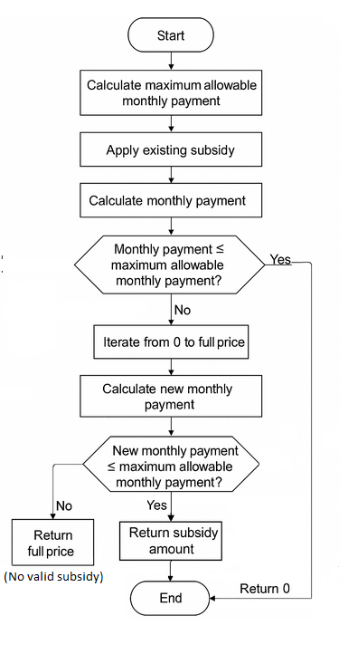
Additional Subsidy Computation Logic Flow

Slide 27
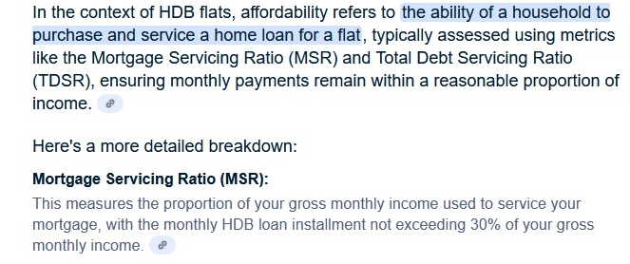
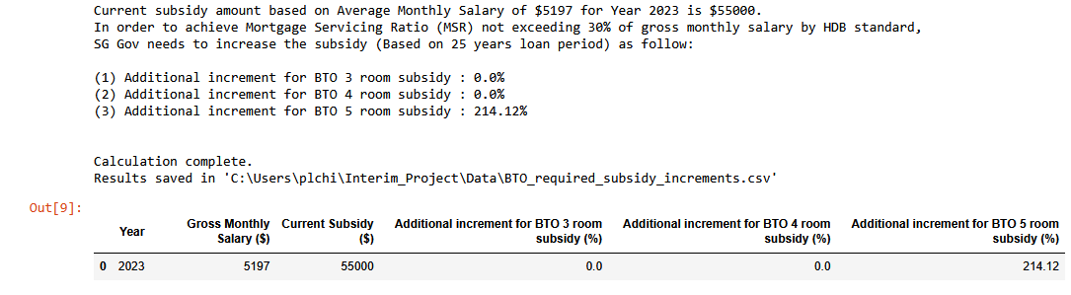
Compute Additional Subsidy SG Gov Could Provide for BTO Flats
To achieve Mortgage Servicing Ratio (MSR) not exceeding 30% of gross monthly salary (Based on 25 years loan period)
CSV file attachment of the calculated result

Slide 28
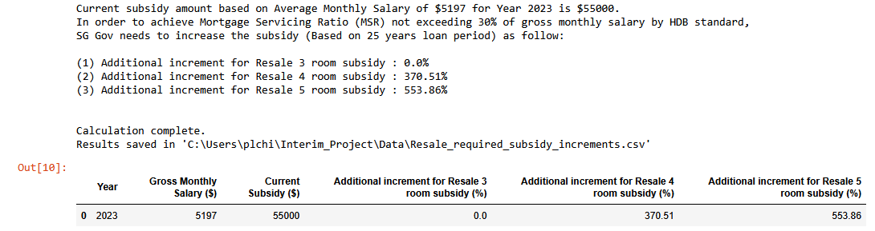
Compute Additional Subsidy SG Gov Could Provide for Resale Flats
To achieve Mortgage Servicing Ratio (MSR) not exceeding 30% of gross monthly salary (Based on 25 years loan period)
CSV file attachment of the calculated result

Slide 29
Analyzed Result
HDB Room Type (BTO) | Results from Analysis (Python, PostgreDB)
3 Room | Thru the data analysis, it was found that BTO 3 room HDB flat Price appreciation has been fast and furious between 2021 and 2023 Still remain affordable to the general public in SG No additional subsidy is required
4 Room | Thru the data analysis, it was found that BTO 4 room HDB flat Price appreciation has been fast and furious between 2021 and 2023 Still remain affordable to the general public in SG No additional subsidy is required
5 Room | Thru the data analysis, it was found that BTO 5 room HDB flat Price appreciation has been fast and furious between 2021 and 2023 Addition subsidy of 214.12% would lessen the burden of young couples to maintain monthly mortgage loan at less than 30% of their monthly income This is due to the fact that some BTO 5 room flats in certain areas are selling above $500K or higher in the recent years

Slide 30
Analyzed Result
HDB Room Type (Resale) | Results from Analysis (Python, PostgreDB)
3 Room | Thru the data analysis, it was found that Resale 3 room HDB flat Price appreciation has been fast and furious between 2021 and 2023 Still remain affordable to the general public in SG No additional subsidy is required
4 Room | Thru the data analysis, it was found that Resale 4 room HDB flat Price appreciation has been fast and furious between 2021 and 2023 Addition subsidy of 370.51% would lessen the burden of young couples to maintain monthly mortgage loan at less than 30% of their monthly income This is due to the fact that some BTO 5 room flats in certain areas are selling above $600K or higher in the recent years
5 Room | Thru the data analysis, it was found that Resale 5 room HDB flat Price appreciation has been fast and furious between 2021 and 2023 Addition subsidy of 553.86% would lessen the burden of young couples to maintain monthly mortgage loan at less than 30% of their monthly income This is due to the fact that some BTO 5 room flats in certain areas are selling above $700K or higher in the recent years

Slide 31

Conclusion

Slide 32
Conclusion
From this project, by using data analysis to assess HDB affordability, we discovered the following :
It offers a data-driven approach to understanding housing trends and their impact on residents.
By analyzing the historical BTO and resale prices, household income levels and loan interest rates, we can identify patterns and make informed decisions.
Through data visualization and statistical analysis, we can evaluate whether housing prices are
keeping pace with income growth
detect areas of rising unaffordability
calculate subsidy rate to achieve Mortgage Servicing Ratio (MSR)
This will aid policymakers in designing effective housing policies and ensure a more equitable and sustainable housing market by aligning housing costs with the financial realities of Singaporeans.

Slide 33
Challenges

Slide 34
Challenges

Slide 35


The End

