Slide 1
Personal Loan Conversion Prediction Model
By Ching Jie

Slide 2
Content
Metrics to assess models
Modelling Approach 1 (Logistic Regression)
Modelling Approach 2 (Decision Tree)
Comparison between both modelling
Recommendation
Appendix (Details on Single Factor Analysis and Data Processing Steps for Model 1)

Slide 3
Metrics used to assess model
AUC Score and Gini Score
Since the model is highly imbalanced, with estimated 10% conversion rate (Personal Loan == 1), it is more ideal to use AUC-ROC score and Gini Score to assess.
AUC-ROC is designed to measure the ability of a classifier to distinguish between 2 classes. Which is the goal of the Use Case, to predict who will convert and who will not after the targeted marketing campaign.
If we were to use Accuracy, which is (TP + TN) / (TP + TN + FP + FN), even if we were to create a model that predict 0% conversion rate, the model would still achieve 90% accuracy.

Slide 4
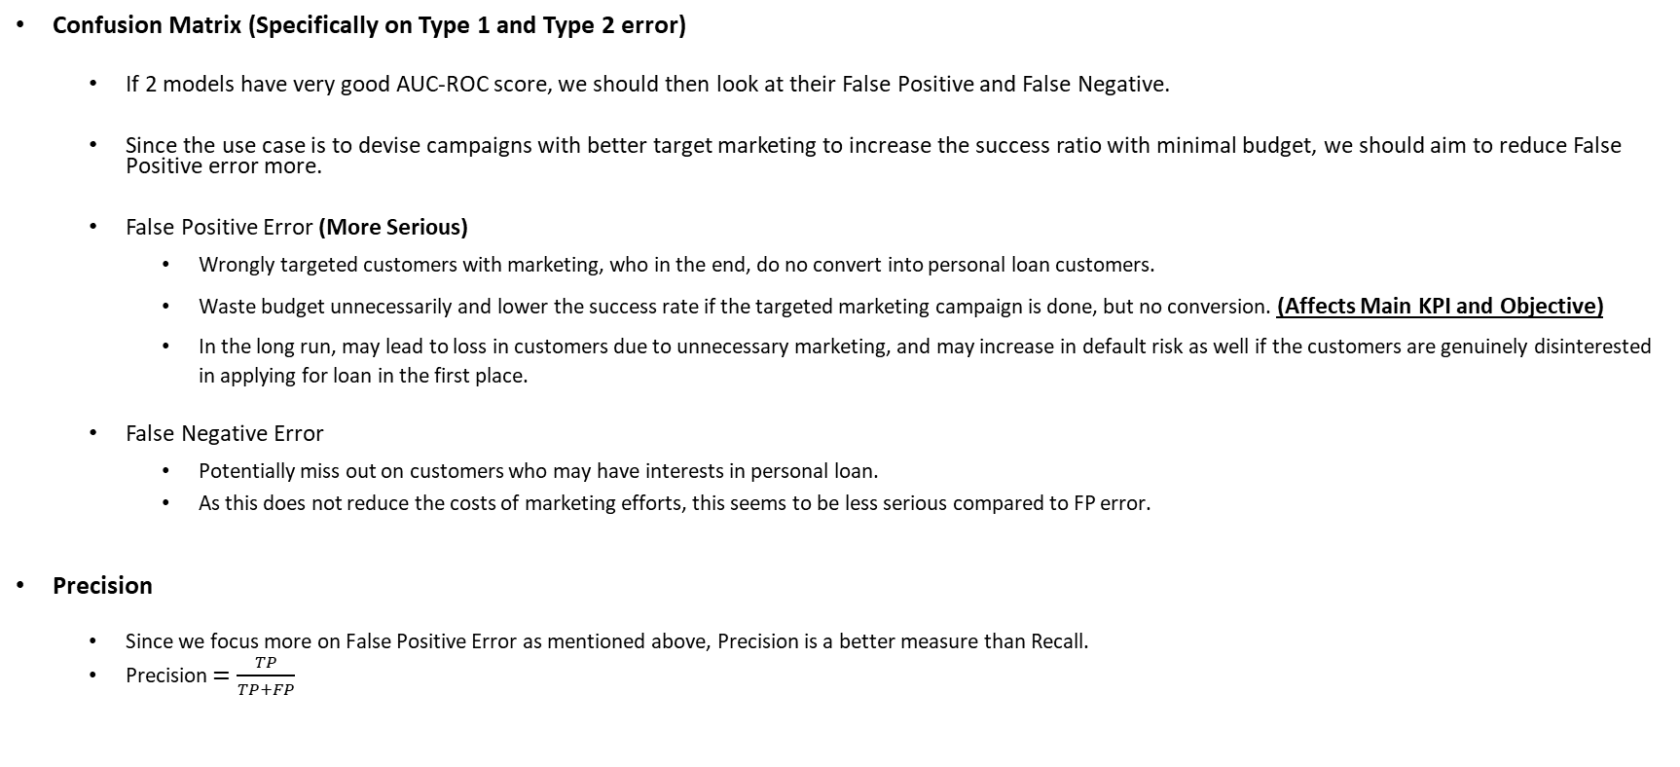
Metrics used to assess model
Confusion Matrix (Specifically on Type 1 and Type 2 error)
If 2 models have very good AUC-ROC score, we should then look at their False Positive and False Negative.
Since the use case is to devise campaigns with better target marketing to increase the success ratio with minimal budget, we should aim to reduce False Positive error more.
False Positive Error (More Serious)
Wrongly targeted customers with marketing, who in the end, do no convert into personal loan customers.
Waste budget unnecessarily and lower the success rate if the targeted marketing campaign is done, but no conversion. (Affects Main KPI and Objective)
In the long run, may lead to loss in customers due to unnecessary marketing, and may increase in default risk as well if the customers are genuinely disinterested in applying for loan in the first place.
False Negative Error
Potentially miss out on customers who may have interests in personal loan.
As this does not reduce the costs of marketing efforts, this seems to be less serious compared to FP error.
Precision
Since we focus more on False Positive Error as mentioned above, Precision is a better measure than Recall.
Precision $=\frac{TP}{TP+FP}$

Slide 5

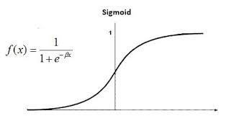
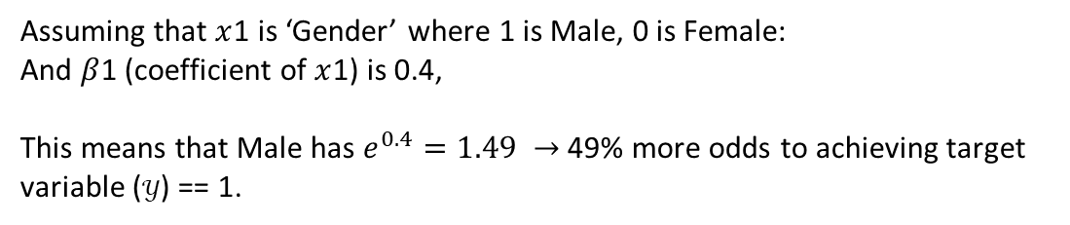
Modelling Approach 1 (White-Box Model)
Decided to use logistic regression as the main modelling approach
Standard Banking Approach, especially for credit risk domain.
Pros: Easy to understand the model and interpret its coefficients result.
Cons: Since it creates linear relationship, won’t obtain better results when dealing with non-linear data. But.. There’s a work-around, using WoE and Coarse-Classing which I will explain later.
Assuming that $x$1 is ‘Gender’ where 1 is Male, 0 is Female:
And $β$1 (coefficient of $x$1) is 0.4,
This means that Male has $e^{0.4}=1.49 →$ 49% more odds to achieving target variable ($𝒴$) == 1.

Slide 6
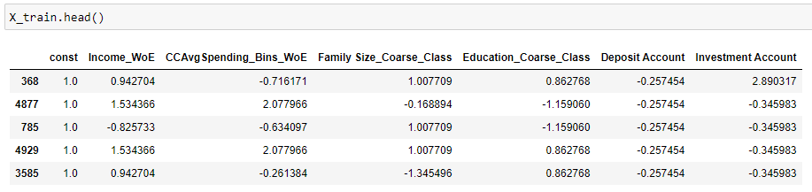
Factors used for Logistic Regression
Income_WoE → Income Variable after coarse classing, use WoE as its input value
Education_Coarse_Class → Education Variable after coarse class Graduate with Advanced Degree
Family Size_Coarse_Class → Bin 4 and above family size into 3. 3 represents 3+ family size
CCAvgSpending_Bins_WoE → CCAvgSpending after coarse classing, use WoE as its input value
Deposit Account
Investment Account
Units have been standardized so that features with larger value such as income compared to family size won't be given higher coefficients if they are not necessarily more important. Algorithms like Logistic Regression which use the weighted-sum of input variables will be affected if the scale is not standardized.

Slide 7
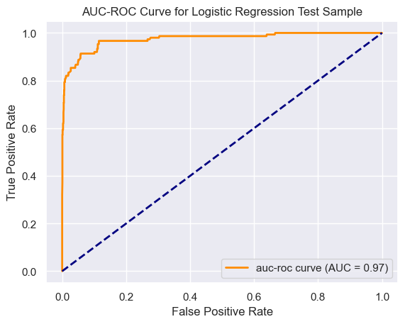

Model Outcome 1 (Logistic Regression)
AUC-ROC and Gini Score are extremely high.
AUC-ROC and Gini Score of 97.5%, 94.9% on validation sample respectively show that the model is well-trained and proven to differentiate which customers will convert from liability customers to personal loan customers after targeted marketing campaign.
From the confusion matrix, we can also see that out of 1,641 customers, only 43 customers are wrongly predicted
120 True Positive
1478 True Negative
30 False Positive
13 False Negative
Model is indeed performing very well even comparing against industrial standards.
Data | Count (N) | AUC-ROC Score | Gini Score | Precision
Training | 3330 | 97.6% | 95.1% | 75.1%
Testing | 1641 | 97.5% | 94.9% | 80.0%
70-30 train-test split.
Usually will conduct 5-fold cross validation, but due to time constraint.

Slide 8
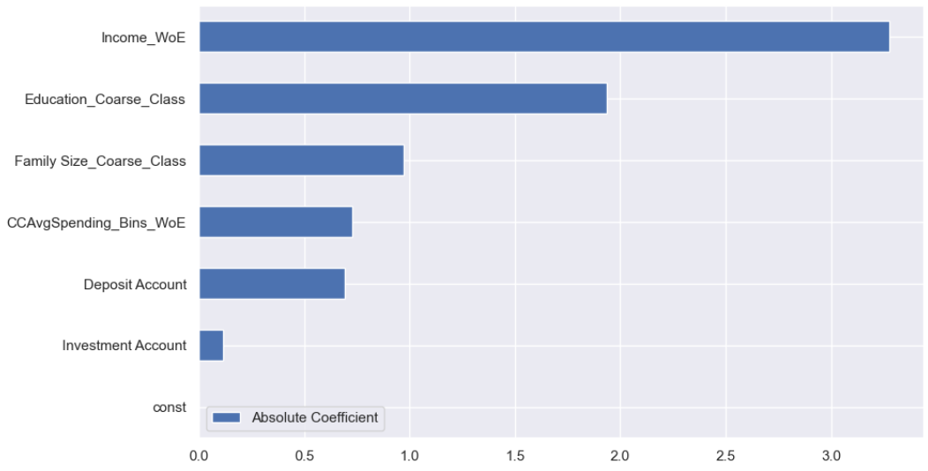
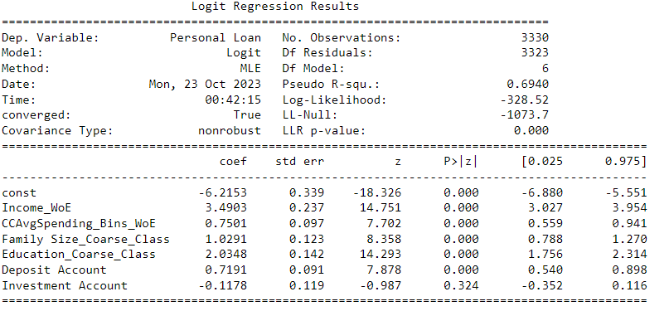
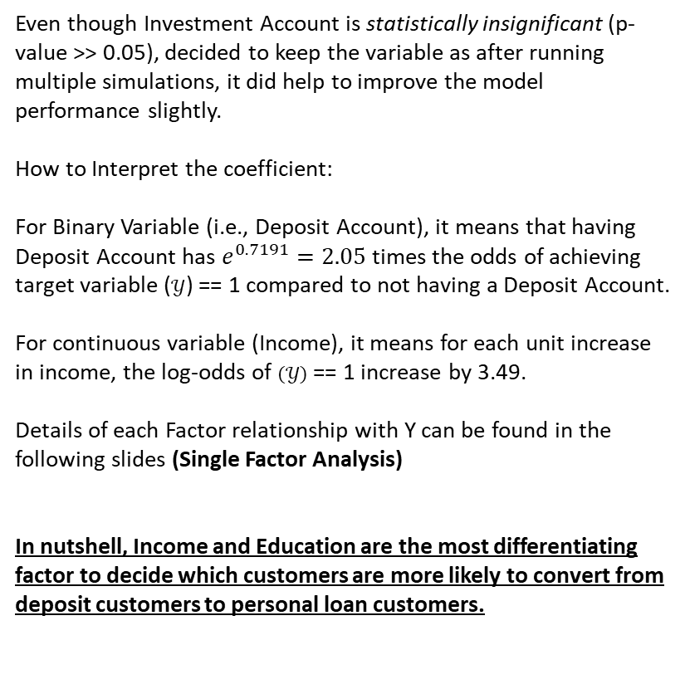
Understanding Regression Outcome for Model 1
Even though Investment Account is statistically insignificant (p-value >> 0.05), decided to keep the variable as after running multiple simulations, it did help to improve the model performance slightly.
How to Interpret the coefficient:
For Binary Variable (i.e., Deposit Account), it means that having Deposit Account has $e^{0.7191}=2.05$times the odds of achieving target variable ($𝒴$) == 1 compared to not having a Deposit Account.
For continuous variable (Income), it means for each unit increase in income, the log-odds of $(𝒴)$ == 1 increase by 3.49.
Details of each Factor relationship with Y can be found in the following slides (Single Factor Analysis)
In nutshell, Income and Education are the most differentiating factor to decide which customers are more likely to convert from deposit customers to personal loan customers.

Slide 9
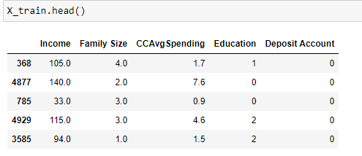
Factors used for Decision Tree
Note!
Features are very different from Logistic Regression because different kind of algorithm. Logistic Regression rely more heavily on linear relationship, so there’s a need to transform WoE values and also coarse class certain bins to ensure there are linear relationship.
Decision Tree on the other hand are able to take on non-linear and more complicated relationship, so these variables are derived by simply just running the feature importance algorithm.
Income
Education
Family Size
CCAvgSpending
Logistic regressions and tree-based algorithms such as decision trees are not sensitive to the magnitude of variables. So standardization is not needed before fitting these kinds of models.

Slide 10


Model Outcome 2 (Decision Tree)
AUC-ROC and Gini Score are extremely high.
AUC-ROC and Gini Score of 98.7%, 97.5% on validation sample respectively show that the model is well-trained and proven to differentiate which customers will convert from liability customers to personal loan customers after targeted marketing campaign.
From the confusion matrix, we can also see that out of 1,641 customers, only 43 customers are wrongly predicted
129 True Positive
1482 True Negative
21 False Positive
9 False Negative
Model is performing better than first Model. In every way possible. (AR Score, Gini, FP, FN)
Data | Count (N) | AUC-ROC Score | Gini Score | Precision
Training | 3330 | 99.5% | 99.1% | 85.4%
Testing | 1641 | 98.7% | 97.5% | 86.0%
70-30 train-test split.
Usually will conduct 5-fold cross validation, but due to time constraint.

Slide 11
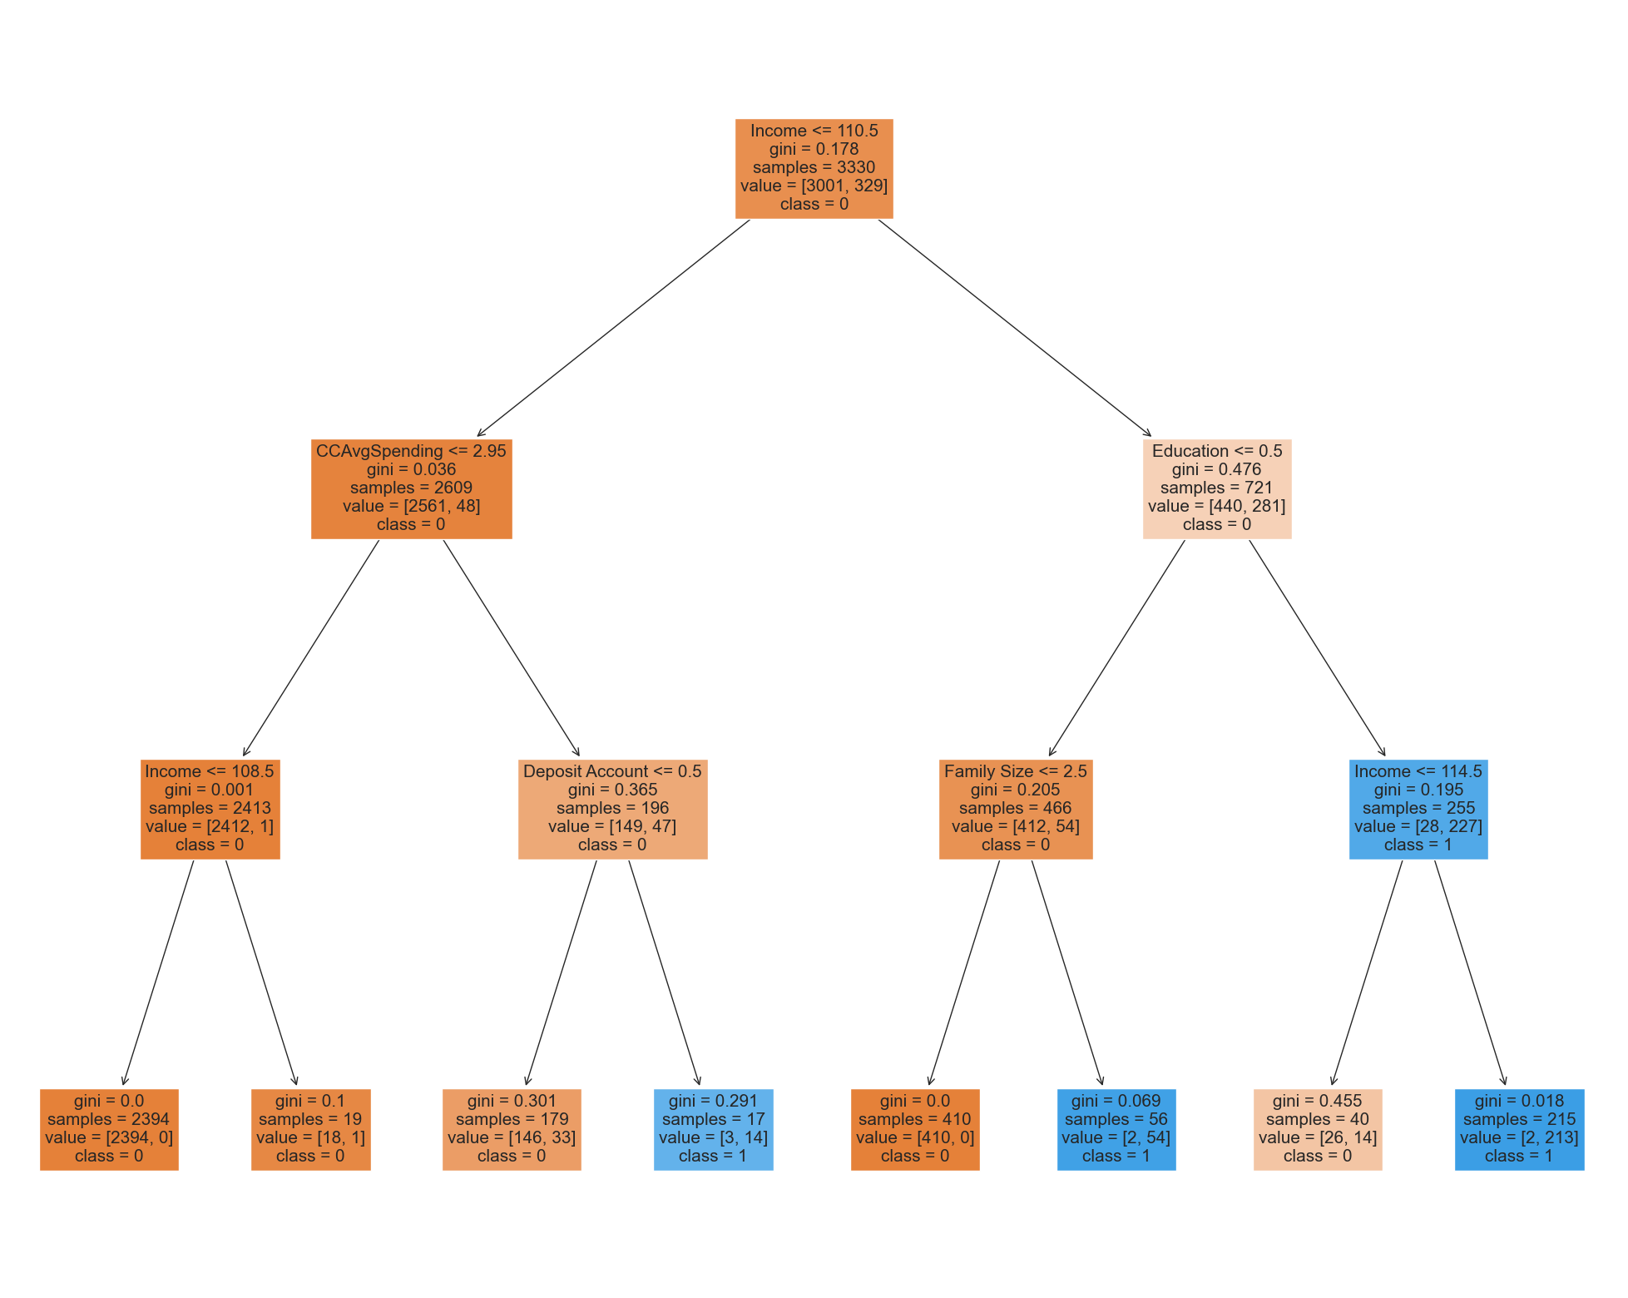
Understanding Decision Tree outcome for Model 2
Root Node
Decision Tree visualization shows that the most important factor in differentiating a customer converting into personal loan customer is Income (Root Node).
Followed by Education and Credit Card Average Spending.
Decision Nodes
Decision Nodes
Leaf Nodes

Slide 12
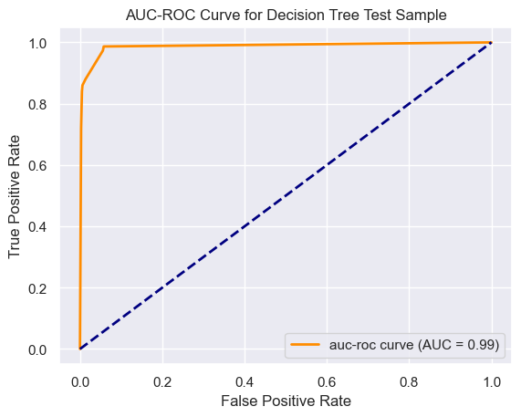
Comparing Logistic Regression and Decision Tree
Model | Count (N) | AUC-ROC Score | Gini Score | Precision
Logistic Regression | 1641 | 97.5% | 94.9% | 80.0%
Decision Tree | 1641 | 98.7% | 97.5% | 86.0%
Logistic Regression
Decision Tree
Logistic Regression perform slightly worse than Decision Tree in terms of AUC-ROC Score, Gini Score, FP, FN as well as Precision.
It also requires a much longer time to build the model since there are a lot more data processing to build a good logistic regression model. (i.e., Standardizing of units across all variables, fine-classing and looking at WoE to see if there’s any credit intuition or linear relationship with the predictor variable, and also the need to coarse-class some bins together. )

Slide 13
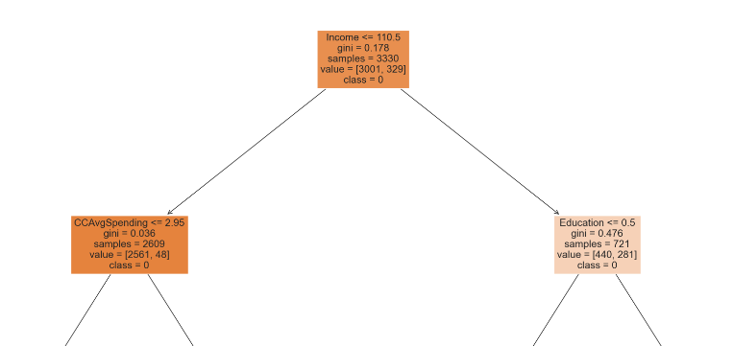
Comparing Model 1 and Model 2
Both models predict that Income and Education are the most important factor to predict whether a customers would want to convert.
For logistic regression, there is more emphasis on Income, Education and Family Size.
For decision tree, there is more emphasis on Income, Education and Credit Card Average Spending according to how the tree is split via Gini index.

Slide 14
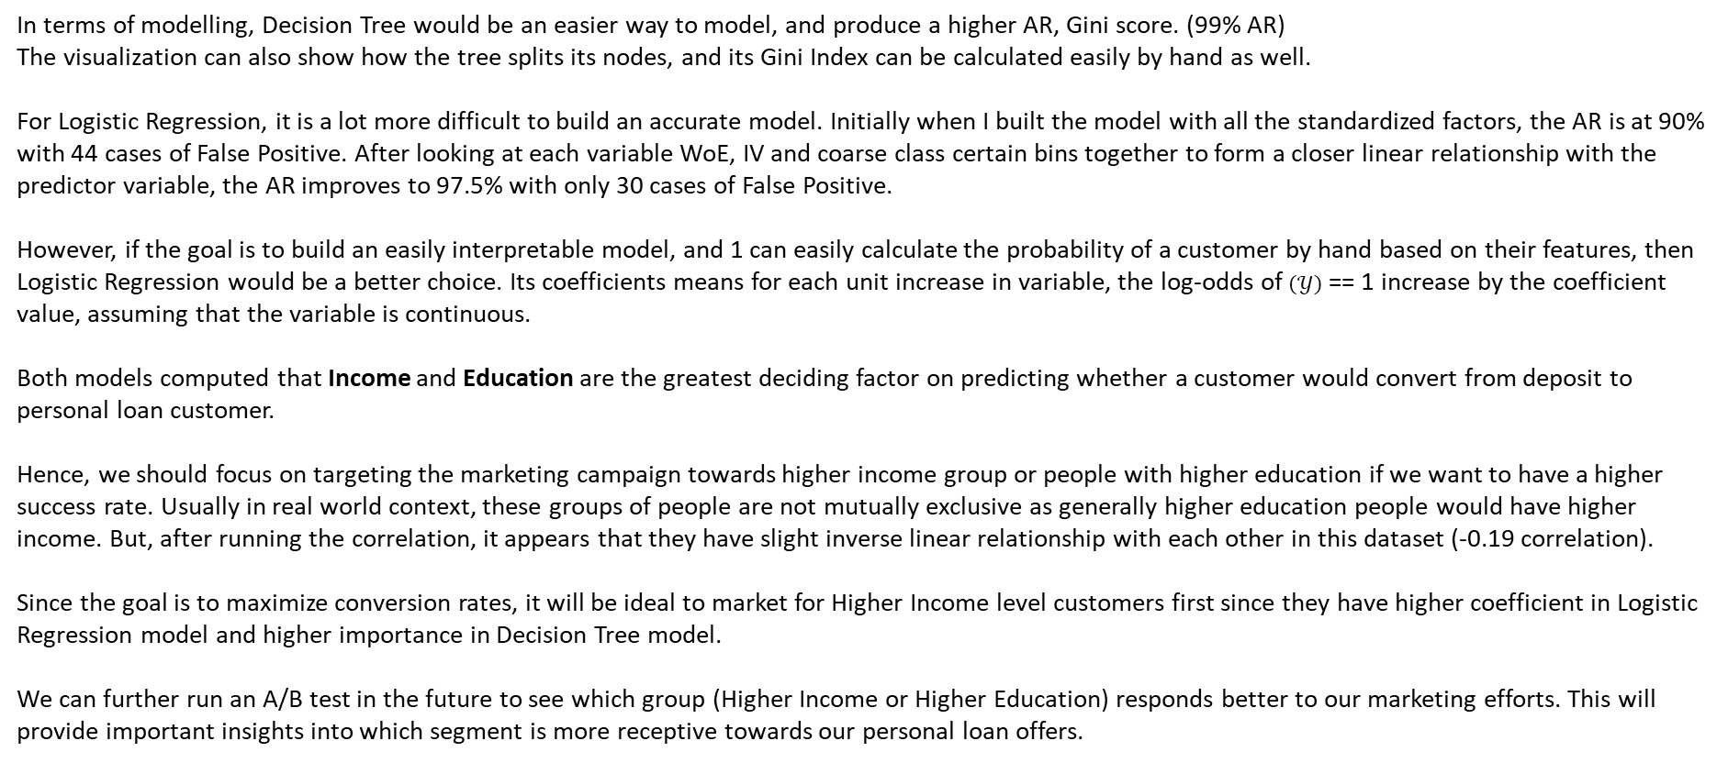
Recommendations
In terms of modelling, Decision Tree would be an easier way to model, and produce a higher AR, Gini score. (99% AR)
The visualization can also show how the tree splits its nodes, and its Gini Index can be calculated easily by hand as well.
For Logistic Regression, it is a lot more difficult to build an accurate model. Initially when I built the model with all the standardized factors, the AR is at 90% with 44 cases of False Positive. After looking at each variable WoE, IV and coarse class certain bins together to form a closer linear relationship with the predictor variable, the AR improves to 97.5% with only 30 cases of False Positive.
However, if the goal is to build an easily interpretable model, and 1 can easily calculate the probability of a customer by hand based on their features, then Logistic Regression would be a better choice. Its coefficients means for each unit increase in variable, the log-odds of $(𝒴)$ == 1 increase by the coefficient value, assuming that the variable is continuous.
Both models computed that Income and Education are the greatest deciding factor on predicting whether a customer would convert from deposit to personal loan customer.
Hence, we should focus on targeting the marketing campaign towards higher income group or people with higher education if we want to have a higher success rate. Usually in real world context, these groups of people are not mutually exclusive as generally higher education people would have higher income. But, after running the correlation, it appears that they have slight inverse linear relationship with each other in this dataset (-0.19 correlation).
Since the goal is to maximize conversion rates, it will be ideal to market for Higher Income level customers first since they have higher coefficient in Logistic Regression model and higher importance in Decision Tree model.
We can further run an A/B test in the future to see which group (Higher Income or Higher Education) responds better to our marketing efforts. This will provide important insights into which segment is more receptive towards our personal loan offers.

Slide 15
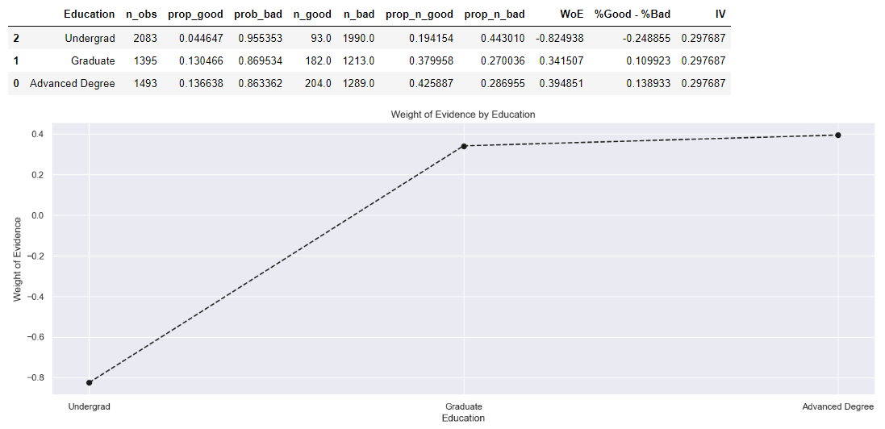
Single Factor Analysis (Weight Of Evidence)
For Education (Keep and Coarse-Class ‘Graduate’ with ‘Advanced Degree’)
Trend: As Education level increases, chance of personal loan also increases.
Coarse-Class ‘Graduate’ with ‘Advanced Degree’ to improve the model performance.

Slide 16
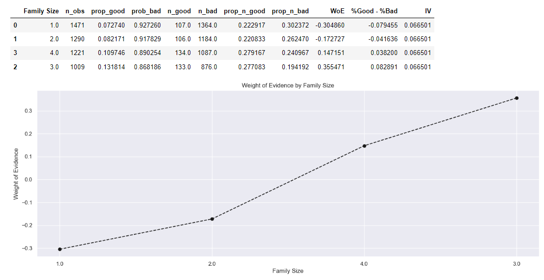
Single Factor Analysis (Weight Of Evidence)
For Family Size (Keep and Coarse-Class size of 3 and 4)
WoE trend is reversed for family of 3 and 4.
Trend: As family size increases, chance of personal loan also increases.
Coarse-Class size of 3 and 4 together to improve model performance. Treat 3 as 3++ family size

Slide 17
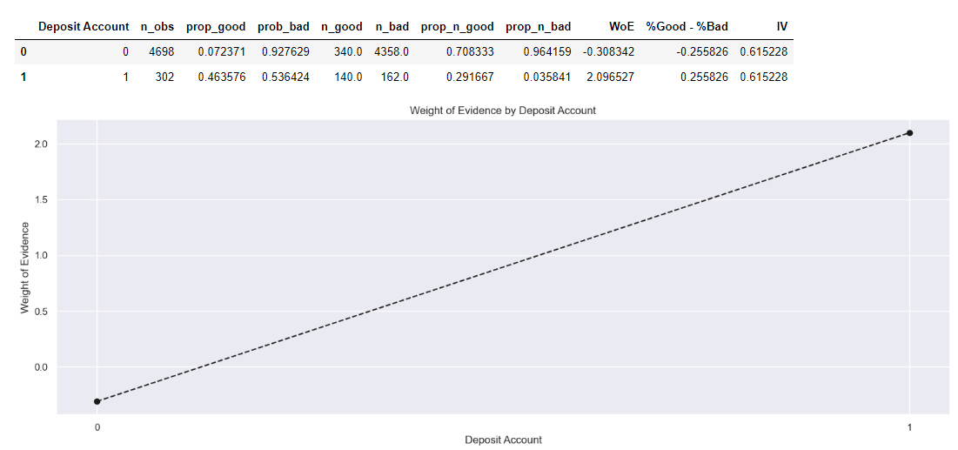
Single Factor Analysis (Weight Of Evidence)
For Deposit Account (Keep)
Trend: Has Deposit Account, chance of personal loan increases.
Good WoE difference between the 2 categories

Slide 18
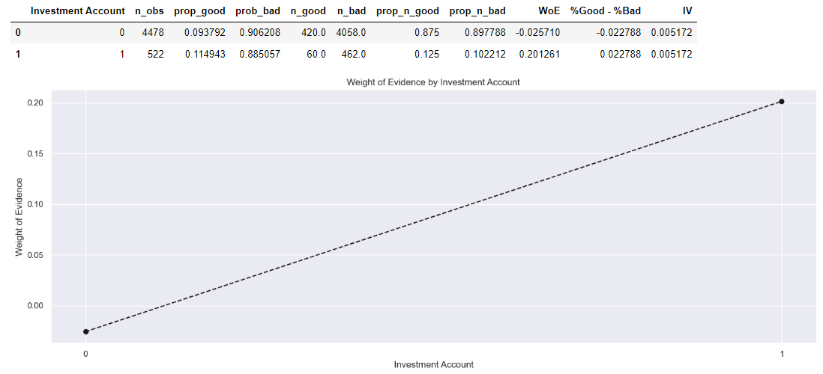
Single Factor Analysis (Weight Of Evidence)
For Investment Account (Keep)
Weak Information Value
WoE trend is okay. Decided to keep after running multiple simulations. Seem to improve the model very slightly.

Slide 19
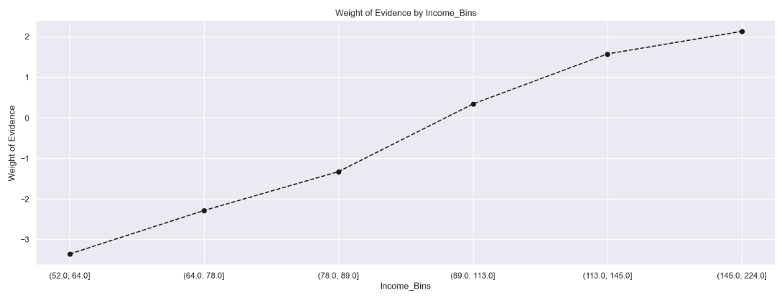
Single Factor Analysis (Weight Of Evidence)
For Income (Keep, but coarse class)
Trend: As Income level increases, chance of personal loan also increases.
Coarse class income with <= 52 with WoE of (52.0, 64.0] -- Details in the code provided.
Improved the model drastically by doing the above adjustment. (91% to 95% Gini Score)

Slide 20
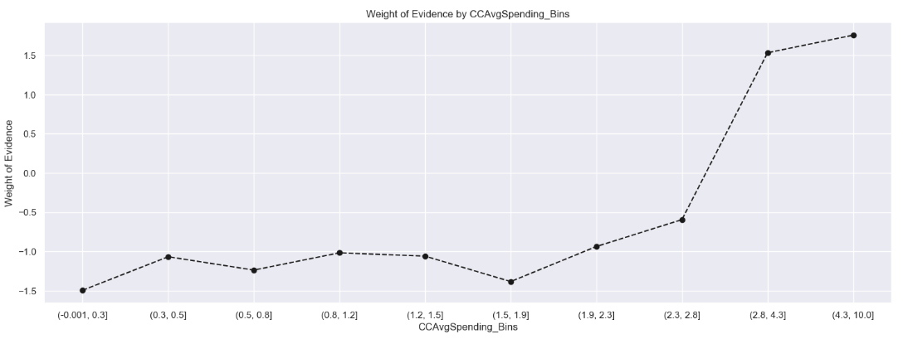
Single Factor Analysis (Weight Of Evidence)
For CCAvgSpending (Keep, but coarse class)
Trend: As Credit Card spending increases from certain level, chance of personal loan also increases.
Coarse class bins from bins from (-0.001 TO 1.1], (1.1 TO 2.3] -- Details in the code provided.
Improved the model substantially as well. Helped to reduce FN rate from simulations.

Slide 21
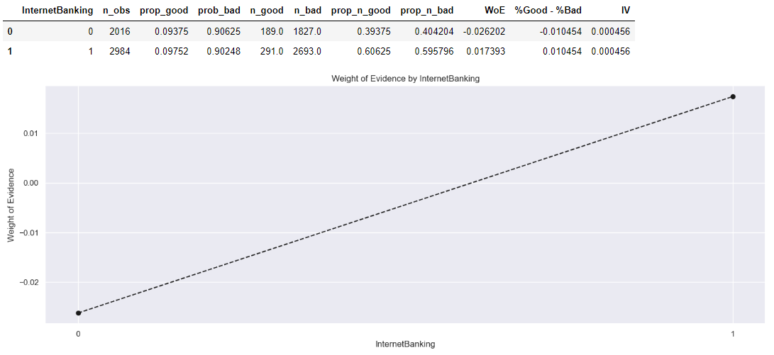
Single Factor Analysis (Weight Of Evidence)
For InternetBanking (Drop)
Weak Information Value
WoE difference is very slight, no clear trend.

Slide 22
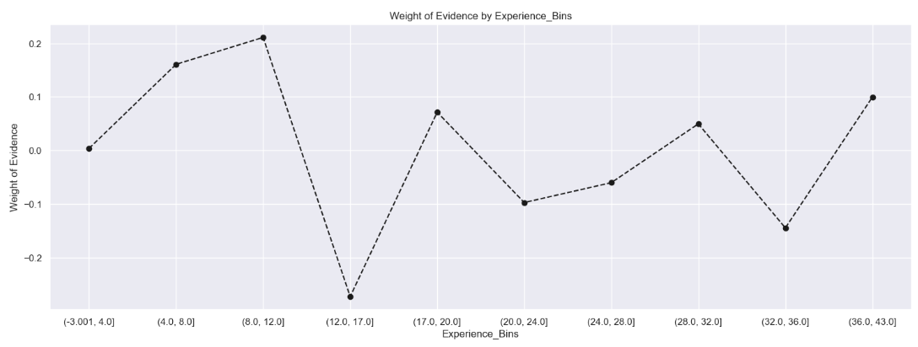
Single Factor Analysis (Weight Of Evidence)
For Experience (Drop)
Bin Variable into 10 Bins, No noticeable WoE trend at all.
Dropped.

Slide 23

Data Processing Steps
Check for Null Values
Eliminate as the count is insignificant, < 5% of total dataset.
Hot-Encode Categorical Variables
Personal Loan (No = 0, Yes = 0)
Investment Account (No = 0, Yes = 0)
Deposit Account (No = 0, Yes = 0)
InternetBanking (No = 0, Yes = 0)
Encode Ordinal Variable
Education (Undergrad = 0, Graduate = 1, Advanced Degree = 2)

Slide 24
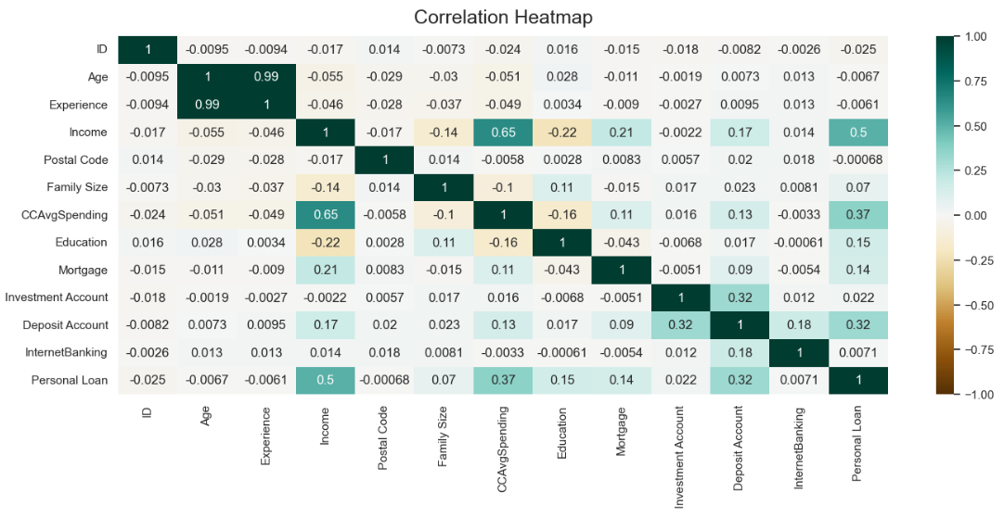
Data Processing Steps
Remove correlated variables (Age)
Remove ID and postal Code. No intuition behind these variables.
Remove Highly Concentrated Variable (Mortgage) -> 69% with 0 value, and is highly statistical insignificance (p-value)
Perform Single Factor Analysis on all variables by checking on their WoE and Information Value.

