Slide 1



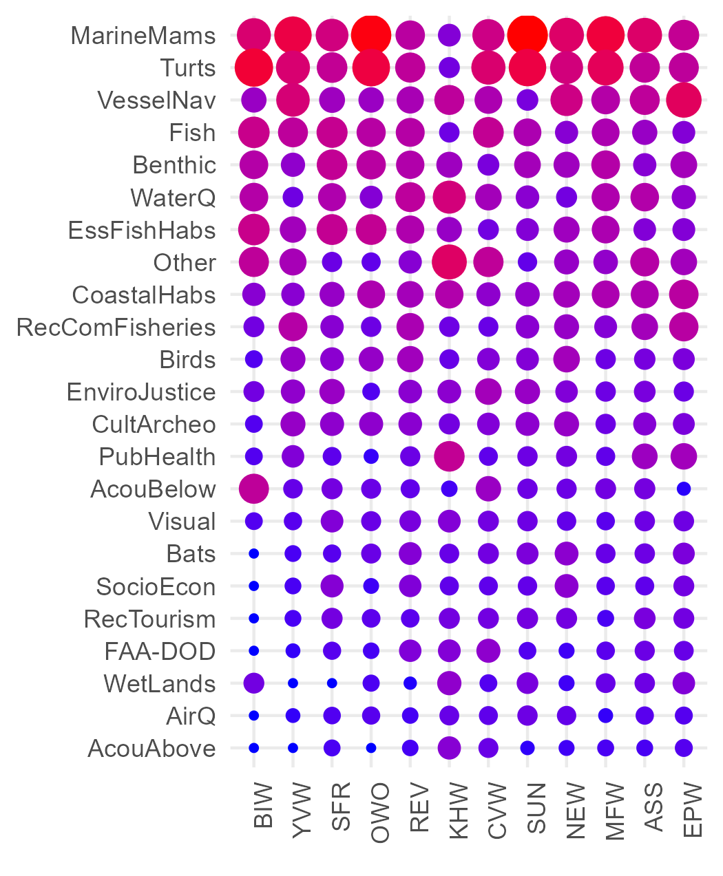
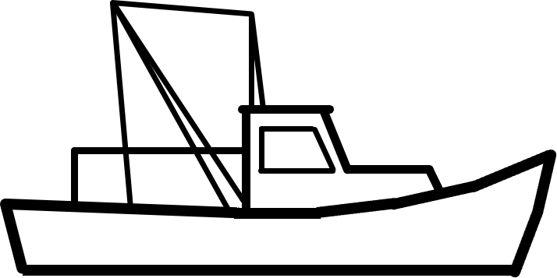




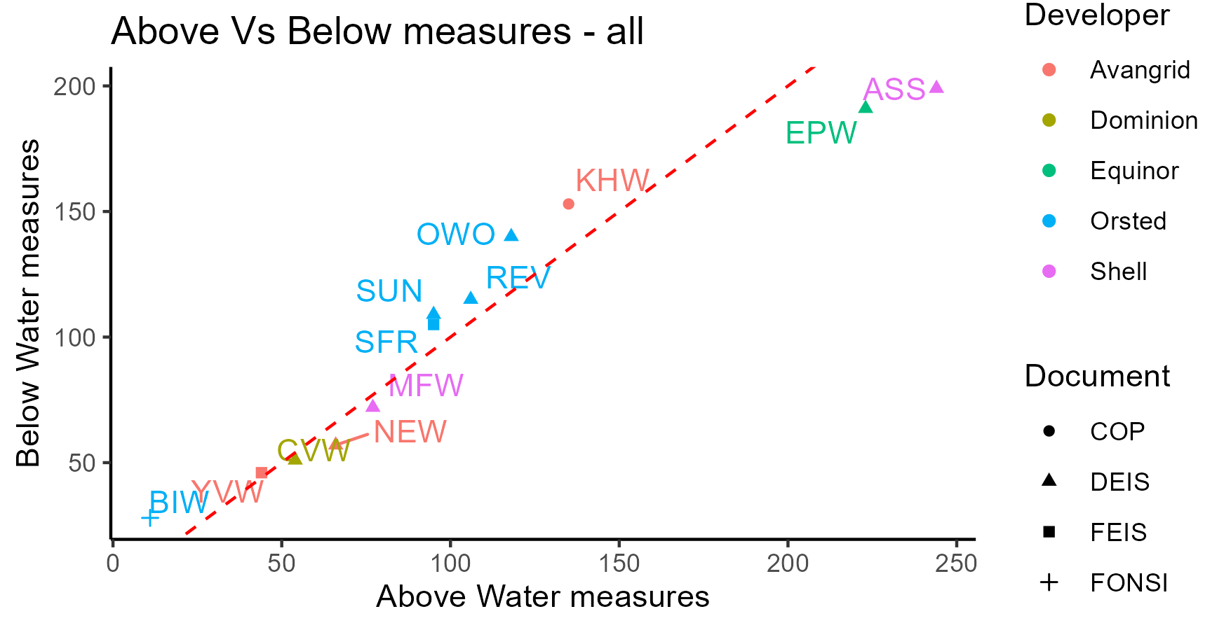
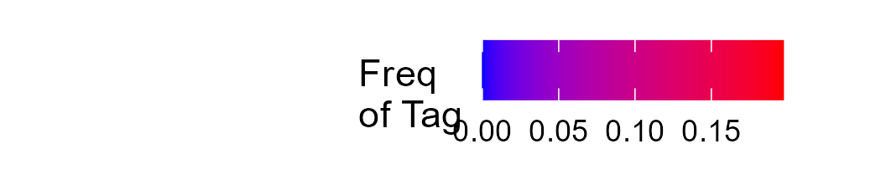
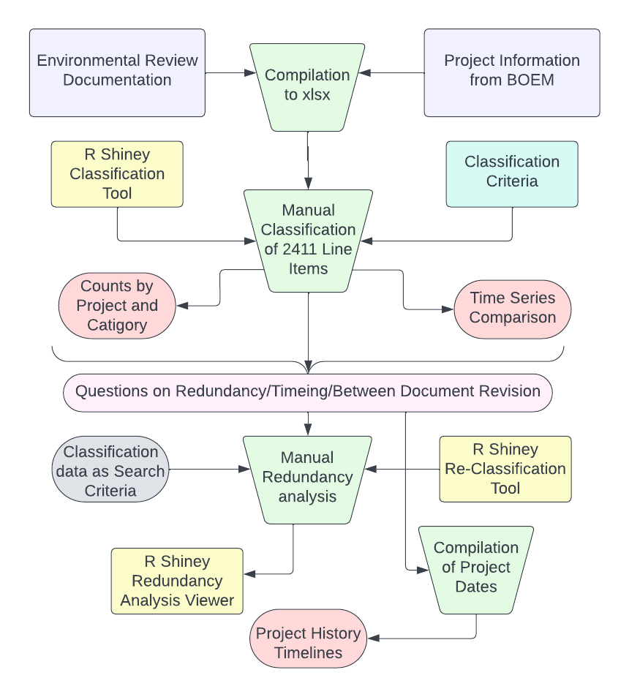
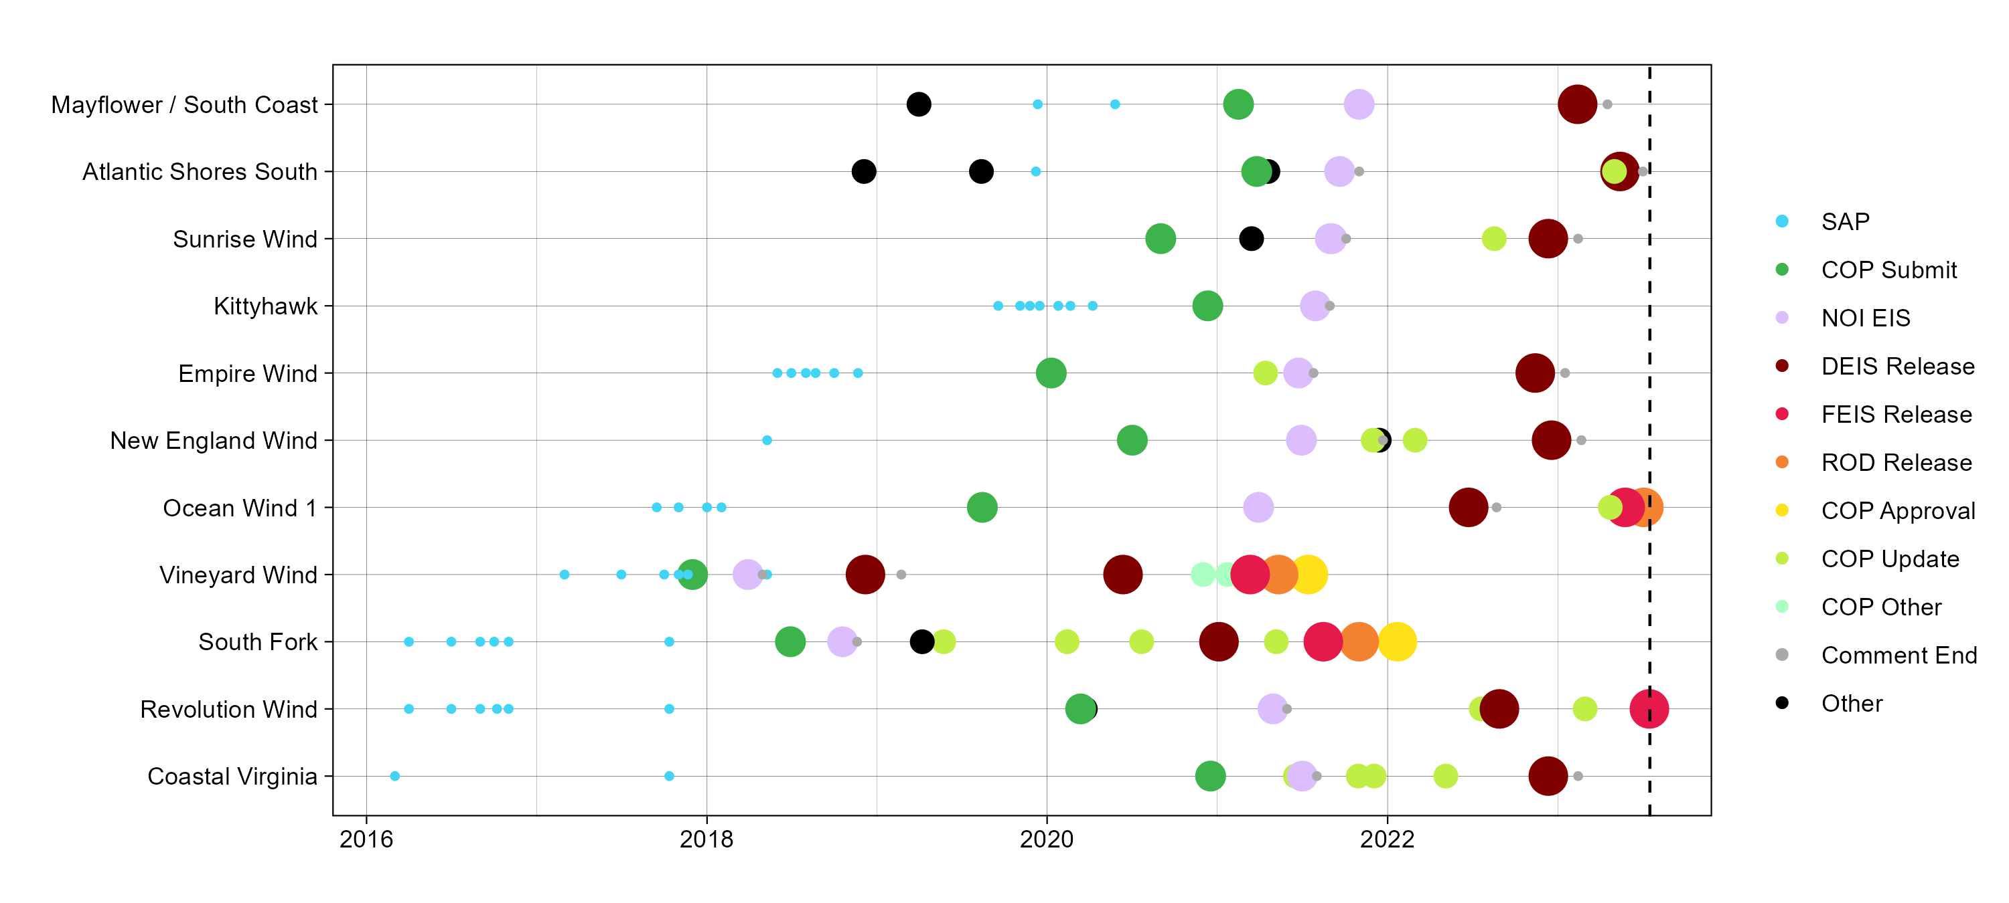
Comparing Monitoring and Mitigation efforts in Northeast Offshore Wind Developments
Andrew E. Chingos¹, Everett J. Rzeszowski² and Dr. Damian C. Brady²
¹University of St Andrews, ²University of Maine – Darling Marine Center
Introduction:
Our Dataset:
Frequency of Protected
Resource by Tag:
Explosion in offshore wind development to meet renewable energy goals – 30 GW by 2030
Commercial scale projects pose potential impacts to resources both onshore and in the ocean
Known nearfield effects must be mitigated against and unknown population impacts must be monitored for
Classification Criteria:
Above
Below
HDD
Research Gap:
Onshore | Cable | Site
Extensive and complex environmental review documentation
Minimal understanding of environmental review process and the timeline of development
No resources on comparing the monitoring and mitigation efforts across Northeast commercial projects
Phase:
Pre-C
Con
O&M
Decom
Measure Type:
Monitoring
Both
Mitigation
Protected Resource:
Results:
Methods:
Significance:
Provides means to assess each projects commitments to environmental protection
Searchable database for project line items
Simplification of environmental review documentation
Timeline of Project Development:
Resources:
- State Activities. Bureau of Ocean Energy Management. (n.d.). https://www.boem.gov/renewable-energy/state-activities
- Chang W, Cheng J, Allaire J, Sievert C, Schloerke B, Xie Y, Allen J, McPherson J, Dipert A, Borges B (2023). _shiny: Web Application Framework for R_. R package version 1.7.4.1, <https://CRAN.R-project.org/package=shiny>.

